Slide 1

IMDB Movie Reviews NLP Classification Project
Monika Helak

Slide 2
Problem Statement
Can we build a model that can tell whether a review is positive or negative just based on the text description?

Slide 3
Data Preprocessing
Tokenization
Lowercase
Replacing extraneous symbols
Removal of punctuation
Stemming
Filtering only alphabetic tokens

Slide 4
Vectorization
Two common options in NLTK:
- CountVectorizer: gives equal weight to all words. Frequent words are given more importance.
- TfidfVectorizer: downplays the significance of frequent words. References overall prevalence within a document and across all documents. (slightly better performance)

Slide 5
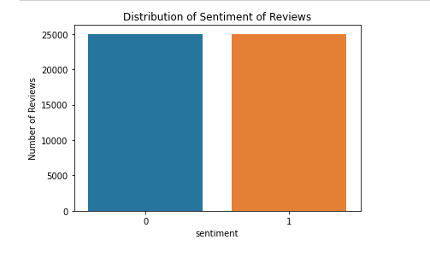
Exploratory Data Analysis Barplot of Target Variable
Balanced outcome variable
Large number of reviews available

Slide 6
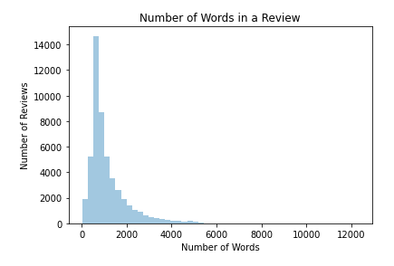
Exploratory Data Analysis Distribution of Number of Words in a Review
Most reviews are under 1000 words
Mean number of words per review is 1133

Slide 7
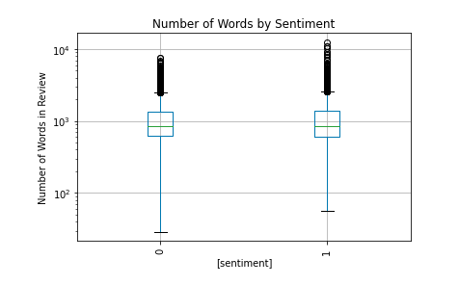
Exploratory Data Analysis Number of Words by Sentiment
Statistical test found significant difference

Slide 8
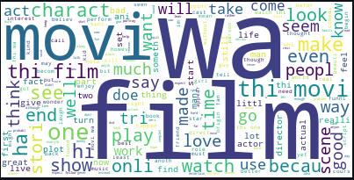
Exploratory Data Analysis Word Cloud
Could filter down with TfidfVectorizer to keep only most important words not common across all reviews

Slide 9
Model Selection
 | Decision Tree | Logistic Regression | Naïve Bayes
Advantages | Does not require normalization | Simple Interpretation | Efficient space and time complexity
Disadvantages | Prone to overfitting | Independent variables must be linearly related to log odds | Only works well when features are independent
Accuracy | 0.709 | 0.885 | 0.852
F1-score | 0.715 | 0.887 | 0.853
Training Time | 157.19s | 5.46s | 0.31s

Slide 10
Shortcomings and Limitations
More extensive data preprocessing
Filtering of words common across texts
Lemmatization
Removal of onomatopoeia and other non-words
Inclusion of features other than just text
Number of words in a review
Other types of Naïve Bayes Models

Slide 11

Thank you!

