Slide 1


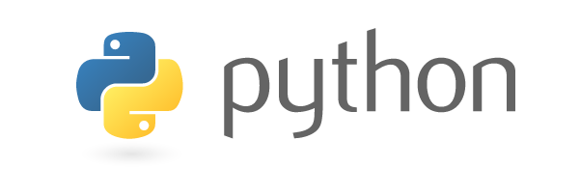
CS244: Advanced Programming Applications
Lecture 10: Introduction to Python Scripting
A readable, dynamic, pleasant,
flexible, fast and powerful language
Dr. Manal Helal, Fall 2013
http://moodle.manalhelal.com

Slide 2
Previous Lecture
Creating manual pages using groff utility.
Software deployment using tar ball files, make files, RPM, DEP files.
Debugging using gdb.
Using static & dynamic analysis tools to list functions and their calls, and to profile program execution, and debug memory leaks.

Slide 3
Motivation

Slide 4
Programming Languages
Machine Language Assembly Language High-Level Language
Machine language is a set of primitive instructions built into every computer. The instructions are in the form of binary code, so you have to enter binary codes for various instructions. Program with native machine language is a tedious process. Moreover the programs are highly difficult to read and modify. For example, to add two numbers, you might write an instruction in binary like this:
  1101101010011010

Slide 5
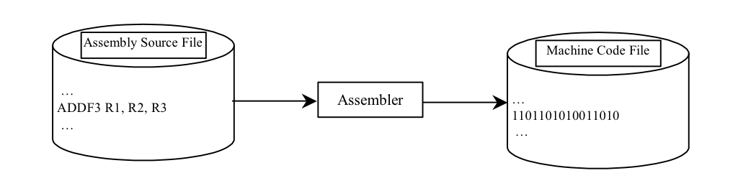
Programming Languages
Machine Language Assembly Language High-Level Language
Assembly languages were developed to make programming easy. Since the computer cannot understand assembly language, however, a program called assembler is used to convert assembly language programs into machine code. For example, to add two numbers, you might write an instruction in assembly code like this:
ADDF3 R1, R2, R3

Slide 6
Programming Languages
Machine Language Assembly Language High-Level Language
The high-level languages are English-like and easy to learn and program. For example, the following is a high-level language statement that computes the area of a circle with radius 5:
area = 5 * 5 * 3.1415;

Slide 7
Popular High-Level Languages
COBOL (COmmon Business Oriented Language)
FORTRAN (FORmula TRANslation)
BASIC (Beginner All-purpose Symbolic Instructional Code)
Pascal (named for Blaise Pascal)
Ada (named for Ada Lovelace)
C (whose developer designed B first)
Visual Basic (Basic-like visual language developed by Microsoft)
Delphi (Pascal-like visual language developed by Borland)
C++ (an object-oriented language, based on C)
C# (a Python-like language developed by Microsoft)
Python (We use it in the book)

Slide 8
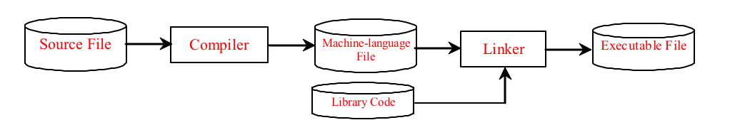
Compiling Source Code
A program written in a high-level language is called a source program. Since a computer cannot understand a source program. Program called a compiler is used to translate the source program into a machine language program called an object program. The object program is often then linked with other supporting library code before the object can be executed on the machine.

Slide 9
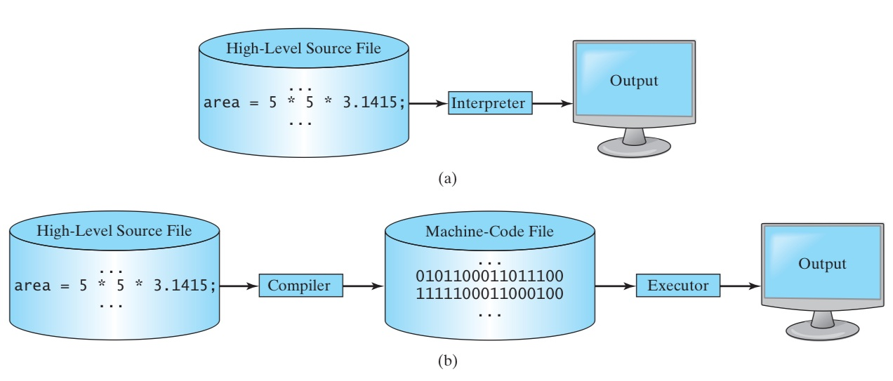
Interpreted vs. Compiled languages

Slide 10
Objectives
Learn about Python background
Study Python Syntax
Effectively Use Types / Operators / Control Flow
Effectively Use Functions
Understand & Use Python Classes

Slide 11
What is Python?
General Purpose Interpreted Object-Oriented
Python is a general purpose programming language. That means you can use Python to write code for any programming tasks. Python are now used in Google search engine, in mission critical projects in NASA, in processing financial transactions at New York Stock Exchange.

Slide 12
What is Python
Multi-purpose (Web, GUI, Scripting, etc.)
Object Oriented
Interpreted
Strongly typed and Dynamically typed
Focus on readability and productivity

Slide 13
Type Systems
 | Weak Typing | Strong Typing
Pseudocode | a = 2 b = "2" concatenate(a, b) # Returns "22" add(a, b) # Returns 4 | a = 2 = "2" concatenate(a, b) # Type Error add(a, b) # Type Error concatenate(str(a), b) # Returns "22" add(a, int(b)) # Returns 4
Languages | BASIC, JavaScript, Perl, PHP, Rexx | Java, ActionScript 3, C#, Python, OCaml, Ada
Dynamic Typing: the majority of the type checking operations is performed at run-time as opposed to at compile-time. In dynamic typing values have types, but variables do not; that is, a variable can refer to a value of any type.
OOP in Java : © W. Milner 2005 : Slide

Slide 14
What is Python?
General Purpose Interpreted Object-Oriented
Python is interpreted, which means that python code is translated and executed by an interpreter one statement at a time. In a compiled language, the entire source code is compiled and then executed altogether.

Slide 15
What is Python?
General Purpose Interpreted Object-Oriented
Python is an object-oriented programming language. Data in Python are objects created from classes. A class is essentially a type that defines the objects of the same kind with properties and methods for manipulating objects. Object-oriented programming is a powerful tool for developing reusable software.

Slide 16
Python’s History
Created by Guido van Rossum in Netherlands in 1989
Open source
Releases
Python 1.0 released in 1994
Python 2.0 released in 2000
Python 3.0 released in 2008
Python 2.7 is the recommended version
3.0 adoption will take a few years

Slide 17
Python 2 vs. Python 3
Python 3 is a newer version, but it is not backward compatible with Python 2. That means if you write a program using Python 2, it may not work on Python 3.

Slide 18
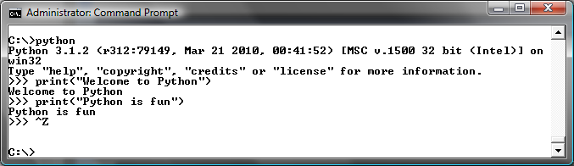
Launch Python

Slide 19
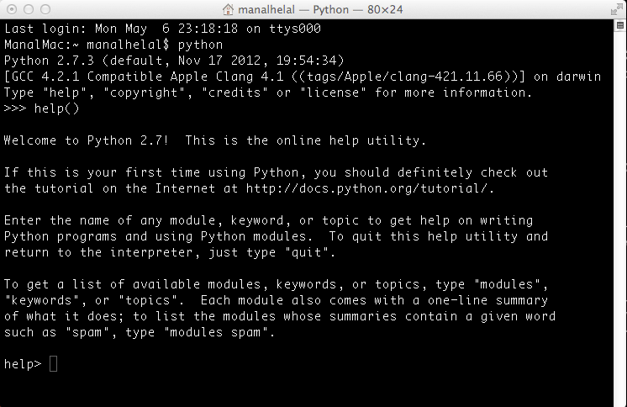

Slide 20
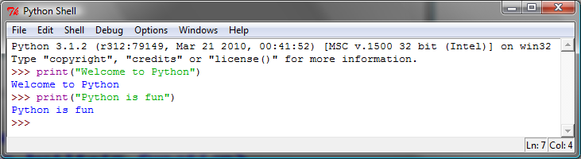
Launch Python IDLE

Slide 21
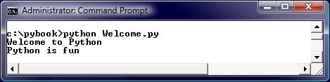
Run Python Script

Slide 22
A Simple Python Program
Listing 1.1
# Display two messages
print("Welcome to Python")
print("Python is fun")
IMPORTANT NOTE:
(1) To enable the buttons, you must download the entire slide file slide.zip and unzip the files into a directory (e.g., c:\slide). (2) You must have installed Python and set python bin directory in the environment path. (3) If you are using Office 2010, check PowerPoint2010.doc located in the same folder with this ppt file.
Welcome

Slide 23

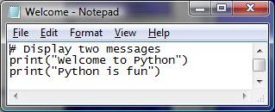
Creating and Editing Using Notepad
To use Notepad, type
  notepad Welcome.py
from the DOS prompt.

Slide 24
Trace a Program Execution
animation
Execute a statement
# Display two messages
print("Welcome to Python")
print("Python is fun")

Slide 25
Trace a Program Execution
animation
Execute a statement
# Display two messages
print("Welcome to Python")
print("Python is fun")

Slide 26
Two More Simple Examples
WelcomeWithThreeMessages
ComputeExpression

Slide 27
Supplements on the Companion Website
Companion Website
See Supplement I.B for installing and configuring Python
See Supplement I.C for developing Python programs from Eclipse
www.cs.armstrong.edu/liang/py

Slide 28
Anatomy of a Python Program
Statements
Comments
Indentation

Slide 29
Statement
A statement represents an action or a sequence of actions. The statement print("Welcome to Python") in the program in Listing 1.1 is a statement to display the greeting "Welcome to Python“.
# Display two messages
print("Welcome to Python")
print("Python is fun")

Slide 30
Indentation
The indentation matters in Python. Note that the statements are entered from the first column in the new line. It would cause an error if the program is typed as follows:
# Display two messages
print("Welcome to Python")
print("Python is fun")

Slide 31
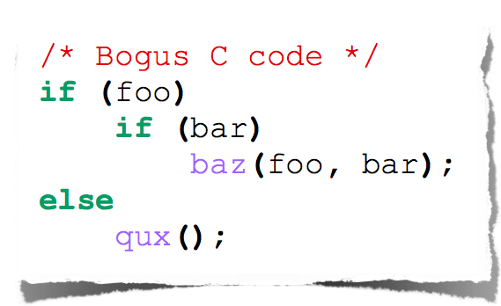
Indentation
The else here actually belongs to the 2nd if statement

Slide 32
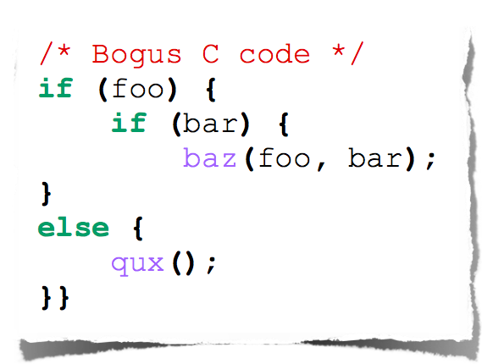
Indentation
The else here actually belongs to the 2nd if statement

Slide 33
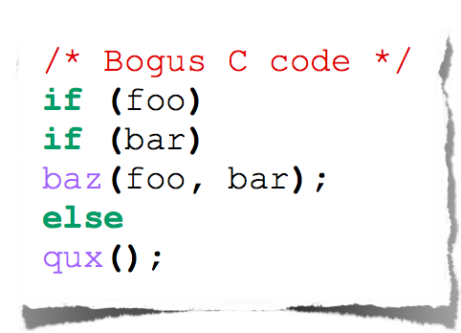
Indentation
I knew a coder like this

Slide 34
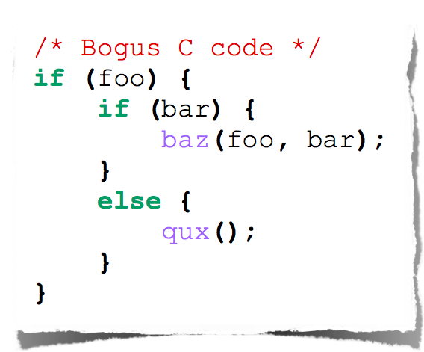
Indentation
You should always be explicit

Slide 35
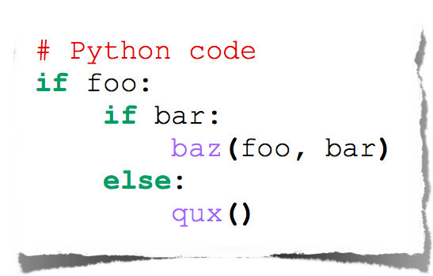
Indentation
Text
Python embraces indentation

Slide 36
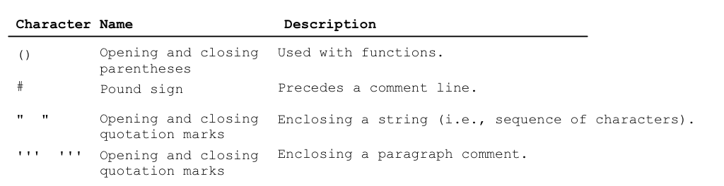
Special Symbols

Slide 37
Programming Style and Documentation
Appropriate Comments
Proper Indentation and Spacing Lines

Slide 38
Appropriate Comments
Include a summary at the beginning of the program to explain what the program does, its key features, its supporting data structures, and any unique techniques it uses.
Include your name, class section, instructor, date, and a brief description at the beginning of the program.

Slide 39
Proper Indentation and Spacing
Indentation
  Indent four spaces.
  A consistent spacing style makes programs clear and easy to read, debug, and maintain.
Spacing
  Use blank line to separate segments of the code.

Slide 40
Programming Errors
Syntax Errors
  Error in code construction
Runtime Errors
  Causes the program to abort
Logic Errors
  Produces incorrect result

Slide 41
Getting Started with GUI Programming
Why GUI? Turtle Tkniter
GUI is a great pedagogical tool to motivate studetns and stimulate student interests in programming.

Slide 42
Getting Started with GUI Programming
Why GUI? Turtle Tkniter
A simple way to start graphics programming is to use Python built-in Turtle package.
A Turtule Example

Slide 43
Getting Started with GUI Programming
Why GUI? Turtle Tkniter
Later in the book, we will also introduce Tkinter for developing comprehensive GUI applications.
A Tkinter Example

Slide 44
Python Features
Batteries Included
Everything is an Object
Interactive Shell
Strong Introspection
Cross Platform

Slide 45
Python Implementations
CPython:
  an interpreter for python implemented in C and running as a native application
IronPython:
  runs on the .Net common runtime (interfaces more cleanly with other .Net apps)
Jython:
  runs on the JVM (interfaces more cleanly with Java and other JVM apps)
PyPy:
  A Python interpreter which includes a just-in-time compiler which can significantly increase program execution performance.
  The interpreter and JIT are implemented in RPython (rather than C), a restricted subset of Python which is amenable to static analysis and type inference.
Stackless Python:
  An implementation of a python interpreter which doesn't rely on recursion on the native C runtime stack, and therefore allows a load of other interesting programming constructs and techniques (including lightweight threads) not available in CPython.

Slide 46
Syntax

Slide 47
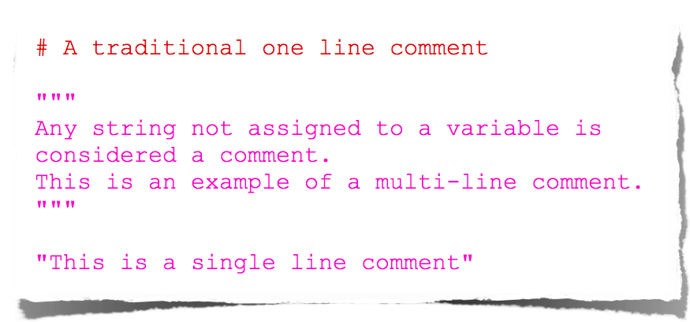
Comments

Slide 48
Elementary I/O
two built-in functions for elementary input:
  input(prompt): user may enter any
Python expression -- returns its value
  raw_input(prompt): returns string
  trims trailing \n
one statement for elementary output:
  print <0+ comma-separated expressions>
  separates results with a space
  \n at end (unless trailing comma)
  print itself does no fancy formatting
OOP in Java : © W. Milner 2005 : Slide

Slide 49
Types

Slide 50
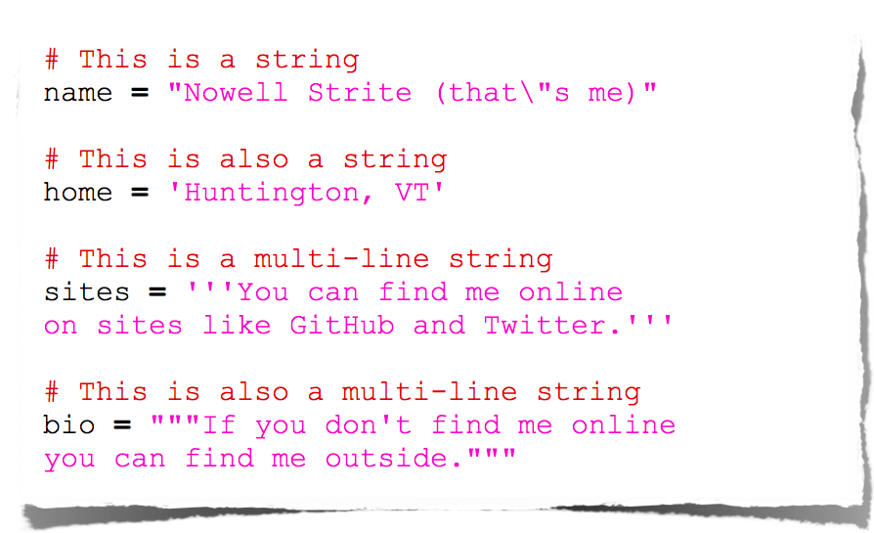
Strings

Slide 51
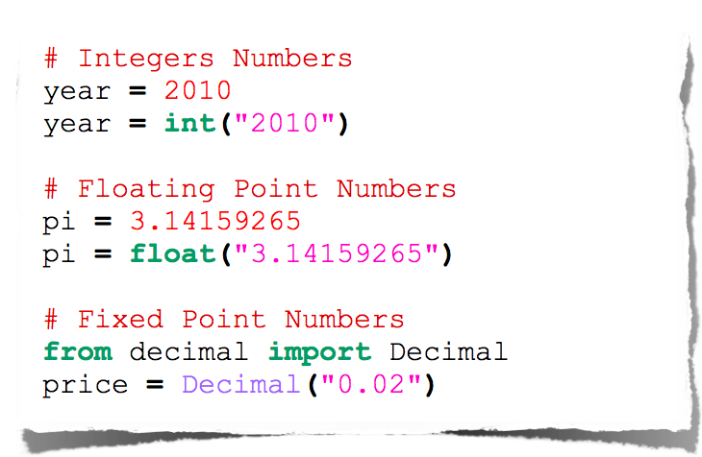
Numbers

Slide 52
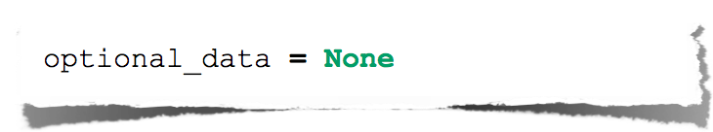
Null

Slide 53
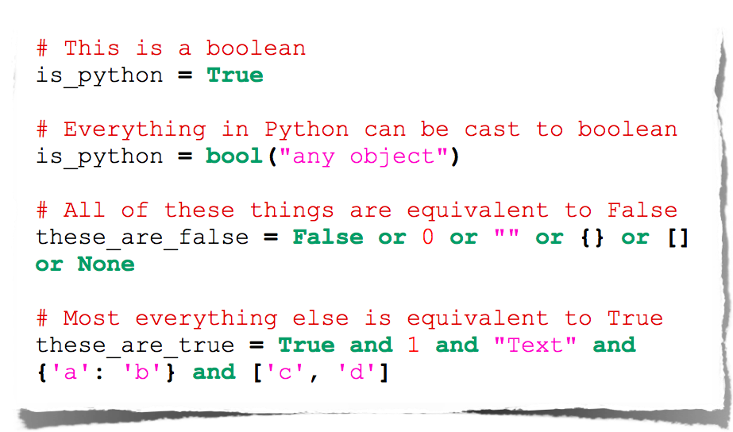
Booleans

Slide 54
Operators

Slide 55
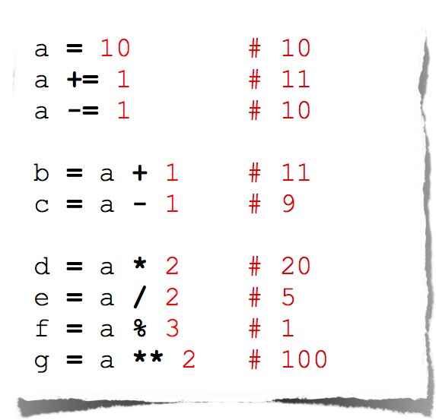
Arithmetic

Slide 56
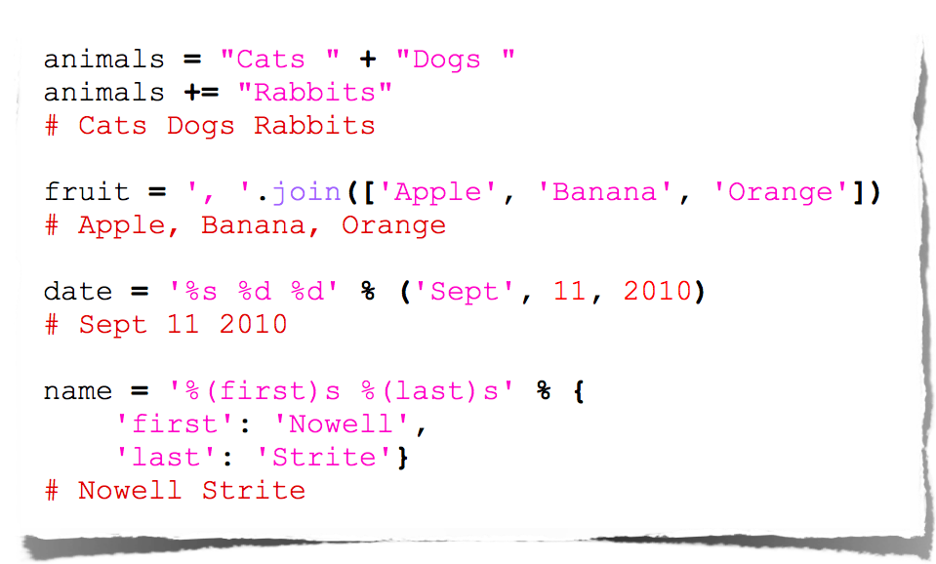
String Manipulation

Slide 57
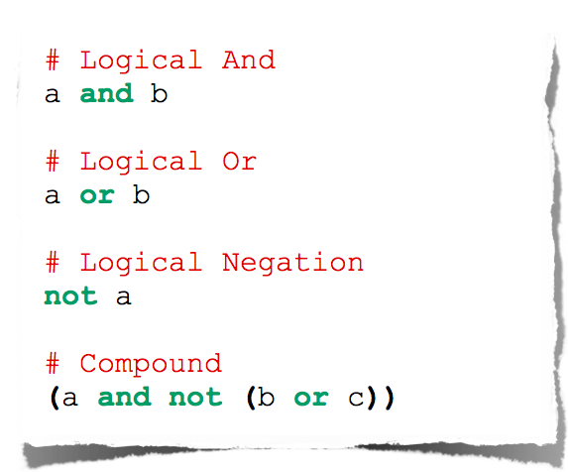
Logical Comparison

Slide 58
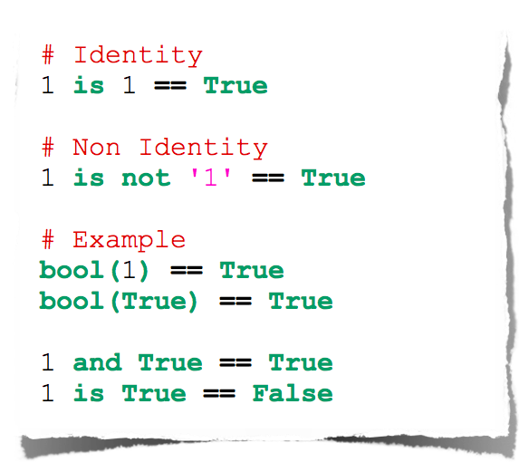
Identity Comparison

Slide 59
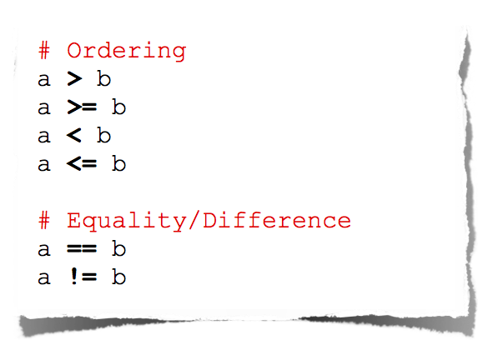
Arithmetic Comparison

Slide 60
Control Flow

Slide 61
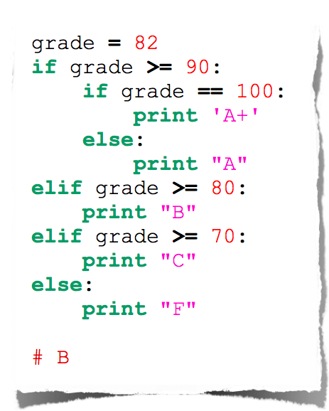
Conditionals

Slide 62
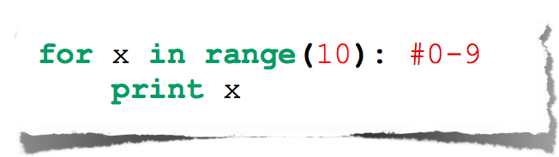
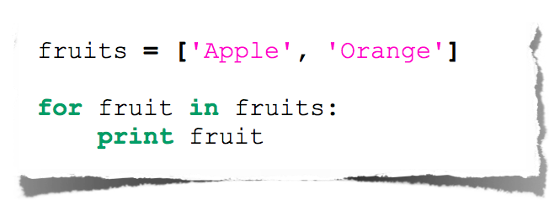
For Loop

Slide 63
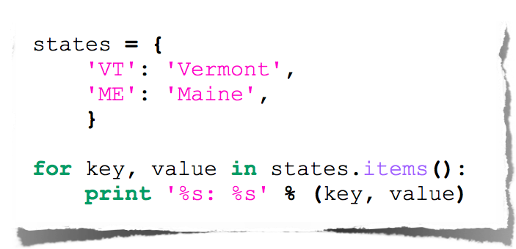
Expanded For Loop

Slide 64
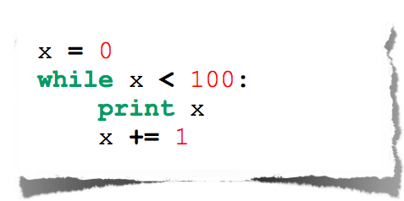
While Loop

Slide 65
Assignment 10
Implement a calculator python script that takes three input arguments from the user and print the result such as:
$./calculator.y 2 + 2
4
$./calculator.py 2 * 3
6

