Slide 1



CS244: Advanced Programming Applications
Lecture 11: Python GUI & Lists & Sets: Ch 9, 10, 11, 14
Dr. Manal Helal, Fall 2013
http://moodle.manalhelal.com

Slide 2
Chapter 9 ILOs
To create a simple GUI application using Tkinter (§9.2).
To process events using callback functions bound to widget’s command option (§9.3).
To use a variety of widget classes to create widgets (§9.4).
To use labels, entries, buttons, check buttons, radio buttons, messages, and texts to create graphical user interfaces (§9.4).
To draw lines, rectangles, ovals, polygons, and arcs and display strings in a canvas (§9.5).
To encapsulate data fields to make classes easy to maintain (§9.5).
To layout widgets in a container using the geometry managers (§9.6).
To pack widgets side-by-side or a top of each other using the pack manager (§9.6.1).
To layout widgets in a grid using the grid manager (§9.6.2).
To place widgets in absolute locations using the manager (§9.6.3).
To use containers to group widgets to achieve desired layout (§9.7).
To use images in widgets (§9.8).
To create applications using menus (§9.9).
To create applications using popup menus (§9.10).
To bind mouse and key event on a widget to a callback function for processing events (§9.11).
To develop animations (§9.12).
To use scrollbars to scroll contents in a Text widget (§9.13).
To use standard dialog boxes for display messages and receive input (§9.14).

Slide 3
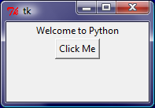
Getting Started with Tkinter
Getting started with Tkinter with a simple example.
from tkinter import * # Import tkinter
root = Tk() # Create a root window
label = Label(root, text = "Welcome to Python") # Create a label
button = Button(root, text = "Click Me") # Create a button
label.pack() # Display the label in the window
button.pack() # Display the button in the window
root.mainloop() # Create an event loop
SimpleGUI

Slide 4

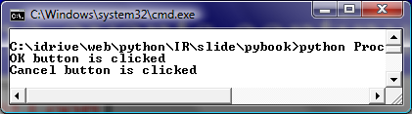
Processing Events
window.mainloop() # Create an event loop
The statement creates an event loop. The event loop processes the events continuously.
ProcessButtonEvent

Slide 5
The Widget Classes

Slide 6
Color and Font
To specify a color, you can either use a color name such as red, yellow, green, blue, white, black, purple, etc, or explicitly specify the red, green, and blue (RGB) color components using a string #RRGGBB, where RR, GG, BB are hexadecimal representations of the red, green and blue values, respectively.
"Times 10 bold"
"Helvetica 10 bold italic"
"Courier New 20 bold italic"
"Courier New 20 bold italic over strike underline"

Slide 7
Text Formatting
The text in a label and a button is centered by default. You can change it by using the justify option with values LEFT, CENTER, or RIGHT. You can also display the text in multiple lines by inserting the newline character \n to separate texts.

Slide 8
Mouse Cursor
You can set a mouse cursor by using the cursor option with values such as "arrow" (default), "circle", "cross" "plus", etc.

Slide 9
Change Properties
widgetName["propertyName] = newPropertyValue
btShowOrHide = Button(window, text = "Show", bg = "white")
btShowOrHide["text"] = "Hide"
btShowOrHide["bg"] = "red"
btShowOrHide["fg"] = "#AB84F9" # Change fg color to #AB84F9
btShowOrHide["cursor"] = "plus" # Change mouse cursor to plus

Slide 10
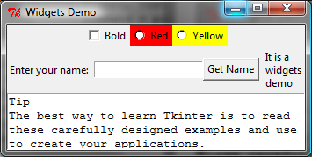
Widget Demo
WidgetsDemo
class WidgetsDemo:
def __init__(self):
window = Tk() # Create a window
…
frame1 = Frame(window) # Create and add a frame to window
self.v1 = IntVar()
cbtBold = Checkbutton(frame1, text = "Bold",
variable = self.v1, command = self.processCheckbutton)
…
def processCheckbutton(self):
print("check button is "
+ ("checked " if self.v1.get() == 1 else "unchecked"))
…
WidgetsDemo() # Create GUI

Slide 11
Canvas
Canvas can be used to display shapes. You can use the method such as create_rectangle, create_oval, create_arc, create_polygon, and create_line to draw a rectangle, oval, arc, polygon, and line on a canvas.

Slide 12
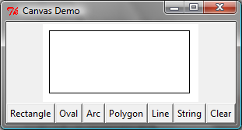
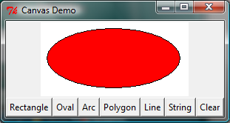
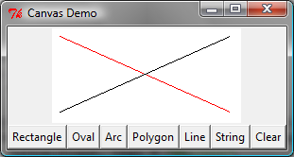
Canvas Demo
CanvasDemo
from tkinter import * # Import tkinter
class CanvasDemo:
def __init__(self):
window = Tk() # Create a window
…
# Place self.canvas in the window
self.canvas = Canvas(window, width = 200, height = 100,
bg = "white")
self.canvas.pack()
…
btRectangle = Button(frame, text = "Rectangle",
command = self.displayRect)
…
def displayRect(self):
self.canvas.create_rectangle(10, 10, 190, 90, tags = "rect")

Slide 13
Drawing Methods

Slide 14
Geometry Managers
Grid Manager
Pack Manager
Place Manager
Since each manager has its own style of placing the widget, it is not a good practice to mix the managers for the widgets in the same container. You can use a frame as a subcontainer to achieve desired layout.

Slide 15
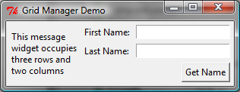
Grid Managers
GridManagerDemo
from tkinter import * # Import tkinter
class GridManagerDemo:
window = Tk() # Create a window
window.title("Grid Manager Demo") # Set title
message = Message(window, text =
"This Message widget occupies three rows and two columns")
message.grid(row = 1, column = 1, rowspan = 3, columnspan = 2)
Label(window, text = "First Name:").grid(row = 1, column = 3)
Entry(window).grid(row = 1, column = 4, padx = 5, pady = 5)
Label(window, text = "Last Name:").grid(row = 2, column = 3)
Entry(window).grid(row = 2, column = 4)
Button(window, text = "Get Name").grid(row = 3,
padx = 5, pady = 5, column = 4, sticky = E)
window.mainloop() # Create an event loop
GridManagerDemo() # Create GUI

Slide 16
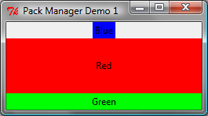
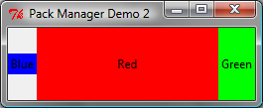
Pack Managers
PackManagerDemo
PackManagerDemoWithSide
Label(window, text = "Blue",
bg = "blue").pack()
Label(window, text = "Red",
bg = "red").pack(
fill = BOTH, expand = 1)
Label(window, text = "Green",
bg = "green").pack(
fill = BOTH)
Label(window, text = "Blue", bg =
"blue").pack(side = LEFT)
Label(window, text = "Red", bg =
"red").pack(side = LEFT, fill =
BOTH, expand = 1)
Label(window, text = "Green", bg =
"green").pack(side = LEFT, fill =
BOTH)

Slide 17
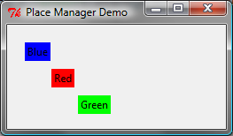
Place Managers
PlaceManagerDemo
Label(window, text = "Blue", bg = "blue").place(
x = 20, y = 20)
Label(window, text = "Red", bg = "red").place(
x = 50, y = 50)
Label(window, text = "Green", bg = "green").place(
x = 80, y = 80)

Slide 18
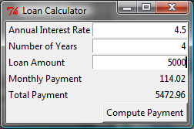
Case Study: Loan Calculator
LoanCalculator

Slide 19
Display Images
You can add an image in a label, button, check button, and radio button. To create an image, use the PhotoImage class as follows:
photo = PhotoImage(file = imagefilename)
The image file must be GIF. You can use a conversion utility to convert image files in other format into GIF.

Slide 20
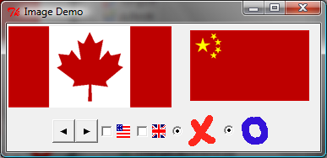
Image Example
ImageDemo
caImage = PhotoImage(file = "../image/ca.gif")
chinaImage = PhotoImage(file = "../image/china.gif")
…
Label(frame1, image = caImage).pack(side = LEFT)
canvas = Canvas(frame1)
canvas.create_image(90, 50, image = chinaImage)
canvas["width"] = 200
canvas["height"] = 100
canvas.pack(side = LEFT)
…
Button(frame2, image = leftImage).pack(side = LEFT)
Checkbutton(frame2, image = usImage).pack(side = LEFT)
Radiobutton(frame2, image = crossImage).pack(side = LEFT)

Slide 21
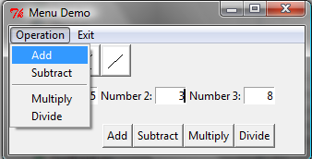
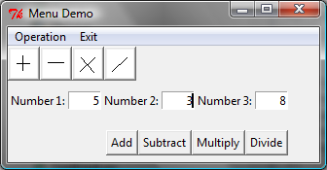
Menus
MenuDemo
Tkinter provides a comprehensive solution for building graphical user interfaces.
menubar = Menu(window)
window.config(menu = menubar) # Display the menu bar
operationMenu = Menu(menubar, tearoff = 0)
menubar.add_cascade(label = "Operation", menu = operationMenu)
operationMenu.add_command(label = "Add", command = self.add)
…
exitmenu = Menu(menubar, tearoff = 0)
menubar.add_cascade(label = "Exit", menu = exitmenu)
…
def add(self):
self.v3.set(eval(self.v1.get()) + eval(self.v2.get()))

Slide 22
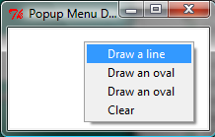
Popup Menus
PopupMenuDemo
# Create a popup menu
self.menu = Menu(window, tearoff = 0)
self.menu.add_command(label ="Draw a line",command = self.displayLine)
self.menu.add_command(label ="Draw an oval",command = self.displayOval)
…
# Place canvas in window
self.canvas = Canvas(window, width = 200,height = 100, bg = "white")
self.canvas.pack()
# Bind popup to canvas
self.canvas.bind("<Button-3>", self.popup)
…
def popup(self, event):
self.menu.post(event.x_root, event.y_root)

Slide 23
Mouse and Key Events
widget.bind(event, handler)
def popup(event):
menu.post(event.x_root, event.y_root)

Slide 24
Events

Slide 25
Event Properties

Slide 26
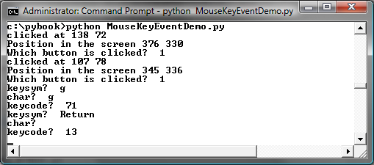
Mouse Key Event Demo
MouseKeyEventDemo
…
# Bind with <Button-1> event
canvas.bind("<Button-1>", self.processMouseEvent)
# Bind with <Key> event
canvas.bind("<Key>", self.processKeyEvent)
canvas.focus_set()
…
def processMouseEvent(self, event):
print("clicked at", event.x, event.y)
print("Position in the screen", event.x_root, event.y_root)
print("Which button is clicked? ", event.num)
def processKeyEvent(self, event):
print("keysym? ", event.keysym)
print("char? ", event.char)
print("keycode? ", event.keycode)

Slide 27
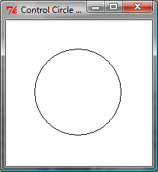
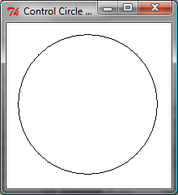
Control Circle Demo
ControlCircle

Slide 28

Animations
AnimationDemo
x = 0 # Starting x position
canvas.create_text(x, 30,
text = "Message moving?", tags = "text")
dx = 3
while True:
canvas.move("text", dx, 0) # Move text dx unit
canvas.after(100) # Sleep for 100 milliseconds
canvas.update() # Update canvas
if x < width:
x += dx # Get the current position for string
else:
x = 0 # Reset string position to the beginning
canvas.delete("text")
# Redraw text at the beginning
canvas.create_text(x, 30, text = "Message moving?",
tags = "text")

Slide 29
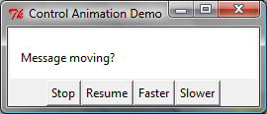
Control Animations
ControlAnimation
def animate(self): # Move the message
while not self.isStopped:
self.canvas.move("text", self.dx, 0) # Move text
self.canvas.after(self.sleepTime) # Sleep
self.canvas.update() # Update self.canvas
if self.x < self.width:
self.x += self.dx # Set new position
else:
self.x = 0 # Reset string position to the beginning
self.canvas.delete("text")
# Redraw text at the beginning
self.canvas.create_text(self.x, 30,
text = "Message moving?", tags = "text")

Slide 30
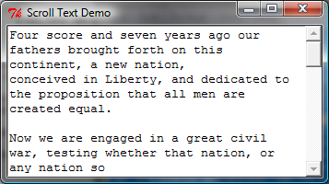
Scrollbar
ScrollText

Slide 31
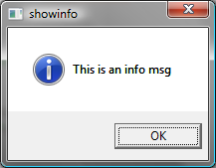
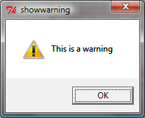
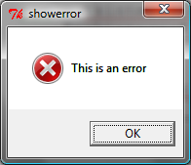
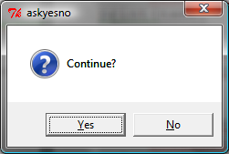
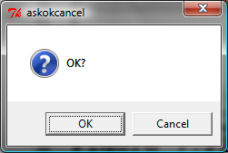
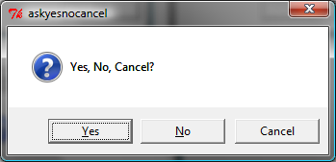
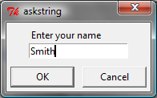
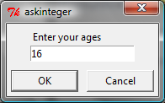
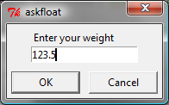
Standard Dialogs
DialogDemo

Slide 32
Standard Dialogs – Cont’d
tkinter.messagebox.showinfo("showinfo", "This is an info msg")
tkinter.messagebox.showwarning("showwarning", "This is a warning")
tkinter.messagebox.showerror("showerror", "This is an error")
isYes = tkinter.messagebox.askyesno("ashyesno", "Continue?")
print(isYes)
isOK = tkinter.messagebox.askokcancel("ashokcancle", "OK?")
print(isOK)
isYesNoCancel = tkinter.messagebox.askyesnocancel(
"askyesnocancel", "Yes, No, Cancel?")
print(isYesNoCancel)
name = tkinter.simpledialog.askstring(
"askstring", "Enter your name")
age = tkinter.simpledialog.askinteger("askinteger", "Enter your age")
weight = tkinter.simpledialog.askfloat("askfloat", "Enter your weight")

Slide 33
Chapter 10 ILOs
To create lists (§10.2.1).
To invoke list’s append, insert, extend, remove, pop, index, count, sort, reverse methods (§10.2.2).
To use the len, min/max, sum, and random.shuffle functions for a list (§10.2.3).
To access list elements using indexed variables (§10.2.4).
To obtain a sublist using the slicing operator [start:end] (§10.2.5).
To use +, *, and in/not in operators on lists (§10.2.6).
To traverse elements in a list using a for-each loop (§10.2.7).
To create lists using list comprehension (§10.2.8).
To compare lists using comparison operators (§10.2.9).

Slide 34
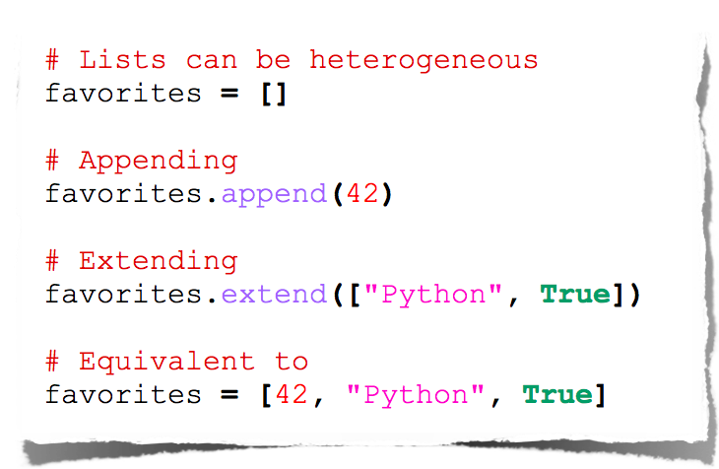
Lists
34

Slide 35
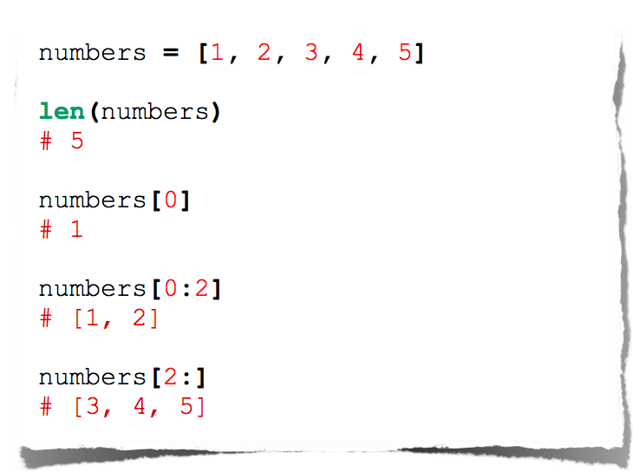
Lists
35

Slide 36
Creating Lists
Creating list using the list class
list1 = list() # Create an empty list
list2 = list([2, 3, 4]) # Create a list with elements 2, 3, 4
list3 = list(["red", "green", "blue"]) # Create a list with strings
list4 = list(range(3, 6)) # Create a list with elements 3, 4, 5
list5 = list("abcd") # Create a list with characters a, b, c
For convenience, you may create a list using the following syntax:
list1 = [] # Same as list()
list2 = [2, 3, 4] # Same as list([2, 3, 4])
list3 = ["red", "green"] # Same as list(["red", "green"])

Slide 37
list Methods

Slide 38
Functions for lists
>>> list1 = [2, 3, 4, 1, 32]
>>> len(list1)
5
>>> max(list1)
32
>>> min(list1)
1
>>> sum(list1)
42
>>> import random
>>> random.shuffle(list1) # Shuffle the items in the list
>>> list1
[4, 1, 2, 32, 3]

Slide 39
Indexer Operator []

Slide 40
The +, *, [ : ], and in Operators
>>> list1 = [2, 3]
>>> list2 = [1, 9]
>>> list3 = list1 + list2
>>> list3
[2, 3, 1, 9]
>>> list3 = 2 * list1
>>> list3
[2, 3, 2, 3, 2, 3]
>>> list4 = list3[2 : 4]
>>> list4
[2, 3]

Slide 41
The +, *, [ : ], and in Operators
>>> list1 = [2, 3, 5, 2, 33, 21]
>>> list1[-1]
21
>>> list1[-3]
2
>>> list1 = [2, 3, 5, 2, 33, 21]
>>> 2 in list1
True
>>> list1 = [2, 3, 5, 2, 33, 21]
>>> 2.5 in list1
False

Slide 42
off-by-one Error
i = 0
while i <= len(lst):
print(lst[i])
i += 1

Slide 43
List Comprehension
List comprehensions provide a concise way to create items from sequence. A list comprehension consists of brackets containing an expression followed by a for clause, then zero or more for or if clauses. The result will be a list resulting from evaluating the expression. Here are some examples:
>>> list1 = [x for x range(0, 5)] # Returns a list of 0, 1, 2, 4
>>> list1
[0, 1, 2, 3, 4]
>>> list2 = [0.5 * x for x in list1]
>>> list2
[0.0, 0.5, 1.0, 1.5, 2.0]
>>> list3 = [x for x in list2 if x < 1.5]
>>> list3
[0.0, 0.5, 1.0]

Slide 44
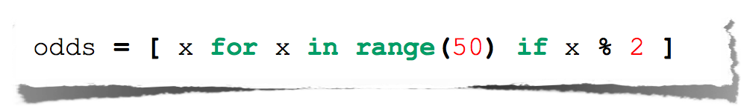
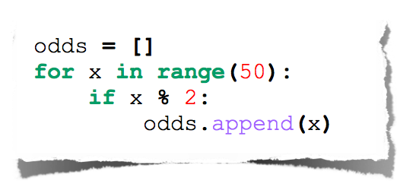
List Comprehensions
Useful for replacing simple for-loops.
44

Slide 45
Comparing Lists
>>>list1 = ["green", "red", "blue"]
>>>list2 = ["red", "blue", "green"]
>>>list2 == list1
False
>>>list2 != list1
True
>>>list2 >= list1
False
>>>list2 > list1
False
>>>list2 < list1
True
>>>list2 <= list1
True

Slide 46
Splitting a String to a List
items = "Welcome to the US".split()
print(items)
['Welcome', 'to', 'the', 'US']
items = "34#13#78#45".split("#")
print(items)
['34', '13', '78', '45']

Slide 47
Chapter 11 ILOs
To give examples of representing data using two-dimensional lists (§11.1).
To access elements in a two-dimensional list using row and column indexes (§11.2).
To program common operations for two-dimensional lists (displaying lists, summing all elements, finding min and max elements, and random shuffling) (§11.2).
To write a program for grading multiple-choice questions using two-dimensional lists (§11.4).

Slide 48
Processing Two-Dimensional lists
You can view a two-dimensional list as a list that consists of rows. Each row is a list that contains the values. The rows can be accessed using the index, conveniently called a row index. The values in each row can be accessed through another index, conveniently called a column index.

Slide 49
Processing Two-Dimensional lists
See the examples in the text.
(Initializing lists with input values)
(Initializing lists with random values)
(Printing lists)
(Summing all elements)
(Summing all elements by column)
(Which row has the largest sum)
(Random shuffling)
import random
matrix = [] # Create an empty list
numberOfRows = eval(input("Enter the number of rows: "))
numberOfColumns = eval(input("Enter the number of columns: "))
for row in range(numberOfRows):
matrix.append([]) # Add an empty new row
for column in range(numberOfColumns):
matrix[row].append(random.randint(0, 99))
print(matrix)

Slide 50
Summing elements by column
matrix = [[1, 2, 3], [4, 5, 6], [7, 8, 9]] # Assume a list is given
total = 0
for column in range(0, len(matrix[0])):
for row in range(0, len(matrix)):
total += matrix[row][column]
print("Sum for column " + str(column) + " is " + str(total))

Slide 51
Finding the Row with the Largest Sum
matrix = [[1, 2, 3], [4, 5, 6], [7, 8, 9]] # Assume a list is given
maxRow = sum(matrix[0]) # Get sum of the first row in maxRow
indexOfMaxRow = 0
for row in range(1, len(matrix)):
if sum(matrix[row]) > maxRow:
maxRow = sum(matrix[row])
indexOfMaxRow = row
print("Row " + str(indexOfMaxRow)

Slide 52
Random shuffling
import random
matrix = [[1, 2, 3], [4, 5, 6], [7, 8, 9]] # Assume a list is given
for row in range(0, len(matrix)):
for column in range(0, len(matrix[row])):
i = random.randrange(0, len(matrix))
j = random.randrange(0, len(matrix[row]))
# Swap matrix[row][column] with matrix[i][j]
matrix[row][column], matrix[i][j] = \
matrix[i][j], matrix[row][column]
print(matrix)

Slide 53
Problem: Grading Multiple-Choice Test
Objective: write a program that grades multiple-choice test.
GradeExam

Slide 54
Problem: Finding Two Points Nearest to Each Other
FindNearestPoints

Slide 55
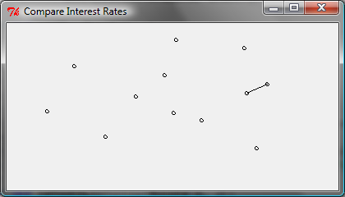
GUI: Finding Two Points Nearest to Each Other
NearestPoints

Slide 56
Multidimensional lists
scores = [
[[9.5, 20.5], [9.0, 22.5], [15, 33.5], [13, 21.5], [15, 2.5]],
[[4.5, 21.5], [9.0, 22.5], [15, 34.5], [12, 20.5], [14, 9.5]],
[[6.5, 30.5], [9.4, 10.5], [11, 33.5], [11, 23.5], [10, 2.5]],
[[6.5, 23.5], [9.4, 32.5], [13, 34.5], [11, 20.5], [16, 9.5]],
[[8.5, 26.5], [9.4, 52.5], [13, 36.5], [13, 24.5], [16, 2.5]],
[[9.5, 20.5], [9.4, 42.5], [13, 31.5], [12, 20.5], [16, 6.5]]]

Slide 57
Problem: Weather Information
Suppose a meteorology station records the temperature and humidity at each hour of every day and stores the data for the past ten days in a text file named weather.txt. Each line of the file consists of four numbers that indicate the day, hour, temperature, and humidity. Your task is to write a program that calculates the average daily temperature and humidity for the 10 days.
Weather

Slide 58
Chapter 14 ILOs
To use tuples as immutable lists (§14.2).
To use sets for storing and fast accessing non-duplicate elements (§14.3).
To understand the performance differences between sets and lists (§14.4).
To store key/value pairs in a dictionary and access value using the key (§14.5).
To use dictionaries to develop applications (§14.6).

Slide 59
Tuples
Tuples are like lists except they are immutable. Once they are created, their contents cannot be changed.
If the contents of a list in your application do not change, you should use a tuple to prevent data from being modified accidentally. Furthermore, tuples are more efficient than lists.

Slide 60
Creating Tuples
t1 = () # Create an empty tuple
t2 = (1, 3, 5) # Create a set with three elements
# Create a tuple from a list
t3 = tuple([2 * x for x in range(1, 5)])
# Create a tuple from a string
t4 = tuple("abac") # t4 is ['a', 'b', 'a', 'c']

Slide 61
Tuples
TupleDemo
Tuples can be used like lists except they are immutable.
tuple1 = ("green", "red", "blue") # Create a tuple
tuple2 = tuple([7, 1, 2, 23, 4, 5]) # Create a tuple from a list
print("length is", len(tuple2), "max is", max(tuple2), "min is",
min(tuple2), "sum is", sum(tuple2))
print("The first element is", tuple2[0]) # Use indexer
tuple3 = tuple1 + tuple2 # Combine 2 tuples
tuple3 = 2 * tuple1 # Multiple a tuple
print(tuple2[2 : 4]) # Slicing operator
print(2 in tuple2) # in operator
for v in tuple1:
print(v, end = " ")
print()
list1 = list(tuple2) # Obtain a list from a tuple
list1.sort()
tuple4 = tuple(list1)
tuple5 = tuple(list1)
print(tuple4)
print(tuple4 == tuple5) # Compare two tuples

Slide 62
Sets
Sets are like lists to store a collection of items. Unlike lists, the elements in a set are unique and are not placed in any particular ordered. If your application does not care about the order of the elements, using a set to store elements is more efficient than using lists. The syntax for sets is braces {}.

Slide 63
Creating Sets
s1 = set() # Create an empty set
s2 = {1, 3, 5} # Create a set with three elements
s3 = set([1, 3, 5]) # Create a set from a tuple
# Create a set from a list
s4 = set([x * 2 for x in range(1, 10)])
# Create a set from a string
s5 = set("abac") # s5 is {'a', 'b', 'c'}

Slide 64
Manipulating and Accessing Sets
>>> s1 = {1, 2, 4}
>>> s1.add(6)
>>> s1
{1, 2, 4, 6}
>>> len(s1)
4
>>> max(s1)
6
>>> min(s1)
1
>>> sum(s1)
13
>>> 3 in s1
False
>>> s1.remove(4)
>>> s1
{1, 2, 6}
>>>

Slide 65
Subset and Superset
>>> s1 = {1, 2, 4}
>>> s2 = {1, 4, 5, 2, 6}
>>> s1.issubset(s2) # s1 is a subset of s2
True
>>>
>>> s1 = {1, 2, 4}
>>> s2 = {1, 4, 5, 2, 6}
>>> s2.issuperset(s1) # s2 is a superset of s1
True
>>>

Slide 66
Equality Test
>>> s1 = {1, 2, 4}
>>> s2 = {1, 4, 2}
>>> s1 == s2
True
>>> s1 != s2
False
>>>

Slide 67
Comparison Operators
Note that it makes no sense to compare the sets using the conventional comparison operators (>, >=, <=, <), because the elements in a set are not ordered. However, these operators have special meaning when used for sets.
s1 > s2 returns true is s1 is a proper superset of s2.
s1 >= s2 returns true is s1 is a superset of s2.
s1 < s2 returns true is s1 is a proper subset of s2.
s1 <= s2 returns true is s1 is a subset of s2.

Slide 68
Set Operations (union, |)
>>> s1 = {1, 2, 4}
>>> s2 = {1, 3, 5}
>>> s1.union(s2)
{1, 2, 3, 4, 5}
>>>
>>> s1 | s2
{1, 2, 3, 4, 5}
>>>

Slide 69
Set Operations (intersection, &)
>>> s1 = {1, 2, 4}
>>> s2 = {1, 3, 5}
>>> s1.intersection(s2)
{1}
>>>
>>> s1 & s2
{1}
>>>

Slide 70
Set Operations (difference, -)
>>> s1 = {1, 2, 4}
>>> s2 = {1, 3, 5}
>>> s1.difference(s2)
{2, 4}
>>>
>>> s1 - s2
{2, 4}
>>>

Slide 71
Set Operations (symetric_difference, ^)
>>> s1 = {1, 2, 4}
>>> s2 = {1, 3, 5}
>>> s1.symmetric_difference(s2)
{2, 3, 4, 5}
>>>
>>> s1 ^ s2
{2, 3, 4, 5}
>>>

Slide 72
Sets
SetDemo
set1 = {"green", "red", "blue", "red"} # Create a set
set2 = set([7, 1, 2, 23, 2, 4, 5]) # Create a set from a list
print("Is red in set1?", "red" in set1)
print("length is", len(set2), "max is", max(set2), "min is", min(set2), "sum is", sum(set2))
set3 = set1 | {"green", "yellow"} # Set union
set3 = set1 - {"green", "yellow"} # Set difference
set3 = set1 & {"green", "yellow"} # Set intersection
set3 = set1 ^ {"green", "yellow"} # Set exclusive or
list1 = list(set2) # Obtain a list from a set
print(set1 == {"green", "red", "blue"}) # Compare two sets
set1.add("yellow")
set1.remove("yellow")

Slide 73
Comparing Performance of Sets and Lists
To test if 10000 elements are in the set
The runtime is 2 milliseconds
To test if 10000 elements are in the list
The runtime is 2047 milliseconds
To remove 10000 elements from the set
The runtime is 3 milliseconds
To remove 10000 elements from the list
The runtime is 923 milliseconds
SetListPerformanceTest

Slide 74
Dictionary
Why dictionary?
Suppose your program stores a million students and frequently searches for a student using the social security number. An efficient data structure for this task is the dictionary. A dictionary is a collection that stores the elements along with the keys. The keys are like an indexer.

Slide 75
Key/value pairs

Slide 76
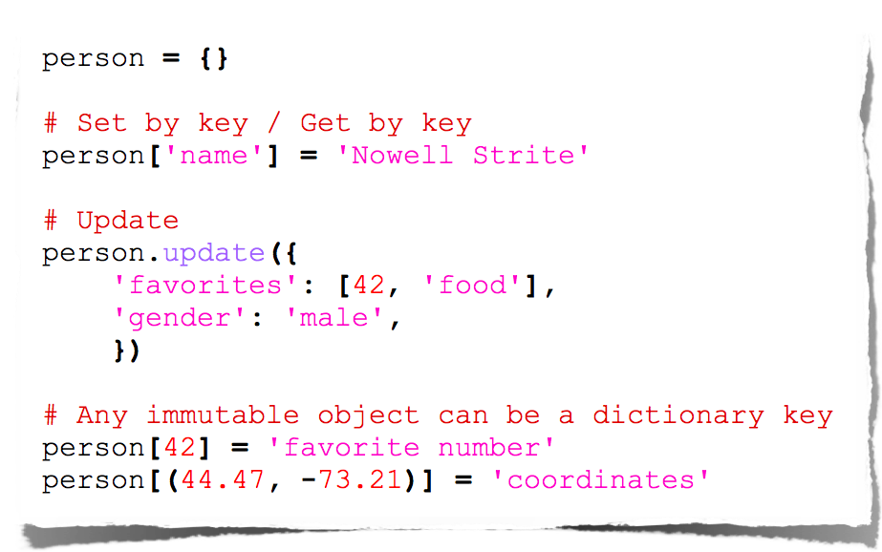
Dictionaries
76

Slide 77
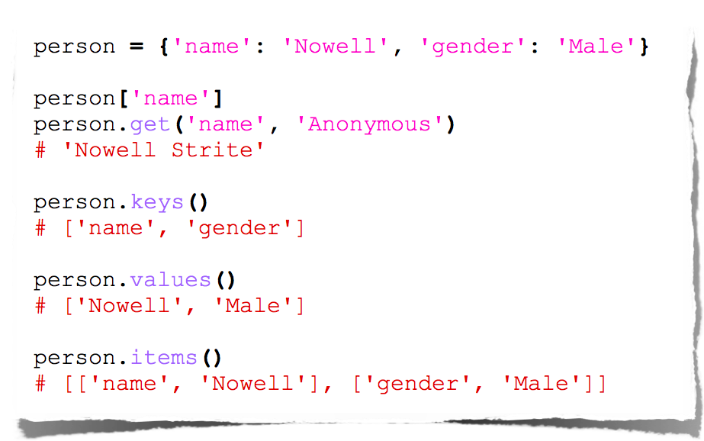
Dictionary Methods
77

Slide 78
Creating a Dictionary
dictionary = {} # Create an empty dictionary
dictionary = {"john":40, "peter":45} # Create a dictionary

Slide 79
Adding/Modifying Entries
To add an entry to a dictionary, use
dictionary[key] = value
For example,
dictionary["susan"] = 50

Slide 80
Deleting Entries
To delete an entry from a dictionary, use
del dictionary[key]
For example,
del dictionary["susan"]

Slide 81
Looping Entries
for key in dictionary:
print(key + ":" + str(dictionary[key]))

Slide 82
The len and in operators
len(dictionary) returns the number of the elements in the dictionary.
>>> dictionary = {"john":40, "peter":45}
>>> "john" in dictionary
True
>>> "johnson" in dictionary
False

Slide 83
The Dictionary Methods

Slide 84
Case Studies: Occurrences of Words
This case study writes a program that counts the occurrences of words in a text file and displays the words and their occurrences in alphabetical order of words. The program uses a dictionary to store an entry consisting of a word and its count. For each word, check whether it is already a key in the dictionary. If not, add to the dictionary an entry with the word as the key and value 1. Otherwise, increase the value for the word (key) by 1 in the dictionary.
CountOccurrenceOfWords

