Slide 1



CS244: Advanced Programming Applications
Lecture 12: Python OOP (Ch 7 & 12), Files Handling (Ch 13) & Libraries & Frameworks
Dr. Manal Helal, Fall 2013
http://moodle.manalhelal.com

Slide 2
Previous Lecture
Python GUI & Lists, Tuples, Sets & Dictionaries

Slide 3
Objectives
Python OOP Concepts (Ch 7 & 12)
Python Files and Exception Handling (Ch 13)
Python Similarities with other languages
Python New Concepts
Python Introspection
Python Modules

Slide 4
Python Classes & Objects
Ch 7

Slide 5
Classes
A Python class uses variables to store data fields and defines methods to perform actions. Additionally, a class provides a special type method, known as initializer, which is invoked to create a new object. An initializer can perform any action, but initializer is designed to perform initializing actions, such as creating the data fields of objects.
class ClassName:
initializer
methods
Circle
TestCircle

Slide 6
Python’s Way
No interfaces
No real private attributes/functions
Private attributes start (but do not end) with double underscores.
Special class methods start and end with double underscores.
__init__: Called when the instance is created;
__del__: Called when the instance is about to be destroyed
__cmp__: Called by comparison operations if there are no rich comparison (__lt__, __le__, __eq__, __ne__, __gt__, __ge__).
__str__: Called by the str() built-in function and by the print statement to compute the “informal” string representation of an object.
__name__ is the class name;
__module__ is the module name in which the class was defined;
__dict__ is the dictionary containing the class’s namespace;
__bases__ is a tuple (possibly empty or a singleton) containing the base classes, in the order of their occurrence in the base class list;
__doc__ is the class’s documentation string, or None if undefined

Slide 7
Constructing & Accessing Objects
After an object is created, you can access its data fields and invoke its methods using the dot operator (.), also known as the object member access operator. For example, the following code accesses the radius data field and invokes the getPerimeter and getArea methods.
>>> from Circle import Circle
>>> c = Circle(5)
>>> c.getPerimeter()
31.41592653589793
>>> c.radius = 10
>>> c.getArea()
314.1592653589793

Slide 8
Why self?
Note that the first parameter is special. It is used in the implementation of the method, but not used when the method is called. So, what is this parameter self for? Why does Python need it?
self is a parameter that represents an object. Using self, you can access instance variables in an object. Instance variables are for storing data fields. Each object is an instance of a class. Instance variables are tied to specific objects. Each object has its own instance variables. You can use the syntax self.x to access the instance variable x for the object self in a method.

Slide 9
Data Field Encapsulation
def __init__(self, radius = 1):
self.__radius = radius
To protect data.
To make class easy to maintain.
To prevent direct modifications of data fields, don’t let the client directly access data fields. This is known as data field encapsulation. This can be done by defining private data fields. In Python, the private data fields are defined with two leading underscores. You can also define a private method named with two leading underscores.
CircleWithPrivateDataRadius

Slide 10
Data Field Encapsulation
CircleWithPrivateDataRadius
>>> from CircleWithPrivateRadius import Circle
>>> c = Circle(5)
>>> c.__radius
AttributeError: 'Circle' object has no attribute '__radius'
>>> c.getRadius()
5

Slide 11
Python Inheritance and Polymorphism
Ch 12

Slide 12
Overriding Methods
A subclass inherits methods from a superclass. Sometimes it is necessary for the subclass to modify the implementation of a method defined in the superclass. This is referred to as method overriding.
class Circle(GeometricObject):
# Other methods are omitted
# Override the __str__ method defined in GeometricObject
def __str__(self):
return super().__str__() + " radius: " + str(radius)

Slide 13
Polymorphism
The three pillars of object-oriented programming are encapsulation, inheritance, and polymorphism.
The inheritance relationship enables a subclass to inherit features from its superclass with additional new features. A subclass is a specialization of its superclass; every instance of a subclass is also an instance of its superclass, but not vice versa. For example, every circle is a geometric object, but not every geometric object is a circle. Therefore, you can always pass an instance of a subclass to a parameter of its superclass type.
PolymorphismDemo

Slide 14
Dynamic Binding
Dynamic binding works as follows: Suppose an object o is an instance of classes C₁, C₂, ..., C_{n-1}, and C_{n}, where C₁ is a subclass of C₂, C₂ is a subclass of C₃, ..., and C_{n-1} is a subclass of C_{n}. That is, C_{n} is the most general class, and C₁ is the most specific class. In Python, C_{n} is the object class. If o invokes a method p, the JVM searches the implementation for the method p in C₁, C₂, ..., C_{n-1} and C_{n}, in this order, until it is found. Once an implementation is found, the search stops and the first-found implementation is invoked.

Slide 15
The isinstance Function
The isinstance function can be used to determine if an object is an instance of a class.
IsinstanceDemo

Slide 16
Python Files Handling
Ch 13

Slide 17
Open a File
How do you write data to a file and read the data back from a file? You need to create a file object that is associated with a physical file. This is called opening a file. The syntax for opening a file is as follows:
file = open(filename, mode)

Slide 18
Write to a File
outfile = open("test.txt", "w")
outfile.write("Welcome to Python")
WriteDemo

Slide 19
Testing File Existence
import os.path
if os.path.isfile("Presidents.txt"):
print("Presidents.txt exists")

Slide 20
Read from a File
After a file is opened for reading data, you can use the read method to read a specified number of characters or all characters, the readline() method to read the next line, and the readlines() method to read all lines into a list.
ReadDemo

Slide 21
Append Data to a File
You can use the 'a' mode to open a file for appending data to an existing file.
AppendDemo

Slide 22
Writing/Reading Numeric Data
To write numbers, convert them into strings, and then use the write method to write them to a file. In order to read the numbers back correctly, you should separate the numbers with a whitespace character such as ' ', '\n'.
WriteReadNumbers

Slide 23
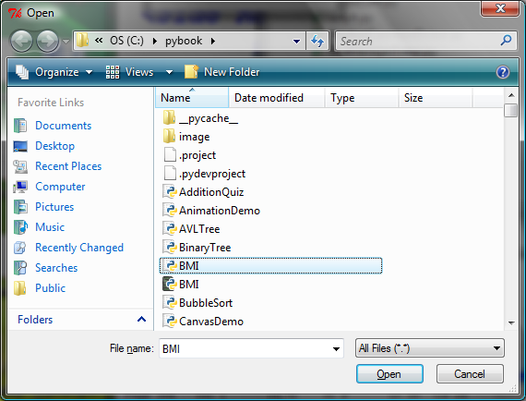
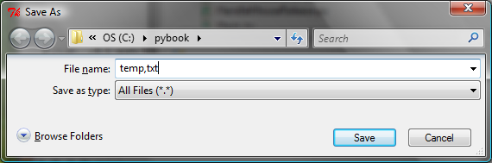
File Dialogs
from tkinter.filedialog import askopenfilename
from tkinter.filedialog import asksaveasfilename
filenameforReading = askopenfilename()
print("You can read from " + filenameforReading)
filenameforWriting = asksaveasfilename()
print("You can write data to " + filenameforWriting)

Slide 24
Python Similarities with Other Languages

Slide 25
Similarities to Java
typically compiled to bytecode
but: compilation is implicit ("auto-make")
everything inherits from "object"
but: also numbers, functions, classes, ...
"everything is ﬁrst-class"
uniform object-reference semantics
assignment, argument passing, return
vast, powerful standard library
garbage collection
introspection, serialization, threads, ...

Slide 26
Similarities to C++
multi-paradigm
OOP, procedural, generic, a little FP
multiple inheritance (structural/mixin)
operator overloading
but: not for "plain assignment"
signature-based polymorphism
as if "everything was a template":-)
lots of choices for all the "side issues"
GUI, Web & other network work, DB, IPC and distributed computing, ...

Slide 27
Similarities to C
"Spirit of C" @87% (more than Java/C++...), as per ISO C Standard's "Rationale":
trust the programmer
don't prevent the programmer from doing what needs to be done
keep the language small and simple
provide only one way to do an operation
(make it fast, even if it's not guaranteed to be portable)

Slide 28
Python vs Java/C++/C
typing: strong, but dynamic
names have no type: objects have types
no "declarations" -- just statements
spare syntax, minimal ornamentation:
no { } for blocks, just indentation
no ( ) for if/while conditions
generally less punctuation
"everything" is a ﬁrst-class object
classes, functions, methods, modules, ...
the focus is on high and very high levels

Slide 29
Python – Whats new?

Slide 30
Function Arguments
Names not Variables
All parameters (arguments) in the Python language are passed by reference.
Required arguments
def printme (str):
Keyword arguments
printme( str = "My string");
Default arguments
def printinfo( name, age = 35 ):
Variable-length arguments
def functionname([formal_args,] *var_args_tuple ):

Slide 31
Everything is First-Class
In Python, functions are objects like everything else, that can be created and passed around dynamically.
Ah, function containing variable, you’re not so special!
>>> issubclass(int, object)
# all objects in Python inherit from a common baseclass
True
>>> def foo():
... pass
>>> foo.__class__ # 1
<type 'function'>
>>> issubclass(foo.__class__, object)
True

Slide 32
Pass Functions to Functions
>>> def add(x, y):
... return x + y
>>> def sub(x, y):
... return x - y
>>> def apply(func, x, y): # 1
... return func(x, y) # 2
>>> apply(add, 2, 1) # 3
3
>>> apply(sub, 2, 1)
1

Slide 33
Inner Functions
>>> def outer():
... def inner():
... print "Inside inner"
... return inner # 1
...
>>> foo = outer() #2
>>> foo # doctest:+ELLIPSIS
<function inner at 0x...>
>>> foo()
Inside inner

Slide 34
Generators
functions that use yield instead of return
each call builds and returns an iterator (object w/method next, suitable in particular for looping on in a for)
end of function raises StopIteration
>>>def enumerate(seq): # actually built-in
n = 0
for item in seq:
yield n, item
n += 1

Slide 35
An unending generator
>>>def fibonacci():
i = j = 1
while True:
r, i, j = i, j, i + j
yield r
>>>for rabbits in fibonacci():
print rabbits,
if rabbits > 100: break
1 1 2 3 5 8 13 21 34 55 89 144

Slide 36
Closures
Exploiting the fact that def is an executable statement that creates a new function object (and also exploiting lexical scoping)...:
>>> def makeAdder(addend):
def adder(augend):
return augend + addend
return adder
>>> a23 = makeAdder(23)
>>> a42 = makeAdder(42)
>>>print a23(100), a42(100), a23(a42(100))
123 142 165

Slide 37
Decorators
A decorator is a callable that takes a function as an argument and returns a replacement function.
>>> def outer(some_func):
... def inner():
... print "before some_func"
... ret = some_func() # 1
... return ret + 1
... return inner
>>> def foo():
... return 1
>>> decorated = outer(foo) # 2
>>> decorated()
before some_func
2

Slide 38
The Anonymous Functions
You can use the lambda keyword to create small anonymous functions.
Lambda forms can take any number of arguments but return just one value in the form of an expression. They cannot contain commands or multiple expressions.
Syntax:
lambda [arg1 [,arg2,.....argn]]:expression
Example:
# Function definition is here
sum = lambda arg1, arg2: arg1 + arg2;
# Now you can call sum as a function
print "Value of total : ", sum( 10, 20 )

Slide 39
The @ Symbol
To wrap a function in a decorator by pre-pending the function definition with a decorator name and the @ symbol.
>>> add = wrapper(add)
Equivalent to:
>>> @wrapper
... def add(a, b):
... return a + b

Slide 40
Python Introspection Examples
>>> a_string = "This is a global variable"
>>> def foo():
... print locals()
>>> print globals()
{..., 'a_string': 'This is a global variable'}
>>> foo() # 2
{}

Slide 41
The sys Module
$ python
Python 2.2.2 (#1, Oct 28 2002, 17:22:19)
[GCC 3.2 (Mandrake Linux 9.0 3.2-1mdk)] on linux2
Type "help", "copyright", "credits" or "license" for more information.
>>> import sys
>>> sys.executable
'/usr/local/bin/python‘
>>> sys.platform
'linux2‘
>>> sys.version
'2.2.2 (#1, Oct 28 2002, 17:22:19) \n[GCC 3.2 (Mandrake Linux 9.0 3.2-1mdk)]'
>>> sys.version_info
(2, 2, 2, 'final', 0)
>>> sys.maxint
2147483647
>>> sys.argv
['']
>>> sys.path
['', '/home/pobrien/Code',
'/usr/local/lib/python2.2',
'/usr/local/lib/python2.2/plat-linux2',
'/usr/local/lib/python2.2/lib-tk',
'/usr/local/lib/python2.2/lib-dynload',
'/usr/local/lib/python2.2/site-packages']
Provides insightful information about Python itself such as a variety of variables and functions that reveal interesting details about the current Python interpreter.
Importing a module enable referencing its contents (such as variables, functions, and classes) using dot (.) notation.
The sys.executable variable contains the path to the Python interpreter.
The platform variable tells us which operating system we are on.

Slide 42
The dir Function
>>> dir()
['__builtins__', '__doc__', '__name__', 'keyword', 'sys']
>>> dir(keyword)
['__all__', '__builtins__', '__doc__', '__file__', '__name__',
'iskeyword', 'keyword', 'kwdict', 'kwlist', 'main']
>>> dir(sys)
['__displayhook__', '__doc__', '__excepthook__', '__name__', '__stderr__',
'__stdin__', '__stdout__', '_getframe', 'argv', 'builtin_module_names',
'byteorder', 'copyright', 'displayhook', 'exc_info', 'exc_type', 'excepthook',
'exec_prefix', 'executable', 'exit', 'getdefaultencoding', 'getdlopenflags',
'getrecursionlimit', 'getrefcount', 'hexversion', 'last_traceback',
'last_type', 'last_value', 'maxint', 'maxunicode', 'modules', 'path',
'platform', 'prefix', 'ps1', 'ps2', 'setcheckinterval', 'setdlopenflags',
'setprofile', 'setrecursionlimit', 'settrace', 'stderr', 'stdin', 'stdout', 'version', 'version_info', 'warnoptions']
The built-in dir() function examines the contents of modules (and other objects).
It returns a sorted list of attribute names for any object passed to it.
If no object is specified, dir() returns the names in the current scope.
An application of dir() to the keyword & sys modules is shown.

Slide 43
>>> dir(__builtins__)
['ArithmeticError', 'AssertionError', 'AttributeError', 'DeprecationWarning', 'EOFError', 'Ellipsis', 'EnvironmentError', 'Exception', 'False', 'FloatingPointError', 'IOError', 'ImportError', 'IndentationError', 'IndexError', 'KeyError', 'KeyboardInterrupt', 'LookupError', 'MemoryError', 'NameError', 'None', 'NotImplemented', 'NotImplementedError', 'OSError', 'OverflowError', 'OverflowWarning', 'ReferenceError', 'RuntimeError','RuntimeWarning', 'StandardError', 'StopIteration', 'SyntaxError', 'SyntaxWarning', 'SystemError', 'SystemExit', 'TabError', 'True', 'TypeError', 'UnboundLocalError', 'UnicodeError', 'UserWarning', 'ValueError', 'Warning', 'ZeroDivisionError', '_', '__debug__', '__doc__', '__import__', '__name__', 'abs', 'apply', 'bool', 'buffer', 'callable', 'chr', 'classmethod', 'cmp', 'coerce', 'compile', 'complex', 'copyright', 'credits', 'delattr', 'dict', 'dir', 'divmod', 'eval', 'execfile', 'exit', 'file', 'filter', 'float', 'getattr', 'globals', 'hasattr', 'hash', 'help', 'hex', 'id', 'input', 'int', 'intern', 'isinstance', 'issubclass', 'iter', 'len', 'license', 'list', 'locals', 'long', 'map', 'max', 'min', 'object', 'oct', 'open', 'ord', 'pow', 'property', 'quit', 'range', 'raw_input', 'reduce', 'reload', 'repr', 'round', 'setattr', 'slice', 'staticmethod', 'str', 'super', 'tuple', 'type', 'unichr', 'unicode', 'vars', 'xrange', 'zip']

Slide 44
>>> class Person(object):
... """Person class."""
... def __init__(self, name, age):
... self.name = name
... self.age = age
... def intro(self):
... """Return an introduction."""
... return "Hello, my name is %s and I'm %s." % (self.name, self.age)
...
>>> bob = Person("Robert", 35) # Create a Person instance
>>> joe = Person("Joseph", 17) # Create another
>>> joe.sport = "football" # Assign a new attribute to one instance
>>> dir(Person) # Attributes of the Person class
['__class__', '__delattr__', '__dict__', '__doc__', '__getattribute__', '__hash__', '__init__', '__module__', '__new__', '__reduce__', '__repr__', '__setattr__', '__str__', '__weakref__', 'intro']
>>> dir(bob) # Attributes of bob
['__class__', '__delattr__', '__dict__', '__doc__', '__getattribute__', '__hash__', '__init__', '__module__', '__new__', '__reduce__', '__repr__', '__setattr__', '__str__', '__weakref__', 'age', 'intro', 'name']
>>> dir(joe) # Note that joe has an additional attribute
['__class__', '__delattr__', '__dict__', '__doc__', '__getattribute__', '__hash__', '__init__', '__module__', '__new__', '__reduce__', '__repr__', '__setattr__', '__str__', '__weakref__', 'age', 'intro', 'name', 'sport']
>>> bob.intro() # Calling bob's intro method
"Hello, my name is Robert and I'm 35."
>>> dir(bob.intro) # Attributes of the intro method
['__call__', '__class__', '__cmp__', '__delattr__', '__doc__', '__get__', '__getattribute__', '__hash__', '__init__', '__new__', '__reduce__', '__repr__', '__setattr__', '__str__', 'im_class', 'im_func', 'im_self']

Slide 45
Python: Whats more?

Slide 46
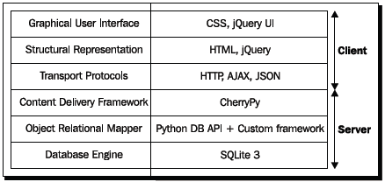
Web Frameworks
Presentation framework (GUI):
Yate library - HTML-generating helper functions
jQuery UI library
Web Development:
Django
a high-level Python Web framework that encourages rapid development and clean, pragmatic design.
Flask
Pylons
TurboGears
Zope
Grok
WebServer
CherryPy written in python
Database
SQLite

Slide 47
IDEs
Emacs
Vim
Komodo
PyCharm
Eclipse (PyDev)

Slide 48
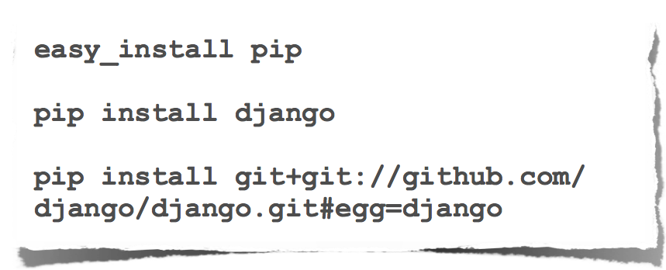
Package Management

