Slide 1


Python Tutorial
A readable, dynamic, pleasant,
flexible, fast and powerful language

Slide 2
Programming Languages
Machine language:
Byte: 11011010
Assembly languages:
mov va1, 14 # assign value to va1
mov va2, 10 # assign value to va2
add va1, va2 # add va2 to va1
high-level languages:
va1 = 14 + 10

Slide 3
Popular High-Level Languages
COBOL (COmmon Business Oriented Language)
FORTRAN (FORmula TRANslation)
BASIC (Beginner All-purpose Symbolic Instructional Code)
Pascal (named for Blaise Pascal)
Ada (named for Ada Lovelace)
C (whose developer designed B first)
Visual Basic (Basic-like visual language developed by Microsoft)
Delphi (Pascal-like visual language developed by Borland)
C++ (an object-oriented language, based on C)
C# (More friendly based on C++ developed by Microsoft)
Java (More friendly developed by Oracle)
Python (We use it in the book)

Slide 4
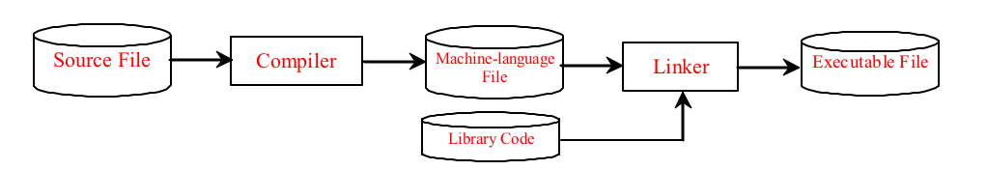
Compiling Source Code
A program written in a high-level language is called a source program. Since a computer cannot understand a source program. Program called a compiler is used to translate the source program into a machine language program called an object program. The object program is often then linked with other supporting library code before the object can be executed on the machine.

Slide 5
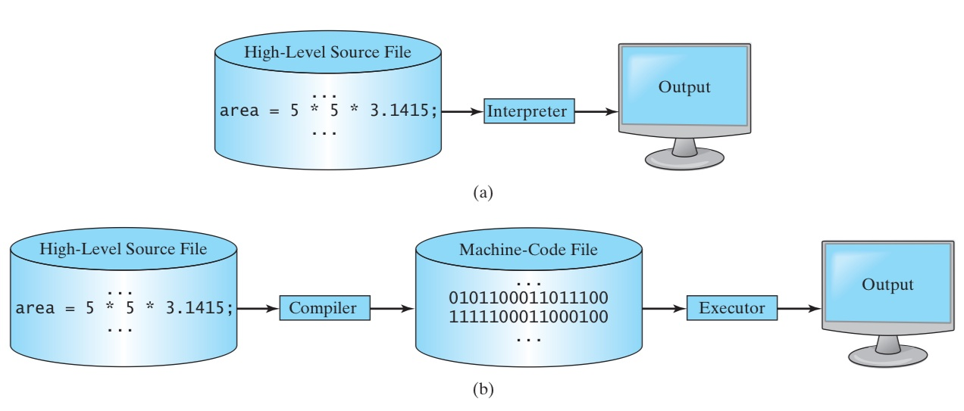
Interpreted vs. Compiled languages

Slide 6
What is Python
Multi-purpose (Web, GUI, Scripting, etc.)
Object Oriented
Interpreted
Strongly typed and Dynamically typed
Focus on readability and productivity

Slide 7
What is Python?
Python is a general purpose programming language. That means you can use Python to write code for any programming tasks. Python are now used in Google search engine, in mission critical projects in NASA, in processing financial transactions at New York Stock Exchange.
Python is interpreted, which means that python code is translated and executed by an interpreter one statement at a time. In a compiled language, the entire source code is compiled and then executed altogether.
Python is an object-oriented programming language. Data in Python are objects created from classes. A class is essentially a type that defines the objects of the same kind with properties and methods for manipulating objects. Object-oriented programming is a powerful tool for developing reusable software.

Slide 8
Python’s History
Created by Guido van Rossum in Netherlands in 1989
Open source
Releases
Python 1.0 released in 1994
Python 2.0 released in 2000
Python 3.0 released in 2008
Python 2.7 is the recommended version – Most used version
3.0 adoption will take a few years
Python 3 is a newer version, but it is not backward compatible with Python 2. That means if you write a program using Python 2, it may not work on Python 3 and vice versa.

Slide 9
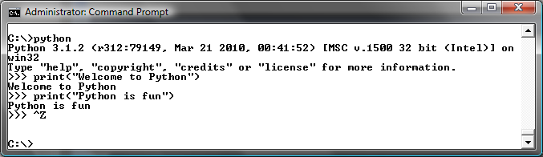
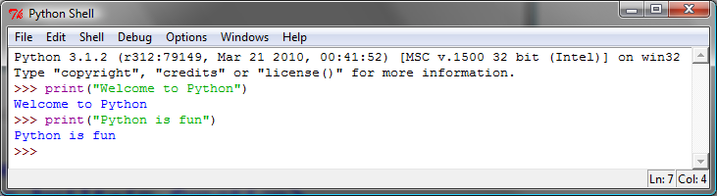
Launch Python

Slide 10
Type Systems
 | Weak Typing | Strong Typing
Pseudocode | a = 2 b = "2" concatenate(a, b) # Returns "22" add(a, b) # Returns 4 | a = 2 = "2" concatenate(a, b) # Type Error add(a, b) # Type Error concatenate(str(a), b) # Returns "22" add(a, int(b)) # Returns 4
Languages | BASIC, JavaScript, Perl, PHP, Rexx | Java, ActionScript 3, C#, Python, OCaml, Ada
Dynamic Typing: the majority of the type checking operations is performed at run-time as opposed to at compile-time. In dynamic typing values have types, but variables do not; that is, a variable can refer to a value of any type.
OOP in Java : © W. Milner 2005 : Slide

Slide 11

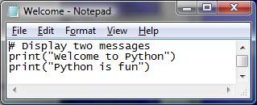
Creating and Editing Using Notepad
To use Notepad, type
  notepad Welcome.py
from the DOS prompt.

Slide 12
Anatomy of a Python Program
Statements
Comments
Indentation

Slide 13
Statement
A statement represents an action or a sequence of actions. The statement print("Welcome to Python") in the program in Listing 1.1 is a statement to display the greeting "Welcome to Python“.
# Display two messages
print("Welcome to Python")
print("Python is fun")

Slide 14
Indentation
The indentation matters in Python. Note that the statements are entered from the first column in the new line. It would cause an error if the program is typed as follows:
# Display two messages
print("Welcome to Python")
print("Python is fun")

Slide 15
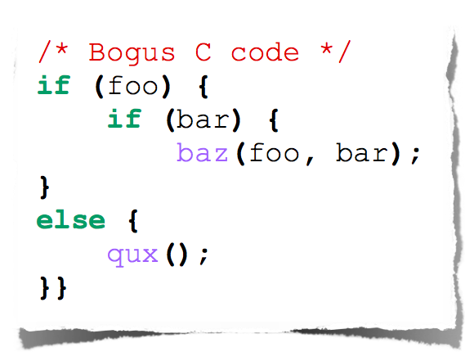
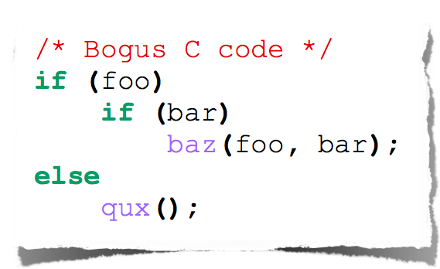
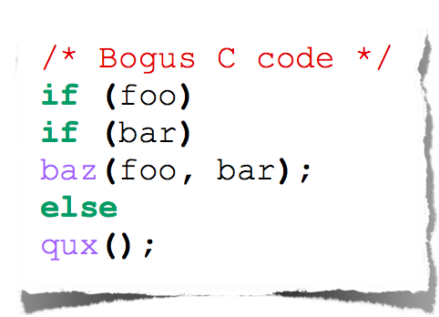
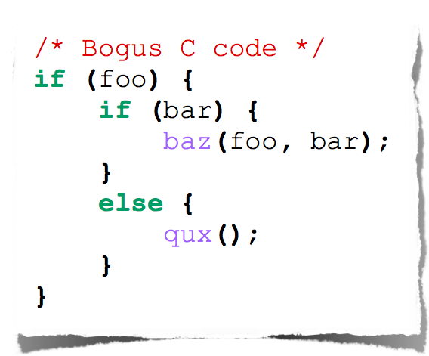
C - Indentation

Slide 16
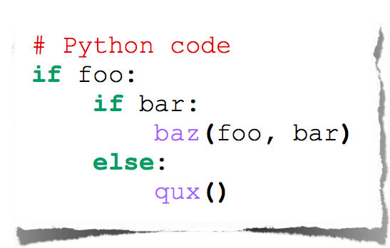
Python - Indentation

Slide 17
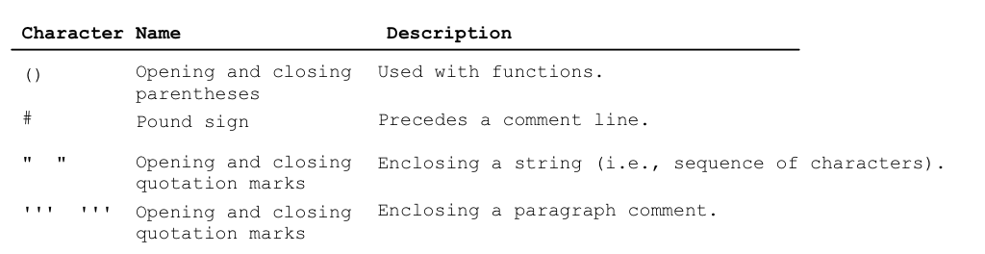
Special Symbols

Slide 18
Appropriate Comments
Include a summary at the beginning of the program to explain what the program does, its key features, its supporting data structures, and any unique techniques it uses.
Include your name, class section, instructor, date, and a brief description at the beginning of the program.

Slide 19
Proper Indentation and Spacing
Indentation
  Indent four spaces.
  A consistent spacing style makes programs clear and easy to read, debug, and maintain.
Spacing
  Use blank line to separate segments of the code.

Slide 20
Programming Errors
Syntax Errors
  Error in code construction
Runtime Errors
  Causes the program to abort
Logic Errors
  Produces incorrect result

Slide 21
Getting Started with GUI Programming
Why GUI? Turtle Tkniter
GUI is a great pedagogical tool to motivate studetns and stimulate student interests in programming.

Slide 22
Getting Started with GUI Programming
Why GUI? Turtle Tkniter
A simple way to start graphics programming is to use Python built-in Turtle package.
A Turtule Example

Slide 23
Getting Started with GUI Programming
Why GUI? Turtle Tkniter
Later in the book, we will also introduce Tkinter for developing comprehensive GUI applications.
A Tkinter Example

Slide 24
Python Features
Batteries Included (large number of libraries)
Everything is an Object
Interactive Shell
Strong Introspection (ability to determine the type of an object at runtime)
Cross Platform (ability to write in many O/S)

Slide 25
Syntax

Slide 26
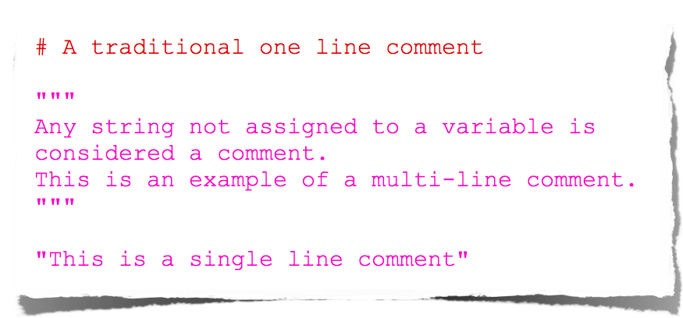
Comments

Slide 27
Elementary I/O
two built-in functions for elementary input:
  input(prompt): user may enter any
Python expression -- returns its value
  raw_input(prompt): returns string
  trims trailing \n
one statement for elementary output:
  print <0+ comma-separated expressions>
  separates results with a space
  \n at end (unless trailing comma)
  print itself does no fancy formatting
OOP in Java : © W. Milner 2005 : Slide

Slide 28
Types

Slide 29
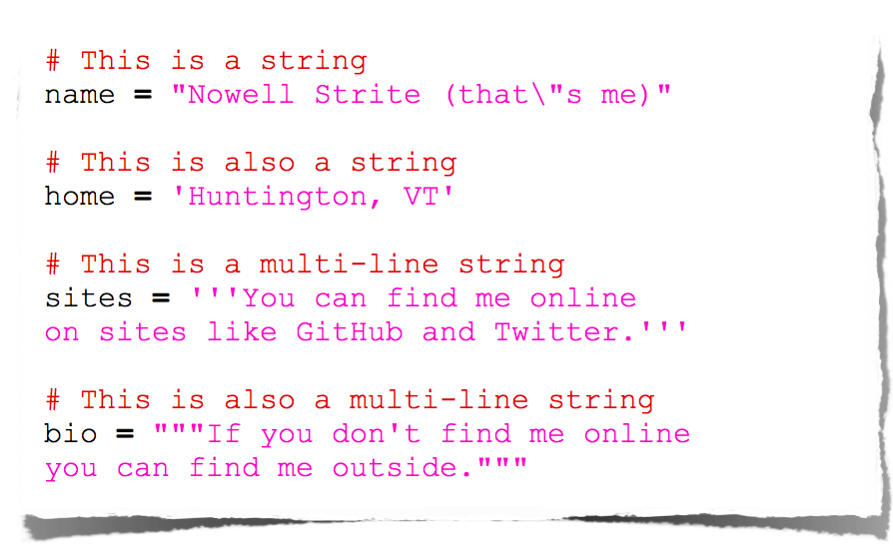
Strings

Slide 30
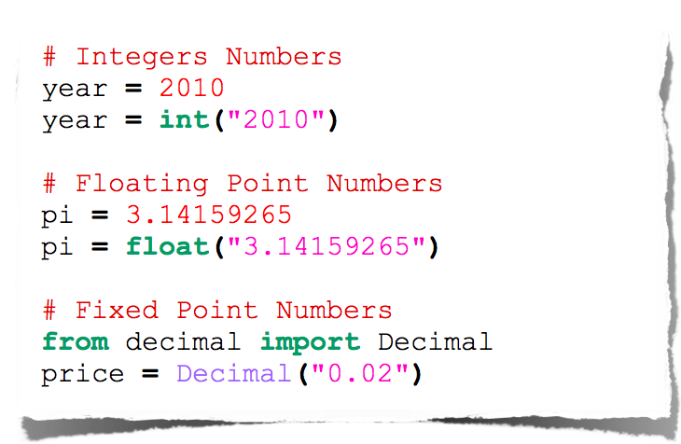
Numbers

Slide 31
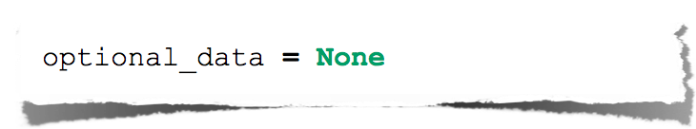
Null

Slide 32
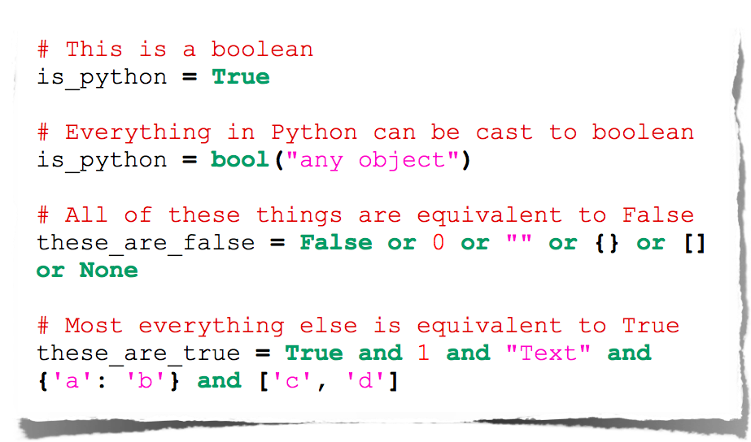
Booleans

Slide 33
Operators

Slide 34
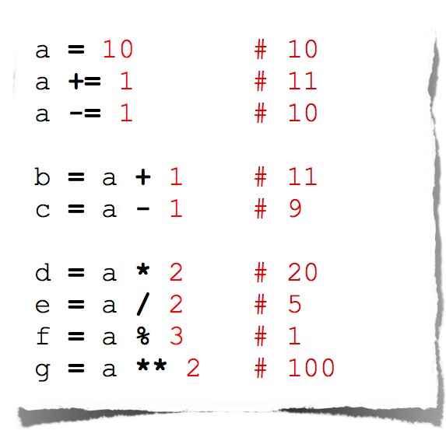
Arithmetic

Slide 35
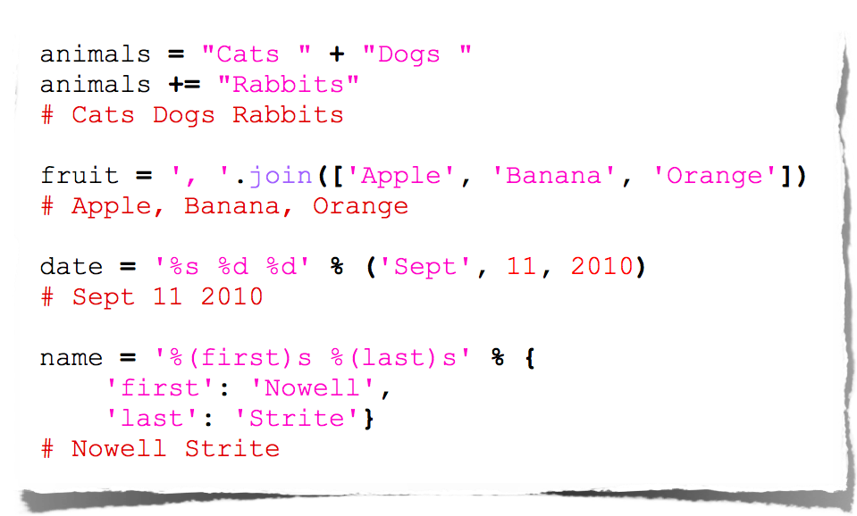
String Manipulation

Slide 36
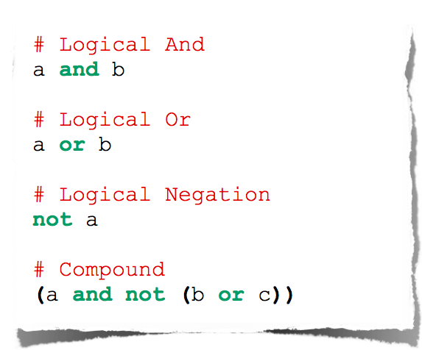
Logical Comparison

Slide 37
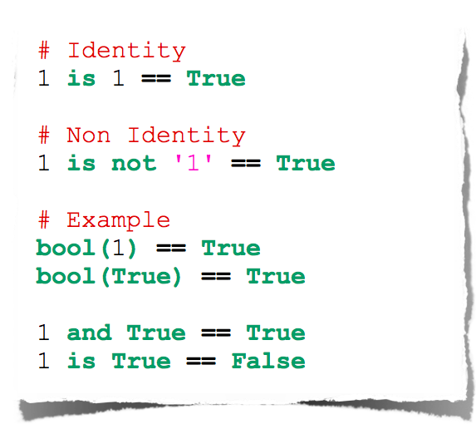
Identity Comparison

Slide 38
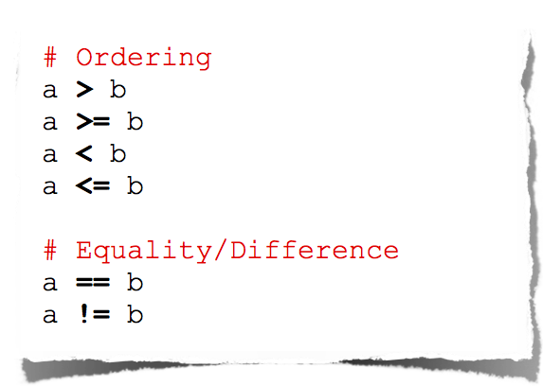
Arithmetic Comparison

Slide 39
Control Flow

Slide 40
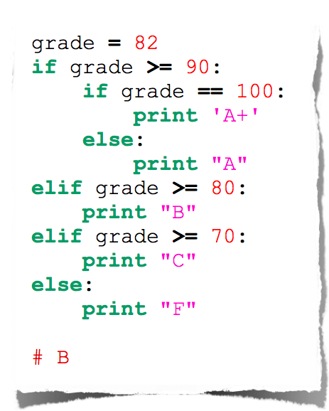
Conditionals

Slide 41
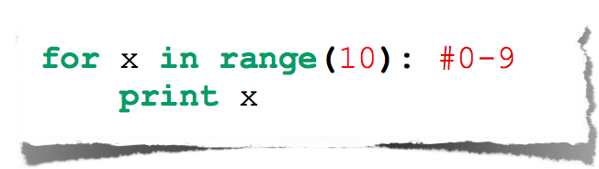
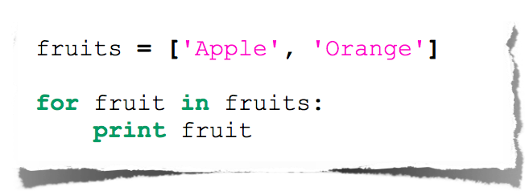
For Loop

Slide 42
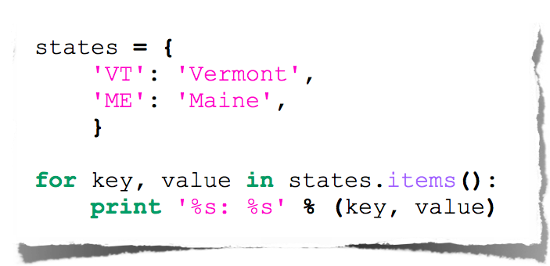
Expanded For Loop

Slide 43
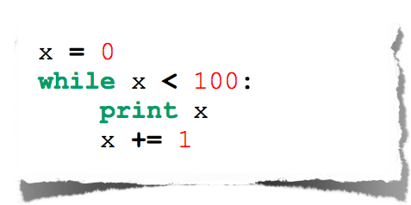
While Loop

Slide 44
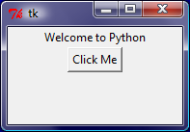
Getting Started with Tkinter
from tkinter import * # Import tkinter
def btn_action():
print(“clicked”)
root = Tk() # Create a root window
label = Label(root, text = "Welcome to Python") # Create a label
button = Button(root, text = "Click Me“, command=btn_action) # Create a button
label.pack() # Display the label in the window
button.pack() # Display the button in the window
root.mainloop() # Create an event loop

Slide 45
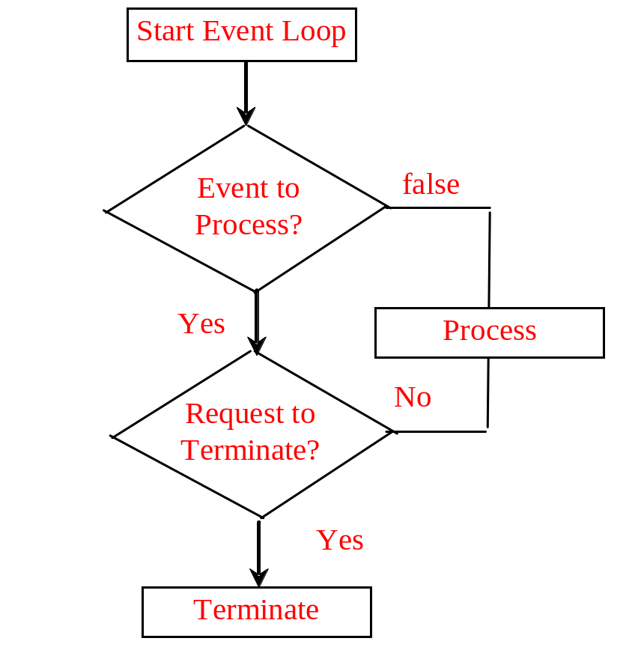

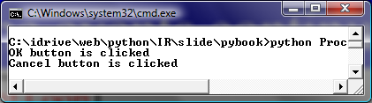
Processing Events
window.mainloop() # Create an event loop
The statement creates an event loop. The event loop processes the events continuously.
ProcessButtonEvent

Slide 46
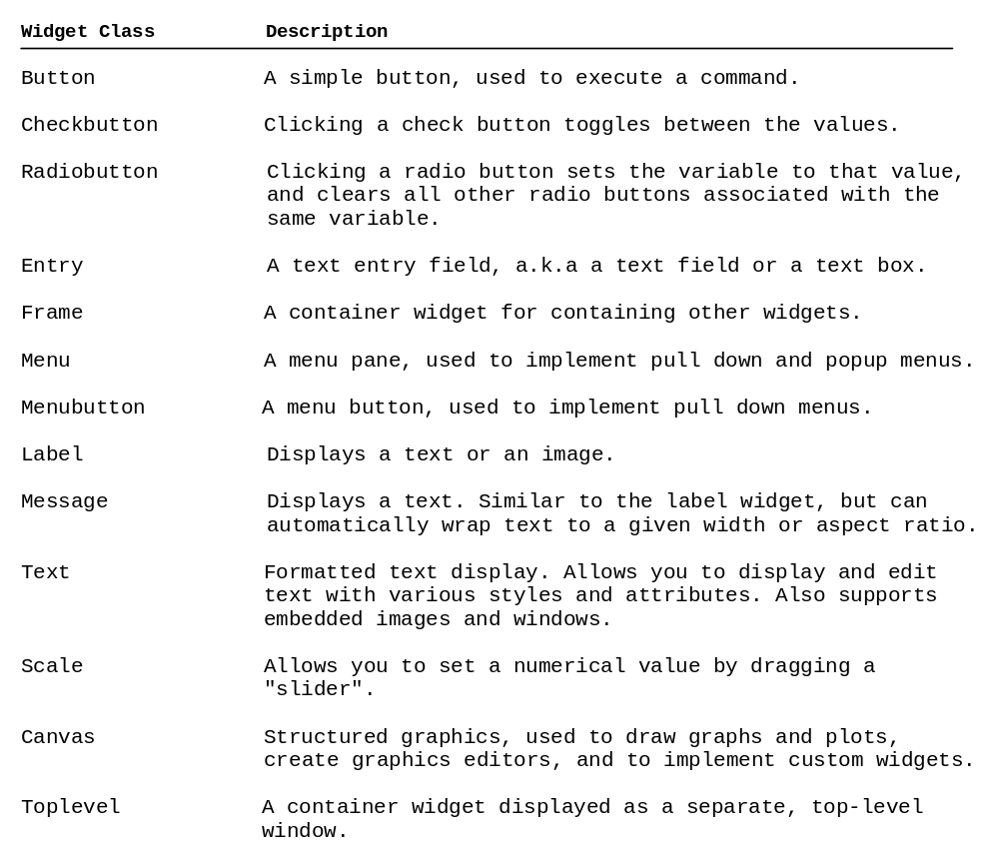
The Widget Classes

Slide 47
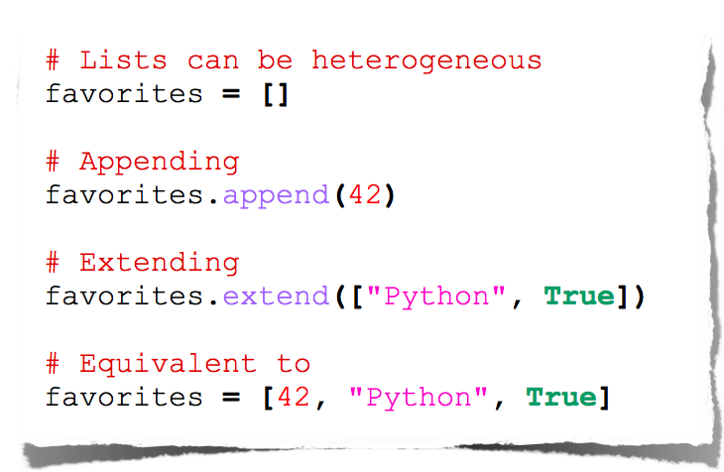
Lists

Slide 48
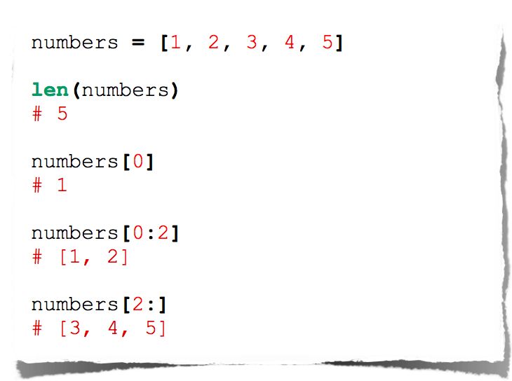
Lists

Slide 49
Creating Lists
Creating list using the list class
list1 = list() # Create an empty list
list2 = list([2, 3, 4]) # Create a list with elements 2, 3, 4
list3 = list(["red", "green", "blue"]) # Create a list with strings
list4 = list(range(3, 6)) # Create a list with elements 3, 4, 5
list5 = list("abcd") # Create a list with characters a, b, c
For convenience, you may create a list using the following syntax:
list1 = [] # Same as list()
list2 = [2, 3, 4] # Same as list([2, 3, 4])
list3 = ["red", "green"] # Same as list(["red", "green"])

Slide 50
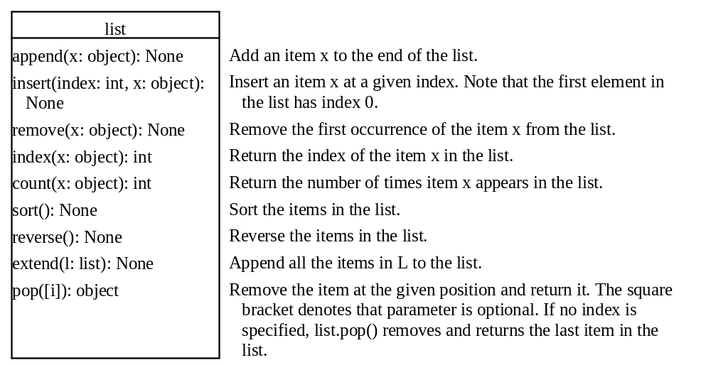
list Methods

Slide 51
Functions for lists
>>> list1 = [2, 3, 4, 1, 32]
>>> len(list1)
5
>>> max(list1)
32
>>> min(list1)
1
>>> sum(list1)
42
>>> import random
>>> random.shuffle(list1) # Shuffle the items in the list
>>> list1
[4, 1, 2, 32, 3]

Slide 52
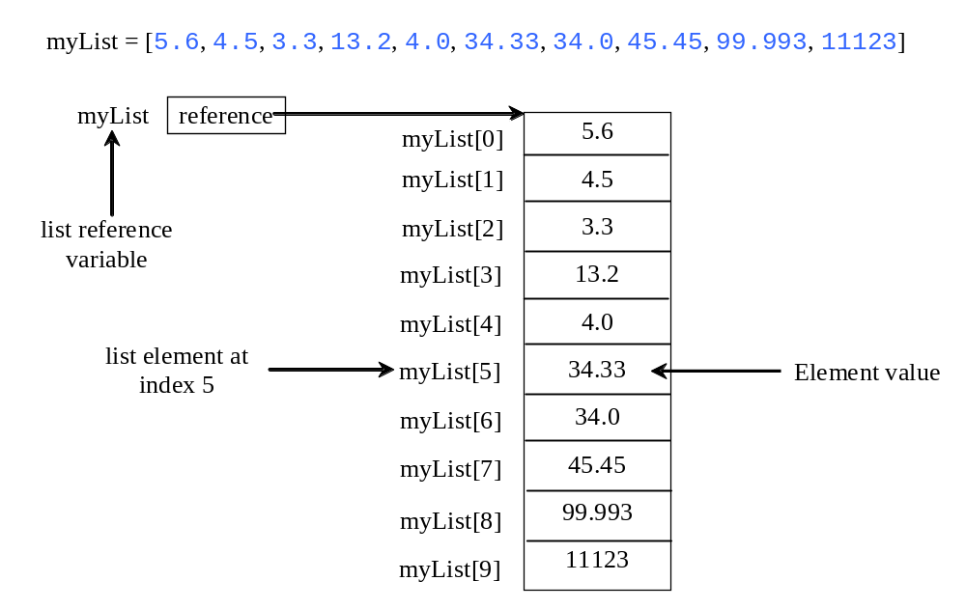
Indexer Operator []

Slide 53
The +, *, [ : ], and in Operators
>>> list1 = [2, 3]
>>> list2 = [1, 9]
>>> list3 = list1 + list2
>>> list3
[2, 3, 1, 9]
>>> list3 = 2 * list1
>>> list3
[2, 3, 2, 3, 2, 3]
>>> list4 = list3[2 : 4]
>>> list4
[2, 3]

Slide 54
The +, *, [ : ], and in Operators
>>> list1 = [2, 3, 5, 2, 33, 21]
>>> list1[-1]
21
>>> list1[-3]
2
>>> list1 = [2, 3, 5, 2, 33, 21]
>>> 2 in list1
True
>>> list1 = [2, 3, 5, 2, 33, 21]
>>> 2.5 in list1
False

Slide 55
off-by-one Error
i = 0
while i <= len(lst):
print(lst[i])
i += 1

Slide 56
List Comprehension
List comprehensions provide a concise way to create items from sequence. A list comprehension consists of brackets containing an expression followed by a for clause, then zero or more for or if clauses. The result will be a list resulting from evaluating the expression. Here are some examples:
>>> list1 = [x for x range(0, 5)] # Returns a list of 0, 1, 2, 4
>>> list1
[0, 1, 2, 3, 4]
>>> list2 = [0.5 * x for x in list1]
>>> list2
[0.0, 0.5, 1.0, 1.5, 2.0]
>>> list3 = [x for x in list2 if x < 1.5]
>>> list3
[0.0, 0.5, 1.0]

Slide 57
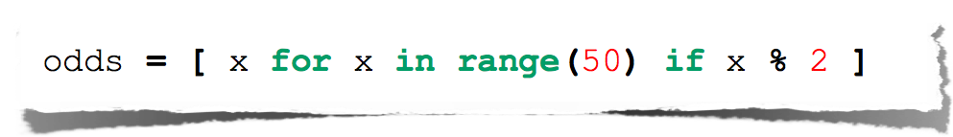
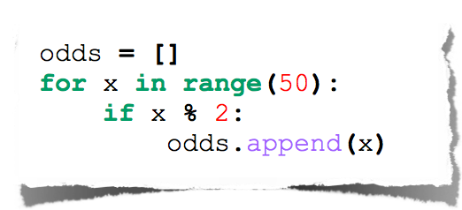
List Comprehensions
Useful for replacing simple for-loops.

Slide 58
Comparing Lists
>>>list1 = ["green", "red", "blue"]
>>>list2 = ["red", "blue", "green"]
>>>list2 == list1
False
>>>list2 != list1
True
>>>list2 >= list1
False
>>>list2 > list1
False
>>>list2 < list1
True
>>>list2 <= list1
True

Slide 59
Splitting a String to a List
items = "Welcome to the US".split()
print(items)
['Welcome', 'to', 'the', 'US']
items = "34#13#78#45".split("#")
print(items)
['34', '13', '78', '45']

Slide 60
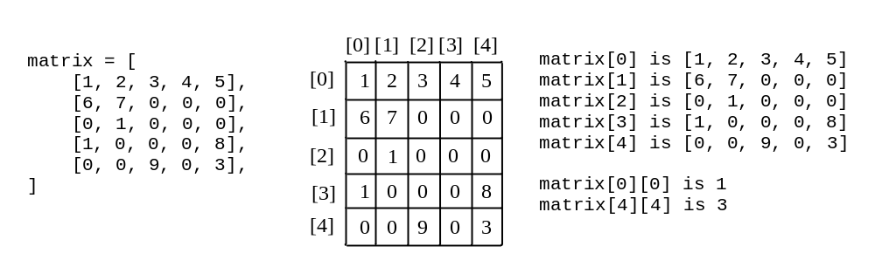
Processing Two-Dimensional lists
You can view a two-dimensional list as a list that consists of rows. Each row is a list that contains the values. The rows can be accessed using the index, conveniently called a row index. The values in each row can be accessed through another index, conveniently called a column index.

Slide 61
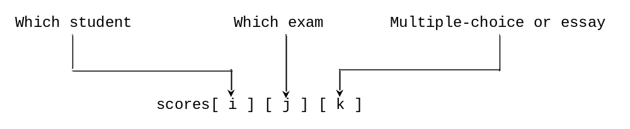
Multidimensional lists
scores = [
[[9.5, 20.5], [9.0, 22.5], [15, 33.5], [13, 21.5], [15, 2.5]],
[[4.5, 21.5], [9.0, 22.5], [15, 34.5], [12, 20.5], [14, 9.5]],
[[6.5, 30.5], [9.4, 10.5], [11, 33.5], [11, 23.5], [10, 2.5]],
[[6.5, 23.5], [9.4, 32.5], [13, 34.5], [11, 20.5], [16, 9.5]],
[[8.5, 26.5], [9.4, 52.5], [13, 36.5], [13, 24.5], [16, 2.5]],
[[9.5, 20.5], [9.4, 42.5], [13, 31.5], [12, 20.5], [16, 6.5]]]

Slide 62
Tuples
Tuples are like lists except they are immutable. Once they are created, their contents cannot be changed.
If the contents of a list in your application do not change, you should use a tuple to prevent data from being modified accidentally. Furthermore, tuples are more efficient than lists.

Slide 63
Creating Tuples
t1 = () # Create an empty tuple
t2 = (1, 3, 5) # Create a set with three elements
# Create a tuple from a list
t3 = tuple([2 * x for x in range(1, 5)])
# Create a tuple from a string
t4 = tuple("abac") # t4 is ['a', 'b', 'a', 'c']

Slide 64
Tuples
Tuples can be used like lists except they are immutable.
tuple1 = ("green", "red", "blue") # Create a tuple
tuple2 = tuple([7, 1, 2, 23, 4, 5]) # Create a tuple from a list
print("length is", len(tuple2), "max is", max(tuple2), "min is",
min(tuple2), "sum is", sum(tuple2))
print("The first element is", tuple2[0]) # Use indexer
tuple3 = tuple1 + tuple2 # Combine 2 tuples
tuple3 = 2 * tuple1 # Multiple a tuple
print(tuple2[2 : 4]) # Slicing operator
print(2 in tuple2) # in operator
for v in tuple1:
print(v, end = " ")
print()
list1 = list(tuple2) # Obtain a list from a tuple
list1.sort()
tuple4 = tuple(list1)
tuple5 = tuple(list1)
print(tuple4)
print(tuple4 == tuple5) # Compare two tuples

Slide 65
Sets
Sets are like lists to store a collection of items. Unlike lists, the elements in a set are unique and are not placed in any particular ordered. If your application does not care about the order of the elements, using a set to store elements is more efficient than using lists. The syntax for sets is braces {}.

Slide 66
Creating Sets
s1 = set() # Create an empty set
s2 = {1, 3, 5} # Create a set with three elements
s3 = set([1, 3, 5]) # Create a set from a tuple
# Create a set from a list
s4 = set([x * 2 for x in range(1, 10)])
# Create a set from a string
s5 = set("abac") # s5 is {'a', 'b', 'c'}

Slide 67
Manipulating and Accessing Sets
>>> s1 = {1, 2, 4}
>>> s1.add(6)
>>> s1
{1, 2, 4, 6}
>>> len(s1)
4
>>> max(s1)
6
>>> min(s1)
1
>>> sum(s1)
13
>>> 3 in s1
False
>>> s1.remove(4)
>>> s1
{1, 2, 6}
>>>

Slide 68
Subset and Superset
>>> s1 = {1, 2, 4}
>>> s2 = {1, 4, 5, 2, 6}
>>> s1.issubset(s2) # s1 is a subset of s2
True
>>>
>>> s1 = {1, 2, 4}
>>> s2 = {1, 4, 5, 2, 6}
>>> s2.issuperset(s1) # s2 is a superset of s1
True
>>>

Slide 69
Equality Test
>>> s1 = {1, 2, 4}
>>> s2 = {1, 4, 2}
>>> s1 == s2
True
>>> s1 != s2
False
>>>

Slide 70
Comparison Operators
Note that it makes no sense to compare the sets using the conventional comparison operators (>, >=, <=, <), because the elements in a set are not ordered. However, these operators have special meaning when used for sets.
s1 > s2 returns true is s1 is a proper superset of s2.
s1 >= s2 returns true is s1 is a superset of s2.
s1 < s2 returns true is s1 is a proper subset of s2.
s1 <= s2 returns true is s1 is a subset of s2.

Slide 71
Set Operations (union, |)
>>> s1 = {1, 2, 4}
>>> s2 = {1, 3, 5}
>>> s1.union(s2)
{1, 2, 3, 4, 5}
>>>
>>> s1 | s2
{1, 2, 3, 4, 5}
>>>

Slide 72
Set Operations (intersection, &)
>>> s1 = {1, 2, 4}
>>> s2 = {1, 3, 5}
>>> s1.intersection(s2)
{1}
>>>
>>> s1 & s2
{1}
>>>

Slide 73
Set Operations (difference, -)
>>> s1 = {1, 2, 4}
>>> s2 = {1, 3, 5}
>>> s1.difference(s2)
{2, 4}
>>>
>>> s1 - s2
{2, 4}
>>>

Slide 74
Set Operations (symetric_difference, ^)
>>> s1 = {1, 2, 4}
>>> s2 = {1, 3, 5}
>>> s1.symmetric_difference(s2)
{2, 3, 4, 5}
>>>
>>> s1 ^ s2
{2, 3, 4, 5}
>>>

Slide 75
Sets
set1 = {"green", "red", "blue", "red"} # Create a set
set2 = set([7, 1, 2, 23, 2, 4, 5]) # Create a set from a list
print("Is red in set1?", "red" in set1)
print("length is", len(set2), "max is", max(set2), "min is", min(set2), "sum is", sum(set2))
set3 = set1 | {"green", "yellow"} # Set union
set3 = set1 - {"green", "yellow"} # Set difference
set3 = set1 & {"green", "yellow"} # Set intersection
set3 = set1 ^ {"green", "yellow"} # Set exclusive or
list1 = list(set2) # Obtain a list from a set
print(set1 == {"green", "red", "blue"}) # Compare two sets
set1.add("yellow")
set1.remove("yellow")

Slide 76
Comparing Performance of Sets and Lists
To test if 10000 elements are in the set
The runtime is 2 milliseconds
To test if 10000 elements are in the list
The runtime is 2047 milliseconds
To remove 10000 elements from the set
The runtime is 3 milliseconds
To remove 10000 elements from the list
The runtime is 923 milliseconds
SetListPerformanceTest

Slide 77
Dictionary
Why dictionary?
Suppose your program stores a million students and frequently searches for a student using the social security number. An efficient data structure for this task is the dictionary. A dictionary is a collection that stores the elements along with the keys. The keys are like an indexer.

Slide 78
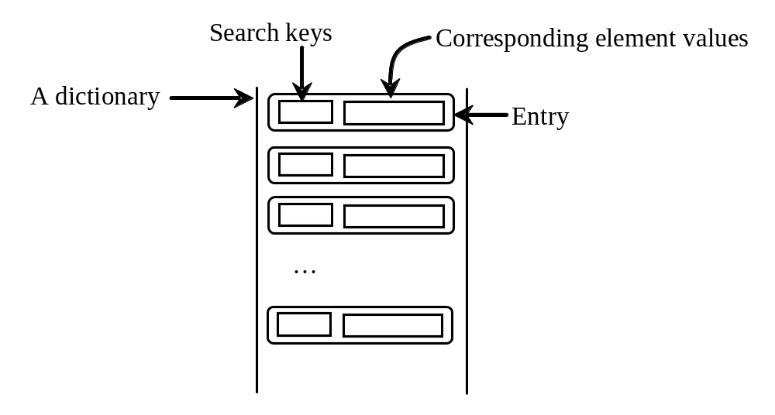
Key/value pairs

Slide 79
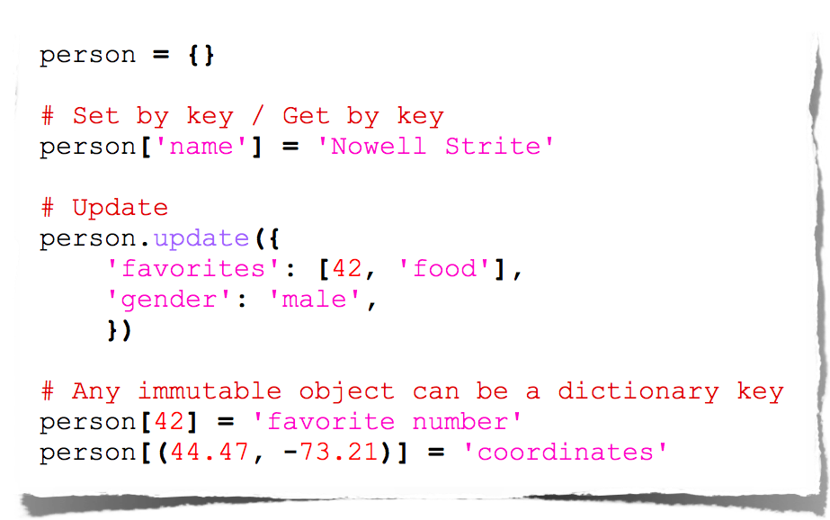
Dictionaries

Slide 80
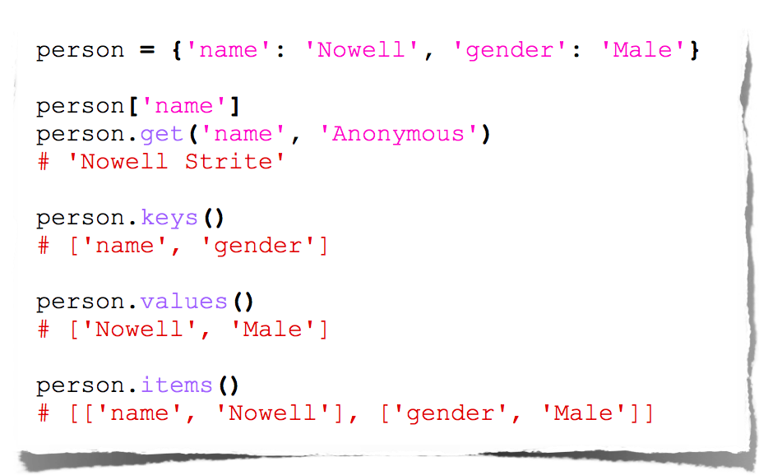
Dictionary Methods

Slide 81
Creating a Dictionary
dictionary = {} # Create an empty dictionary
dictionary = {"john":40, "peter":45} # Create a dictionary

Slide 82
Adding/Modifying Entries
To add an entry to a dictionary, use
dictionary[key] = value
For example,
dictionary["susan"] = 50

Slide 83
Deleting Entries
To delete an entry from a dictionary, use
del dictionary[key]
For example,
del dictionary["susan"]

Slide 84
Looping Entries
for key in dictionary:
print(key + ":" + str(dictionary[key]))

Slide 85
The len and in operators
len(dictionary) returns the number of the elements in the dictionary.
>>> dictionary = {"john":40, "peter":45}
>>> "john" in dictionary
True
>>> "johnson" in dictionary
False

Slide 86
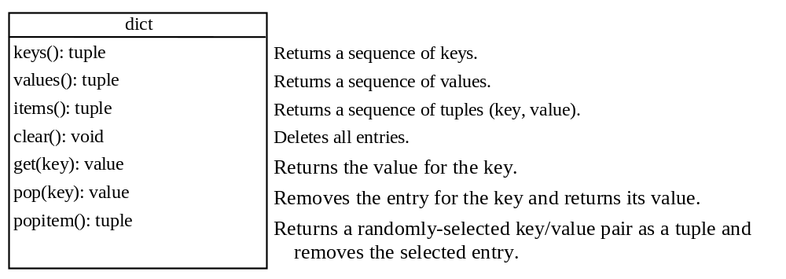
The Dictionary Methods

Slide 87
Case Studies: Occurrences of Words
This case study writes a program that counts the occurrences of words in a text file and displays the words and their occurrences in alphabetical order of words. The program uses a dictionary to store an entry consisting of a word and its count. For each word, check whether it is already a key in the dictionary. If not, add to the dictionary an entry with the word as the key and value 1. Otherwise, increase the value for the word (key) by 1 in the dictionary.
CountOccurrenceOfWords

Slide 88
Classes
A Python class uses variables to store data fields and defines methods to perform actions. Additionally, a class provides a special type method, known as initializer, which is invoked to create a new object. An initializer can perform any action, but initializer is designed to perform initializing actions, such as creating the data fields of objects.
import numpy as np
class Circle(object):
def __init__(self, radius):
self.radius=radius
def getArea(self):
return np.pi*self.radius**2

Slide 89
Python’s Way
No interfaces
No real private attributes/functions
Private attributes start (but do not end) with double underscores.
Special class methods start and end with double underscores.
  __init__: Called when the instance is created;
  __del__: Called when the instance is about to be destroyed
  __cmp__: Called by comparison operations if there are no rich comparison (__lt__, __le__, __eq__, __ne__, __gt__, __ge__).
  __str__: Called by the str() built-in function and by the print statement to compute the “informal” string representation of an object.
  __name__ is the class name;
  __module__ is the module name in which the class was defined;
  __dict__ is the dictionary containing the class’s namespace;
  __bases__ is a tuple (possibly empty or a singleton) containing the base classes, in the order of their occurrence in the base class list;
  __doc__ is the class’s documentation string, or None if undefined

Slide 90
Constructing & Accessing Objects
After an object is created, you can access its data fields and invoke its methods using the dot operator (.), also known as the object member access operator. For example, the following code accesses the radius data field and invokes the getPerimeter and getArea methods.
>>> from Circle import Circle
>>> c = Circle(5)
>>> c.getPerimeter()
31.41592653589793
>>> c.radius = 10
>>> c.getArea()
314.1592653589793

Slide 91
Why self?
Note that the first parameter is special. It is used in the implementation of the method, but not used when the method is called. So, what is this parameter self for? Why does Python need it?
self is a parameter that represents an object. Using self, you can access instance variables in an object. Instance variables are for storing data fields. Each object is an instance of a class. Instance variables are tied to specific objects. Each object has its own instance variables. You can use the syntax self.x to access the instance variable x for the object self in a method.
self.x means global, anybody can access
self._x means protected variable, access only within class object or inherit
self.__x means private variable, access only within class

Slide 92
Overriding Methods
A subclass inherits methods from a superclass. Sometimes it is necessary for the subclass to modify the implementation of a method defined in the superclass. This is referred to as method overriding.
class Circle(GeometricObject):
# Other methods are omitted
# Override the __str__ method defined in GeometricObject
def __str__(self):
return super().__str__() + " radius: " + str(radius)

Slide 93
Function Arguments
Names not Variables
  All parameters (arguments) in the Python language are passed by reference.
Required arguments
  def printme (str):
Keyword arguments
  printme( str = "My string");
Default arguments
  def printinfo( name, age = 35 ):
Variable-length arguments
  def functionname([formal_args,] *var_args_tuple ):

Slide 94
Function Arguments
Names not Variables
  All parameters (arguments) in the Python language are passed by reference.
Required arguments
  def printme (str):
Keyword arguments
  printme( str = "My string");
Default arguments
  def printinfo( name, age = 35 ):
Variable-length arguments
  def functionname([formal_args,] *var_args_tuple ):

Slide 95
Everything is First-Class
In Python, functions are objects like everything else, that can be created and passed around dynamically.
Ah, function containing variable, you’re not so special!
>>> issubclass(int, object)
# all objects in Python inherit from a common baseclass
True
>>> def foo():
... pass
>>> foo.__class__ # 1
<type 'function'>
>>> issubclass(foo.__class__, object)
True

Slide 96
Pass Functions to Functions
>>> def add(x, y):
... return x + y
>>> def sub(x, y):
... return x - y
>>> def apply(func, x, y): # 1
... return func(x, y) # 2
>>> apply(add, 2, 1) # 3
3
>>> apply(sub, 2, 1)
1

Slide 97
Inner Functions
>>> def outer():
... def inner():
... print "Inside inner"
... return inner # 1
...
>>> foo = outer() #2
>>> foo # doctest:+ELLIPSIS
<function inner at 0x...>
>>> foo()
Inside inner

Slide 98
Generators
functions that use yield instead of return
each call builds and returns an iterator (object w/method next, suitable in particular for looping on in a for)
end of function raises StopIteration
>>>def enumerate(seq): # actually built-in
n = 0
for item in seq:
yield n, item
n += 1

Slide 99
An unending generator
>>>def fibonacci():
i = j = 1
while True:
r, i, j = i, j, i + j
yield r
>>>for rabbits in fibonacci():
print rabbits,
if rabbits > 100: break
1 1 2 3 5 8 13 21 34 55 89 144

Slide 100
Closures
Exploiting the fact that def is an executable statement that creates a new function object (and also exploiting lexical scoping)...:
>>> def makeAdder(addend):
def adder(augend):
return augend + addend
return adder
>>> a23 = makeAdder(23)
>>> a42 = makeAdder(42)
>>>print a23(100), a42(100), a23(a42(100))
123 142 165

Slide 101
Decorators
A decorator is a callable that takes a function as an argument and returns a replacement function.
>>> def outer(some_func):
... def inner():
... print "before some_func"
... ret = some_func() # 1
... return ret + 1
... return inner
>>> def foo():
... return 1
>>> decorated = outer(foo) # 2
>>> decorated()
before some_func
2

Slide 102
The sys Module
$ python
Python 2.2.2 (#1, Oct 28 2002, 17:22:19)
[GCC 3.2 (Mandrake Linux 9.0 3.2-1mdk)] on linux2
Type "help", "copyright", "credits" or "license" for more information.
>>> import sys
>>> sys.executable
'/usr/local/bin/python‘
>>> sys.platform
'linux2‘
>>> sys.version
'2.2.2 (#1, Oct 28 2002, 17:22:19) \n[GCC 3.2 (Mandrake Linux 9.0 3.2-1mdk)]'
>>> sys.version_info
(2, 2, 2, 'final', 0)
>>> sys.maxint
2147483647
>>> sys.argv
['']
>>> sys.path
['', '/home/pobrien/Code',
'/usr/local/lib/python2.2',
'/usr/local/lib/python2.2/plat-linux2',
'/usr/local/lib/python2.2/lib-tk',
'/usr/local/lib/python2.2/lib-dynload',
'/usr/local/lib/python2.2/site-packages']
Provides insightful information about Python itself such as a variety of variables and functions that reveal interesting details about the current Python interpreter.
Importing a module enable referencing its contents (such as variables, functions, and classes) using dot (.) notation.
The sys.executable variable contains the path to the Python interpreter.
The platform variable tells us which operating system we are on.

Slide 103
The dir Function
>>> dir()
['__builtins__', '__doc__', '__name__', 'keyword', 'sys']
>>> dir(keyword)
['__all__', '__builtins__', '__doc__', '__file__', '__name__',
'iskeyword', 'keyword', 'kwdict', 'kwlist', 'main']
>>> dir(sys)
['__displayhook__', '__doc__', '__excepthook__', '__name__', '__stderr__',
'__stdin__', '__stdout__', '_getframe', 'argv', 'builtin_module_names',
'byteorder', 'copyright', 'displayhook', 'exc_info', 'exc_type', 'excepthook',
'exec_prefix', 'executable', 'exit', 'getdefaultencoding', 'getdlopenflags',
'getrecursionlimit', 'getrefcount', 'hexversion', 'last_traceback',
'last_type', 'last_value', 'maxint', 'maxunicode', 'modules', 'path',
'platform', 'prefix', 'ps1', 'ps2', 'setcheckinterval', 'setdlopenflags',
'setprofile', 'setrecursionlimit', 'settrace', 'stderr', 'stdin', 'stdout', 'version', 'version_info', 'warnoptions']
The built-in dir() function examines the contents of modules (and other objects).
It returns a sorted list of attribute names for any object passed to it.
If no object is specified, dir() returns the names in the current scope.
An application of dir() to the keyword & sys modules is shown.

Slide 104
>>> class Person(object):
... """Person class."""
... def __init__(self, name, age):
... self.name = name
... self.age = age
... def intro(self):
... """Return an introduction."""
... return "Hello, my name is %s and I'm %s." % (self.name, self.age)
...
>>> bob = Person("Robert", 35) # Create a Person instance
>>> joe = Person("Joseph", 17) # Create another
>>> joe.sport = "football" # Assign a new attribute to one instance
>>> dir(Person) # Attributes of the Person class
['__class__', '__delattr__', '__dict__', '__doc__', '__getattribute__', '__hash__', '__init__', '__module__', '__new__', '__reduce__', '__repr__', '__setattr__', '__str__', '__weakref__', 'intro']
>>> dir(bob) # Attributes of bob
['__class__', '__delattr__', '__dict__', '__doc__', '__getattribute__', '__hash__', '__init__', '__module__', '__new__', '__reduce__', '__repr__', '__setattr__', '__str__', '__weakref__', 'age', 'intro', 'name']
>>> dir(joe) # Note that joe has an additional attribute
['__class__', '__delattr__', '__dict__', '__doc__', '__getattribute__', '__hash__', '__init__', '__module__', '__new__', '__reduce__', '__repr__', '__setattr__', '__str__', '__weakref__', 'age', 'intro', 'name', 'sport']
>>> bob.intro() # Calling bob's intro method
"Hello, my name is Robert and I'm 35."
>>> dir(bob.intro) # Attributes of the intro method
['__call__', '__class__', '__cmp__', '__delattr__', '__doc__', '__get__', '__getattribute__', '__hash__', '__init__', '__new__', '__reduce__', '__repr__', '__setattr__', '__str__', 'im_class', 'im_func', 'im_self']

Slide 105
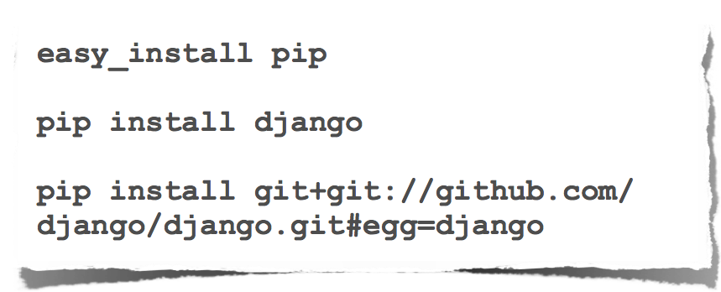
Package Management

Slide 106
IDEs
Emacs
Vim
Komodo
PyCharm
Eclipse (PyDev)

