Slide 1
AI for Kids
UK Robotics Week 2024

Slide 2
This Story is about who's trying to use the narrative AI effectively and ethically
This story is created by:
John
Mary
Manal

Slide 3
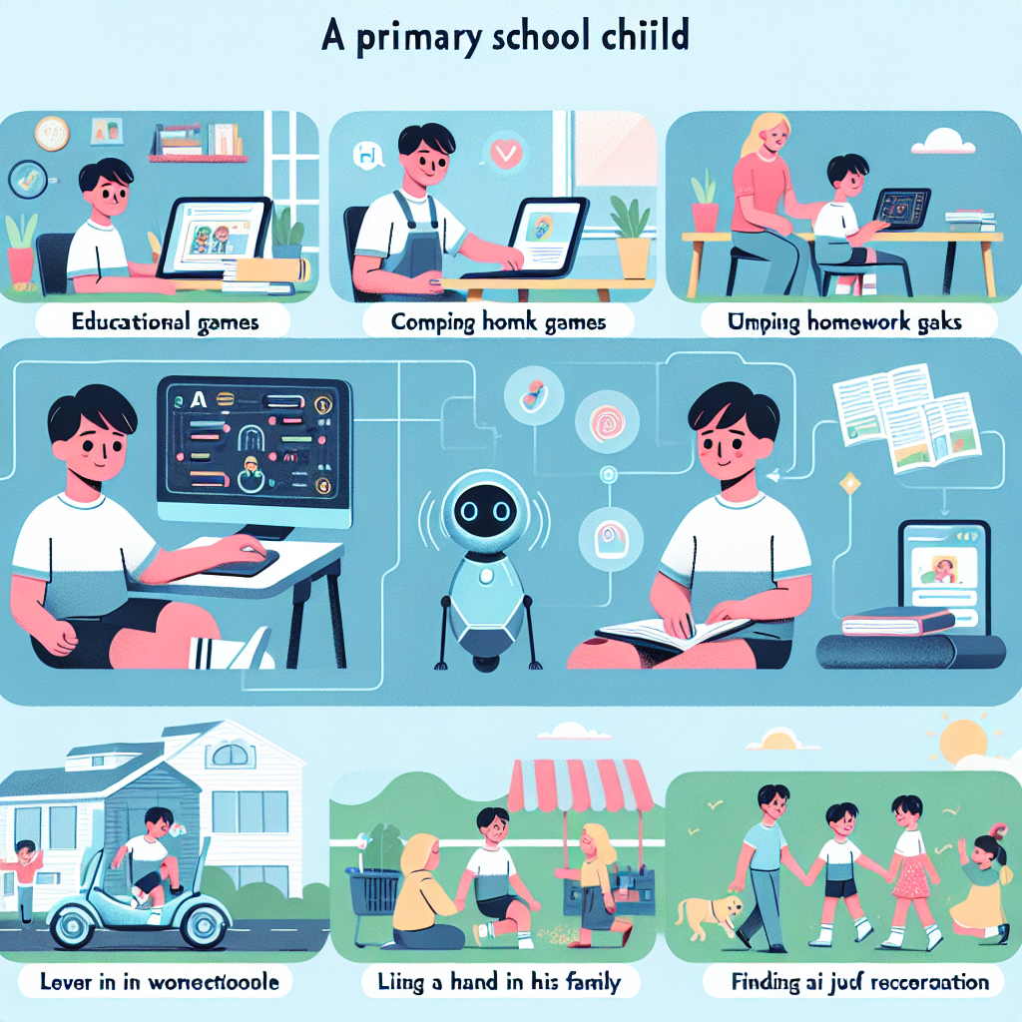
In the story, the superhero child uses generative AI to assist with daily tasks from morning till bedtime. They rely on AI for organizing schedules, studying efficiently, and even playing games. This helps them be smart and effective in all their actions
at school and home. The superhero utilizes AI for communication, studying various subjects, answering homework, and even checking the weather. From traveling to school to planning picnics and playing games, generative AI supports the child in engaging ethically and effectively in all activities.
Create an illustration showcasing a story about a primary school child. This Caucasian boy is utilizing generative AI to partake in various activities. Illustrate him engrossed in playing educational games that aid his academic progress, completing homework tasks efficiently with the help of AI, lending a hand to his family in different chores using AI-powered tools, and finding recreation in AI-driven recreational activities. Conclude the story with a scene displaying how he uses AI even during his outdoor picnics to play games, compete, win, and create a joyful atmosphere.

