Slide 1
AI for Kids
UK Robotics Week 2024

Slide 2
This Story is about create a children's story for a superhero who uses generative AI in an effective and ethical way
This story is created by:
John
Manal
Mary

Slide 3
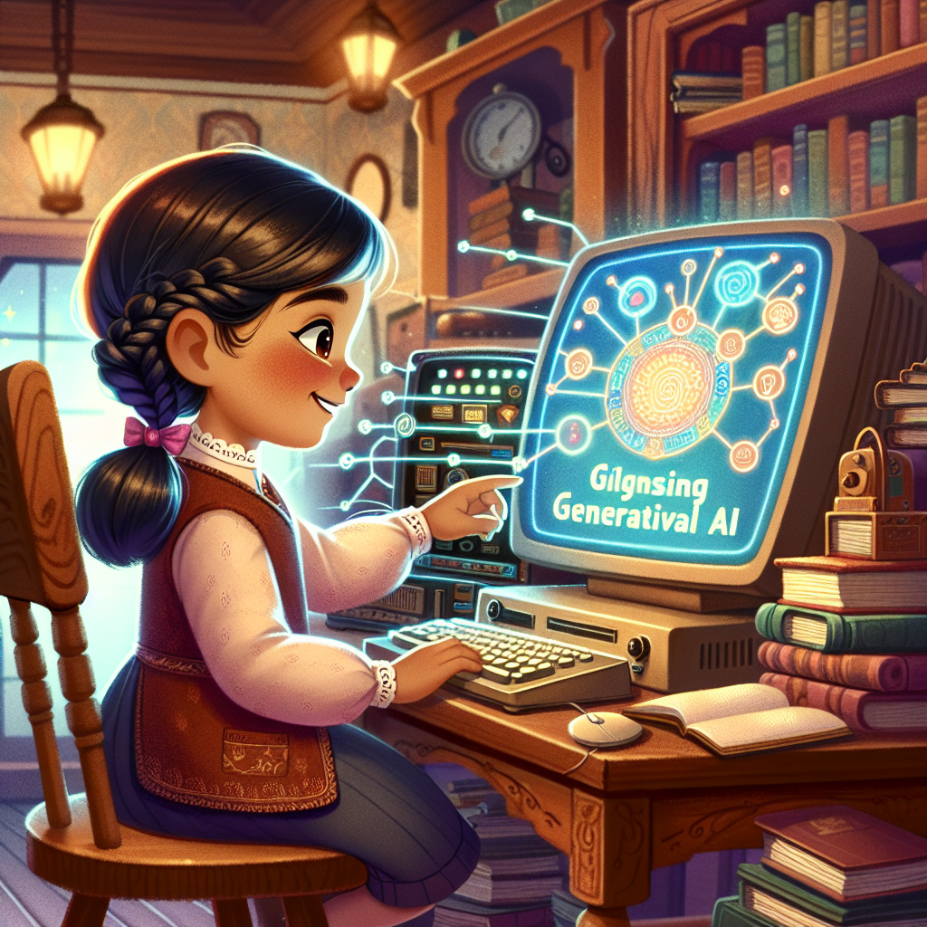
That sounds like a wonderful idea. Learning about generative AI can help you understand how it can be used for good
reasons in the future. It's great to be curious about technology and how it can make the world a better place.
Illustration of an engaging story scene from a children's book. The protagonist is a young girl of Hispanic descent, who is passionately learning about generative AI. She's seated at a traditional wooden desk, surrounded by books and a vintage computer system. She has a look of determination and curiosity on her face as she interacts with the computer. Glowing holograms of AI models and algorithms surround her, symbolizing her growing knowledge. The setting is a warm, cozy room, showcasing the balance of old and new. This image should depict the noble theme of harnessing technology for good.

