Slide 1
AI for Kids
UK Robotics Week 2024

Slide 2
This Story is about about superhero in primary school using generative AI effectively and ethically
This story is created by:
John
Mary
Manal

Slide 3
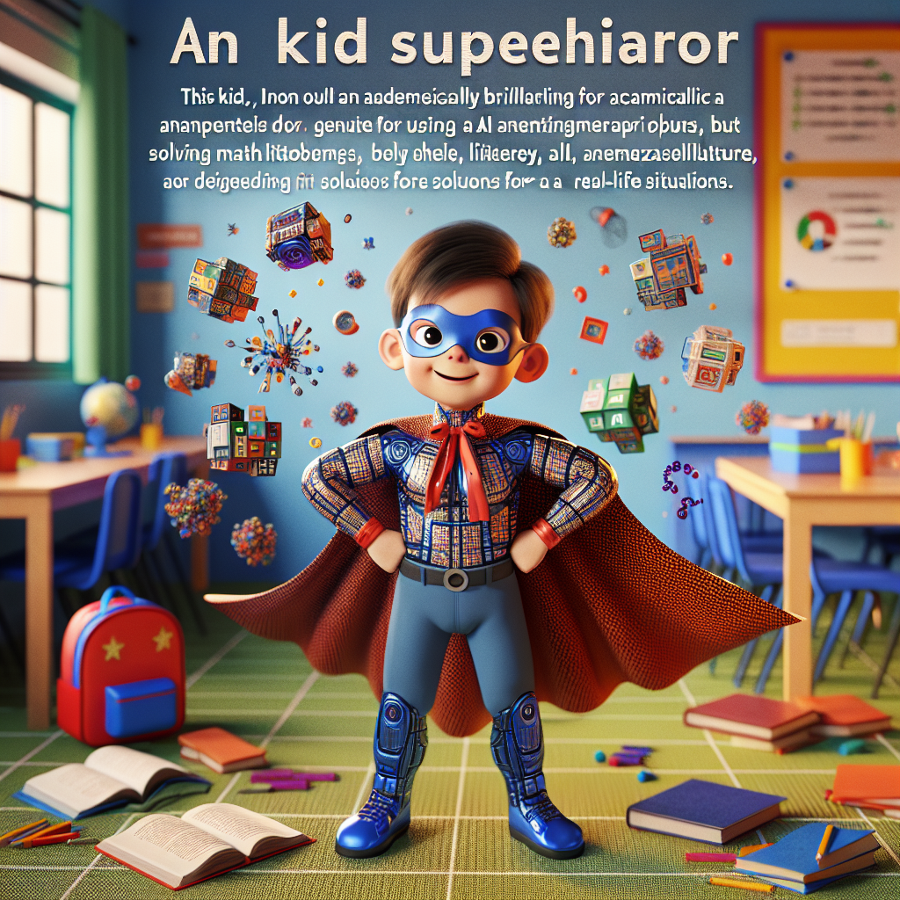
In this children's storybook, we can show how the superhero utilizes generative AI to assist in their daily tasks, from waking up to going to school and completing homework. The story
can portray the superhero as a role model for using AI for productive and positive reasons. Let's highlight the superhero's problem-solving skills and creativity in incorporating AI into their daily routine.
Imagine a child superhero in a primary school setting. This kid is unique: not only are they academically brilliant, but they also possess an unparalleled aptitude for using generative AI. They incorporate AI into all their activities, be it solving complex math problems, analyzing literature, or devising solutions for real-life situations. Indeed, the child's intelligence coupled with their mastery of AI makes them a force to reckon with. Their attire should hint at their superhero status, subtly intertwining with their every-day school attire. Their surroundings are a vibrant, colorful classroom filled with learning materials related to artificial intelligence.

