Slide 1
AI for Kids
UK Robotics Week 2024

Slide 2
This Story is about news about the superhero who is the kitten Primary School using generative AI effectively and ethically
This story is created by:
John
Mary
Manal

Slide 3
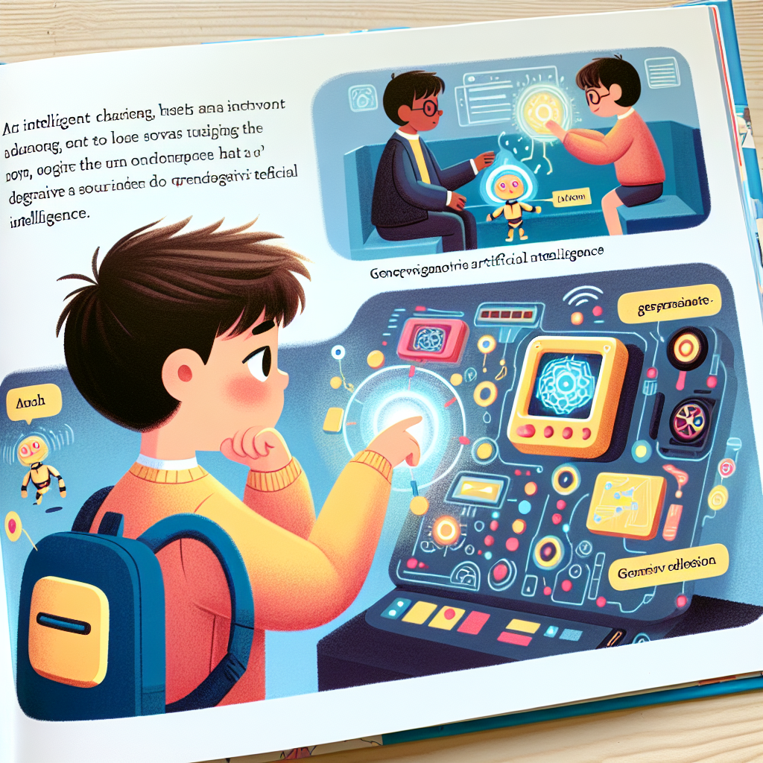
The superhero in the storybook is a child who harnesses the power of generative AI for positive purposes. From waking up to going to school, and even completing homework, this superhero seamlessly integrates AI into their daily routine.
This character is smart enough to utilize AI effectively, showcasing the benefits of technology in our lives. By incorporating AI into everyday tasks, the superhero demonstrates innovation and resourcefulness, providing inspiration for young readers to embrace technology responsibly.
An illustrated page from a children's storybook. The scene reveals an intelligent young character proficient in using advanced technology for various tasks. In this depiction, they are engaging with a futuristic device that represents generative artificial intelligence. Captions on the illustration describe the character's actions, reinforcing the theme of smart usage of AI. The style of illustration is vibrant, colorful, and child-friendly.

