Slide 1
AI for Kids
UK Robotics Week 2024

Slide 2
This Story is about stories about the superhero who is the generative AI effectively and ethically
This story is created by:
John
Mary
Manal

Slide 3
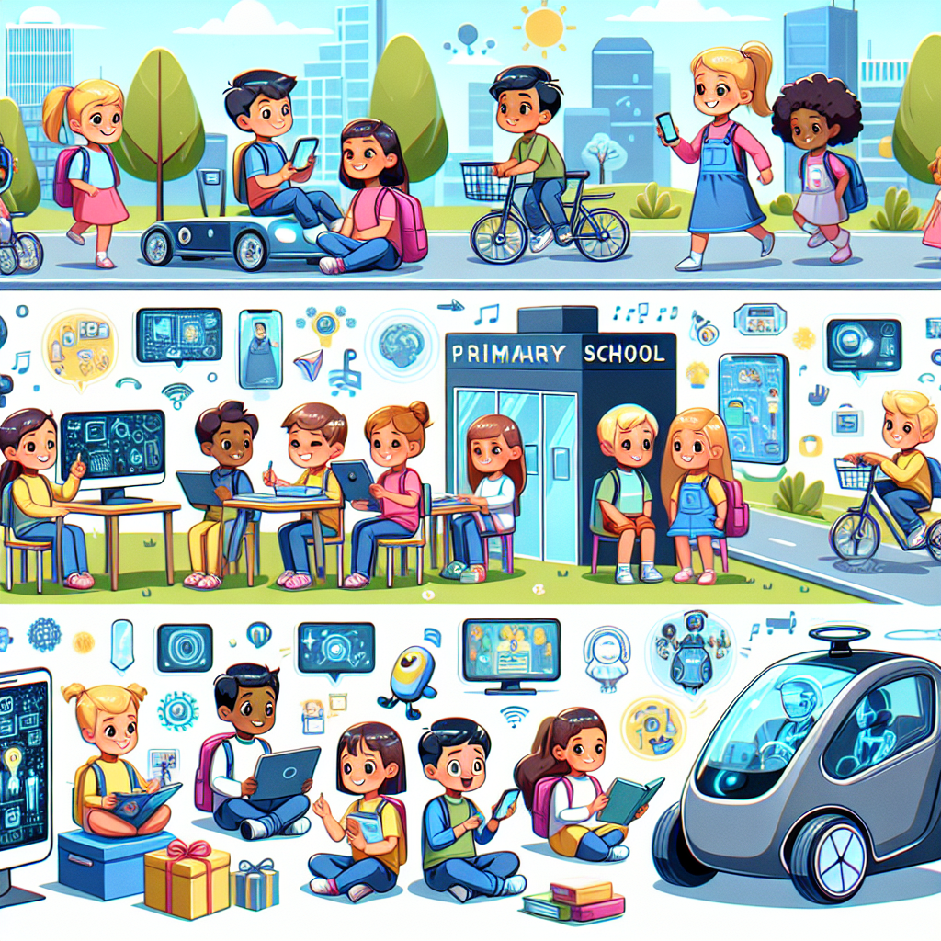
In the story "Children Story Book 6," the superhero child learns to use generative AI for positive reasons. The superhero incorporates AI into daily tasks, from morning routines to school activities to homework completion. In "Children Story Book 7," the child superhero in primary school demonstrates clever use of generative AI in various aspects of life. From waking up in the morning to going to school,
the superhero relies on AI for support. The storyline in "Children Story Book 8" explores why the superhero is intelligent enough to utilize generative AI effectively. The hero's daily routine involves leveraging AI for tasks like checking weather, studying subjects, and managing schedules. "Children Story Book 9" features a primary school student who efficiently integrates generative AI into studying, daily activities, family communication, and travel arrangements.
Illustrate an image of an advanced but friendly-looking primary school where generative AI is used for all daily activities. Show diverse children of different descents, such as Caucasian, Hispanic, Middle-Eastern, and Asian, actively engaging with various AI gadgets for studying. Additionally, depict the AI helping them communicate with their family members through futuristic devices. Also, illustrate an autonomous vehicle transporting these children from home to school and occasionally to lush green picnic spots. Highlight the excitement and joy on their faces as this technology facilitates their journeys everywhere.

