Slide 1
AI for Kids
UK Robotics Week 2024

Slide 2
This Story is about my story is about primary school children who are resisting education don't want to study programming yet and they're 8 years old and they need to be disciplined
This story is created by:
Zeinah
Hana
Manal

Slide 3
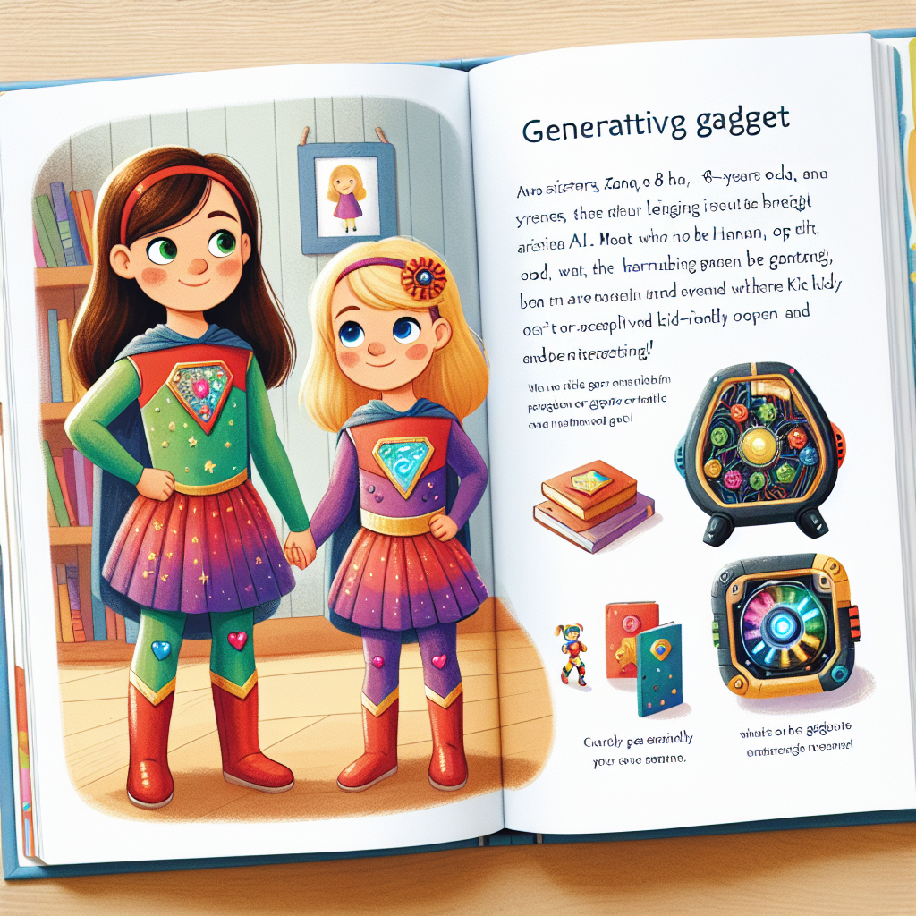
Zana and Hannah can start using generative AI in small steps like helping with homework or learning new things. Encourage them to ask questions and explore how
AI can assist them. It's important to monitor their usage and guide them on using AI ethically and effectively. Gradually introduce more complex tasks to expand their skills.
Create an illustrated page from a children's story book. Show two sisters, Zana, an 8-years old, and Hannah, a 5-year-old, standing together in colourful superhero attire, their unique emblems proudly displayed. They are curious with bright eyes, open to learning and adventures. On the page include a cleverly designed gadget that represents generative AI, which should be kid-friendly and interesting. The setting is their bedroom which is filled with books and toys, symbolizing a nurturing and educational environment.

