Slide 1
AI for Kids
UK Robotics Week 2024

Slide 2
This Story is about my story is about two superhero girls sisters Zena 8 years old Hannah 5 years old they are using generative AI in everyday to become better if use it efficiently and ethically
This story is created by:
Xeinah
Hanah
Manal

Slide 3
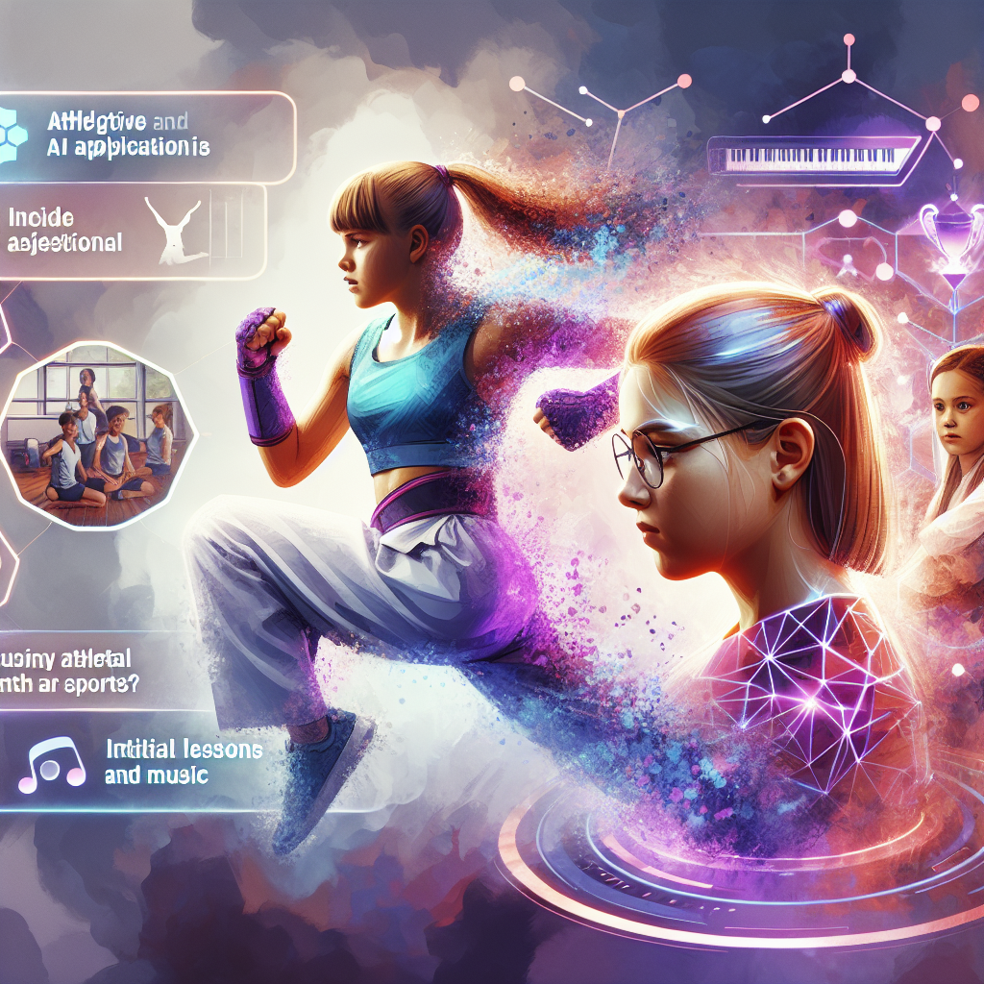
1. The superhero starts his day using generative AI to plan healthy breakfast, school activities, and engage with others. 2. The superhero also uses generative AI to study history and ancient civilizations effectively. 3. As the superhero progresses to university, he delves into comparative history studies. 4. Upon graduating, the superhero considers a good historical question for a Ph.D. in archaeology. 5. In another story, a primary school girl is interested in using generative AI to learn geography. 6. The superhero in that story effectively uses generative AI for various tasks, including school projects and leisure advice. 7. Transitioning
to university, the superhero focuses on geography studies with the help of generative AI. 8. The superhero further pursues a Ph.D. in geography with the support of generative AI suggestions. 9. Another story introduces two young sisters, Zana and Hannah, who are yet to explore generative AI. 10. Zana utilizes generative AI to improve her karate skills while exploring other sports suitable for Hannah's age. 11. The family's diverse professional backgrounds prompt a consideration of paths into the generative AI field. 12. For Hannah's development in both music and sports, generative AI could play a role in her learning journey.
An energetic and strong depiction of a young girl named Xena, demonstrating her karate moves. She is using a virtual assistant that uses generative AI technology to guide her through new techniques and strategies. Nearby, another young girl named Hannah is seen showing a lack of interest in sports. The objective here is to inspire her towards athletic and musical pursuits. Can there be a scene involving intelligent AI applications providing her initial lessons in both sports and music?

