Slide 1
AI for Kids
UK Robotics Week 2024

Slide 2
This Story is about my story is about a good student Primary School pupil using generative AI efficiently and ethically to learn for the drops of tomorrow
This story is created by:
John
Mary
Manal

Slide 3
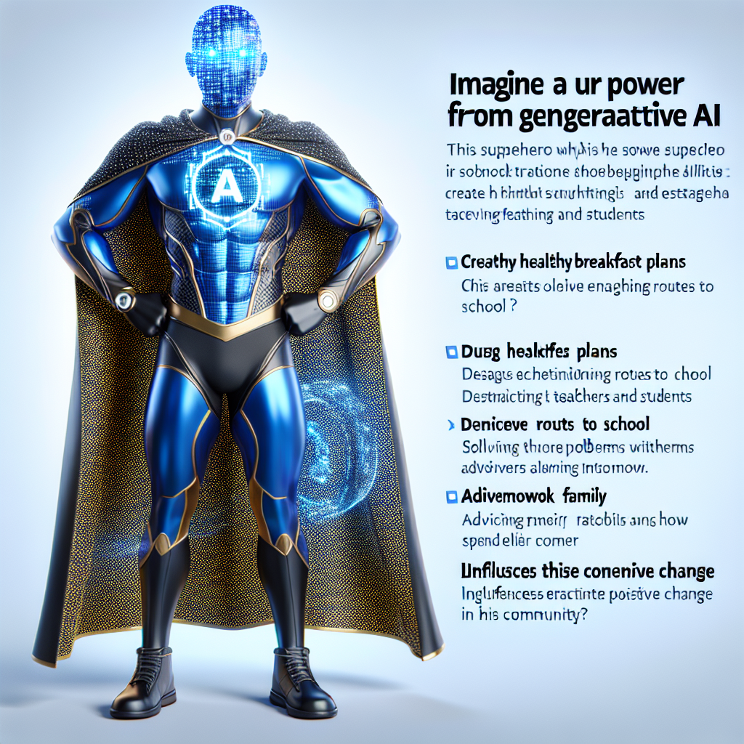
The superhero starts their day by using generative AI to help plan a healthy breakfast and organize their school day. They also use AI to engage with teachers and classmates, study efficiently, and assist
their family with leisure activities. The superhero is eager to use AI to enhance their learning experience and is interested in integrating AI into various aspects of their daily routine to optimize productivity and efficiency.
Imagine a unique superhero whose power is derived from generative AI. This superhero uses his abilities to create healthy breakfast plans, devise efficient routes to school, and establish engaging interactions with teachers and students. Additionally, the superhero uses generative AI in solving homework problems and advising family on how to spend leisure time. Given these abilities, this superhero influences positive change in his community. Trade mark attire is blue and gold outfit with a silver 'A' emblem signifying AI on the chest. His black cape is covered with tiny pixelated patterns symbolising data.

