Slide 1
AI for Kids
UK Robotics Week 2024

Slide 2
This Story is about my story is about primary school kids learning generative AI and how to use it efficiently and ethically in studying for the jobs of tomorrow
This story is created by:
John
Manal
Mary

Slide 3
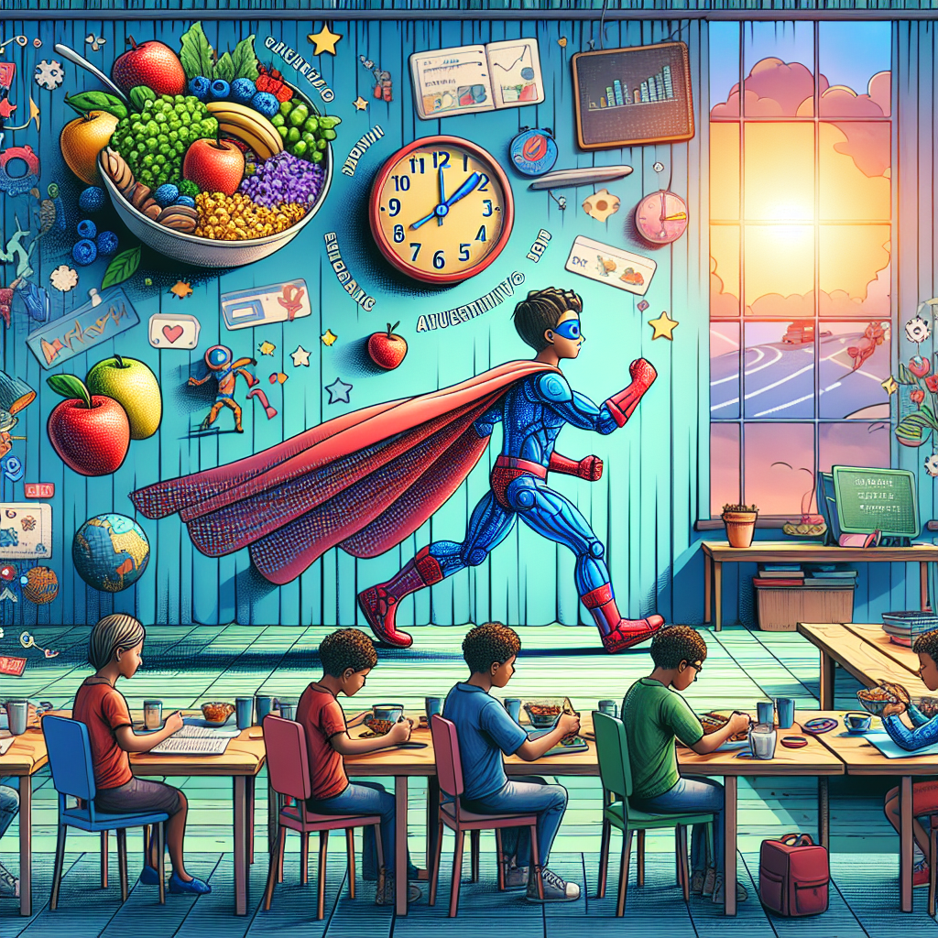
The superhero in the story uses generative AI to plan their day, from breakfast to school to spending time with family. It helps them make healthy choices
and manage their time effectively. The AI assists in studying, interacting with others, and even planning leisure activities, creating a well-rounded and fulfilling day for the superhero.
A children's storybook illustration featuring a superhero utilizing generative AI for life tasks. The superhero, a Black female with a shiny, vibrant costume, operates the AI to plan a healthy breakfast, prep for school sessions, and engage positively with fellow students who vary in descent and gender. The scene continues as she uses AI to optimize family journeys, leisure time, and enhance learning in diverse ways. The overall mood is energetic and joyful, encouraging continuous improvement.

