Slide 1
AI for Kids
UK Robotics Week 2024

Slide 2
This Story is about activity for primary school kids to use large language model ethically and efficiently to plan for the future
This story is created by:
John
Manal
Mary

Slide 3
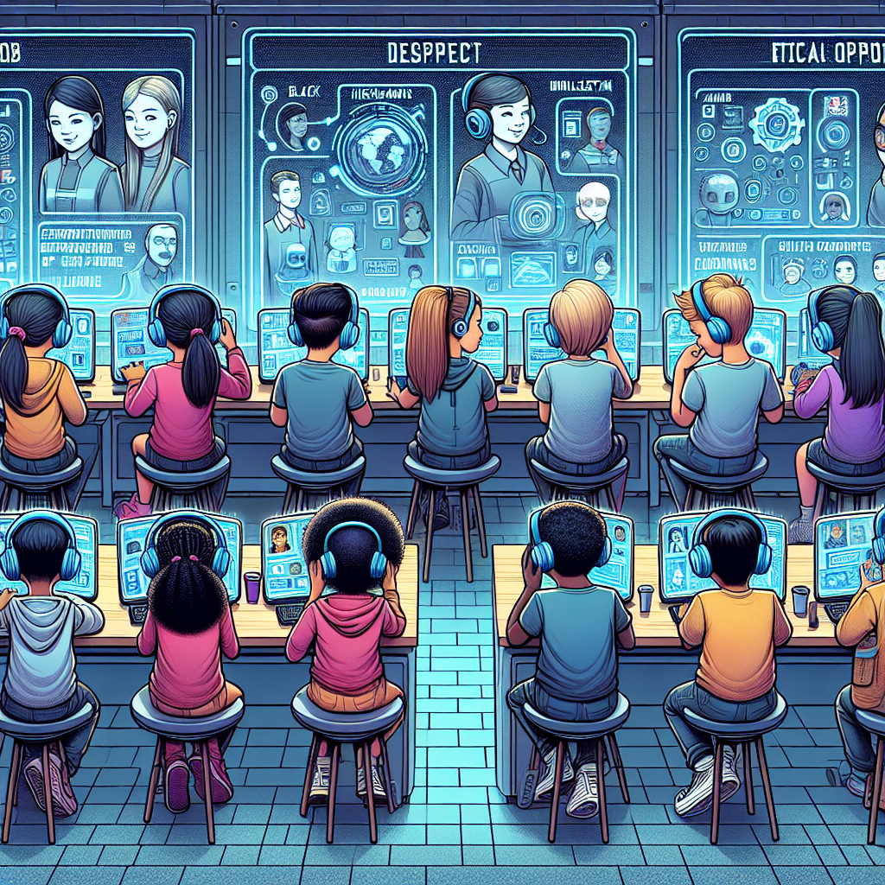
In the story, the primary school kid learns to program computers using understandable language and models efficiently. In the interactive lesson, students will learn how to use
AI ethically and efficiently to prepare for future job opportunities. By understanding AI and programming, kids can equip themselves with valuable skills for the future job market.
A detailed illustration representing a futuristic classroom where children of diverse descents including Caucasian, Hispanic, Black, Middle-Eastern, South Asian, and White are engrossed in using artificial intelligence (AI) platforms for learning. The AI interfaces show various topics related to job opportunities of the future. There are visible signs of respect and ethical use of AI technology, like children patiently awaiting their turns, using headphones to avoid disturbing others, and handling the AI devices with care.

