Slide 1
AI for Kids
UK Robotics Week 2024

Slide 2
This Story is about it's about superhero who wants to use generative AI effectively and ethically
This story is created by:
John
Mary
Manal

Slide 3
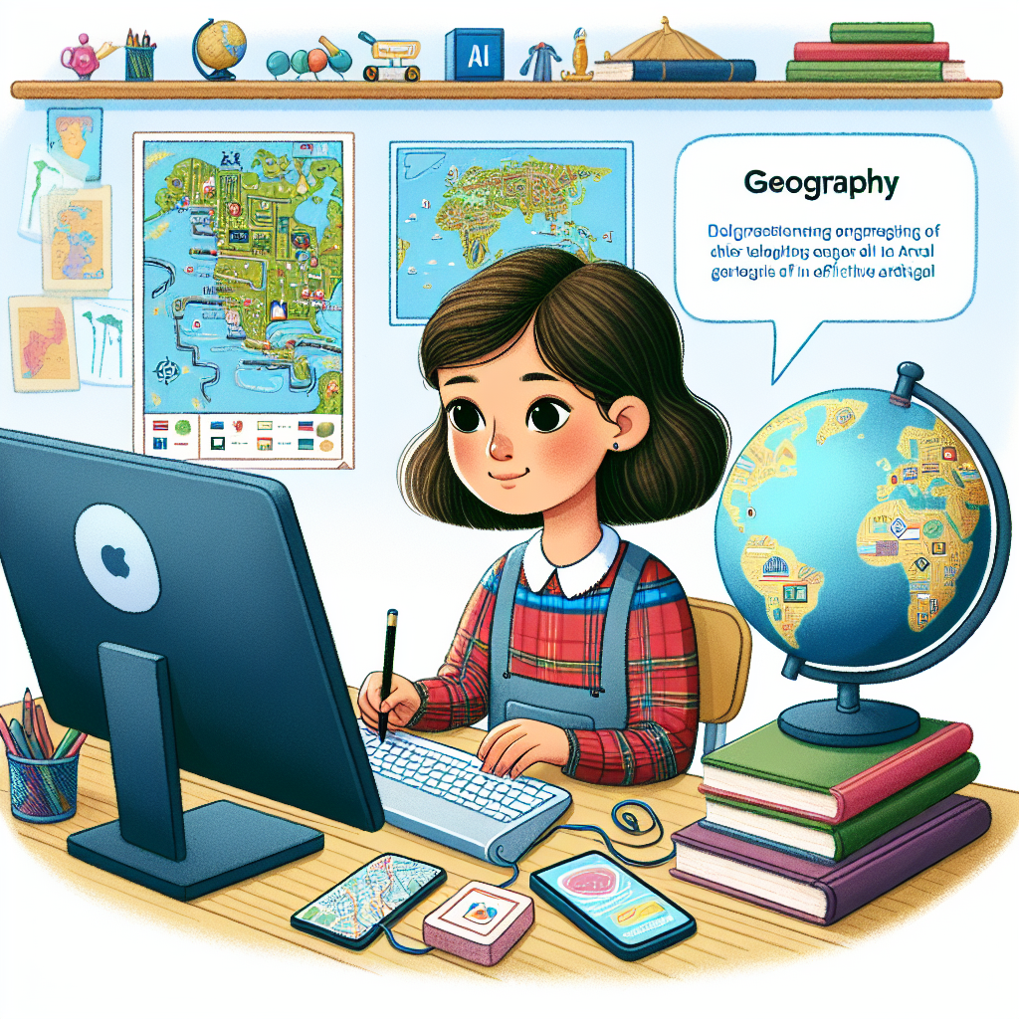
That sounds like a heroic start to the day! Superheroes using AI to plan healthy habits and to excel in their studies is impressive. It's inspiring to see the superhero finding innovative ways to balance academics and family time effectively. It's great to see the superhero interested in history and using generative AI to enhance learning and leisure activities. The superhero seems to be leveraging AI in their daily routines seamlessly - from breakfast planning to engaging with teachers and colleagues. Studying ancient civilizations with generative AI is a unique way to learn history. It's impressive to see the superhero progressing academically and exploring different historical eras with
AI support. Transitioning to university and continuing the journey of learning with AI is commendable. The superhero's interest in history and comparative studies is intriguing, leveraging generative AI for a deeper understanding. Graduating and proposing a historical research topic is a significant accomplishment for the superhero. It's wonderful to see the superhero's academic journey evolve, culminating in a focus on archaeology and monuments for their PhD studies. It's a fantastic feat to see the superhero completing this chapter of their educational quest. It's exciting to see a young student eager to explore geography with the help of generative AI, emphasizing the importance of using technology ethically and effectively.
Illustration for a children's story book. The picture represents a female primary school student of Hispanic descent, showing a keen interest in geography. She's sitting at her study desk, surrounded by maps, globes and geography textbooks. Simultaneously, she's also using her computer, demonstrating the use of generative AI in an effective and ethical manner. The artwork captures her curiosity and enthusiasm for both her subjects, geography and AI.

