Slide 1

Overlapping Domain Cover for Efficient and Scalable Kernel Regression Machines
Mohamed Elhoseiny and Ahmed Elgammal
Rutgers University, Computer Science Department

Slide 2
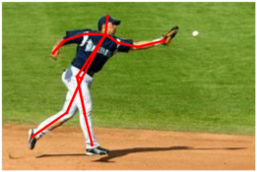
Introduction
Regression helped in formulating various computer vision problems, e.g.,
Segmentation
Image reconstruction
Human 3D pose estimation
Kernel Methods have been adopted but has limitations for its applicability to large data.
Goal
Our focus is to study Efficient and Scalable Kernel Regression Machines based on Overlapping Domain Cover notion introduced in this work.
We think the notion could be useful in general for different machine learning tasks.
Notes:
ADD PICTURE HERE OF APPLICATIONS
The goal of my work is to build kernel machines machines that are scalable.
So, let’s take a look on the state of the art kernel regression machines.
Estimation of a continuous real-valued or a structured-output function from input features is one of the critical problems that appears in many machine learning applications.
Computational complexity of the state of-the-art regression algorithms limits their applicability for big data
We do it by Overlapping domain cover. What is wrong with them and why ODC solves these problem. We will see how this is done in this talk

Slide 3
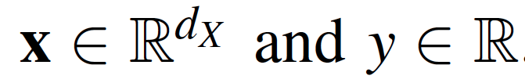

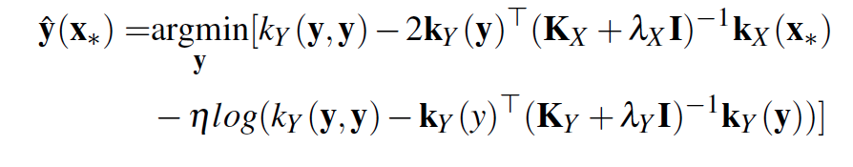
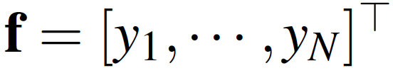
Problems with Full Regression Models
O(N³)
single output regression
Structured output regression
Gaussian Process Regression
Twin Gaussian Processes
N × N gram matrix
N × N gram matrix
N × N gram matrix
Notes:
Add a note very expensive with animation
What’s wrong with these methods
Severe for TGP
----- Meeting Notes (9/5/15 17:37) -----
put this in the figure.
M<<N
use as small notations as possible,
----- Meeting Notes (9/5/15 23:20) -----
before this slide add an abstract

Slide 4
Desirable properties of Kernel Prediction Method
None of the existing methods satisfies all these seven properties.
Accurate
Efficient
Supports high dimensional input and output
Consistent on Boundaries if local
General / Applicable to various kernel machines (e.g. GPR, TGP)
Easy to Parallelize
Make best use of all the training data

Slide 5
Desirable properties of Kernel Prediction Method
(1) (Part et al 2011) supports only GPR, hard to parallelize, applicable to low dimensional input only
Accurate
Efficient
Supports high dimensional input and output
Consistent on Boundaries if local
General / Applicable to various kernel machines (e.g. GPR, TGP)
Easy to Parallelize
Make best use of all the training data

Slide 6
Desirable properties of Kernel Prediction Method
(2) FIC/PIC (2006, 2007) supports only GPR, hard to parallelize, does not make use of all the training examples.
Accurate
Efficient
Supports high dimensional input and output
Consistent on Boundaries if local
General / Applicable to various kernel machines (e.g. GPR, TGP)
Easy to Parallelize
Make best use of all the training data
Notes:
inducing inputs, selected from the training set

Slide 7
Desirable properties of Kernel Prediction Method
(3) Nearest neighbor (NN) (Bo et al 2010): hard to parallelize training, not efficient (have to invert matrix for each test point)
Accurate
Efficient
Supports high dimensional input and output
Consistent on Boundaries if local
General / Applicable to various kernel machines (e.g. GPR, TGP)
Easy to Parallelize
Make best use of all the training data
Notes:
Make the examples in

Slide 8
Overlapping Domain Cover (ODC)
A set of N training points (N = 24 points)
Notes:
Make an animation that add kernel machines f1, f2 , f3.
----- Meeting Notes (9/5/15 17:37) -----
Here,
add a mark of the test point
Make animation
the further away from the center, the lesss acurate it is .
unlikely
for each one have its own kernel .
I should be having a kernel in the picture

Slide 9
Overlapping Domain Cover (ODC)
A set of N training points (N = 24 points)
Cover them by subsets of size M =8 points (M<<N)
Notes:
Make an animation that add kernel machines f1, f2 , f3.
----- Meeting Notes (9/5/15 17:37) -----
Here,
add a mark of the test point
Make animation
the further away from the center, the lesss acurate it is .
unlikely
for each one have its own kernel .
I should be having a kernel in the picture

Slide 10
Overlapping Domain Cover (ODC)
A set of N training points (N = 24 points)
Cover them by subsets of size M =8 points (M<<N)
Learn kernel machine on each subset (subdomain).
At test time, choose closest function for prediction
Notes:
Make an animation that add kernel machines f1, f2 , f3.
----- Meeting Notes (9/5/15 17:37) -----
Here,
add a mark of the test point
Make animation
the further away from the center, the lesss acurate it is .
unlikely
for each one have its own kernel .
I should be having a kernel in the picture

Slide 11
Overlapping Domain Cover (ODC)
An ODC : A set of overlapping subsets (spatially cohesive as possibe) covering the training data. (e.g., N= 24, M=8)
non-overlapping cover (disjoint subsets) , overlap p=0
overlapping cover (overlapping subsets), overlap p=0.5
Notes:
----- Meeting Notes (9/5/15 17:37) -----
Here,
add a mark of the test point
Make animation
the further away from the center, the lesss acurate it is .
unlikely
for each one have its own kernel .
I should be having a kernel in the picture

Slide 12
Contributions
Overlapping Domain Cover notion for structured kernel regression.
Questions
“Why is ODC useful?
“How do overlapping kernel machines speedup computation?”
Overlapping domain cover framework for kernel regression machines.
A practical method for generating equal size clusters as a variant of kmeans, outperforming RPC clustering.
N = 24, M=8, p = 0.5, K = 6
Notes:
Reduce text here
----- Meeting Notes (9/5/15 17:37) -----
This is too much text
avoid this
Use few notations
Write all the
K:
P:
M
N:
YOu may not worry about K.
talk about the parameter in a picture
define overlapping subset here
when notation show

Slide 13

Overlapping Domain Cover (ODC) Parameterization
N : Total number of training examples.
p: Overlapping ratio
M: size of each overlapping subset
= number of points to train each kernel machine
K: Number of kernel machines (calculated)
K = N/( (1-p) M)
N = 24, M=8, p = 0.5, K = 6
Notes:
Put a legend in each slide with to show N, p, M,
----- Meeting Notes (9/5/15 17:37) -----
This is too much text
avoid this
Use few notations
Write all the
K:
P:
M
N:
YOu may not worry about K.
talk about the parameter in a picture
define overlapping subset here
when notation show
----- Meeting Notes (9/5/15 23:06) -----
fix eq

Slide 14
Overlapping Domain Cover (ODC) Parameterization
N = 24, M=8
p = 0.5
K = 24/ ((1-0.5) 8)= 6
p = 0
K = 24/ ((1-0) 8)= 3
Notes:
Put a legend in each slide with to show N, p, M,
----- Meeting Notes (9/5/15 17:37) -----
This is too much text
avoid this
Use few notations
Write all the
K:
P:
M
N:
YOu may not worry about K.
talk about the parameter in a picture
define overlapping subset here
when notation show
----- Meeting Notes (9/5/15 23:06) -----
fix eq

Slide 15
Lemma
As p increases, the closer the nearest model to an arbitrary test point and the more likely that model get trained on a big neighborhood of the test point (Informal Definition).
Detailed proof could be found in the paper and the supplementary materials.
Notes:
With assumptions on the distribution
----- Meeting Notes (9/5/15 17:37) -----
make a shorter .
draw picture as overlap cluster.
0 overlap.
fix a traijinng point.
look hilglit the neasrest poinfr

Slide 16
Overlapping Domain Cover (ODC) Framework
Two steps to generate the ODC 1) Partition the N points into K= N/((1-p) M) clusters, each is (1-p) M
2) Generate an ODC of K subsets, each subset is one cluster + p M points brought from neighbors
Equal Size
Clustering
Overlapping Domain Cover Generation
Training local Models
Prediction
Existing overlapping clustering methods either
do not satisfy the equal size constraints
are computational expensive (not practical for large data)

Slide 17
ODC Framework: Equal Size Clustering
Overlapping Domain Cover Generation
Training local Models
Prediction
Equal Size
Clustering
Clustering the points into K = N/( (1-p) M ) clusters of (1-p) M points (equal size clusters).
We studied two algorithms for equal size clustering
Recursive Projection Clustering (RPC) clustering (Chalupka etal, JMLR, 2013) : used in the context of GPR.
We propose a variant of the K-means algorithm that produces equal size clusters to compare with RPC.

Slide 18
ODC Framework: Equal Size Clustering
Overlapping Domain Cover Generation
Training local Models
Prediction
Equal Size
Clustering
A) RPC clustering (Chalupka, etal, JMLR 2013) : used in the context of GPR.
Disadvantages
The number of clusters in this method has to be a power of two.
It might produce long thin clusters (bad Spatial cohesion).
Notes:
----- Meeting Notes (9/5/15 17:37) -----
I should add more details about the the purpose of Ekmeans

Slide 19
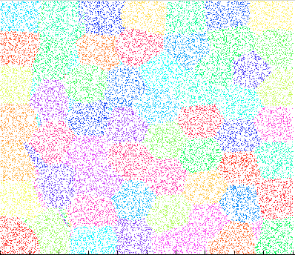
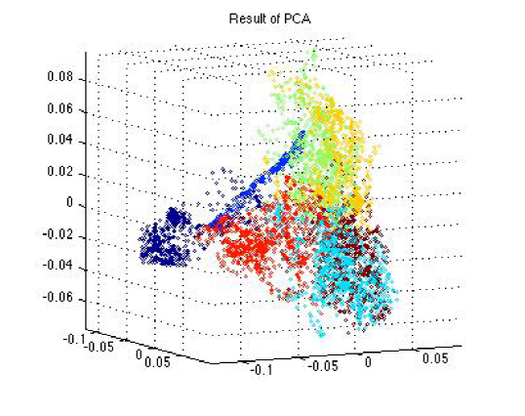
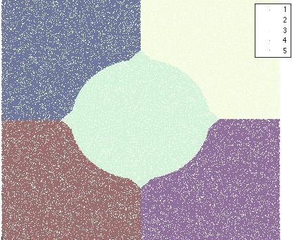
ODC Framework: Equal Size Clustering
Overlapping Domain Cover Generation
Training local Models
Prediction
Equal Size
Clustering
B) Equal Size Kmeans: Assign & Balance (AB) k-means
AB kmeans modifies the assignment step of the kmeans to bound the size of the resulting clusters
Synthetic, K=5
Synthetic, K=57
Human Eva( PCA), K=7
Notes:
Details could be found in the supplementary materials

Slide 20
ODC Framework: Equal Size Clustering
Overlapping Domain Cover Generation
Training local Models
Prediction
Equal Size
Clustering
B) Equal Size Kmeans: Assign & Balance (AB) k-means
Assign the points to their closest center as typically done in the assignment step of the standard k-means.
This results in three types of clusters:
I) balanced (size = N/K)
II) overfull (size > N/K)
III) underfull clusters (size < N/K)
Notes:
We use C(x_p) to denote the cluster assignment of a given point x_p.
Details could be found in the supplementary materials
----- Meeting Notes (9/5/15 17:37) -----
fix notations
Draw a pictures.
Draw a picture
Draw
Make animation for tbe Ekmeans algorotghm

Slide 21
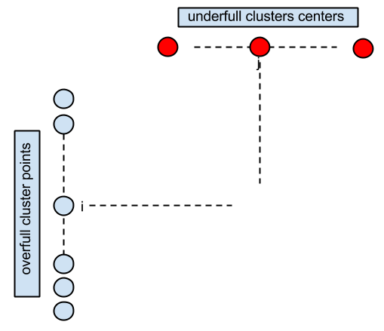

ODC Framework: Equal Size Clustering
Overlapping Domain Cover Generation
Training local Models
Prediction
Equal Size
Clustering
B) Equal Size Kmeans: Assign & Balance (AB) k-means
Compute distances between the points in the
overfull clusters and the underfull cluster means.
Iteratively
pick the minimum distance pair
Merge to cluster .
Remove the point from the overfull pool.
Remove underfull cluster when balanced.
Remove overfull cluster points when balanced.
Assignment Step inside the EM Loop
pool
Notes:
We use C(x_p) to denote the cluster assignment of a given point x_p.
Details could be found in the supplementary materials
----- Meeting Notes (9/5/15 17:37) -----
fix notations
Draw a pictures.
Draw a picture
Draw
Make animation for tbe Ekmeans algorotghm

Slide 22
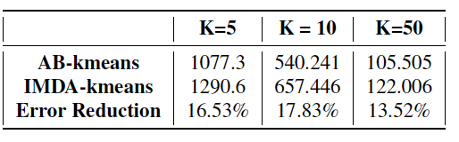
ODC Framework: Equal Size Clustering
Overlapping Domain Cover Generation
Training local Models
Prediction
Equal Size
Clustering
B) Equal Size Kmeans: : Assign & Balance (AB) k-means
We found Assign & Balance (AB) k-means works better than another variant that we also tried
Iterative Minimum-Distance Assignments (IMDA) k-means
does not initialize the assignment
Notes:
Details could be found in the supplementary materials

Slide 23
ODC Framework: Equal Size Clustering
Overlapping Domain Cover Generation
Training local Models
Prediction
Equal Size
Clustering
B) Equal Size Kmeans: Assign & Balance (AB) k-means
Intuition
The cost (given the computed means) is minimally increased by each swap while balancing the clusters
Because the minimum distance pair is picked in each iteration
Not optimal but practical since the Equal Size Kmeans is an NP hard problem
Notes:
intuition behind this algorithms is thatHence the cost is kept as low as possible while
balancing the clusters.

Slide 24
ODC Framework: Equal Size Clustering
Equal Size
Clustering
Overlapping Domain Cover Generation
Training local Models
Prediction
N : Total number of training examples.
p: Overlapping ratio
M: size of each overlapping subset on each a kernel machine is trained
B) Equal Size Kmeans: Assign & Balance (AB) k-means
The clustering step ends up with K = N/( (1-p) M) non-overlapping clusters,
each is of (1-p) M points.
The Overlapping Domain Cover (ODC) Generation starts from these cluster and augment each cluster with the p M points from the neighboring clusters.
t controls p M points are selected.
t=1.0 maps to the best choice (overlapping points are from the neighboring clusters.)
t>1 means that the overlapping points may be selected from further clusters.
Notes:
intuition behind this algorithms is thatHence the cost is kept as low as possible while
balancing the clusters.

Slide 25
ODC Framework: Equal Size Clustering + ODC Generation
Equal Size
Clustering
Overlapping Domain Cover Generation
Training local Models
Prediction
Equal Size
Clustering
Overlapping Domain Cover Generation
Notes:
----- Meeting Notes (9/5/15 17:37) -----
too many tecnhical details.
Just keep intuition.
Don't mention to RPC.
It should be mainly the intuition.

Slide 26
ODC Framework: Training local Models
Equal Size
Clustering
Overlapping Domain Cover Generation
Training local Models
Prediction
could be any regression function (e.g. GPR or TGP)
overlapping cover p=0.5
26

Slide 27
ODC Framework: Training local Models
Equal Size
Clustering
Overlapping Domain Cover Generation
Training local Models
Prediction
M << N (Very Cheap)
M is size of each overlapping subset on each a kernel machine is trained
Gaussian Process Regression (GPR)
i
i
i
i
i
M
Twin Gaussian Processes (TGP)
i
i
could be any regression function (e.g. GPR or TGP)
i
27
Notes:
Precomputing these things

Slide 28

ODC Framework: Prediction
Equal Size
Clustering
Overlapping Domain Cover Generation
Training local Models
Prediction
Given a test point , determine the nearest kernel machines and combine them to predict the output
Find the closest K’ clusters to the test point
Evaluate for each of the K’ closest models
Compute the final prediction as
F depends on how close the subset i to

Slide 29
ODC Framework: Summary of studied parameters / notations
Equal Size
Clustering
Overlapping Domain Cover Generation
Training local Models
Prediction/Test
N : Total number of training examples (unassigned)
 | Definition | Phase
p | Overlapping ratio | Training
M | M: size of each overlapping subset/ points per kenel machine. K= N/ ((1-p) M): Number of kernel machines/ overlapping subsets | Training
K’ << K | Closest K’ of test point x* is used | Test
t | Just to experimentally verify that getting the overlapping points from neighboring clusters is better | Training

Slide 30
ODC Framework: Summary of studied parameters / notations
Equal Size
Clustering
Overlapping Domain Cover Generation
Training local Models
Prediction/Test
 | Definition | Phase
p | Overlapping ratio | Training
M | M: size of each overlapping subset/ points per kenel machine. K= N/ ((1-p) M) : Number of kernel machines/ overlapping subsets | Training
K’ =1 with high p | Closet K’ kernel machines of test point x* are used for prediction | Test
t=1 | Just to experimentally verify that getting the overlapping points from neighboring clusters is better | Training

Slide 31
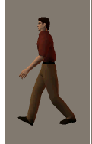
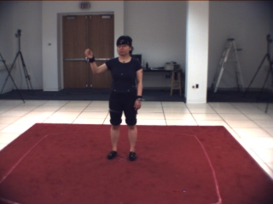
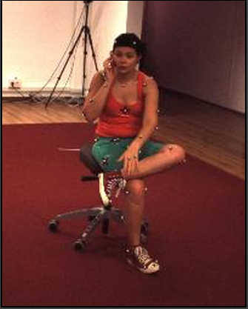



Experimental Results
Three human pose estimation
datasets
 | Poser Dataset (Agarwal etal, 06) | Human Eva Dataset (Sigal etal, 2006) | Human 3.6M Dataset (Ionescu etal, 2014)
Training Size | 1,927 | 4,815 | 335 K
Test Size | 418 | 4,815 | 165 K
Features | boW silhouette features | HOG | HOG
Error
Number of Views | 1 | 3 | 4
Pose representation | Joint angles | Joints relative position
is the estimated pose, is the ground truth pose

Slide 32
Experimental Results: Analysis on Poser and Human Eva
TGP- Human Eva (M=800)
Reminder : Closest K’ <<K kernel machines of test point x* are used for final prediction
ODC notations for training
N : Total number of training examples.
p: Overlapping ratio
M: size of each overlapping subset on each a kernel machine is trained
K: number of kernel machines
= N/ ((1-p) M )
depends on how close
kernel machine I to x*

Slide 33
Experimental Results: Analysis on Poser and Human Eva
TGP- Human Eva (M=800)

Slide 34
Experimental Results: Analysis on Poser and Human Eva
TGP- Human Eva (M=800)

Slide 35
Effect of M (kernel machine size), p=0.9, K’=1
TGP
 | Human Eva Error
ODC M=200 | 43.88 mm
ODC M=400 | 39.5 mm
ODC M=800 | 38.9 mm
Full | 40.3 mm
i.e., only several hundred points locally are sufficient to gain accurate prediction
GPR
 | Human Eva Error
ODC M=400 | 46.8 mm
ODC M=800 | 47.5 mm
Full | 59.62 mm

Slide 36
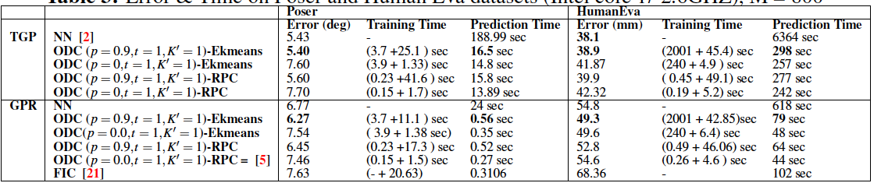
Experimental Results
Error & Time on Poser and Human Eva datasets (Intel core-i7 2.6GHZ), M = 800
KL TGP works generally better than GPR
Ekmeans outperforms RPC
GPR: ODC outperforms NN, FIC, (Chalupka et.al., JMLR,13) for GPR
KL TGP: ODC outperforms NN for TGP (state of the art of TGP) and significantly faster

Slide 37
Experimental Results
TGP
NN = (Bo et al 2010)
21 X
11 X

Slide 38
Experimental Results
GPR

Slide 39
Experimental Results
Human 3.6M
ODC
Error 13.8 cm
Prediction time: 4.03 hours.
NN
Error 13.5 cm
Prediction Time = 168.02 hours ( ~ 7 days )
42 X
TGP
Better implementation is expected to be much faster. Theoretically the speedup is cubic compared to quadratic
on M
Notes:
M= 1390, t=1, K’=1, p=0.6, EKmeans for clustering
----- Meeting Notes (9/5/15 17:37) -----
p=0.66

Slide 40
Conclusion
We study efficient kernel machines based on the Overlapping Domain Cover (ODC) notion
“How overlapping kernel machines speedup computation?”
Key Idea of our ODC Framework:
Equally partition the data (proposed Assign & Balance Ekmeans)
create spatially cohesive overlapping subsets (as possible)
local kernel machines are trained for each.
Use the closest kernel machine at test time
First local quadratic performance for TGP (quadratic in M (M<<N very cheap)) instead of cubic (Bo etal 2010).
Overlapping kernel machines with several hundred points performs similar or better than full models.
N ranges from 1500 to 335,000 , M ranges from 200 to 1350 in our experiments
The framework could be applied to various kernel machine beyond GPR, KL TGP, IWTGP (Importance Weighted TGP) validated in this work.
e.g., Generaized TGP which is based on Sharma Mittal divergence (brought from Physics community) (Sharma Mittal TGP, MACH, 2015 (also in ECMLPKDD 15) )
We theoretically justified our framework’s notion in Lemma 4.1
(please refer to the paper and the supplementary materials for details)
Notes:
Too much text

Slide 41
Future Work
Our MATLAB implementation is not optimal.
Generalize our ODC Lemma to include more complicated distributions of kernel machines
Our proof of the ODC kernel machines assume spherical distribution of the kernel machine.
Propose better a method to perform Equal Size kmeans to address the failure cases of the current algorithm. However, it worked well on the three datasets in our experiments.
Theoretical validate the proposed Ekmeans properties and its approximation to the NP hard Equal size Kmeans problem.
Our notion could be applied to distill neural networks (e.g., Hinton, etal arxiv, 2015)
Notes:
Too much text

Slide 42

Acknowledgement: Funded by NSF USA # 1409683.

