Slide 2
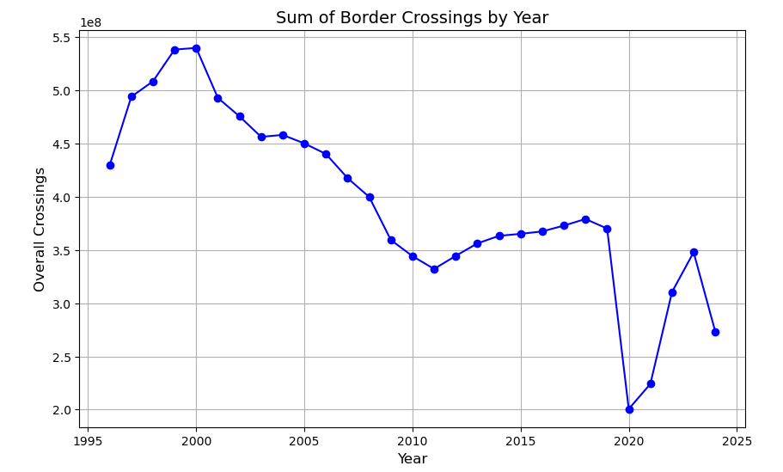
Initial Analysis
Initially reviewed the dataset using python/pandas. Looked over summaries of overall crossings by year, state, etc. Used matplotlib to summarize overall crossings by year included in dataset.
Data shows that border crossings have been at a decrease over time but has fluctuated.

Slide 3
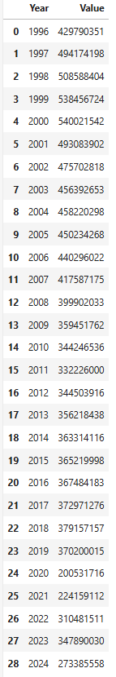
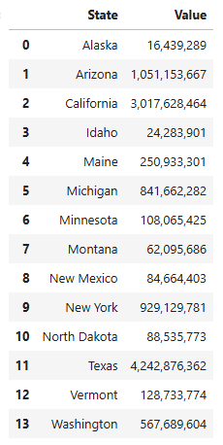
Initial Analysis
Overall, the dataset shows that Texas had the most crossings between 1997-2024.
Crossings were at an all time high in 2000 with the total recorded number being 540,021,542.

Slide 4
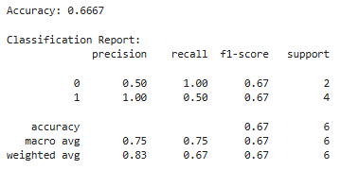
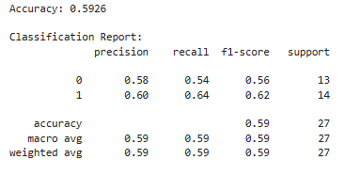
Future Predictions
Linear Regression:
Wanted to predict whether or not overall crossings will increase or decrease throughout the future.
Tested a few machine learning methods to predict an increase/decrease for future years. Used, summarized data by year/state and overall crossings. Then added column with % increase/decrease from year to year, and additional with increase/decrease result. Used linear Regression to predict from a sample. Accuracy was only 67%.
Tried to switch to Logistic Regression using the same data frame, but accuracy decreased.
Logistic Regression:

Slide 5
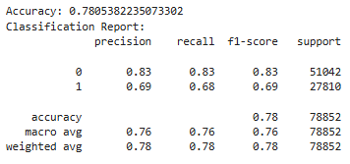
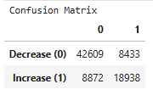
Future Predictions
Random Forest:
Decided to increase the size of the sample dataset instead of using summarized data frame, and switch machine learning model using Random Forest.
Used label encoder to update data to numeric so all columns can be included in the model.
Used similar python/pandas code from previous attempts to add columns with % increase, and general result increase/decrease.
Updates to model returned 78% accuracy
Confusion Matrix:
The model correctly predicted future decreases in 42,609 cases and was incorrect in 8,433 cases. For increases, the model predicted correctly in 18,938 cases and was incorrect on 8,872 cases.

Slide 6
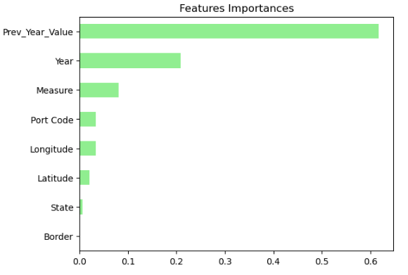
Random Forest
Concluded that the Random Forest was the most accurate method used when testing the data.
Reviewing the confusion matrix, the model predicted more decreases than increases in the future. Although crossings will fluctuate, we can conclude that as we move forward, the number of border crossings recorded will decrease.
Above are the features included in the model sorted by the importance that each served in the results.

