Slide 1
annotlib: Annotator Library
Simulation of Annotators in Active Learning

Slide 2


















Motivation of Active Learning
passive learning
active learning
$$+$$
$$+$$
$$+$$
$$+$$
$$+$$
$$+$$
$$+$$
$$+$$
$$+$$
$$−$$
$$+$$
$$−$$
$$+$$
$$+$$
$$−$$
$$+$$
$$−$$
$$+$$
$$−$$
$$+$$
$$−$$
$$−$$
$$−$$
$$−$$
$$−$$
$$−$$
$$−$$
$$−$$
$$−$$
$$−$$
classifiers need labelled samples
labelling samples is expensive
unlabelled data is often plentiful available and the inquiry is simple
goal: train high-performance classifier with minimal labelling cost

Slide 3








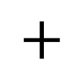
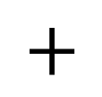
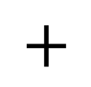
Active Learning with Multiple Annotators
provide
$$+$$
$$−$$
annotators
$$−$$
select
$$−$$
select
selection strategy
$$+$$
$$−$$
$$−$$
$$−$$
$$+$$
$$+$$
$$−$$
$$−$$
$$+$$
unlabelled pool
labelled pool
continue
stop
retrain
stopping criterion
classifier

Slide 4
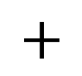
Why annotlib?
Problems:
lack of publicly available data sets with labels provided by multiple annotators
huge diversity of techniques to simulate annotators → issue of comparability
Objectives of annotlib:
model annotators in Python environment
provide techniques to simulate annotators reflecting realistic assumptions
data representation according to scikit-learn
Scope of annotlib:
provide
$$+$$
$$−$$
annotators
model and simulate
different annotator types as Python classes
represent labelling
process as Python
methods

Slide 5
Class Structure of annotlib
BaseAnnot
DynamicAnnot
StandardAnnot
MultiAnnotTypes
ClassifierBasedAnnot
ClusterBasedAnnot
DifficultyBasedAnnot

Slide 6
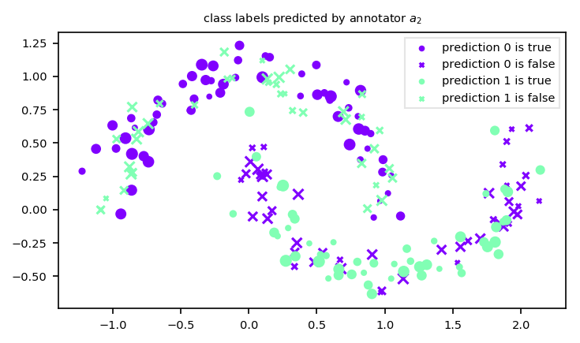
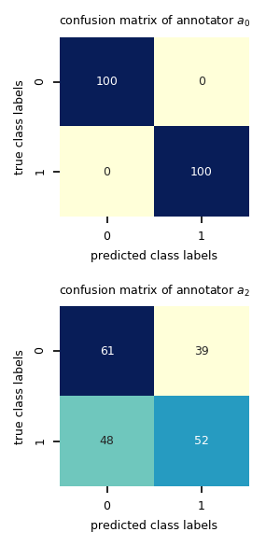
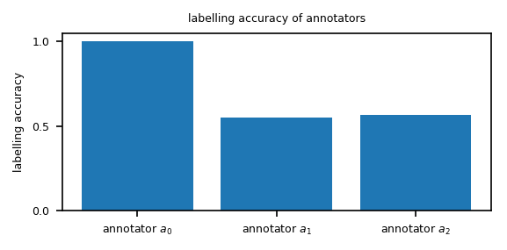
Base and Standard Annotators
BaseAnnot:
defines main functionality of each annotator
implements methods for analysis of annotators
StandardAnnot:
simplest implementation of an annotator
user defines mapping between samples and class labels respectively confidence scores → no simulation

Slide 7
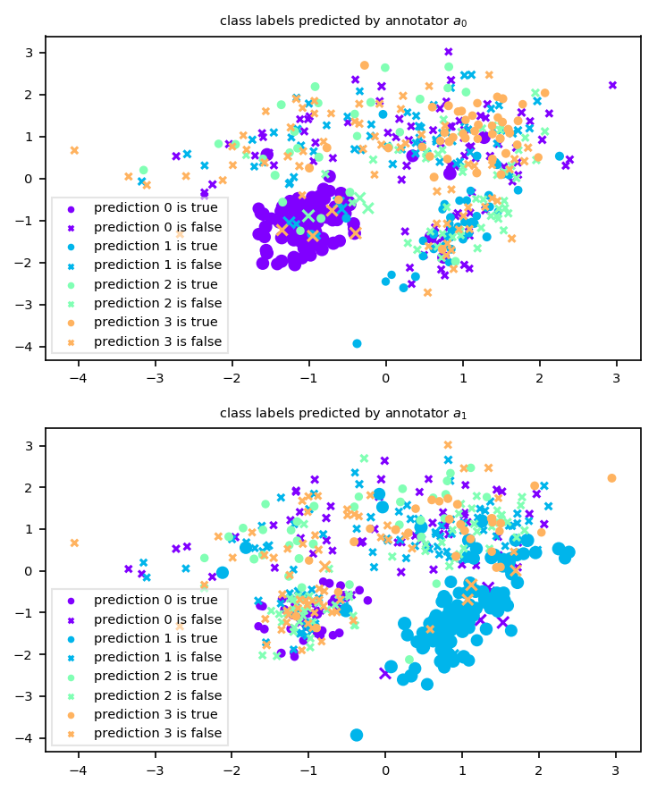
Clusters as Knowledge Areas
ClusterBasedAnnot:
simulate annotators whose knowledge depends on defined clusters
annotator’s knowledge on a cluster is defined by an interval
probability of providing a correct class label is uniformly drawn from this interval
Options to find clusters:
true class labels as clustering
all samples belong to the same cluster
clustering algorithms
areas of high expertise

Slide 8
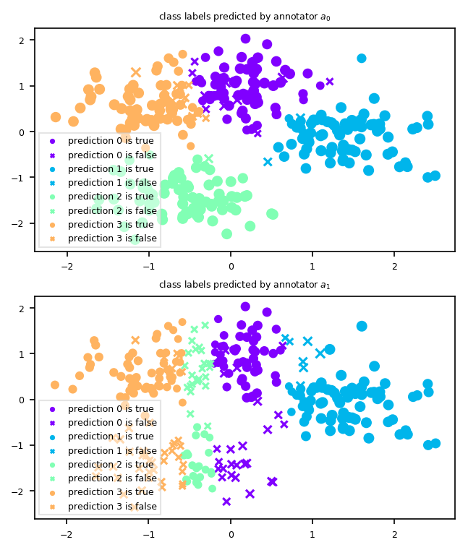



Classifiers as Annotators
ClassifierBasedAnnot:
simulate annotators as classifiers trained on the true class labels
Options to train classifiers:
vary size of training set → modelling experience of annotator
vary set of considered features → modelling decision criteria of annotator
vary type of classifier → modelling decision making
Example: vary considered features
$$x_{1}$$
$$x_{0}$$
$$x_{0}$$

Slide 9
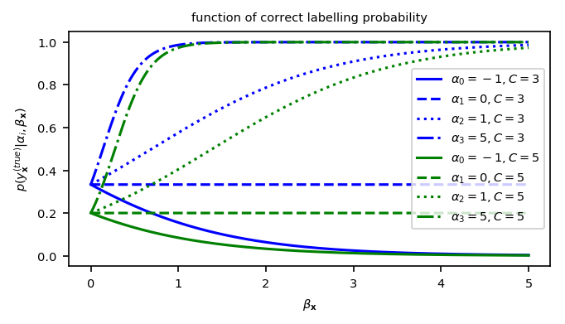
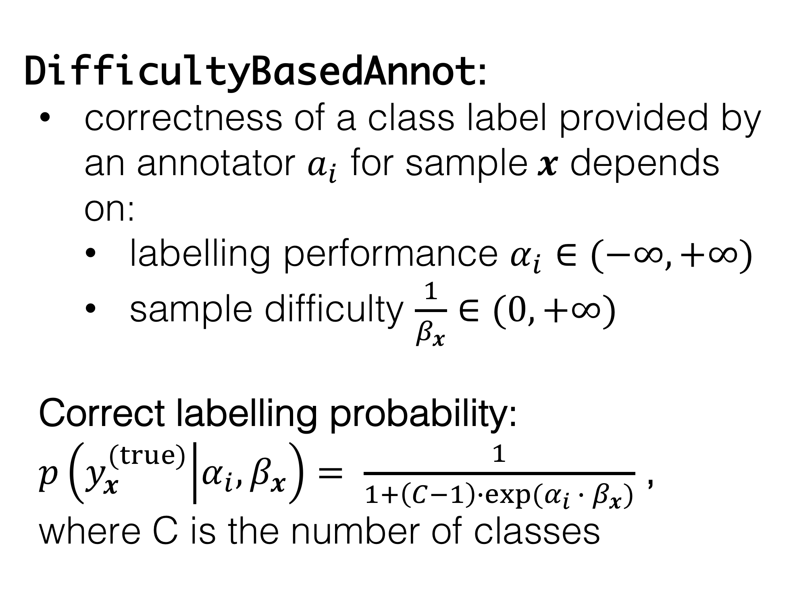
Sample Difficulty Estimation – I
DifficultyBasedAnnot:
correctness of a class label provided by an annotator $a_{i}$ for sample$x$ depends on:
labelling performance $α_{i}∈(−∞, +∞)$
sample difficulty $\frac{1}{β_{x}}∈(0, +∞)$
Correct labelling probability:
$p\left(y_{x}^{(true)} | α_{i}, β_{x}\right)= \frac{1}{1+\left(C−1\right)∙exp⁡(α_{i} ∙ β_{x})}$ , where C is the number of classes

Slide 10
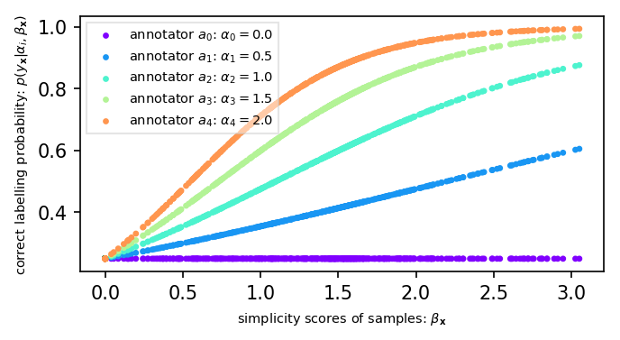
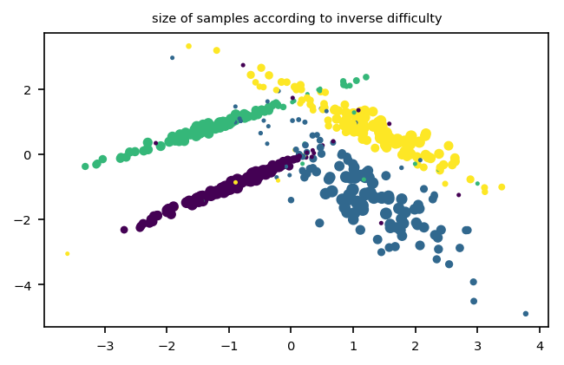
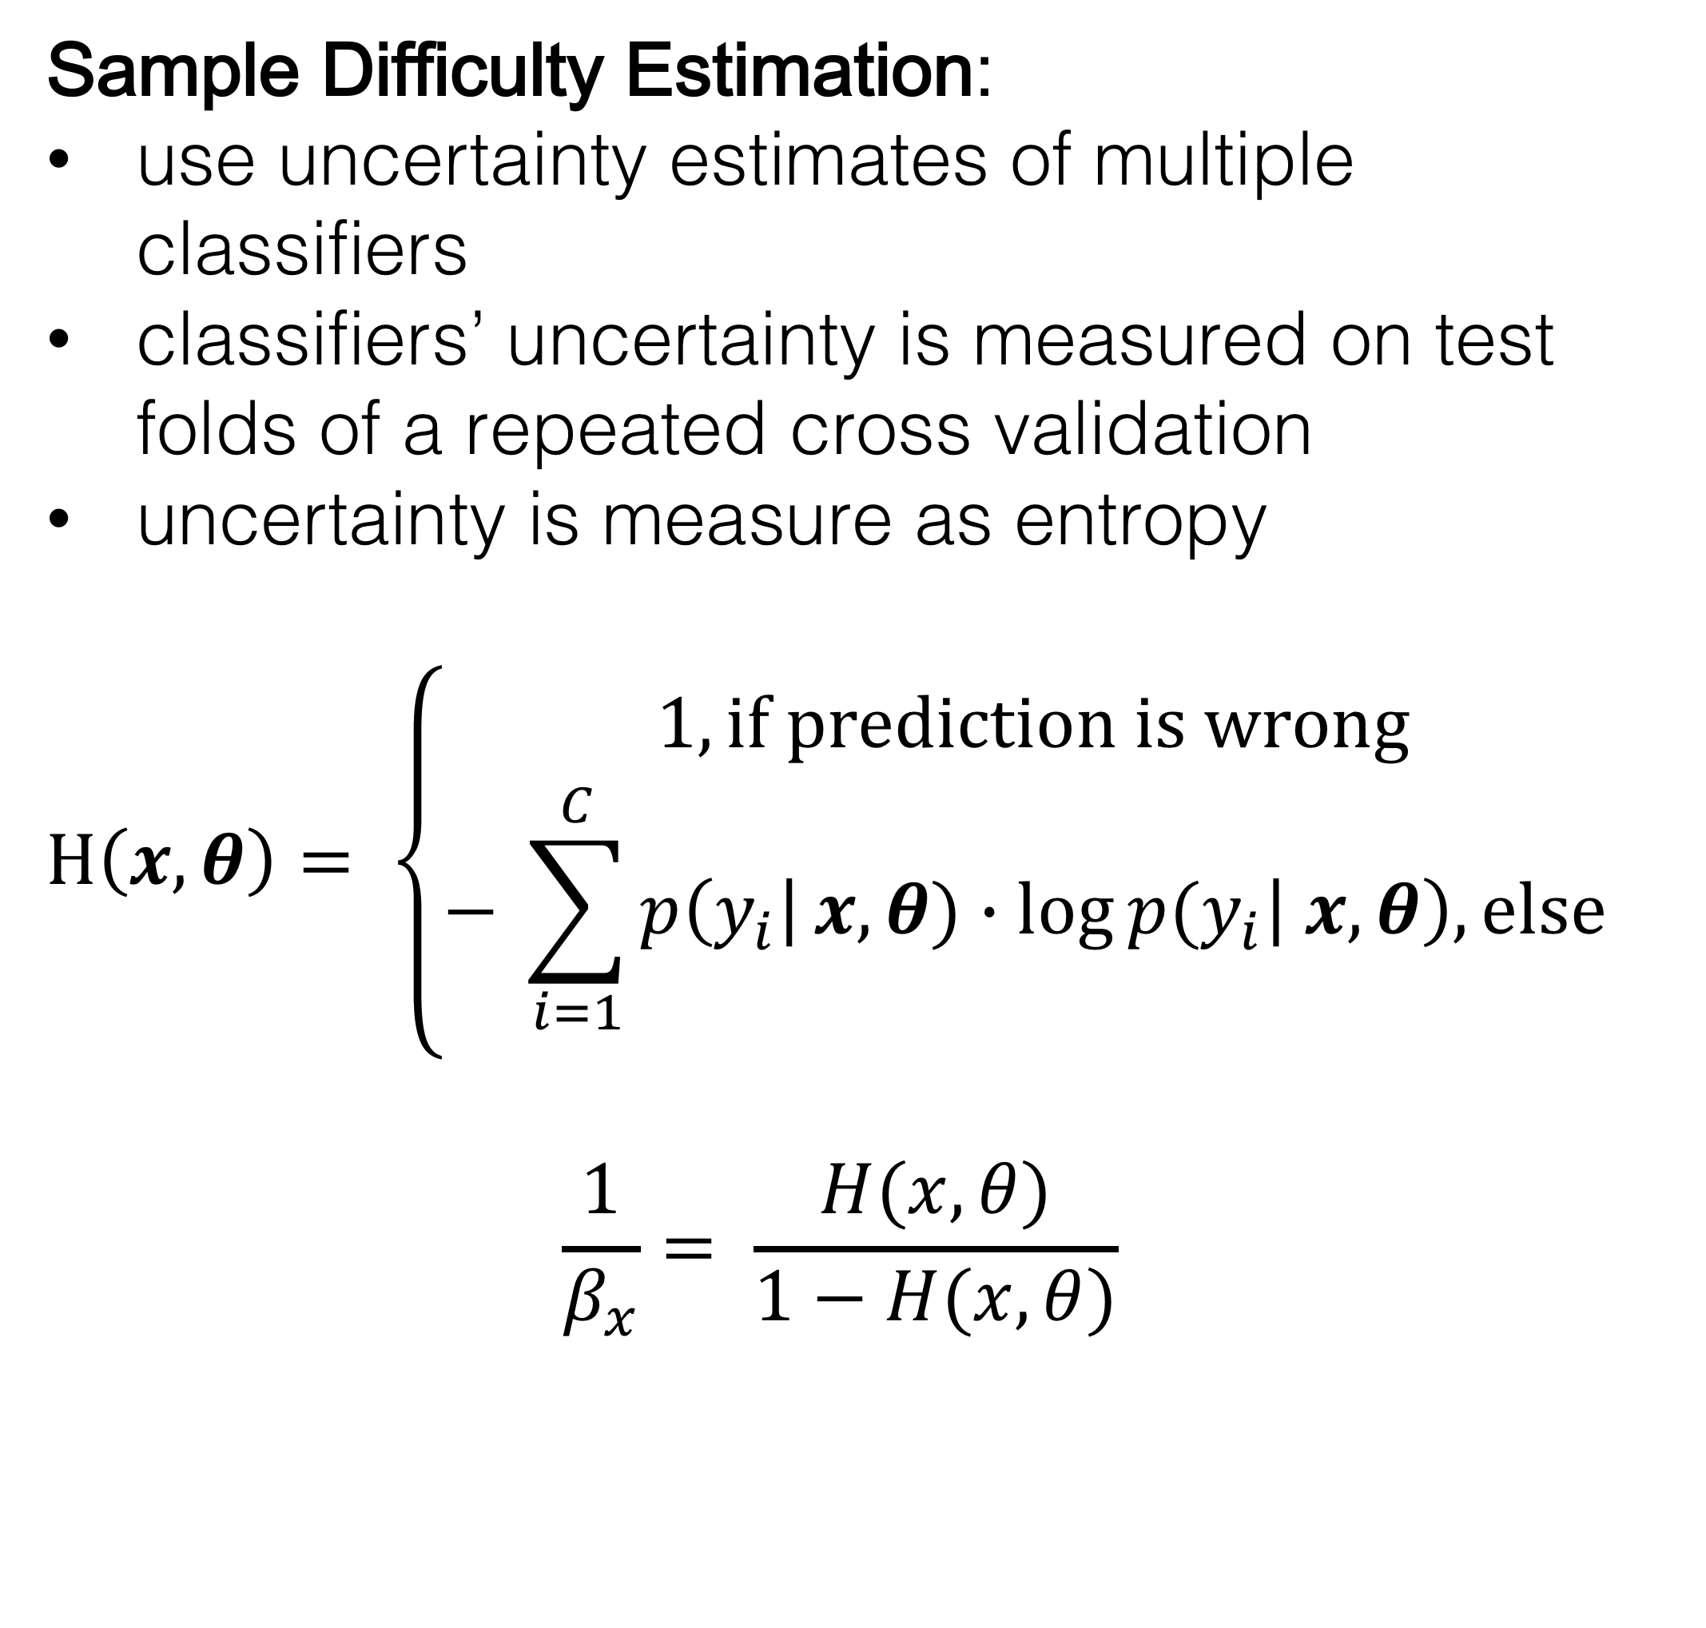
Sample Difficulty Estimation – II
Sample Difficulty Estimation:
use uncertainty estimates of multiple classifiers
classifiers’ uncertainty is measured on test folds of a repeated cross validation
uncertainty is measure as entropy
$$H\left(x, θ\right)= \left\{\begin{aligned}1, if prediction is wrong \\ − \sum_{i=1}^{C}{p\left(y_{i}\right|}x, θ)∙log⁡p(y_{i}\left| x, θ\right), else \end{aligned}\right.$$
$$\frac{1}{β_{x}}= \frac{H(x,θ)}{1−H(x,θ)}$$

Slide 11
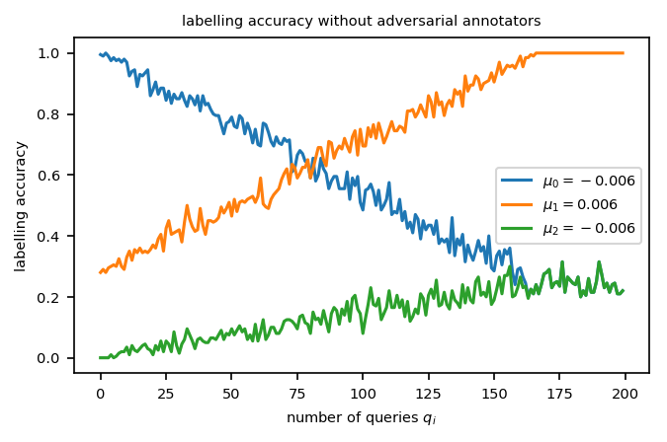
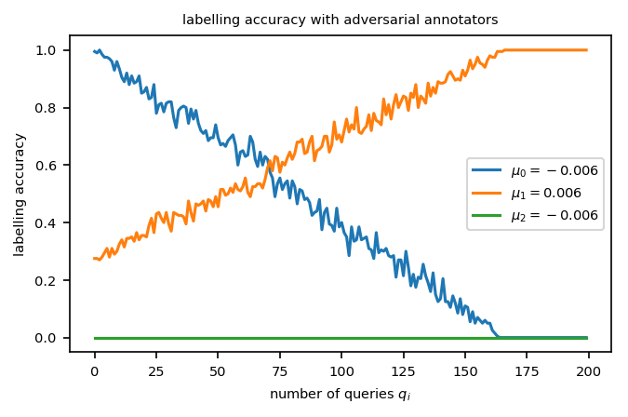
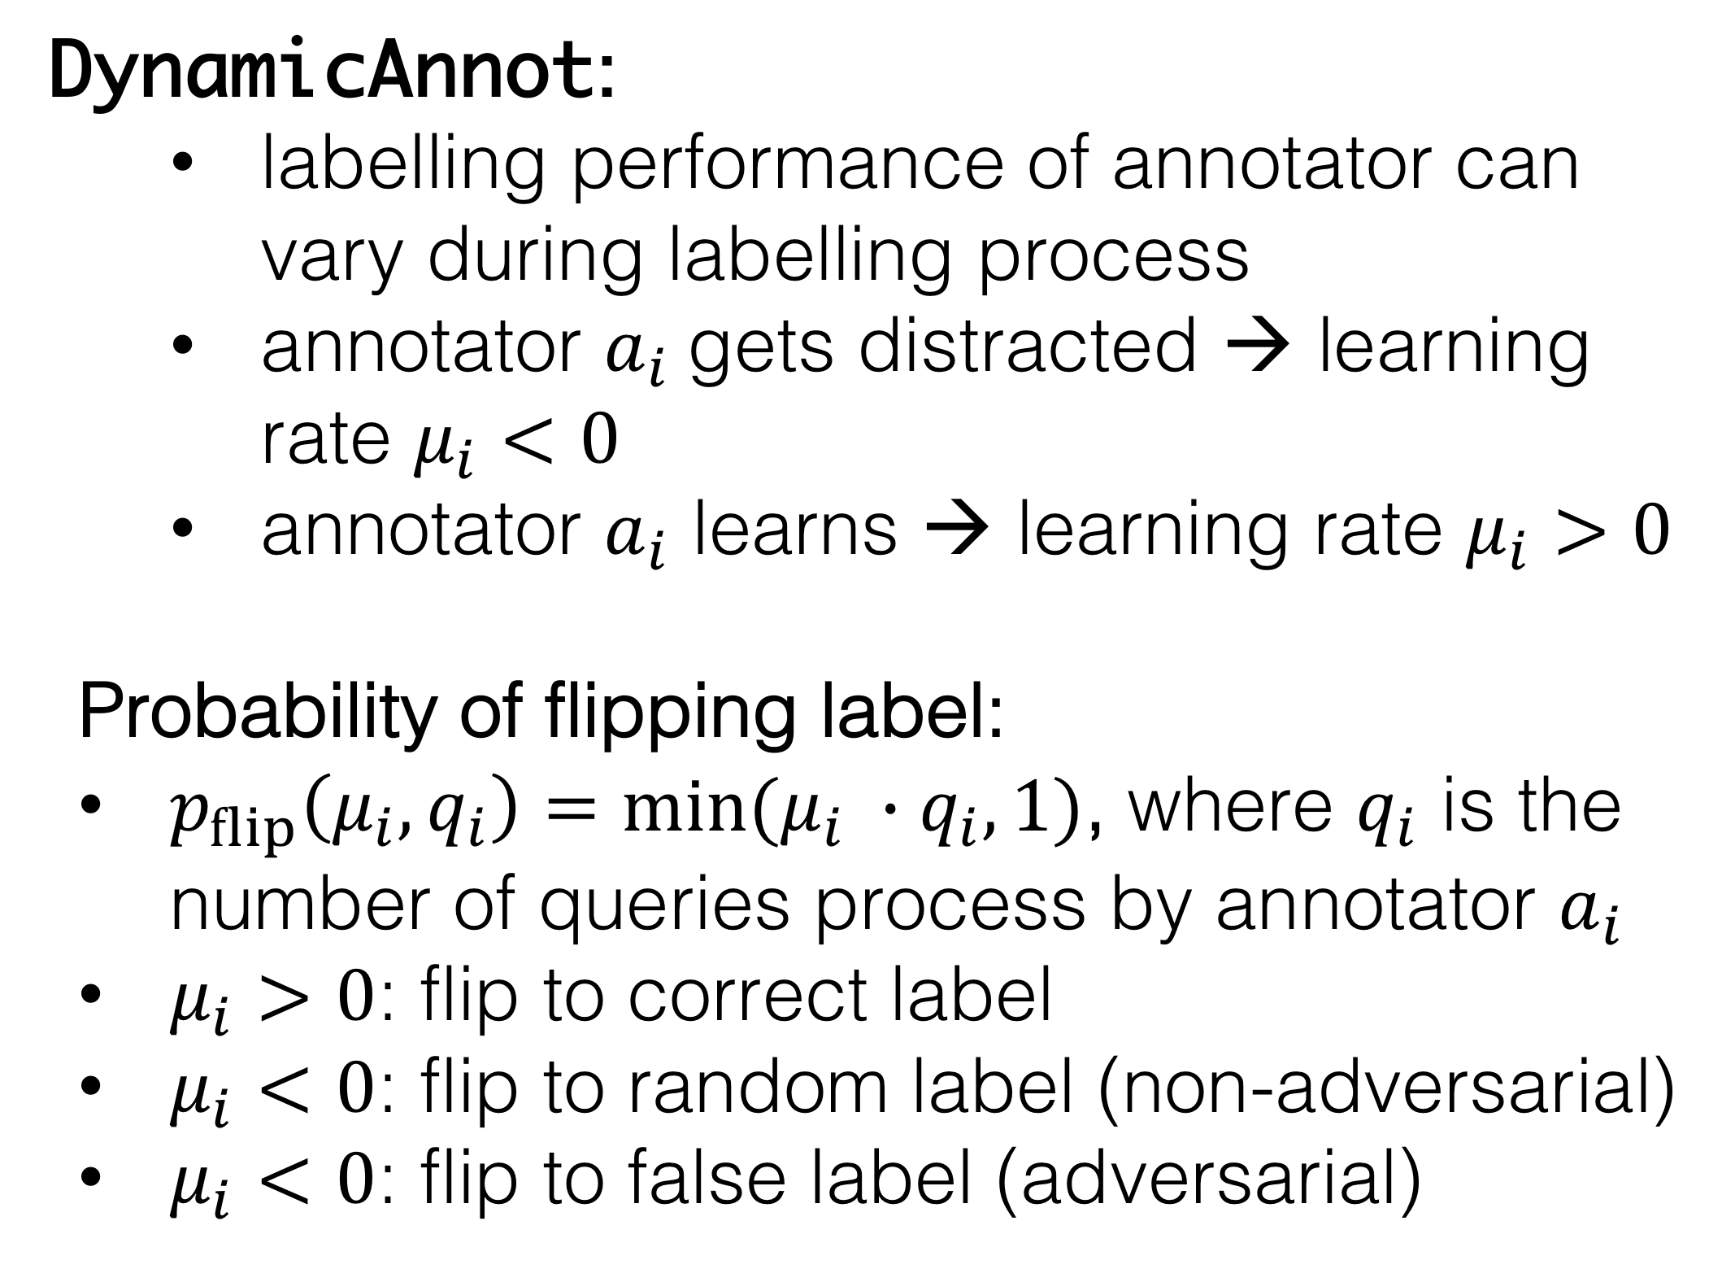
Dynamic Labelling Performance
DynamicAnnot:
labelling performance of annotator can vary during labelling process
annotator $a_{i}$gets distracted → learning rate $μ_{i}<0$
annotator $a_{i}$ learns → learning rate $μ_{i}>0$
Probability of flipping label:
$p_{flip}\left(μ_{i}, q_{i}\right)=min⁡(μ_{i} ∙q_{i},1)$, where $q_{i}$ is the number of queries process by annotator $a_{i}$
$μ_{i}>0$: flip to correct label
$μ_{i}<0$: flip to random label (non-adversarial)
$μ_{i}<0$: flip to false label (adversarial)

Slide 12
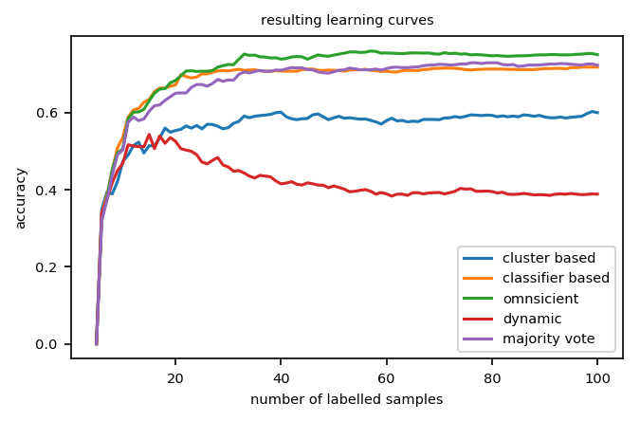
Multiple Annotator Types
MultiAnnotTypes:
container class to combine annotators of different types/classes
Exemplary active learning experiment:
four different types of annotators
omniscient annotator
annotator simulated by means of clustering
SVM trained on 5% of the data as annotator
annotator with decreasing labelling performance
selection strategy: random sampling
classifier: k-NN
comparing majority vote with individual annotators
Results:

Slide 13
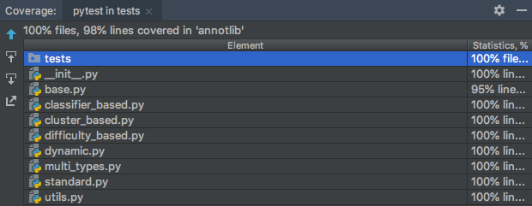
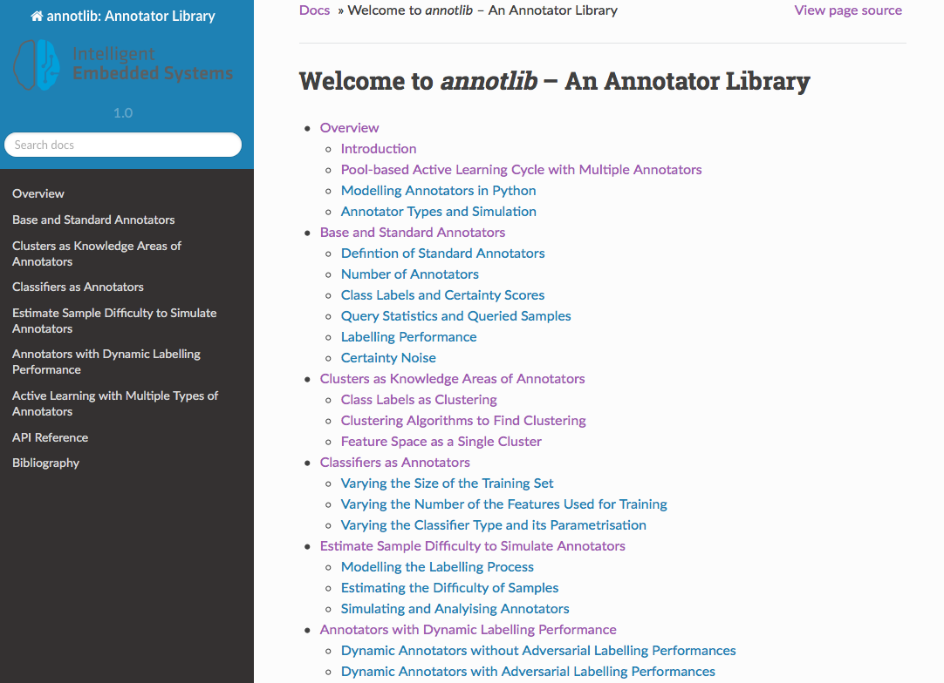
Conclusion
data representation of annotlib is in accordance to scitkit-learn
annotators of annotlib can be simply combined with libact
code test coverage is about 100%
annotlib has a user guide containing Jupyter notebooks as examples for each annotator type and a detailed API
simulation techniques of annotlib are motivated by realistic scenarios
annotlib offers functions for detailed analysis of annotators

Slide 14



Future Work
apply annotlib in bigger active learning projects including multiple annotators
enable simple installation of annotlib with help of pip and conda
provide running versions for
continuous maintenance to guaranty usability

Slide 15
Thank you for your attention! Discussion?

