Slide 1
AWK

Slide 2
Why use awk?
Many datasets come in text files arranged into rows (records) and columns (fields)
Tasks for this dataset:
  organize
  extract (some or all)
  do math on it
Awk does all of this and (much) more
Plus, it’s fast and portable

Slide 3


Why not Excel?
It’s made by Microsoft
Requires payment (awk is FREE!)
Have to open separate program, import data, and export after analysis
Much slower, especially for big files

Slide 4
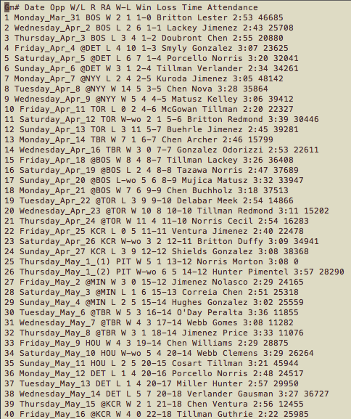
Print Statement
Baltimore Orioles 2014 season results
  (baseball-reference.com)
Who was the opponent?
awk ‘{print $3}’ 2014_orioles.txt
“Print the third field (column) in each record (line) to the terminal”

Slide 5
Print Statement
Baltimore Orioles 2014 season results
  (baseball-reference.com)
What about the date in addition to the opponent?
awk ‘{print $2,$3}’ 2014_orioles.txt
Try putting a space instead of a comma (I make this mistake a lot).
“Print the second and third fields separated by a space to the terminal”

Slide 6
Print Statement
Baltimore Orioles 2014 season results
  (baseball-reference.com)
Rearrange the dataset to W-L record then date
awk ‘{print $7,$2}’ 2014_orioles.txt
The fields don’t need to be in order, and they can be repeated

Slide 7
Print Statement
Baltimore Orioles 2014 season results
  (baseball-reference.com)
What if we wanted everything?
awk ‘{print $0}’ 2014_orioles.txt
“$0” stands for the entire record

Slide 8
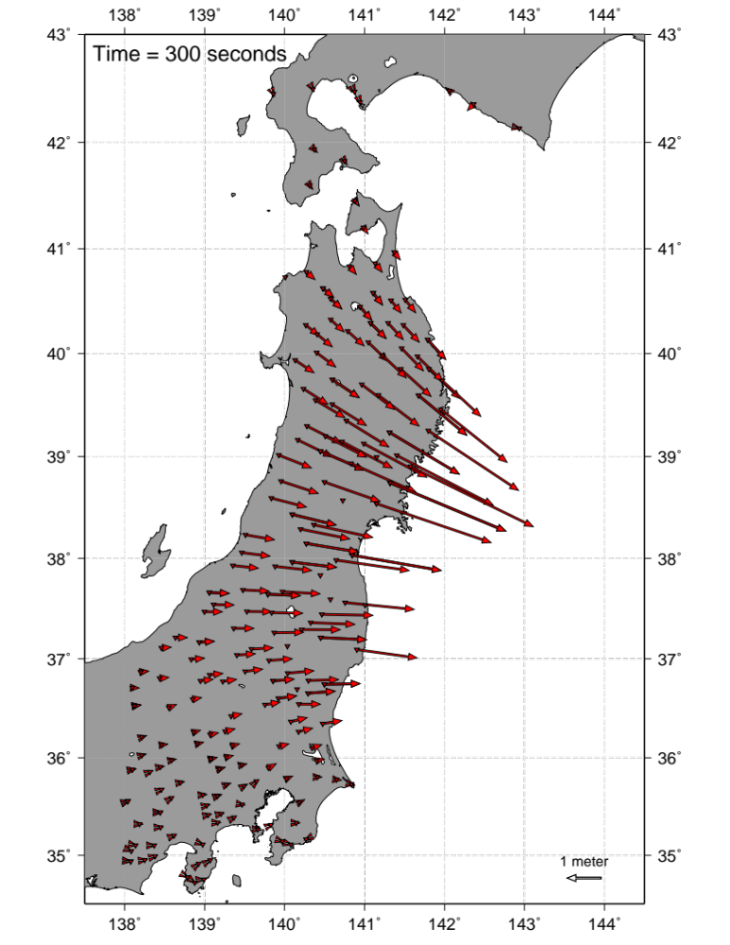
Math in Awk
Displacements from 2011 M 9.0 Tohoku earthquake
What do we need to make this figure?

Slide 9
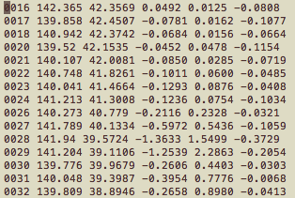
Math in Awk
Location, direction, and magnitude
Station ID
Coordinates
N E Z Displacement

Slide 10
Math in Awk
Addition x+y
Subtraction x-y
Multiplication x*y
Division x/y
Modulo x%y
Exponentiation x^y
Square root sqrt(x)
Trig functions cos(x), sin(x),
atan2(y,x)
Exponential fns exp(x), log(x)
Arguments are in radians, not degrees.
No tangent function!
Natural logarithm

Slide 11
Math in Awk
Location, direction, and magnitude
E
N
mag
az
Station ID
Coordinates
N E Z Displacement
Coordinates are easy
Pythagoras strikes again
awk ‘{
print $2,$3,atan2($5,$4),sqrt($4*$4+$5*$5)
}’ TIME_300.dat
Returns angle in radians!
Note the different formatting; awk is somewhat flexible in this regard.

Slide 12
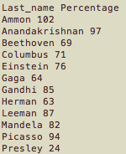
Conditional Statement
Grade assignments
>= 100: A+
90-100: A
80-90: B
70-80: C
60-70: D
< 60: F
Only print to terminal if the second field is greater than or equal to 100
awk ‘{if ($2>=100) print $1,”A+”}’ grades.txt
To print text, enclose it in double quotes

Slide 13
Conditional Statement
Grade assignments
awk ‘{
if ($2>=100) print $1,”A+”
else if ($2>=90) print $1,”A”
else if ($2>=80) print $1,”B”
else if ($2>=70) print $1,”C”
else if ($2>=60) print $1,”D”
else print $1,”F”
}’ grades.txt

Slide 14
Conditional Statement
Baltimore Orioles 2014 season results
  (baseball-reference.com)
What were the attendance values?
awk ‘{
if (substr($3,1,1) != “@”)
print $11
}’ 2014_orioles.txt
“substr” takes three arguments: (1) the field, (2) the position to start, (3) number of characters

Slide 15
Conditional Statement
Baltimore Orioles 2014 season results
  (baseball-reference.com)
What were the attendance values?
awk ‘{
if (substr($3,1,1) != “@”)
print $11
}’ 2014_orioles.txt
{
{
}
Home Games

Slide 16
BEGIN and END
Baltimore Orioles 2014 season results
  (baseball-reference.com)
What was the average home attendance?
awk ‘
BEGIN{tot=0;count=0}
{if (substr($3,1,1) != “@”) {tot=tot+$11;count=count+1}}
END{print sum/count}’ 2014_orioles.txt

Slide 17
BEGIN and END
Baltimore Orioles 2014 season results
  (baseball-reference.com)
Why do we need BEGIN and END here?
awk ‘
BEGIN{tot=0;count=0}
{if (substr($3,1,1) != “@”) {tot=tot+$11;count=count+1}}
END{print sum/count}’ 2014_orioles.txt
Without BEGIN, variables tot and count are uninitialized
END allows you to do operations after finishing file

Slide 18
Maximum Displacement
Largest horizontal displacement
Station ID
Coordinates
N E Z Displacement

Slide 19
Maximum Displacement
awk ‘
BEGIN{max=0}
{
mag = sqrt($4*$4+$5*$5)
if (mag > max) {
stid = $1
stlo = $2
stla = $3
max = mag
}
END{
print “STID”,stid
print “STLO”,stlo
print “STLA”,stla
print “MAX”,max
}
}’ TIME_300.dat

Slide 20
Last Thing: Delimiters
What if fields are separated by something besides whitespace?
Use -F fs
For a comma-separated variable (.csv) file:
awk -F, ‘{print $3}’ file.csv

Slide 21
What’s Next?
Piping into awk (or from awk)
Other powerful Unix commands (sed, grep)
Regular expressions (steep learning curve, incredible utility)
Plotting data (GMT, Python, gnuplot, etc.)
echo 3 4| awk ‘{print sqrt($1*$1+$2*$2)}’
Echo prints text to the terminal.
The vertical line “pipes” the output of echo into awk.

