Slide 1
Impact Assessment: Quality & Condition Ratings on Housing Prices in Ames, IA
Max Hersch
Junior Data Analyst
January 12, 2022

Slide 2
The purpose of this presentation is to assess factors that drive home prices and to recommend strategies that will improve returns on future mortgage-backed securities.

Slide 3
What determines the value of a house?
Quantifiable
Observable
Qualitative
Lot area
# of beds/baths
Year built
Building type
Garage type
Building materials
Condition
Quality
Overall Condition Rating (Cond)
1
2
3
4
5
6
7
8
9
10
Overall Quality Rating (Qual)
Low
High
How does overall condition rating affect the sale price of a house?
How does overall quality rating affect the sale price of a house?

Slide 4
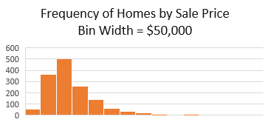
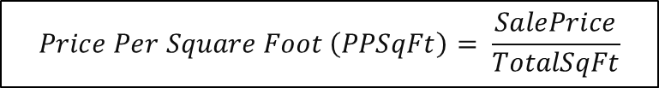
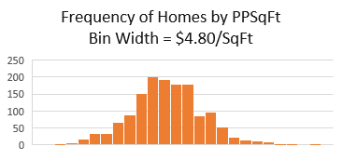
Hypotheses & Data
There is no significant difference in the sale price of properties with a 1-point difference in overall condition rating.
There is no significant difference in the sale price of properties with a 1-point difference in overall quality rating.
Housing data from 25 neighborhoods in Ames, IA.
Collected from the sale of 1460 homes sold between 2006 – 2010.
Sale prices are not normally distributed.
PPSqFt is approximately normally distributed.
$$Price Per Square Foot \left(PPSqFt\right)= \frac{SalePrice}{TotalSqFt}$$

Slide 5
Methods
Split data into bins according to condition/quality rating.
Descriptive/inferential stats calculated using Excel Analysis ToolPak.
Conducted independent sample t-tests assuming unequal variances.
  Independent variable = condition/quality rating
  Dependent variable = PPSqFt
  Alpha level of .05
Ratings 1-3 and 9-10 were omitted due to small sample sizes (n < 30).

Slide 6

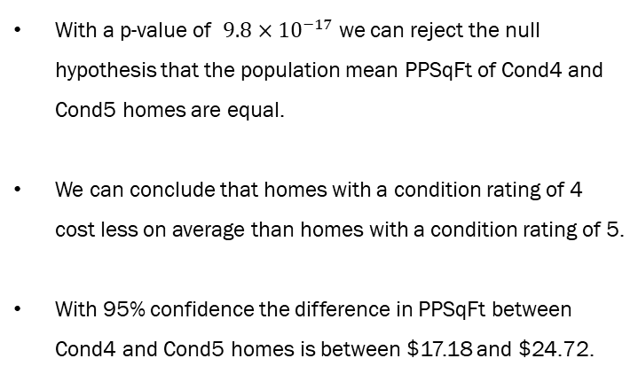
Results 1 – Condition Ratings
H₀ = The population mean PPSqFt of homes with a condition rating of 4 is equal to the population mean of homes with a condition rating of 5.
H_{a} = The population mean PPSqFt of homes with a condition rating of 4 is not equal to the population mean of homes with a condition rating of 5.
t-Test: Two-Sample Assuming Unequal Variances | PPSqFt 4 | PPSqFt 5
Mean | 52.04494 | 72.99597
Variance | 186.8666 | 235.029
Observations | 57 | 821
Hypothesized Mean Difference | 0
df | 66
t Stat | -11.0968
P(T<=t) two-tail | 9.81E-17
t Critical two-tail | 1.996564
With a p-value of $9.8×{10}^{−17}$ we can reject the null hypothesis that the population mean PPSqFt of Cond4 and Cond5 homes are equal.
We can conclude that homes with a condition rating of 4 cost less on average than homes with a condition rating of 5.
With 95% confidence the difference in PPSqFt between Cond4 and Cond5 homes is between $17.18 and $24.72.
$9.8×{10}^{−17} < .05$
Reject the Null

Slide 7

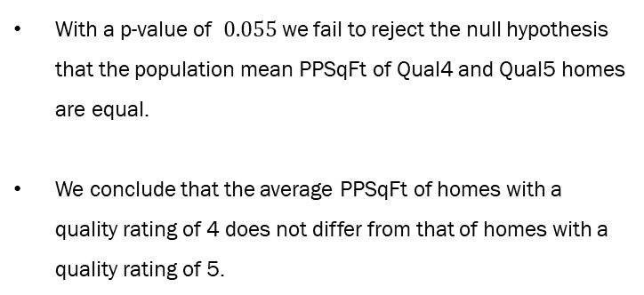
Results 2 – Quality Ratings
H₀ = The population mean PPSqFt of homes with a quality rating of 4 is equal to the population mean of homes with a quality rating of 5.
H_{a} = The population mean PPSqFt of homes with a quality rating of 4 is not equal to the population mean of homes with a quality rating of 5.
t-Test: Two-Sample Assuming Unequal Variances | PPSqFt 4 | PPSqFt 5
Mean | 60.29997 | 63.26904
Variance | 219.7792 | 181.727
Observations | 116 | 397
Hypothesized Mean Difference | 0
df | 174
t Stat | -1.93582
P(T<=t) two-tail | 0.05451
t Critical two-tail | 1.973691
With a p-value of $0.055$ we fail to reject the null hypothesis that the population mean PPSqFt of Qual4 and Qual5 homes are equal.
We conclude that the average PPSqFt of homes with a quality rating of 4 does not differ from that of homes with a quality rating of 5.
$0.055> .05$
Fail to Reject the Null

Slide 8
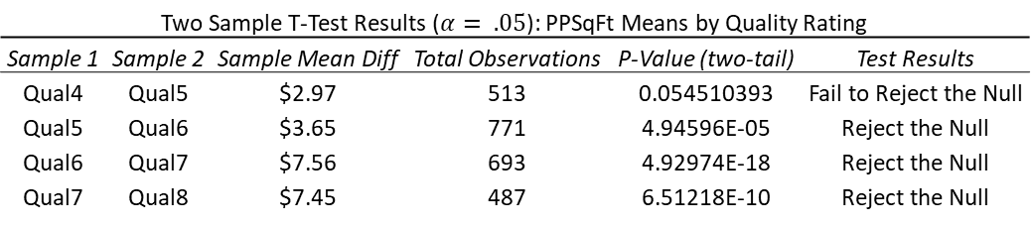
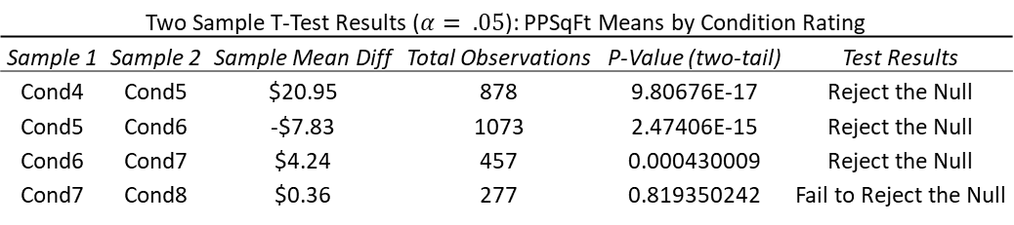
Results Summary
H₀ = The population mean PPSqFt of Sample 1 is equal to the population mean of Sample 2.
H_{a} = The population mean PPSqFt of Sample 1 is not equal to the population mean of Sample 2.
Two Sample T-Test Results ($α= .05$): PPSqFt Means by Condition Rating
Sample 1 | Sample 2 | Sample Mean Diff | Total Observations | P-Value (two-tail) | Test Results
Cond4 | Cond5 | $20.95 | 878 | 9.80676E-17 | Reject the Null
Cond5 | Cond6 | -$7.83 | 1073 | 2.47406E-15 | Reject the Null
Cond6 | Cond7 | $4.24 | 457 | 0.000430009 | Reject the Null
Cond7 | Cond8 | $0.36 | 277 | 0.819350242 | Fail to Reject the Null
For both condition and quality ratings, 3 out of 4 of the tests showed a statistically significant difference in the average price for homes with 1-point differences in overall rating.
Two Sample T-Test Results ($α= .05$): PPSqFt Means by Quality Rating
Sample 1 | Sample 2 | Sample Mean Diff | Total Observations | P-Value (two-tail) | Test Results
Qual4 | Qual5 | $2.97 | 513 | 0.054510393 | Fail to Reject the Null
Qual5 | Qual6 | $3.65 | 771 | 4.94596E-05 | Reject the Null
Qual6 | Qual7 | $7.56 | 693 | 4.92974E-18 | Reject the Null
Qual7 | Qual8 | $7.45 | 487 | 6.51218E-10 | Reject the Null

Slide 9
Recommendations
Based on the data that analyzed here is it evident that 1-point differences in condition and quality ratings do have impacts on sale prices of homes. Single-point differences in quality ratings can impact sale prices by more than $25k while single-point differences in condition ratings can yield differences greater than $63k.
Investments should be made into homes with the highest possible quality and condition ratings to ensure the largest returns on investment.
Similar tests should be conducted with larger samples of homes with quality and condition ratings of 1-3 and 9-10 to investigate if the patterns identified here are consistent.

Slide 10
Thank you for your time.

