Slide 1

p2p-player
An experimental shared audio player on a p2p network
Dario Mazza
Sebastiano Merlino

Slide 2
Information
What is this ?
This is an academic project for the course “Tecniche di Programmazione avanzata”
Design project, Wiki pages and source code are available on the “p2p-player” project on Google Code: http://code.google.com/p/p2p-player/

Slide 3
Overview
An experimental shared audio player on a p2p network
Experimental : this application uses an innovative load balancing and multi-source download system to enhance the streaming performance and reduce audio player buffering interval; this reduces user awareness of all network-related issues
Audio Player: an ad hoc developed graphical interface allows users to control tracks sharing and streaming over the network.
Peer- to-peer network: information about tracks are shared using a custom implementation (using a keyword-based knowledge base) of the Kademlia specifications.

Slide 4
Overview
What makes it so special ?
Free Software: this application is released under the Affero General Public License (AGPL) and the source code is available on Google Code.
Fast Download: the enhanced download speed reduces the time that users spend waiting for the end of buffering phase. During tests on small networks (up to 10 peers) with Gigabit Ethernet LAN the playback experience is fluid, buffering states are extremely rare and limited to the starting phase of the streaming session.

Slide 5
Installation
How can I put this on my PC ?
Using the installer is extremely easy to install the system on your PC.
After the installation, the peer is fully configured and has a copy of the list of super nodes.
Super Nodes are peers that are always running and can be used by other peers to join the network (during the so-called “bootstrap phase”)

Slide 6
Utilization
What I have to do for listening to music ?
Listen to music is easy as type your desires.
Use the “Search Query” field in the Main Window and press the Search Button. The list below will be quickly populated with the search results.
Double click on row or click on “Start Stream” button of the track you want to listen.
Enjoy listening !

Slide 7
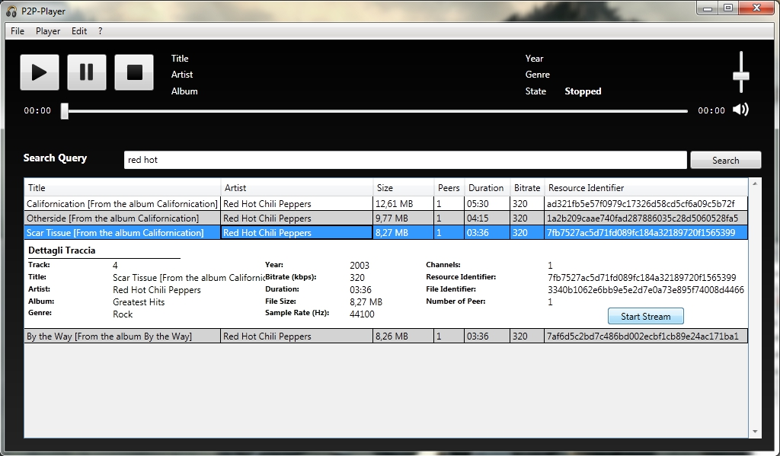
Utilization
How it looks like ?

Slide 8
Utilization
How can I share my music ?
Sharing your music is even simpler than listen
From “Tool” menu you can choose Local Music Store and use the Add File button to add a new file to you Music Store
Once the track is added to you store, you became a suppliers for this track. Now other people can see your file and can use it as source for their streaming session
Before sharing remember that there are a lot of legal issue related to sharing content protected by copyright. We gave you a gun, don’t mess around shooting to people !

Slide 9
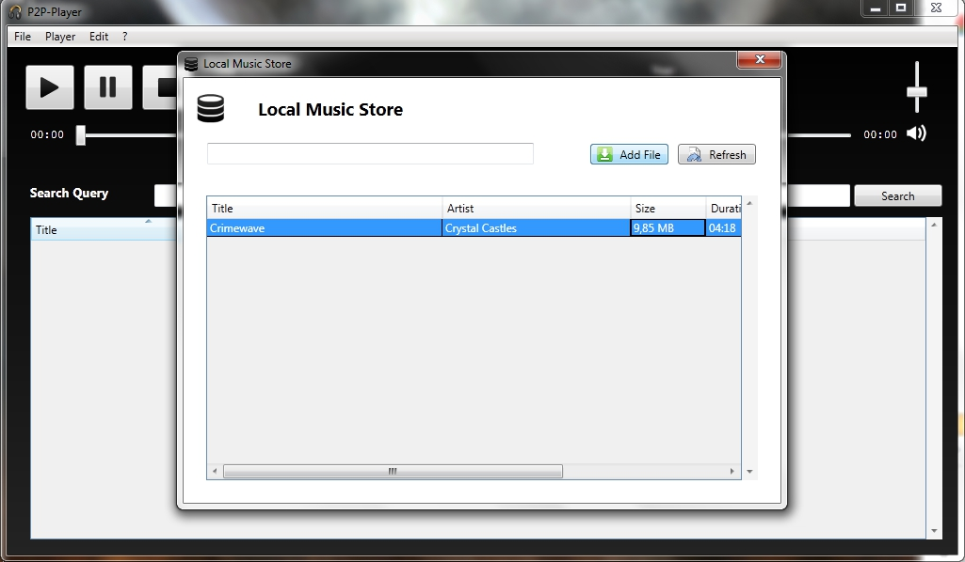
Utilization
How Local Music Store looks like ?

Slide 10
Details
What’s beyond the scene ?
During store procedure the track information will be published on the Kademlia Network using a keyword base approach: each resource (track) can be referenced by multiple keywords published on the network.
During search procedure the query string is divided in keyword and all resources that is referenced on the Kademlia Network by this keyword will be returned as valid result.
During streaming procedure each supplier of the chosen resource will be used as source for the download.

Slide 11
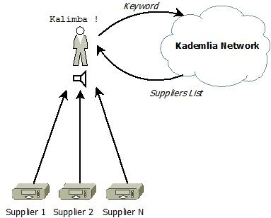
Details
What’s beyond the scene ?

Slide 12
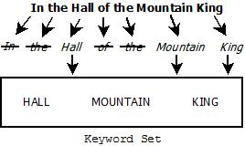
Details
What’s beyond the scene ?
Procedure used to extract keyword from a string

Slide 13
Future Works
What is the plans for the near future ?
Playlist : supports the creation of playlist storing information about tracks suppliers
Linux Porting : develop a port of this application for Linux using the power of the Mono Platform.
Memory and Disk usage : reduce the application usage of memory and disk space by changing technology used for storing the data.

