Slide 1
Movement Science at Grand Valley
Clients: Dr. Christina Beaudoin and Dr. Colleen Lewis
Consultants: Michael Heylmun and Jacob Maring

Slide 2
Project Background
Looking at GVSU's FIT classes:
FIT classes are physical activity oriented one-credit academic courses. They are credit/no credit.
There is wide variety in what these courses look like. Typically just under 100 courses running each semester.
FIT classes have very low barriers to entry.
Who takes FIT courses, and how does it serve them?
We’re interested in how these FIT classes benefit first-year students.
Notes:
Data from Fall 2018 to Fall 2023

Slide 3
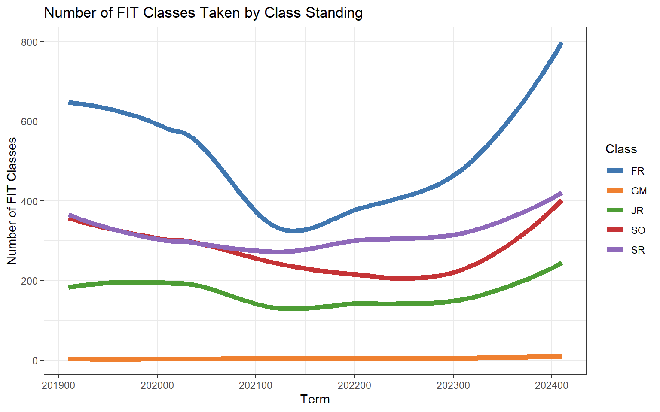
Number of FIT Courses Taken by Class
Freshmen are the predominant class that take FIT courses.
Sophomores and Seniors take a comparable number of courses.
Graduate students hardly take any FIT courses.

Slide 4
Project Objectives
What is the difference in retention for first-year students who enroll in FIT courses and those who do not enroll in FIT courses?
How does enrollment in a FIT course in a student’s freshman year relate to their time to graduate?
How does enrollment in a FIT course in a student’s freshman year relate to their first year GPA?

Slide 5
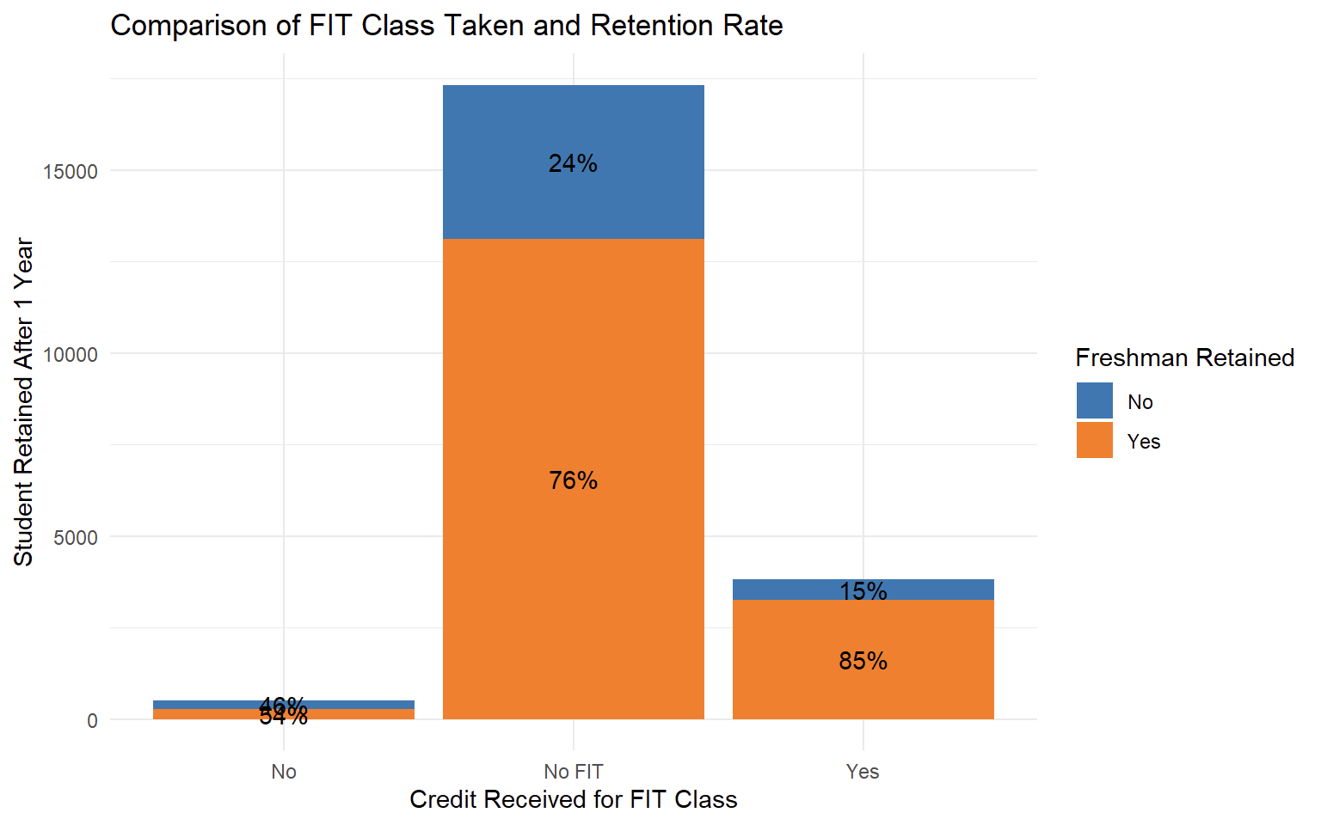
Freshman Retention Rate
Freshman Retained is a "Yes" if student returns the following year.
85% of freshman that took a FIT class and received credit were retained compared to only 76% that did not take any FIT courses.

Slide 6
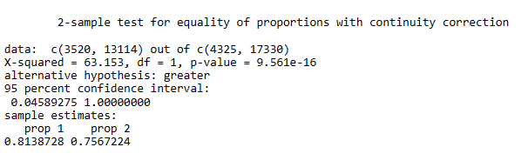
Chi-Squared Test
The difference is significant; freshman who take a FIT class are more likely to return to Grand Valley for a second year.

Slide 7
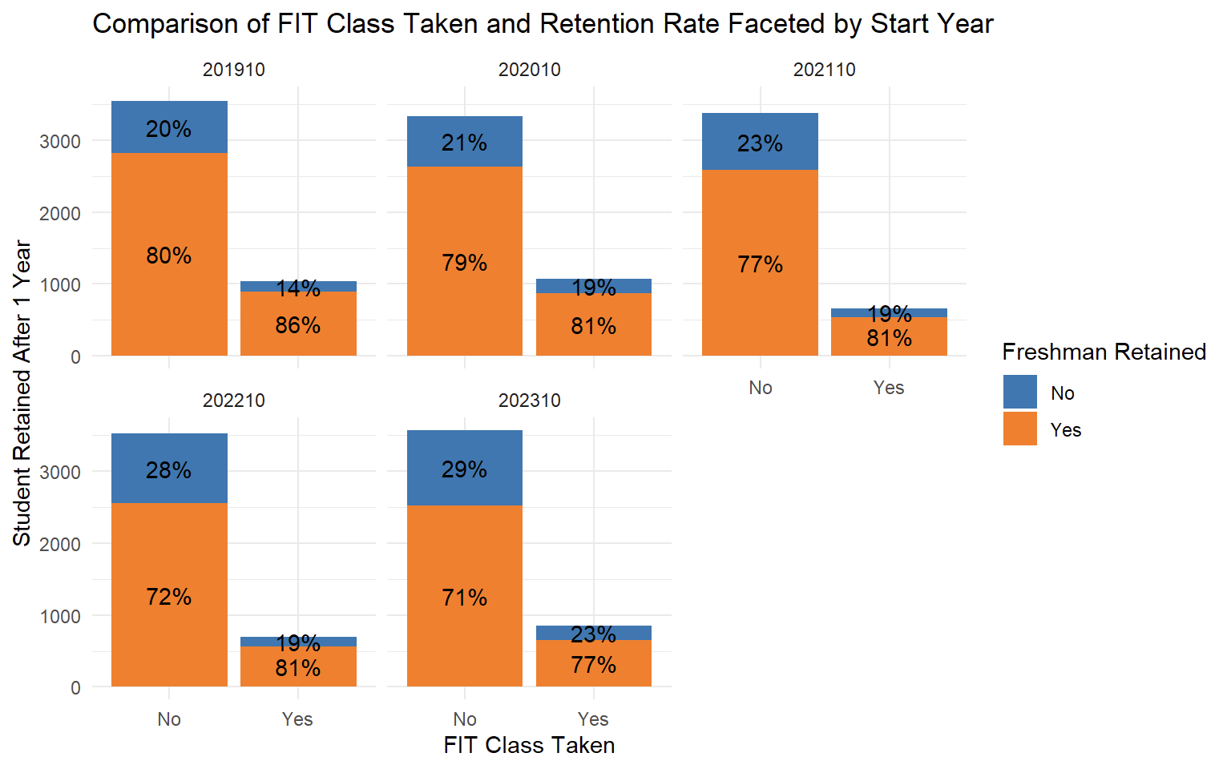
Freshman Retention Rate by Year
This result holds for freshman starting in every academic year as well, with the effect in some years greater than others.

Slide 8
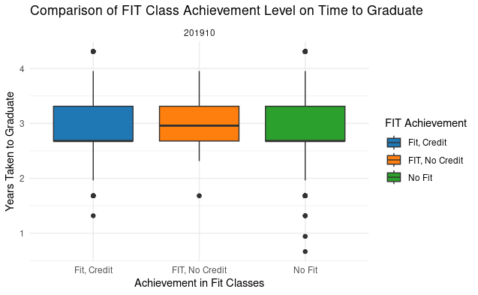
Graduation Times by FIT Class
Students graduate when terms end.
There is likely no difference between students who succeed in FIT, and those who don't take FIT courses.

Slide 9
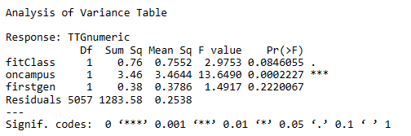
ANOVA Table of Time to Graduation
The effect of FIT classes is not significantly related to Time to Graduate.

Slide 10
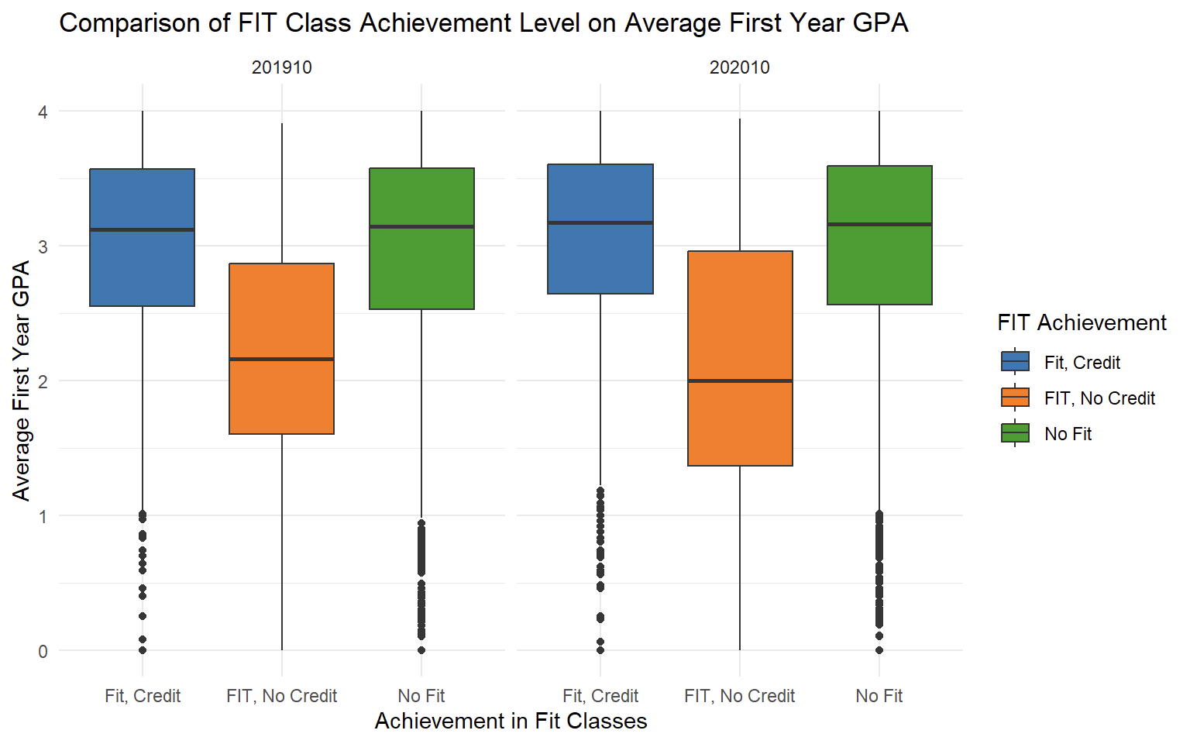
Freshman GPA by FIT Class
Similarly with GPA, there is likely no difference in freshman GPA from those who take FIT classes and those that don’t.

Slide 11
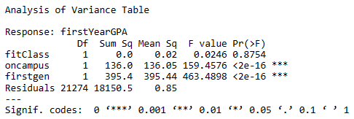
ANOVA Table of Freshman GPA
Again, the effect of FIT classes is not significantly related to a student's first-year GPA. The effect should only diminish for later years.

Slide 12
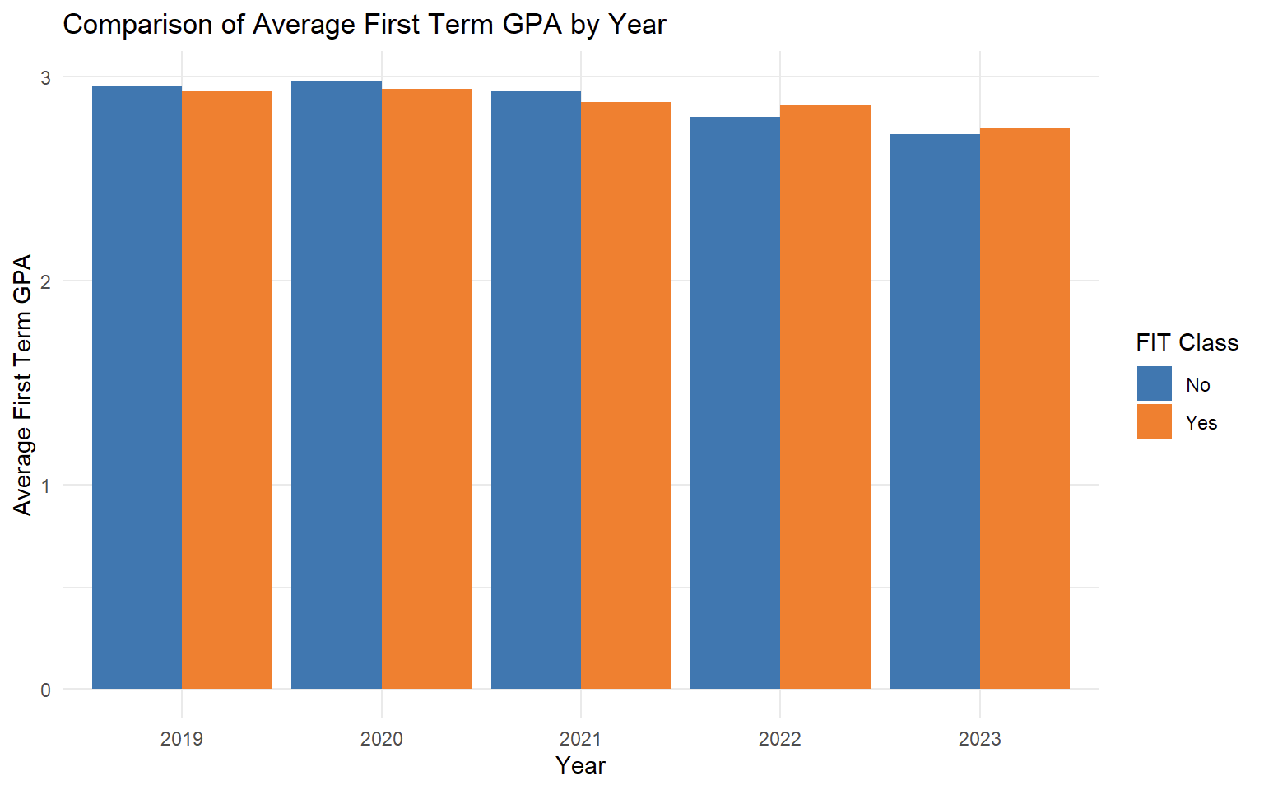
Freshman GPA by Year
The difference can be seen further here when it is broken down by year.
There does seem to be a negative trend in GPA over the last four years.

Slide 13
Conclusions
The difference in retention rates for freshmen students is statistically significant and is higher for those that took a FIT course their freshman year over those that did not.
Freshmen enrolled in a FIT course was not statistically significant in decreasing time to graduate. It was not shown that freshmen that took FIT courses graduated faster than their peers.
No correlation was found between a freshman taking a FIT course and an increased GPA.

Slide 14

Questions/Feedback?

