Slide 1
Coursera IBM Applied Data Science Capstone Project
Seattle Accident Analysis and Classification
Hossein Faghih
Sep 20

Slide 2
Introduction
There are more than 10000 accidents in Seattle each year
We need to understand why these accident happen to employ policies

Slide 3
Problem
How to create a model than can predicts an accident

Slide 4
Data
Nearly 200 thousand reports of accidents during 2005-2020

Slide 5
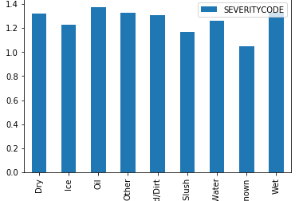
Road Conditions

Slide 6
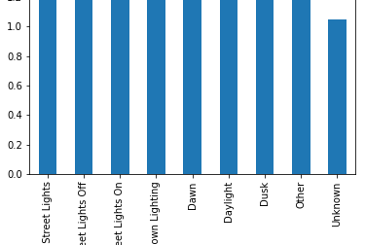
Light Condition

Slide 7
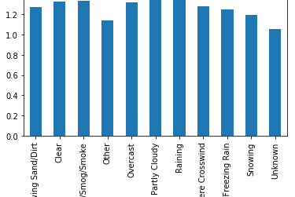
Weather

Slide 8
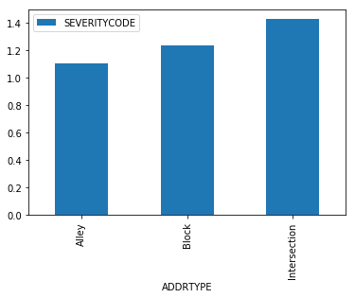
Address Type

Slide 9
Personal
Is the driver under influence?
Is the driver speeding?
Is the driver in-attending?

Slide 10
Models
Logistic Regression
Decision Tree

Slide 11
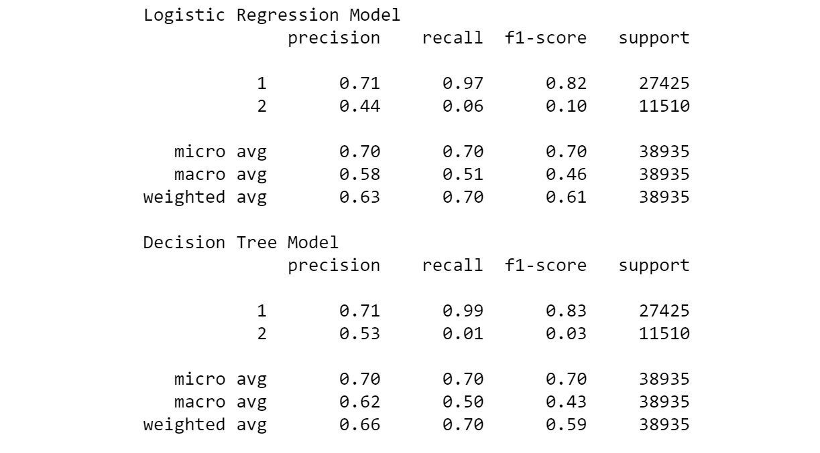
Model Results

