Slide 1
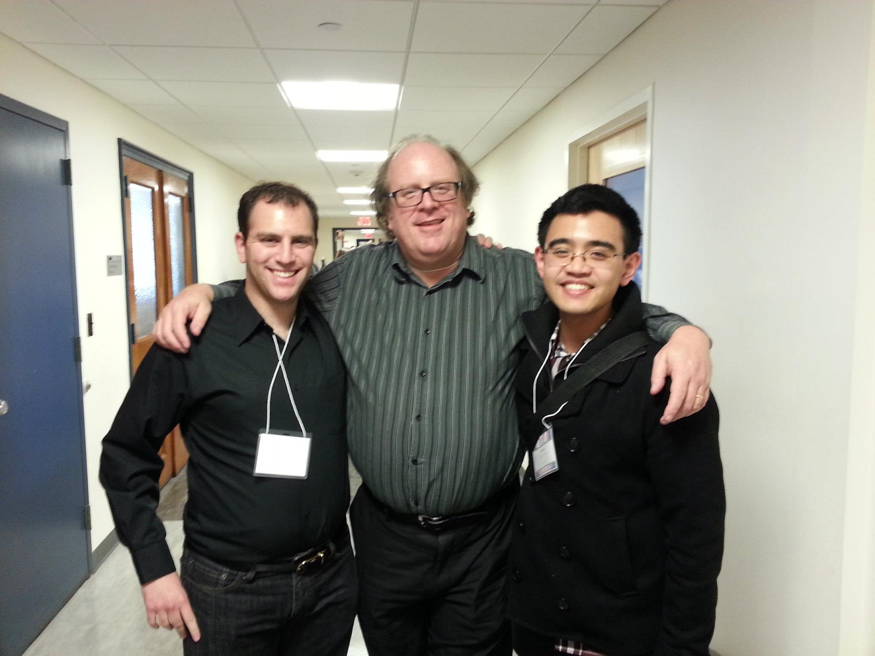

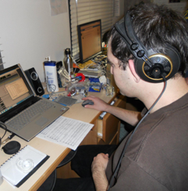
Grammy award-winning producer Bill Hare!
Future Data Scientist Maxwell Fisch! (Zero Grammys)

