Slide 1

Problem Statement
Can graph theory find patterns in the property market that standard statistics might miss?

Slide 2

Data available
Resale flat price data from HDB dating from Jan 2017 to Sept 2020, with about 80k entries.
Examples of information included:
Year and month the transaction was registered
Floor area
Flat type
Remaining lease
Resale price and others.
<Please provide a data dictionary and a sample set of the data*>

Slide 3

Proposed solution
Graph schema: undirected and unweighted
Nodes: Individual property listings
Edges: Same and similar attributes (same town, same flat type, similar floor area, similar resale price).
To find out: “hubs” - listings that connect many others (price benchmarks, dominant flat types).
Without these hubs, price benchmarking is compromised.
Notes:
Nodes: individual property listings Edges: same and similar attributes (same town, same flat type, similar floor area, similar resale price). Criteria:1. Same town 2. Same flat_type 3. AND floor area difference ≤ 10 sqm (arbitral threshold) 4. AND resale price difference ≤ 10% (arbitral threshold) Hubs: listings that connect many others -> price benchmarks, popular locations, dominant flat types. Without these hubs, price benchmarking is compromised.Graph schema: undirected, unweighted graph

Slide 4
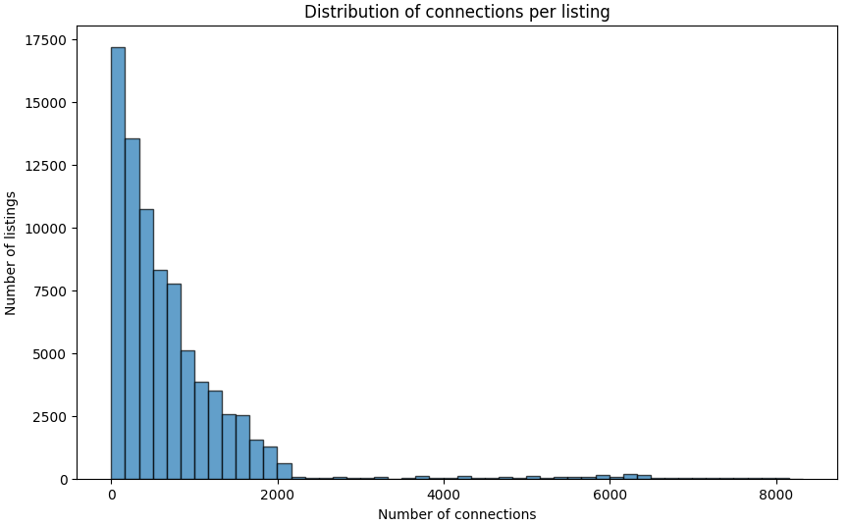
Sparse connections: Properties connect within their own circles
Most listings don't connect to most other listings.
The market is highly segmented by criteria (town, flat type, floor area, price).
Properties are only comparable to a small subset of similar properties.

Slide 5
Hubs detected
Date | Town | Flat Type | Block | Street Name | Resale price | Number of connections
2017-10 | GEYLANG | 3 ROOM | 302 | UBI AVE 1 | 282000 | 8320
2019-08 | TAMPINES | 3 ROOM | 439 | TAMPINES ST 43 | 275000 | 8187
2017-07 | TOA PAYOH | 3 ROOM | 113 | LOR 1 TOA PAYOH | 275000 | 8184
2018-08 | YISHUN | 3 ROOM | 719 | YISHUN ST 71 | 275000 | 8183
Interpretation: these properties serve as price benchmarks for their respective town and flat type.

Slide 6
Outliers detected
Date | Town | Flat Type | Block | Street Name | Resale price | Number of connections
2020-05 | ANG MO KIO | EXECUTIVE | 608 | ANG MO KIO AVE 5 | 1030000 | 0
2017-11 | BEDOK | EXECUTIVE | 33 | BEDOK STH AVE 2 | 815000 | 0
2019-06 | BISHAN | MULTI-GENERATION | 137 | BISHAN ST 12 | 840000 | 0
2020-08 | BUKIT MERAH | 4 ROOM | 43 | MOH GUAN TER | 1088000 | 0
Interpretation: these properties have no connections (no comparable listings). They are potentially mispriced.

