Slide 1

Problem Statement
1. What are the factors affecting prices of residential properties in Singapore?
2. Are there ways to curb housing prices inflation?

Slide 2

Data available
Resale flat price data from HDB dating from Jan 1990 to Sept 2020, with about 800k entries.
Examples of information included:
Year and month the transaction was approved or registered
Floor area
Flat type
Remaining lease
Resale price and others.
<Please provide a data dictionary and a sample set of the data*>
Notes:
Assumption:
For records prior to March 2012, the data are based on the date of approval for the resale transactions.
From March 2012 onwards, the data are based on the date of registration of the resale transactions.
From desktop research, the difference between date of approval and date of registration of resale transactions differ about 2 weeks apart. Since our data records this information by year and month, this gap can be ignored, and the dates can be treated as equivalent.

Slide 3

Proposed solutions
We will be using the independent variables (e.g. (floor area, flat type, remaining lease) to predict the dependent variable (resale price) of HDBs.
Regression models: Linear, Ridge and Lasso
Tree-based model: Decision tree

Slide 4
Data exploration and preparation
Standardisation of entries
Examples:
Flat Type: All entries to be standardised (e.g. 'multi generation’ -> 'multi-generation’)
Flat Model: All entries to be in upper case (e.g. 'Premium Apartment’ -> 'PREMIUM APARTMENT’)

Slide 5
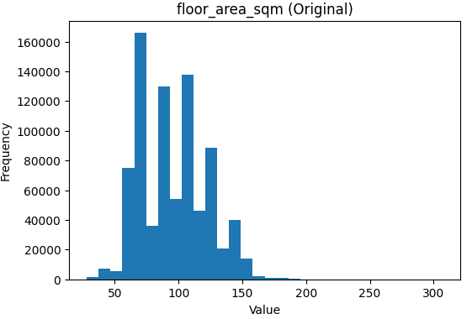
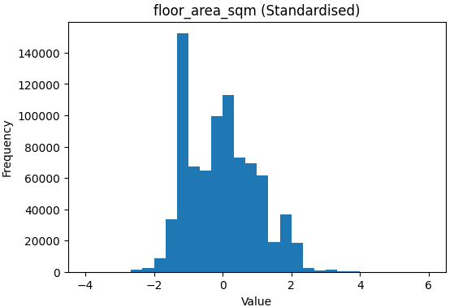
Data exploration and preparation
Standardisation (to have 0 mean and 1 variance) of independent variables
Example:
Intuition: Standardisation puts all variables on the same scale, so no variable dominates the results just because it is measured in bigger numbers.

Slide 6
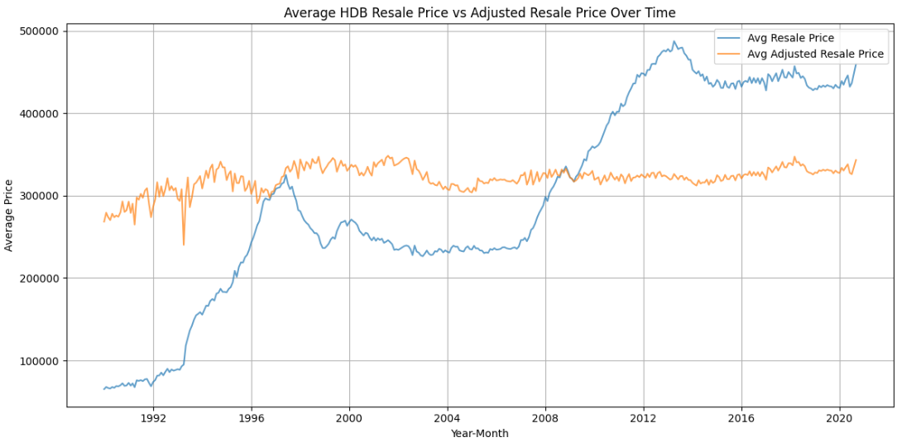
Data exploration and preparation
Removal of inflation effects on dependent variable (resale price) by using the Resale Price Index provided by HDB.

Slide 7
Performance of models
Models | Score
Linear regression | 0.837334
Ridge regression | 0.837333
Lasso regression | 0.837330
Decision Tree | 0.752846

Slide 8
Regression Identifies: Top Drivers of Price Increases
Flat Model (Terrace, Type S2, Type S1) and Marine Parade Location
Property being a terrace leads to an
increase of $148,925 in
adjusted resale price.
Notes:
All 3 regression models agree that Flat model Terrace, Type S2 and S1 are the top 3 largest drivers of increases in resale prices.
Linear and Ridge: Marine Parade is 4th
Lasso: Marine Parade is 5th
OLS: “True” effect, holding other variables constant.
Ridge: Direction and relative importance matter more than size. (A value of 20k means: after penalising large coefficients, terrace flats are associated with about $20k higher resale prices, holding others constant.)
Lasso: Presence vs absence matters more than size. (If it is 20k, it means terrace flats have about $20k higher prices, conditional on the variables lasso kept.)

Slide 9
Regression Identifies: Top Drivers of Price Decreases
Flat Type (1 room flat, 2 room flat) and Sembawang Location
Absolute values presented.
Property being a 1 room flat leads to a decrease of $118,021 in
adjusted resale price.
Notes:
All 3 regression models agree that 1 room flat is the largest driver of decreases in resale prices.
Linear and Ridge: property being in Sembawang is the next top driver.
Lasso indicates that flat_type_2 room is the next top driver.

Slide 10
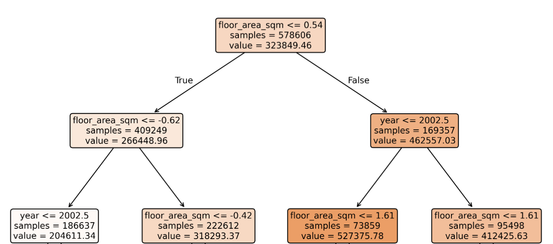
Decision Tree Reveals: Floor Area Drives Price Segmentation
Notes:
Decision trees helps to capture non‑linear thresholds (e.g. floor area).

Slide 11

Further exploration
Data: Include crucial predictors of resale prices (e.g. distance to the MRT stations, markets and schools).
Models: Upgrade to Random Forests (from decision trees)
Builds on decision trees by creating hundreds of trees, then averages their predictions for more reliable results.
Intuition: Each tree spots patterns slightly differently (using random samples), so averaging them cancels out errors - like asking many experts for their opinion, then taking the consensus.

