Slide 1
MIDTERM CAPSTONE PROJECT
1.4M
Healthcare Insurance
Source Rows
Claims Data Warehouse
9
& Analytics Platform
DW Tables
8
SQL | Python | ETL Pipeline | Star Schema | Data Masking | Visualization
Charts
Group 5 | Batch 2024-25
Midterm Capstone

Slide 2
Project Overview
End-to-end healthcare insurance claims data warehouse solution
Business Scenario
A national health insurer needs a centralized Data Warehouse to analyze claims costs, utilisation, provider performance and fraud indicators â€” while fully protecting patient privacy (PII/PHI). Source data arrives as 7 CSV files with ~1.4 million rows containing intentional quality issues including missing values, orphan foreign keys, and type mismatches.
1
Star Schema
Design
2
ETL Pipeline
3
Data Masking
4
Analytics
& Charts
Model a DW with
dims + facts
Full + Incremental
load with audit logs
Protect PII/PHI
preserve join keys
SQL + Python +
8 Matplotlib charts
Technologies:
Python 3.10+
Pandas
SQLite / SQL
Matplotlib
Jupyter Notebook
Dataset: 7 CSV files | ~1.4 Million rows | 1.2M clean + 0.2M intentionally imperfect

Slide 3
Source Data â€“ 7 CSV Files
OLTP-style extracts from the insurance system
CSV File
Description
Rows
Primary Key
Key Columns
members_merged.csv
Patient/member master
2,60,000
member_id
name, DOB, email, phone, city, state
providers_merged.csv
Doctors and hospitals
40,000
provider_id
specialty, city, state, tax_id, license_no
claims_merged.csv
Insurance claim headers
2,40,000
claim_number
member_id, provider_id, admit_date, paid_amount
claim_lines_merged.csv
Services inside each claim
7,60,000
line_id
claim_number, procedure_code, units, rate
payments_merged.csv
Payments on claims
1,00,000
payment_id
claim_number, payment_date, paid_amount
diagnoses_merged.csv
ICD diagnosis codes per claim
60,000
diag_id
claim_number, diagnosis_code, icd_version
procedures_merged.csv
CPT codes per claim line
40,000
proc_id
line_id, procedure_code
TOTAL
7 source entities
~14,00,000
â€”
1.2M clean + 0.2M imperfect
Missing Values: blank/NULL fields
Orphan FKs: __ORPHAN__ marker
Negative Amounts: invalid numbers
Future Dates: impossible timestamps
Duplicate Keys: repeated IDs
Type Mismatches: text in numbers

Slide 4
Entity Relationship Diagram
Source system table structures and foreign key relationships
LEGEND
MEMBERS
CLAIMS
PAYMENTS
PK
PK - Primary Key
PK
PK
member_id
claim_number
payment_id
VARCHAR
VARCHAR
VARCHAR
FK - Foreign Key
FK
FK
first_name
VARCHAR
member_id
claim_number
VARCHAR
VARCHAR
Line - Relationship
FK
email
VARCHAR
provider_id
payment_date
VARCHAR
DATE
phone
VARCHAR
admit_date
DATE
payment_method
VARCHAR
dob
DATE
discharge_date
DATE
paid_amount
NUMERIC
city / state
VARCHAR
paid_amount
NUMERIC
adjustment_code
VARCHAR
is_active
BOOLEAN
denial_code
VARCHAR
length_of_stay
INT
PROVIDERS
CLAIM_LINES
DIAGNOSES
PROCEDURES
PK
provider_id
PK
line_id
PK
diag_id
PK
proc_id
VARCHAR
VARCHAR
VARCHAR
VARCHAR
provider_name
VARCHAR
FK
claim_number
FK
claim_number
FK
line_id
VARCHAR
VARCHAR
VARCHAR
specialty
VARCHAR
service_date
DATE
diag_code
VARCHAR
procedure_code
VARCHAR
city / state
VARCHAR
procedure_code
VARCHAR
icd_version
VARCHAR
tax_id
VARCHAR
units
INT
license_no
VARCHAR
rate
NUMERIC
line_amount
NUMERIC

Slide 5
Star Schema - Data Warehouse Design
Fact tables (measures) connected to dimension tables (descriptors)
DIM
dim_member
DIM
dim_date
DIM
dim_provider
member_id (PK) masked
date_key (PK)
provider_id (PK) masked
gender
year, quarter, month
specialty
city, state
month_name, week
city, state
birth_year
day_name, is_weekend
tax_id masked
is_active
license_no masked
FACT
fact_claim_line
FACT
fact_claim
FACT
fact_payment
line_id (PK)
claim_number (PK)
payment_id (PK)
claim_number (FK)
member_id (FK)
claim_number (FK)
service_date_key (FK)
provider_id (FK)
payment_date_key (FK)
procedure_code (FK)
admit_date_key (FK)
payment_method
units, rate, line_amount
length_of_stay
paid_amount
allowed_amount, paid_amount
denial_code, is_denied
DIM
dim_diagnosis
DIM
dim_location
DIM
dim_procedure
diagnosis_code (PK)
location_key (PK)
procedure_code (PK)
icd_version
city, state
FACT - stores measurable data (amounts, counts)
DIM - stores descriptive data (who, what, when)
Line - relationship between tables

Slide 6
ETL Pipeline Architecture
Extract -> Profile -> Clean -> Mask -> Load -> Analyse
01
02
03
04
05
06
Source
CSVs
Profile
Clean &
Validate
Mask
PII / PHI
Full ETL
Load
Incremental
Load
>
>
>
>
>
7 files
1.4M rows
Detect all
quality issues
Remove bad rows
Save rejects
Hash sensitive
fields
Build schema
Load all data
New rows only
watermark-based
step1_profile.py
step2_clean.py
step3_mask.py
step4_load_full.py
step5_incremental.py
FULL LOAD
INCREMENTAL LOAD
-> Drop all existing warehouse data
-> Run DDL to recreate all tables
-> Clean + mask + load all 1.4M rows
-> Use when: first run or full refresh needed
-> Read last_load_dt from etl_watermark table
-> Filter CSV: rows where date > last_load_dt
-> Process and load ONLY those new rows
-> Use when: daily/regular refresh needed
Outputs: warehouse.db | rejected_rows/*.csv | logs/profiling_summary.json | logs/masking_audit.json

Slide 7
Data Quality Challenges
Issues identified during data profiling phase â€” 6 categories of bad data found in the source CSVs
Missing Values
Orphan Foreign Keys
Negative Amounts
Blank or NULL in required fields
__ORPHAN__ marker where parent record is missing
Invalid negative values in financial columns
Columns affected:
Columns affected:
Columns affected:
first_name, email, city, diagnosis_code, specialty
member_id in claims, claim_number in payments/diagnoses
allowed_amount, paid_amount, units, line_amount
27,793 member rows | 1,576 provider rows | 3 diagnosis rows
30,000 orphan member_id | 40,000 orphan claim_number in payments
30,000 negative allowed_amount | 110,000 negative units
Future Dates
Duplicate Primary Keys
Type Mismatches
Timestamps set in the future (impossible for past events)
Same primary key value appearing more than once
Text values found where numeric data is required
Columns affected:
Columns affected:
Columns affected:
admit_date, service_date, dob, payment_date
claim_number, member_id, provider_id, line_id
paid_amount, rate, length_of_stay (LOS)
22,880 future DOB | 75 future admit_date | 329 future service_date
7,500 duplicate claim_number | 6,000 duplicate member_id
paid_amount = 'ERR' | rate = 'MISSING' | 40,000+ rows affected

Slide 8
Data Cleaning Results
Validation applied entity-by-entity in dependency order
Entity
Total In
Valid (Kept)
Rejected
Rate
Main Rejection Reasons
members
2,60,000
2,32,207
27,793
10.7%
Missing name, future DOB, duplicate ID
providers
40,000
38,424
1,576
3.9%
Missing specialty, duplicate ID
claims
2,40,000
2,08,640
31,360
13.1%
Orphan member_id, negative amount, future date
claim_lines
7,60,000
6,45,733
1,14,267
15.0%
Orphan claim_number, negative units, bad rate
payments
1,00,000
59,615
40,385
40.4%
Orphan claim_number, non-numeric amount
diagnoses
60,000
39,741
20,259
33.8%
Orphan claim_number, invalid ICD version
procedures
40,000
24,844
15,156
37.9%
Orphan line_id, missing procedure code
TOTAL
14,00,000
12,49,204
2,50,796
17.9%
All quality issues combined
12,49,204
2,50,796
17.9%
7 files
Valid Rows Loaded
Rows Rejected
Overall Reject Rate
Audit CSVs Saved

Slide 9
Data Masking â€“ PII / PHI Protection
Deterministic HMAC-SHA256 tokenisation applied before warehouse loading
Why Masking?
How It Works â€” HMAC-SHA256
Analysts querying the warehouse must never see real patient names, emails, phone numbers or exact dates of birth. Masking protects privacy while keeping all analytical relationships intact.
DETERMINISTIC: same input always produces the same token (JOINs work)
IRREVERSIBLE: cannot be decoded back to the original value
SALT: a secret key makes tokens unique to this project only
Field
Entity
Technique
Before (Raw)
After (Masked)
member_id
members
Deterministic token
M0000001
MBR3F9A2C1D4E
first_name
members
Deterministic token
Alice
FN8B2C3D4E5F6A
email
members
Deterministic token
alice@gmail.com
EMAIF29A3B1C2D
phone
members
Deterministic token
9876543210
PH8A2B3C4D5E
dob
members
Year only (generalise)
1985-03-10
1985
tax_id
providers
Deterministic token
908430420
TAX2B3C4D5E6F
claim_number
claims
Deterministic token
CL00155929
CLM4E5F6A7B8C
city / state
members
Kept as-is
Mumbai, Maharashtra
Mumbai, Maharashtra
Fields kept clear: city, state, gender, specialty, procedure_code, diagnosis_code, amounts, payment_method, dates (non-DOB)

Slide 10
Analytical SQL Queries
10 business questions answered from the warehouse
Q1
Total Claims Summary
Q2
Monthly Paid Trend
COUNT, SUM, AVG on fact_claim
JOIN fact_claim + dim_date, GROUP BY year/month
Q3
Top 10 Procedures
Q4
Provider Scorecard
GROUP BY procedure_code ORDER BY COUNT(*)
JOIN dim_provider, AVG paid, denial_rate %
Q5
Denial Rate Breakdown
Q6
Length of Stay Dist.
CASE WHEN denial_code, GROUP BY denial_reason
GROUP BY length_of_stay, AVG paid_amount
Q7
Member Utilisation
Q8
Geographic Analysis
JOIN dim_member, SUM paid, ORDER BY spend
JOIN dim_member on city/state, SUM by state
Q9
Payment Method Split
Q10
Diagnosis Cost Analysis
GROUP BY payment_method, SUM paid_amount
Link diagnoses to claims, cost by ICD code
All queries run against the live SQLite warehouse via Python / Jupyter Notebook

Slide 11
Key Business Metrics
Live results from the warehouse after full ETL load
Total Claims
Total Allowed
Total Paid
Avg per Claim
2,08,640
Rs 20.9B
Rs 15.68B
Rs 75,156
billed
paid out
average
Denial Rate
Top State
Top Procedure
Payment Methods
49.92%
Punjab
CPT35289
4 types
claims denied
highest spend
417 uses
equal split
Source: warehouse.db | 208,640 valid claims | ~12.5 million total rows across all tables

Slide 12
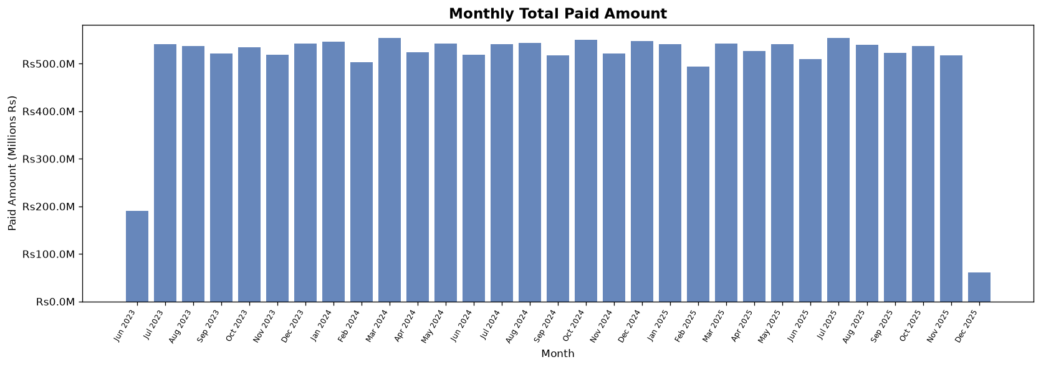
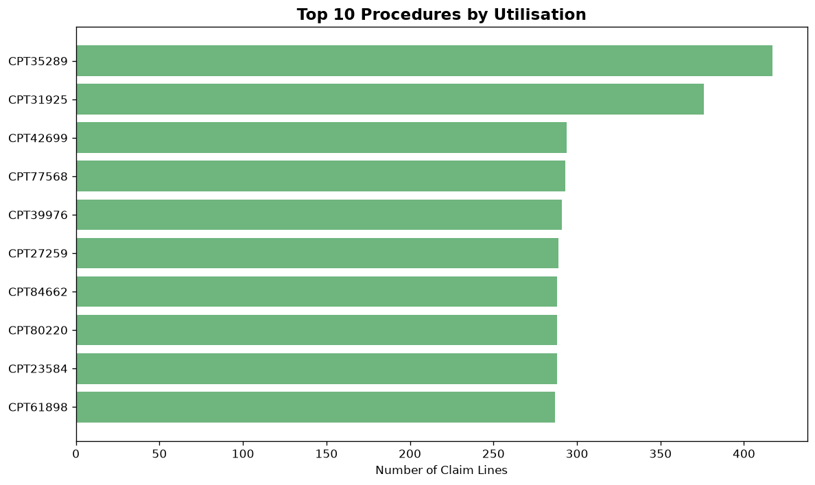
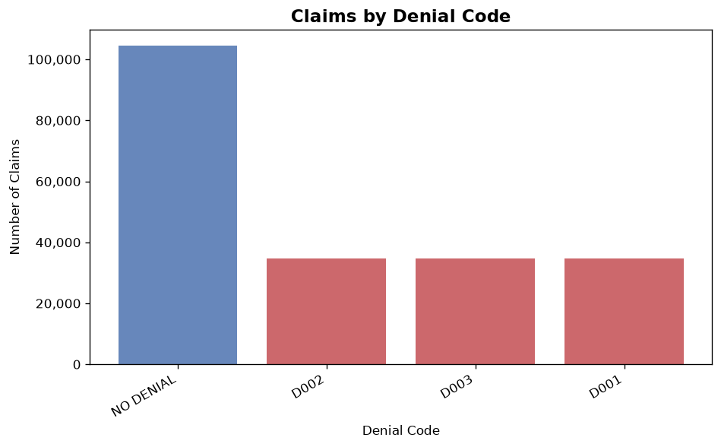
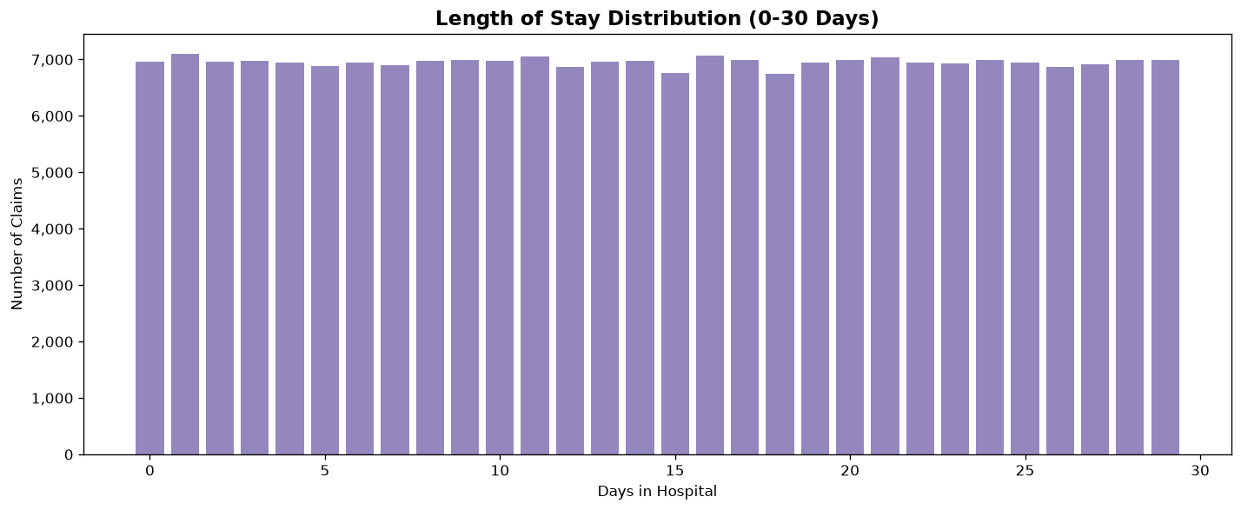
Analytics Visualizations â€“ Part 1 of 2
Monthly trend | Top procedures | Denial rate | Length of stay
Monthly Paid Amount
Top 10 Procedures
Consistent ~Rs 540M/month
CPT35289 highest at 417 uses
Denial Rate by Code
Length of Stay (0-30 days)
49.9% denied â€” D001/D002/D003
Flat distribution across LOS

Slide 13
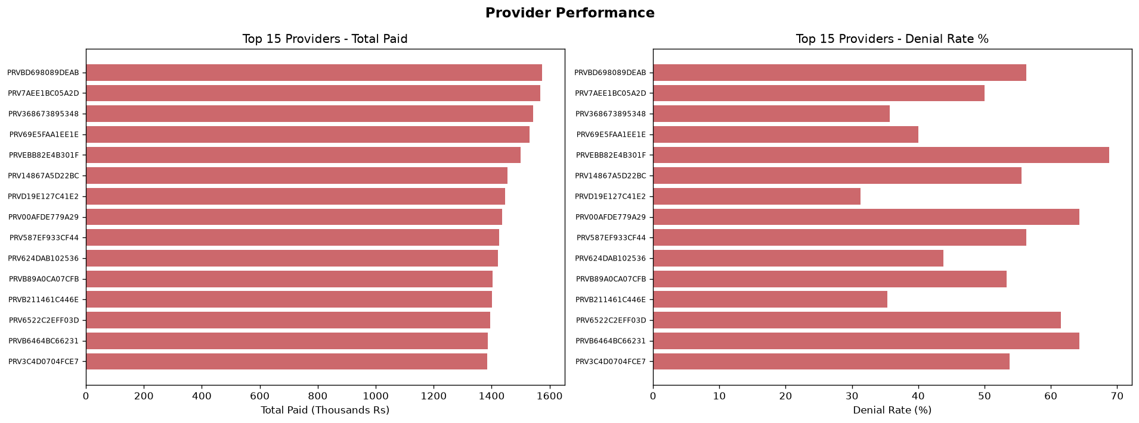
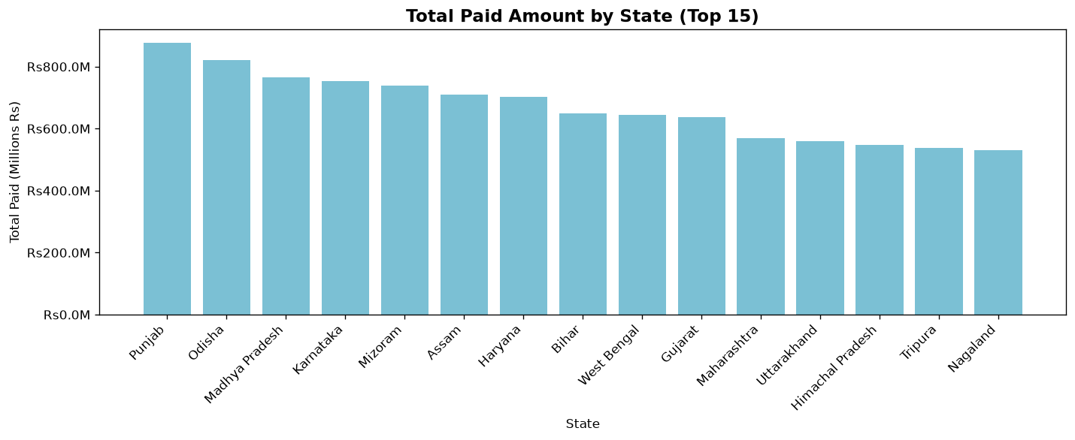
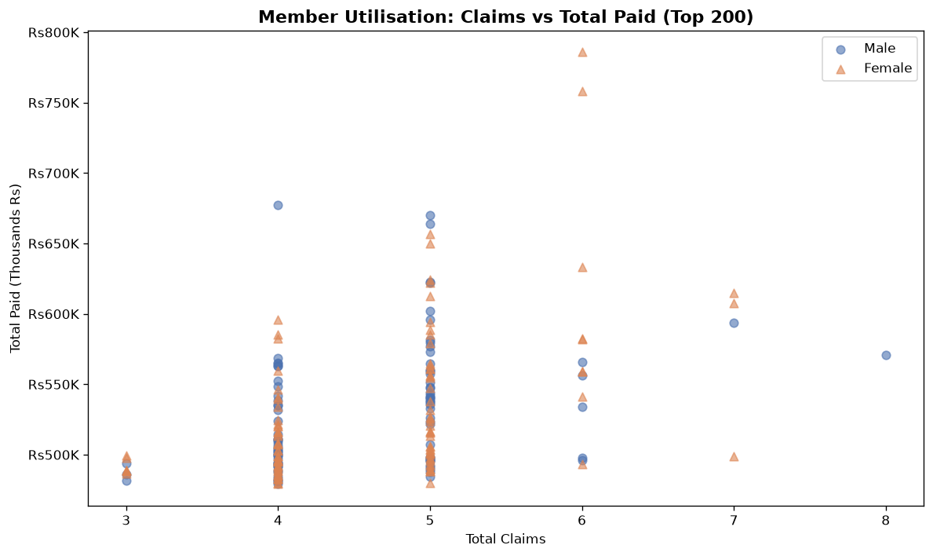
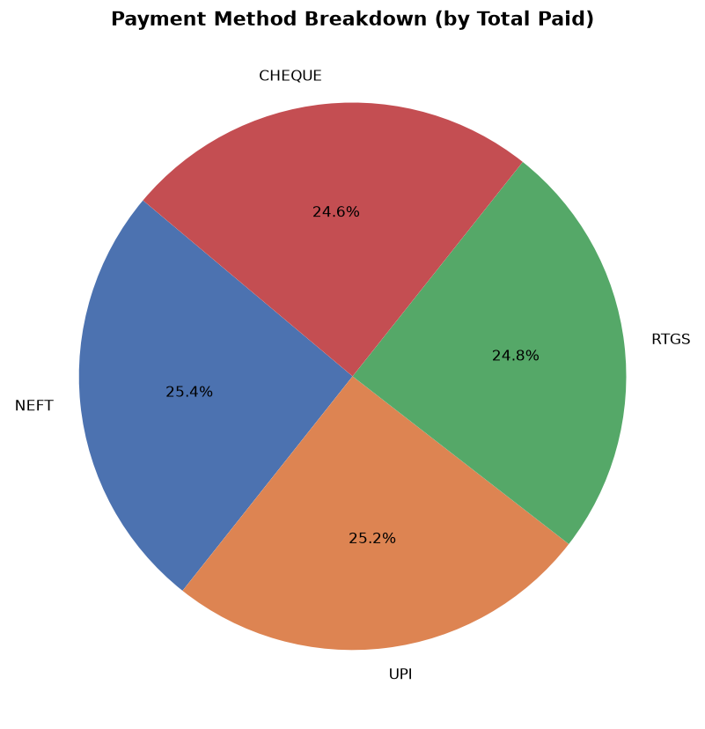
Analytics Visualizations â€“ Part 2 of 2
Provider performance | Geographic | Member utilisation | Payment methods
Provider Performance
Paid by State
Some providers >60% denial rate
Punjab & Odisha lead
Member Utilisation
Payment Methods
High-spend members by gender
NEFT/UPI/RTGS/Cheque equal split

Slide 14
Optimisation
Database indexes + vectorised Pandas + masking impact
Database Indexes (in DDL)
Vectorised Pandas Operations
Index
Table
Column
pd.to_numeric(col, errors='coerce')
idx_fc_member
fact_claim
member_id
Converts entire column at once â€” no row loops
idx_fc_provider
fact_claim
provider_id
pd.to_datetime(col, errors='coerce')
Parses all dates in single operation
idx_fc_admit
fact_claim
admit_date_key
df[boolean_mask]
idx_fc_denied
fact_claim
is_denied
Filters millions of rows instantly
idx_fcl_claim
fact_claim_line
claim_number
Series.map(dictionary)
idx_fp_claim
fact_payment
claim_number
Remaps FK columns â€” 100x faster than apply
idx_dp_specialty
dim_provider
specialty
pd.concat + drop_duplicates
Deduplication across full entity datasets
Masking Impact on Analytics
Deterministic masking means member_id 'M0000001' ALWAYS becomes 'MBR3F9A2C1D4E' -> JOINs between fact_claim, dim_member and dim_provider work correctly.
City/state kept clear -> geographic analysis fully functional. DOB -> birth_year -> age band analysis still possible.
Full ETL run: ~3-5 min on laptop | Incremental: seconds | Warehouse: 9 tables, ~12.5M rows

Slide 15
Project Deliverables
All required outputs per the capstone document
OK
Star Schema Design
OK
ER Diagram
01_star_schema_ddl.sql â€” 9 tables with FK indexes
Entity relationships across all 7 source tables
OK
Analytical SQL Queries
OK
Data Profiling Report
02_analytical_queries.sql â€” 10 business queries
logs/profiling_summary.json â€” quality findings
OK
ETL Full Load Script
OK
ETL Incremental Load
step4_load_full.py â€” drops + reloads everything
step5_load_incremental.py â€” watermark-based new rows
OK
Data Masking Logic
OK
Masking Audit Log
step3_mask.py â€” HMAC-SHA256 deterministic hashing
logs/masking_audit.json â€” fields masked + counts
OK
Error / Rejection Logs
OK
Python Analytics
output/rejected_rows/*.csv â€” 7 audit files
analytics.py â€” 9 queries + CSV results
OK
8 Matplotlib Charts
OK
Jupyter Notebook
output/charts/*.png â€” all visualisations saved
analytics_notebook.ipynb â€” interactive analysis
OK
Optimisation Summary
OK
GitHub Repository
Indexes + vectorised Pandas + masking impact
https://github.com/mhgowda/healthcare-insurance-dw-capstone
GitHub: https://github.com/mhgowda/healthcare-insurance-dw-capstone

Slide 16
Thank You
Questions & Discussion
GitHub Repository
https://github.com/mhgowda/healthcare-insurance-dw-capstone
1.4M
9
17.9%
49.9%
8
Source Rows
DW Tables
Rejected
Denial Rate
Charts
Midterm Capstone | Group 5 | Batch 2024-25

