Slide 1
DNS (Domain Name Server)
Unıversıty of Çukurova
Computer engıneerıng departmant
Internet Architecture and Protocols
Student :Mehmet Harun Gülen
Instructor:Prof.Dr.Fatih Akay

Slide 2
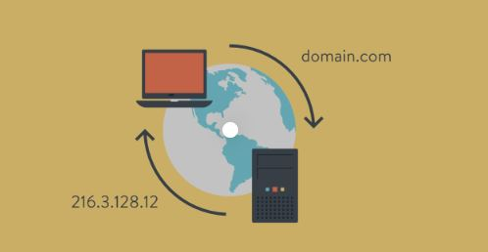
WHAT IS DNS?
The Domain Name System (DNS) is the hierarchical and distributed naming system used to identify computers reachable through the Internet or other Internet Protocol (IP) networks.
Domain Name System (DNS) in Application Layer
DNS is the phone book of the internet.
DNS system to a giant phone book where
If the DNS system had not been established,
we would have to keep in mind the IP address of each website.
d

Slide 3
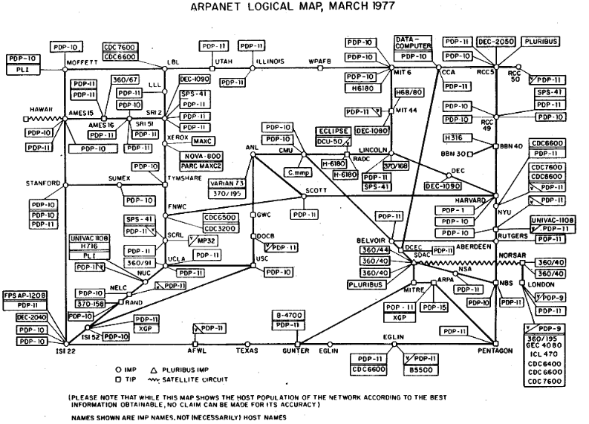
First Usage (ARPANET)
A text file named HOSTS.TXT that mapped host names to the numerical addresses of computers on the ARPANET
DNS Server

Slide 4
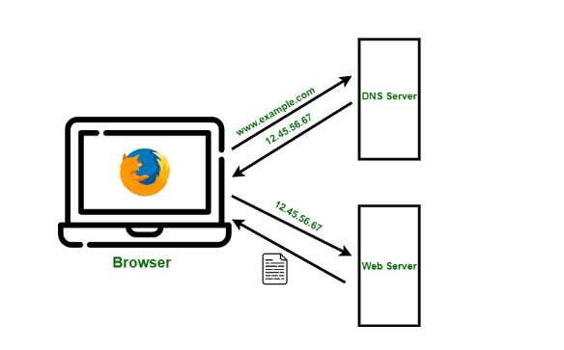
What is DNS Server?
Special servers working for Domain Name System are called DNS Servers.
DNS resolves names to numbers, to be more specific it resolves domain names to IP addresses.
Each unit on the Internet is defined by its IP addresses.
So if you type in a web address in your web browser,
2. DNS will resolve the name to a number
3. Computers know are numbers and can go host

Slide 5
DNS Server TYPE
DNS Resolver (Internet Service Provider)
Root Server
TLD Name Server (Top Level Domain Server)
Authorized Name Server
Step 1: (Internet Service Provider)
An IP address query is made to the Internet Service Provider.
The DNS resolver goes to the Root Server
Step 2:(Root Server)
Root Server directs you to the TLD Server of the extension
Step 3:(Name Server)
TLD Server finds the Name Server where the domain name is hosted according to its extension
Directs you to the authorized Name Server.
Step 4:
Finally, the authorized Name Server (Name Server) gives the IP address information of the domain name it contains,

Slide 6
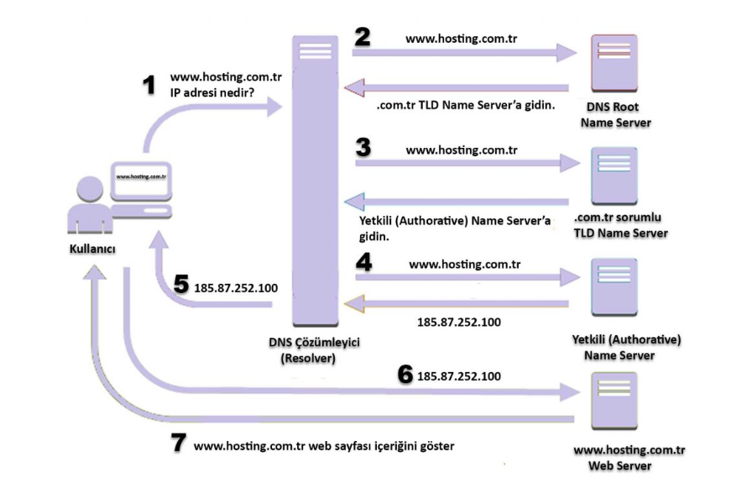

Slide 7
What are DNS Record Types?
A (Address)
CNAME (Canonical Name)
NS (Name Server )
MX (Mail Exchange)
PTR (Pointer)
TXT (Text )

Slide 8
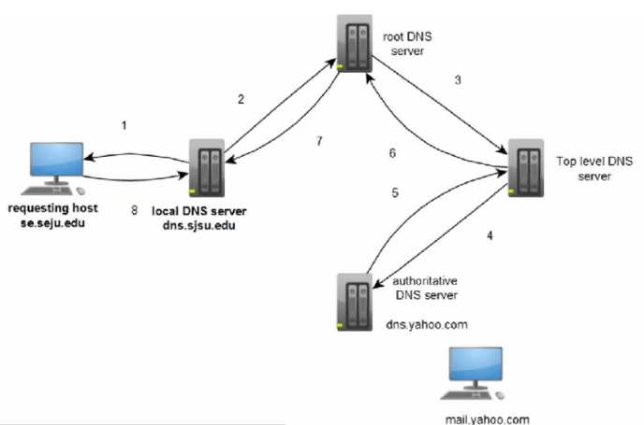
DNS Recursion
DNS Recursion is the process of querying the next level of the server,
which cannot find the DNS resolution information within itself..

Slide 9
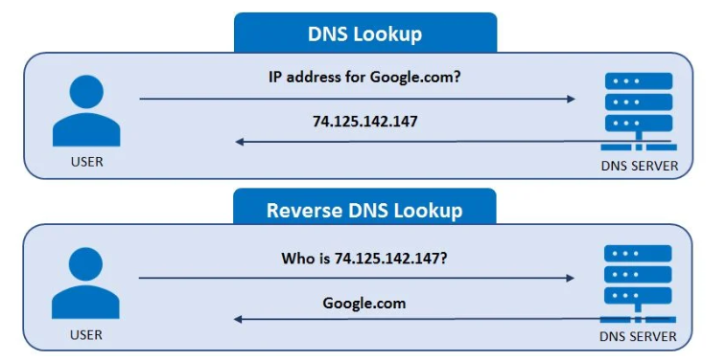
What is Reverse DNS?
Basically, a reverse DNS lookup returns the hostname of an IP address

Slide 10
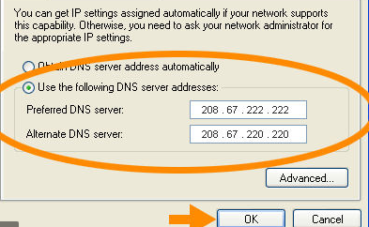
What is Open DNS?
Open DNS gives you the addresses of its own DNS servers, allowing you to open to the internet through those servers.
Open DNS is an open and free DNS service.

Slide 11
DNS Caching
DNS resolution operations is kept in the cache, eliminating the need for a new query each time.
TTL (Time To Live)
DNS Query Types
Recursive Query
İterative Query

Slide 12
Transport Layer (TCP or UDP)
UDP is primary protocol because it is faster.
There is no cost of connection setup and tear down.
But UDP has limited length of packet. Maximal length of DNS response in an UDP packet was defined to be 512 bytes because this is most likely to be delivered. This size is not enough for modern DNS services like Domain Name System Security Extensions - Wikipedia so DNS was updated to use TCP connection too.
TCP does not have request and reply size limit.

Slide 13
Teşekkürler

