Slide 1
File Transfer Protocol
Internet Architecture and Protocols
Department of Computer Engineering
Student :Mehmet Harun Gülen
Instructor:Prof.Dr.Fatih Akay

Slide 2
What is FTP
FTP is a standard internet protocol provided by TCP/IP used for transmitting the files from one host to another.
FTP is built on a client–server model
FTP is often secured with SSL/TLS (FTPS) or SSH File Transfer Protocol (SFTP).
The first FTP client applications were command-line programs
Still shipped with most Windows, Unix, and Linux operating systems
Integrated in web browsers ftp://
Why FTP
Although transferring files from one system to another is very simple and straightforward, but sometimes it can cause problems.
Two systems may have different file conventions.
Two systems may have different ways to represent text and data.
Two systems may have different directory structures.

Slide 3
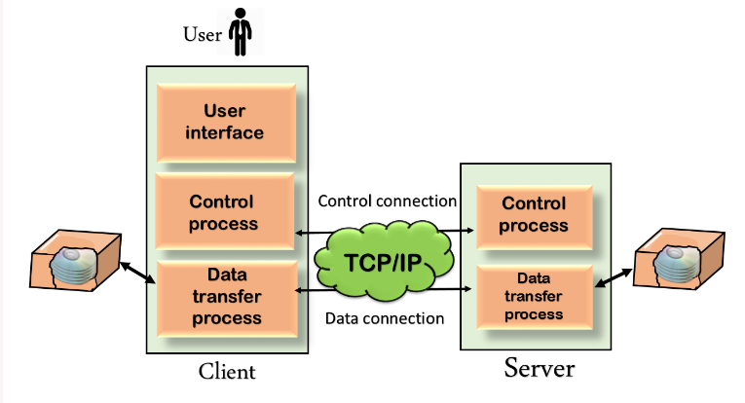
Mechanism of FTP
FTP protocol overcomes these problems by establishing two connections between hosts. One connection is used for data transfer, and another connection is used for the control connection.
The above figure shows the basic model of the FTP.
The FTP client has three components: the user interface, control process, and data transfer process.
The server has two components: the server control process and the server data transfer process.

Slide 4
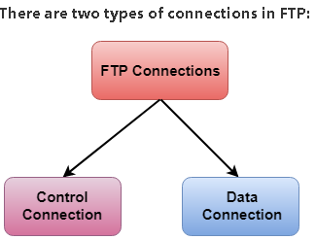
Control Connection: The control connection uses very simple rules for communication.
Transfer a line of command or line of response at a time.
Between the control processes.
Remains connected during the entire interactive FTP session.
Data Connection: The Data Connection uses very complex rules as data types may vary.
Between data transfer processes.
The data connection opens when a command comes for transferring the files and closes when the file is transferred.

Slide 5
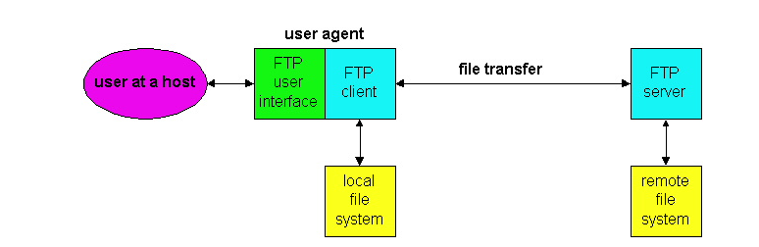
Ftp Session
In a typical FTP session, the user is sitting in front of one host (the local host) and wants to transfer files to or from a remote host
Provides the hostname of the remote host (ftp://dosyalar.kurum.com.tr/sunumlar
Access the remote account
Provide a user identification and a password
Authorization process
Transfer files from the local file system to the remote file system and vice versa

Slide 6
HTTP and FTP
Both file transfer protocols and have many common characteristics
Run on top of TCP the Internet's connection-oriented, transport-layer, reliable data transfer protocol
However, the two application-layer protocols have some important differences.
The most striking difference is that FTP uses two parallel TCP connections to transfer a file,
a control connection and a data connection.

Slide 7
FTP TCP Control Connection
The control connection is used for sending control information
identification,
password,
commands to change remote directory,
and commands to "put" and "get" files.
The data connection is used to actually send a file
FTP is said to send its control information out-of-band

Slide 8
FTP TCP Control Connection
RTSP protocol like FTP also out of band
SMTP protocol like HTTP also in-band
HTTP is in-band
HTTP, sends request and response header lines into the same TCP connection that carries the transferred file itself. For this reason, HTTP is said to send its control information in-band. In the next section we shall see that SMTP, the main protocol for electronic mail, also sends control information in-band. The

Slide 9
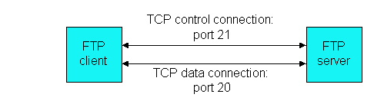
FTP TCP Port Usage
User starts an FTP session with a remote host,
FTP first sets up a control TCP connection on server port number 21. The client side of FTP sends the user identification and password over this control connection.
Client side of FTP also sends, over the control connection, commands to change the remote directory
User requests a file transfer (either to, or from, the remote host), FTP opens a TCP data connection on server port number 20
Close Data Connection
Close Control Connection
FTP sends exactly one file over the data connection and then closes the data connection
For another file, FTP opens another data TCP connection.
The control connection remains open throughout the duration of the user session,

Slide 10
FTP Server
Maintain state about the user
Server must keep track of the user's current directory as the user wanders about the remote directory tree
HTTP, on the other hand, is stateless -- it does not have to keep track of any user state.

Slide 11
FTP COMMAND
Sent across the control TCP connection in 7-bit ASCII format
FTP commands are readable by people like HTTP
Each command consists of four(4) uppercase ASCII characters
Some of the more common commands are given below
USER username : Used to send the user identification to server.
PASS password : Used to send the user password to the server.
LIST : Used to ask the server to send back a list of all the files in the current remote directory. The list of files is sent over a (new and non-persistent) data TCP connection and not over the control TCP connection.
RETR filename : Used to retrieve (i.e., get) a file from the current directory of the remote host.
STOR filename : Used to store (i.e., put) a file into the current directory of the remote host.

Slide 12
TYPE Data types
While transferring data over the network, four data types are defined
(TYPE) ASCII , Image, EBCDIC, Unicode
STRU File structures
File organization is specified using the STRU command.
F or FILE structure (stream-oriented). Files are viewed as an arbitrary sequence of bytes, characters or words.
R or RECORD structure (record-oriented). Files are viewed as divided into records
P or PAGE structure (page-oriented). Files are divided into pages
MODE Data transfer modes
Stream mode, Block mode , Compressed mode

Slide 13
REPLY CODE
Each command is followed by a reply, sent from server to client
The replies are three-digit numbers
Optional message following the number
Similar to the status line of the HTTP response message
Some typical replies, along with their possible messages
331 Username OK, password required
125 Data connection already open; transfer starting
425 Can't open data connection
452 Error writing file

Slide 14
Advantages of FTP
Speed: One of the biggest advantages of FTP is speed. The FTP is one of the fastest way to transfer the files from one computer to another computer.
Efficient: It is more efficient to get the entire file.
Security: To access the FTP server, we need to login with the username and password. Therefore, we can say that FTP is more secure. Brute-force,FTP bounce,Spoofing,DoS or DDoS attack, Packet capture
Derivatives
FTPS use of a SSL or TLS connection. It was specified to use different ports than plain FTP.
SSH File Transfer Protocol
uses the Secure Shell protocol (SSH) to transfer files
Back & forth movement: FTP allows us to transfer the files back and forth. Suppose you are a manager of the company, you send some information to all the employees, and they all send information back on the same server.

Slide 15
Disadvantages of FTP
Encryption ,not all the FTP providers are equal and not all the providers offer encryption. So, we will have to look out for the FTP providers that provides encryption.
File Size Limit and Lack of Simultaneous. However, the size limit of the file is 2GB that can be sent. It also doesn't allow you to run simultaneous transfers to multiple receivers.
Passwords and file contents are sent in clear text that allows unwanted eavesdropping. So, it is quite possible that attackers can carry out the brute force attack by trying to guess the FTP password.
It is not compatible with every system.

Slide 16
Thanks to listening

