Slide 1
Version Control Protocols: GIT
University of Çukurova
Computer engineering departmant
Internet Architecture and Protocols
Student :Mehmet Harun Gülen
Instructor:Prof.Dr.Fatih Akay

Slide 2
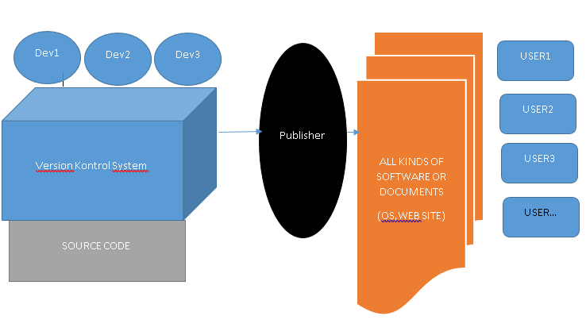
Version Control Protocols
What Is Version Control and Why Is it Important? Version control is important to keep track of changes — and keep every team member working on the right version.

Slide 3
Definitions
Repository, a data structure which stores metadata for a set of files or directory structure
Software repository, a storage location for software packages
Contrubutor
Get,Clone,Pull
Checkout,Undo Checkout
Commit,Stage, Push

Slide 4
Version Control Protocols
In software engineering, version control
also known as
revision control
source control
source code management
computer programs,
documents,
large web sites,
or other collections of information
Version control is a component of software configuration management.
SCM can determine the "what, when, why and who" of the change

Slide 5
Version Control
In computer software engineering,
practice that tracks and provides control over changes to source code, document, configuretion files…
Contrubutor designer, developer,tester and deployer software
Multiple copies of the different versions of the program,

Slide 6
Version Control Software Model
Distributed model
In the distributed approach, each developer works directly with their own local repository,
BitKeeper – was used in Linux kernel development (2002 – April 2005)
Git –, designed by Linus Torvalds based on the needs of the Linux kernel project; decentralized,
aims to be
fast,
flexible
robust

Slide 7
What is Distributed?
In software development,
Distributed version control (also known as distributed revision control)
Compared to centralized version control, this enables
Its full history, is mirrored on every developer's computer.
Automatic management branching and merging, speeds up most operations
Ability to work offline, and does not rely on a single location for backups.
Allows private work
Avoids relying on one physical machine as a single point of failure

Slide 8
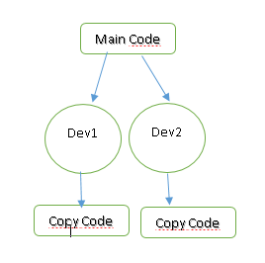
Distributed (git) vs. centralized(svn)
DisAdvantages of DVCS
Initial checkout of a repository is slower as compared to checkout in a centralized version control system, because all branches and revision history are copied to the local machine by default.
Additional storage required for every user to have a complete copy of the complete codebase history.

Slide 9
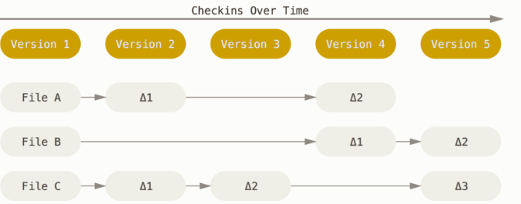
VCS use delta-based?

Slide 10
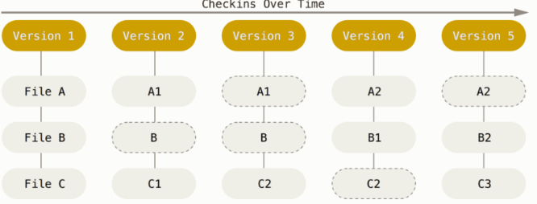
Git thinks about its data more like a stream of snapshots.
This makes Git more like a mini filesystem with some incredibly powerful tools built on top of it, rather than simply a VCS.

Slide 11
Features
Nearly Every Operation Is Local
For example, to browse the history of the project, Git doesn’t need to go out to the server to get the history and display it for you
Git Has Integrity (SHA-1 hash)
Everything in Git is checksummed before it is stored and is then referred to by that checksum. This means it’s impossible to change the contents of any file or directory without Git knowing about it.
Git Generally Only Adds Data
You can lose or mess up changes you haven’t committed yet, but after you commit a snapshot into Git, it is very difficult to lose, especially if you regularly push your database to another repository.

Slide 12
Operations of Contrubutor
Distributed (Git)
FORK, CLONE OR COPY
PULL
MERGE
STAGE-COMMIT-PUSH
PULL REQUEST –MERGE REQUEST (FORK)

Slide 13
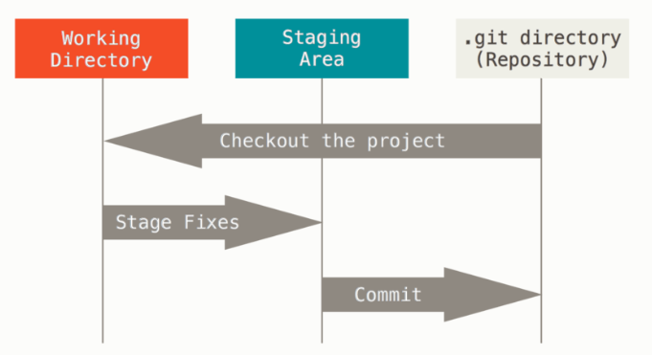
Git -The Three States
modified, staged, and committed:
Modified means that you have changed the file but have not committed it to your database yet.
Staged means that you have marked a modified file in its current version to go into your next commit snapshot.
Committed means that the data is safely stored in your local database.

Slide 14
Git Protocols to transfer data
Git uses Local, HTTP, Secure Shell (SSH) and Git
LOCAL→remote repository is in another directory on the same host
File-based repositories are that they’re simple and they use existing file permissions and network access. If you already have a shared filesystem to which your whole team has access, setting up a repository is very easy.

Slide 15
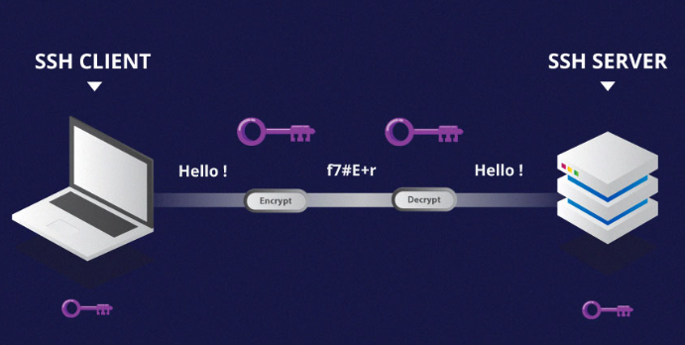
Git Protocols to transfer data
HTTP→ Dumb HTTP Smart HTTP ,
1.Dumb HTTP
The Dumb protocol expects the bare Git repository to be served like normal files from the web server
2.Smart HTTP
Use standard HTTPS ports and can use various HTTP authentication mechanisms
SSH
A common transport protocol for
Git when self-hosting is over SSH.
$ git clone ssh://[user@]server/project.git

Slide 16
Git Protocols to transfer data
-Finally, we have the Git protocol it listens on a dedicated port (9418) service similar to the SSH protocol, but with absolutely no authentication.
-The Git protocol is
fastest network transfer protocol available.
same data-transfer mechanism as the SSH protocol but without the encryption and authentication overhead.
-The downside of the Git
protocol is the lack of authentication
difficult protocol to set up. It also requires firewall access to port 9418,

Slide 17
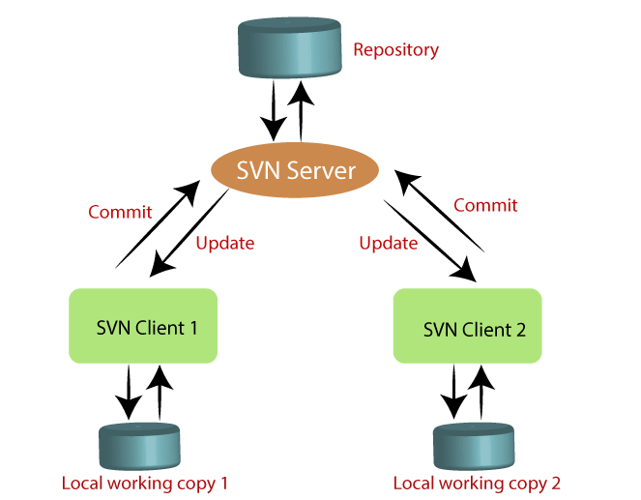
SVN
The features of SVN are as follows:
It supports atomic commits
Less storage area
It keeps a full revision history on server.
It provides file locking for the files that cannot be merged.

Slide 18
Teşekkürler

