Slide 1
HTTP: The Hypertext Transfer Protocol
Student :Mehmet Harun Gülen
Instructor:Prof.Dr.Fatih Akay
Internet Architecture and Protocols

Slide 2
HTTP
HTTP is a protocol, or a definite set of rules, for accessing resources on the web. Resources could mean anything from HTML files to data from a database, photos, text, and so on.
These resources are made available to us via an API and we make requests to these APIs via the HTTP protocol. API stands for application programming interface. It is the mechanism that allows developers to request resources.

Slide 3
General Properties
HTTP is based on the TCP protocol.
The web server uses the TCP port 80 by default.
HTTP is a stateless request / response protocol.
HTTP is text oriented
Method (Get, Post,Head)
Design goals of HTTP are:
Simplicity
Performance

Slide 4
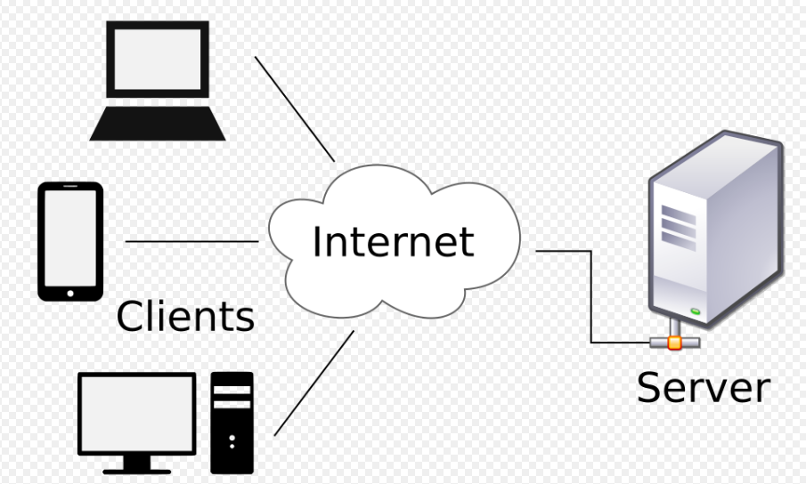
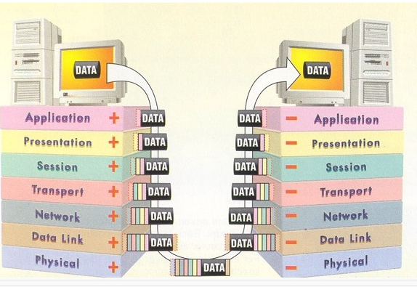
HTTP is an application layer protocol
The Web client and the Web server are application programs
The client and server send messages and data without knowing about the communication network
Application layer programs do useful work like retrieving Web pages, sending and receiving email or transferring files

Slide 5
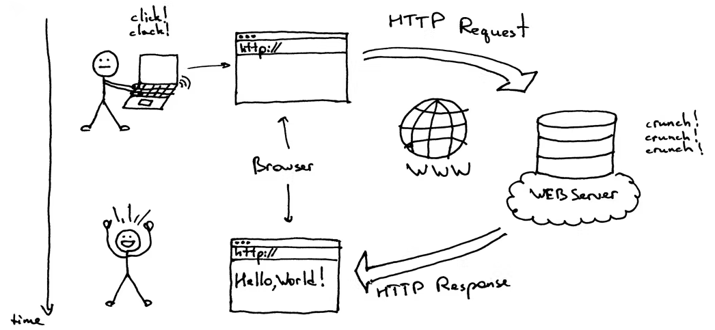
HTTP is the set of rules governing the format and content of the conversation between a Web client and server.

Slide 6
Communication Models for HTTP
The “classic” approach: HTTP/1.0
HTTP over multiple, concurrent TCP connections
Persistent-HTTP: HTTP/1.1
HTTP Pipelining
Transaction-TCP (T/TCP)
HTTP over UDP-based protocols

Slide 7
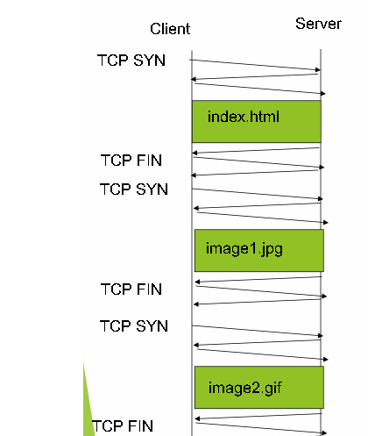
http 1.0, concurrent TCP connections
The “classic” approach
in HTTP/1.0 is to use one
HTTP request per TCP
connection, serially

Slide 8
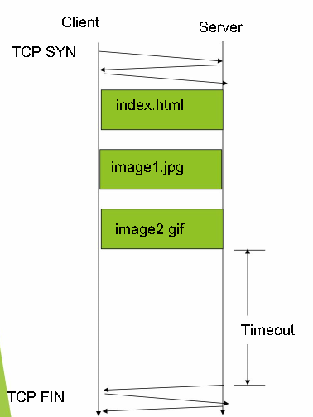
persistent HTTP
The “persistent HTTP”
approach can re-use the
same TCP connection for
Multiple HTTP transfers,
one after another, serially.
Amortizes TCP overhead,
but maintains TCP state
longer at server.

Slide 9
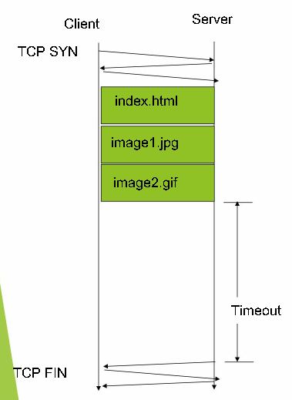
pipelining
The “pipelining” feature in HTTP/1.1 allows
requests to be issued asynchronously on a
persistent connection.Requests must be processed in proper order. Can do clever packaging.

Slide 10
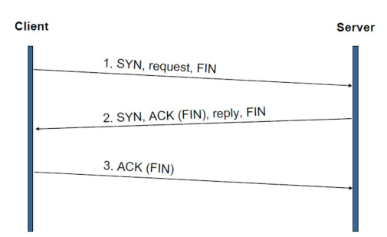
Transaction-TCP

Slide 11
UDP?
HTTP communication usually takes place over TCP/IP connections. The default port is TCP 80, but other ports can be used. This does not preclude HTTP from being implemented on top of any other protocol on the Internet, or on other networks. HTTP only presumes a reliable transport; any protocol that provides such guarantees can be used; the mapping of the HTTP/1.1 request and response structures onto the transport data units of the protocol in question is outside the scope of this specification.
So although it doesn't explicitly say so, UDP is not used because it is not a "reliable transport".
more recently, the QUIC protocol (which is more strictly a pseudo-transport or a session layer protocol) does use UDP for carrying HTTP/2.0 traffic and much of Google's traffic already uses this protocol. It's currently progressing towards standardisation as HTTP/3.

Slide 12
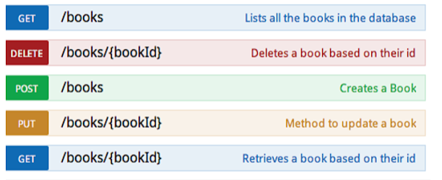
HTTP Methods and Message
GET
POST
PUT
HEAD
DELETE
PATCH
OPTIONS
CONNECT
TRACE
GET is used to request data from a specified resource.
POST is used to send data to a server to create/update a resource.
PUT is used to send data to a server to create/update a resource.
HEAD is almost identical to GET, but without the response body.

Slide 13
HTTP Methods and Message
The DELETE method deletes the specified resource.
The PATCH method is used to apply partial modifications to a resource.
The OPTIONS method describes the communication options for the target resource.
The CONNECT method is used to start a two-way communications (a tunnel) with the requested resource.
The TRACE method is used to perform a message loop-back test that tests the path for the target resource (useful for debugging purposes).

Slide 14
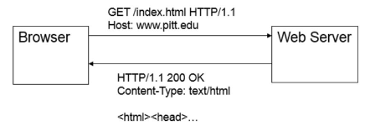
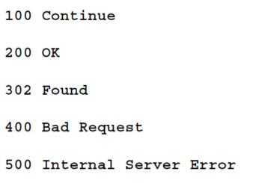
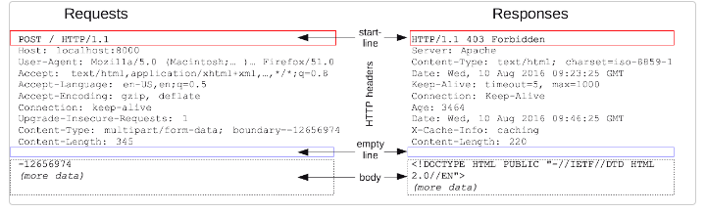
HTTP response status codes
Informational responses (100–199)
Successful responses (200–299)
Redirection messages (300–399)
Client error responses (400–499)
Server error responses (500–599)

Slide 15
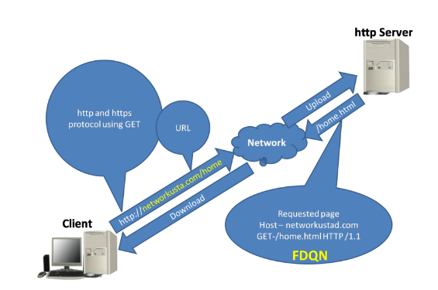
HTTP vs HTML
HTTP is an application protocol that dictates how the information on the World Wide Web travels, whereas HTML dictates how the Web pages are formatted and displayed.
HTTP is the system that tells Web data how to go from one place to another, while HTML is the language in which Web pages are written

Slide 16
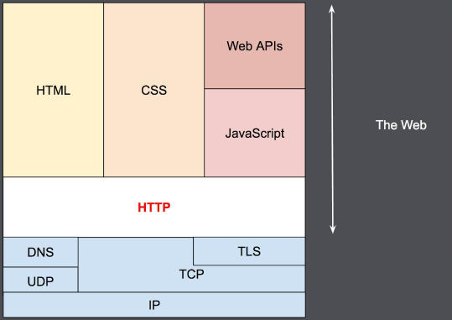
Web technologies and OSI

Slide 17
TEŞEKKÜRLER

