Slide 1
WebDAV
University of Çukurova
Computer engineering departmant
Internet Architecture and Protocols
Student :Mehmet Harun Gülen
Instructor:Prof.Dr.Fatih Akay

Slide 2
WebDAV
WebDAV stands for Web Distributed Authoring and Versioning
It is a digital information management system.
It is an excellent solution for storing, managing and sharing online files, which makes it ideal for online applications and social networking sites.
WebDAV allows you to store, manage, and share updates and files with other web users.

Slide 3
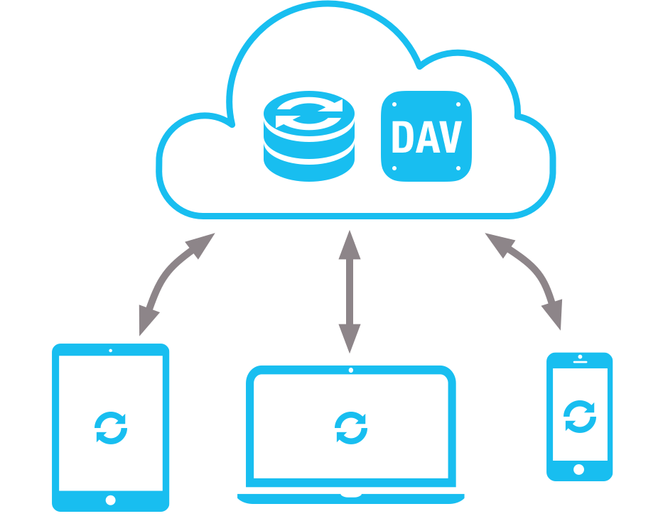
WebDAV
Web Distributed Authoring and Versioning or WebDAV is a protocol whose basic functionality includes enabling users to share, copy, move and edit files through a web server.
It can also be used to support
Collaborative applications with features like file locking
Revision tracking.

Slide 4
Using WebDAV
Create a new file,
Edit an existing file,
Copy or Move files between a local folder and a remote folder on the server,
Delete a file,
Create a folder,
Working like your drive

Slide 5
How WebDAV helps online applications and social networking sites?
Today, online applications are responsible for handling the bulk of web traffic. It's expected that these applications will continue to increase their share of this traffic in the future.
WebDAV allows you to publish files on your website or application without storing them on your computer. With WebDAV, you can store and manage files as long as they're not too large.
You can also share documents with other users using web-based tools like Google Drive.

Slide 6
What are the benefits of WebDAV?
If you're familiar with Dropbox and Evernote services offer cloud storage.
Both of these are great features, but there's one major difference:
When using WebDAV, data doesn't need to be stored in the cloud.
Keep your files safe and available.
WebDAV makes it easy for companies to put information online

Slide 7
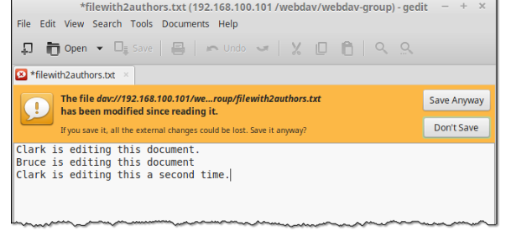
WebDAV vs FTP.
WebDAV has many similarities with FTP.
Operations like copying and moving files or creating and deleting directories can also be performed through FTP
For instance
Edit a file stored on a WebDAV server, there's no need to download it first
WebDAV allows multiple users to edit the same file remotely
This helps users avoid accidental overwrites.
With FTP, you sometimes need to understand the inner workings of active and passive modes of FTP in order to configure your firewalls correctly.

Slide 8
Transport Layer
As an extension of HTTP, WebDAV is typically served through port 80 for HTTP connections or port 443 for HTTPS connections. WebDAV HTTPS connections are encrypted by SSL (Secure Sockets Layer), making them suitable for confidential documents.

Slide 9
Connecting to a WebDAV server
To connect to a WebDAV service, you would need a WebDAV client.
This could be:
a file transfer client like AnyClient,
a file manager like Dolphin or Nemo in Linux, Finder in Mac OS X, or File Explorer in Windows,
a browser capable of running a Java applet, or
any WebDAV-enabled client

Slide 10
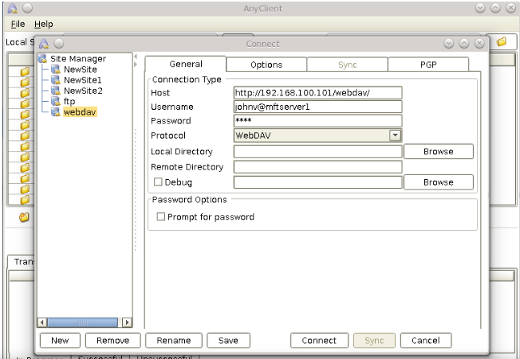
AnyClient (a free WebDAV client)

Slide 11
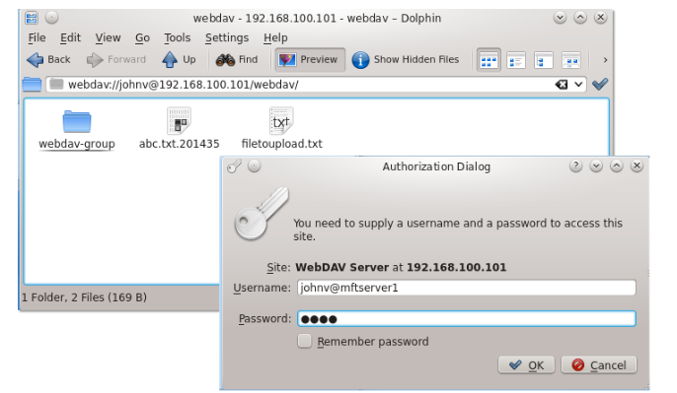
Linux KDE Dolphin connecting to a WebDAV server

Slide 12
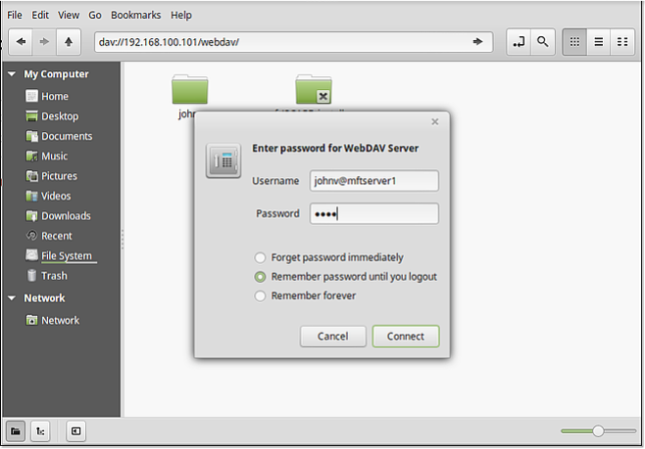
Linux Mint Cinnamon's Nemo connecting to a WebDAV server

Slide 13
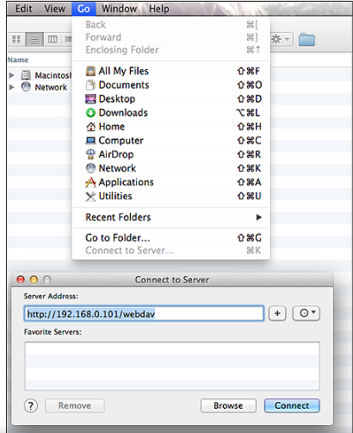
Mac Finder connecting to a WebDAV server
As you can see from the screenshots above, the WebDAV URL syntax can vary from one client to another. Some variations of the URL include:
https://[hostname or IP address]/[path]/
webdav://[username]@[hostname or IP address]/[path]/
dav://[hostname or IP address]/[path]/
Make sure you know exactly which URL is used by your WebDAV client. Otherwise, you'll have trouble connecting.

Slide 14
Get Started
How about giving WebDAV a try? You can download the free, fully-functional evaluation edition of JSCAPE MFT Server, a managed file transfer server that will allow you to set up a WebDAV service. You can then access that service using AnyClient, a free multi-protocol file transfer client.

Slide 15
TEŞEKKÜRLER

