Slide 1
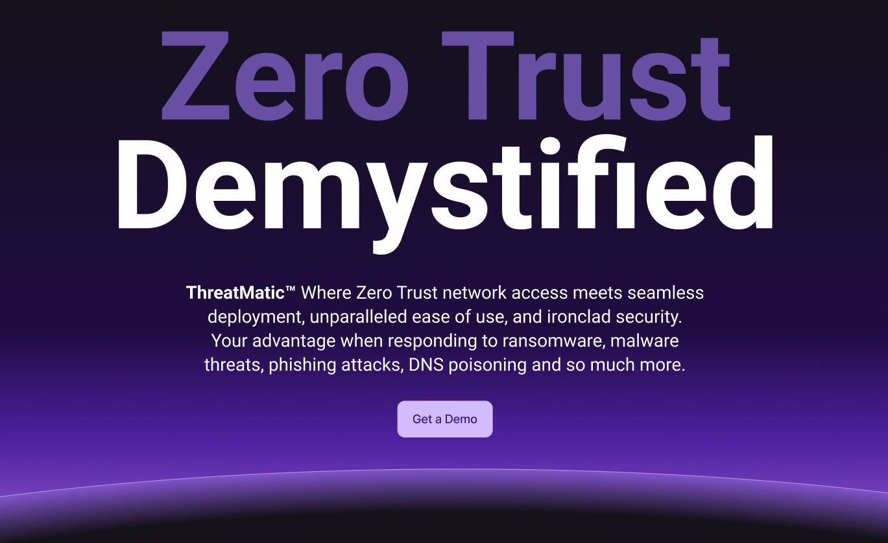

Slide 2
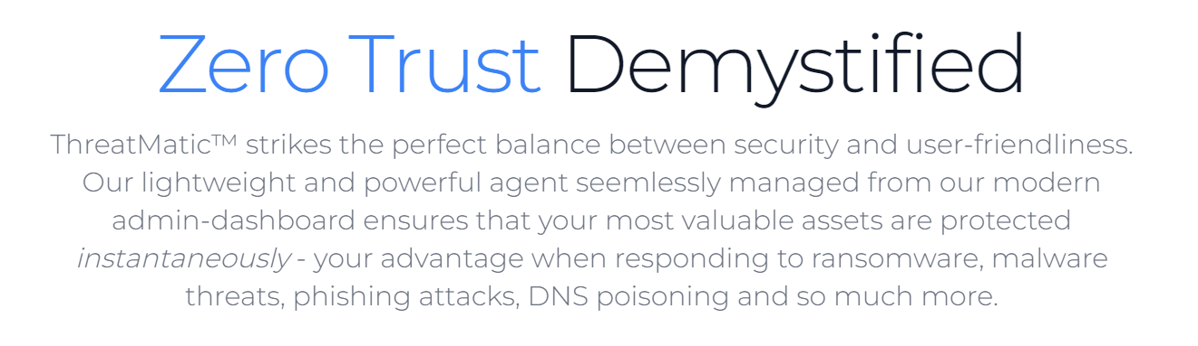
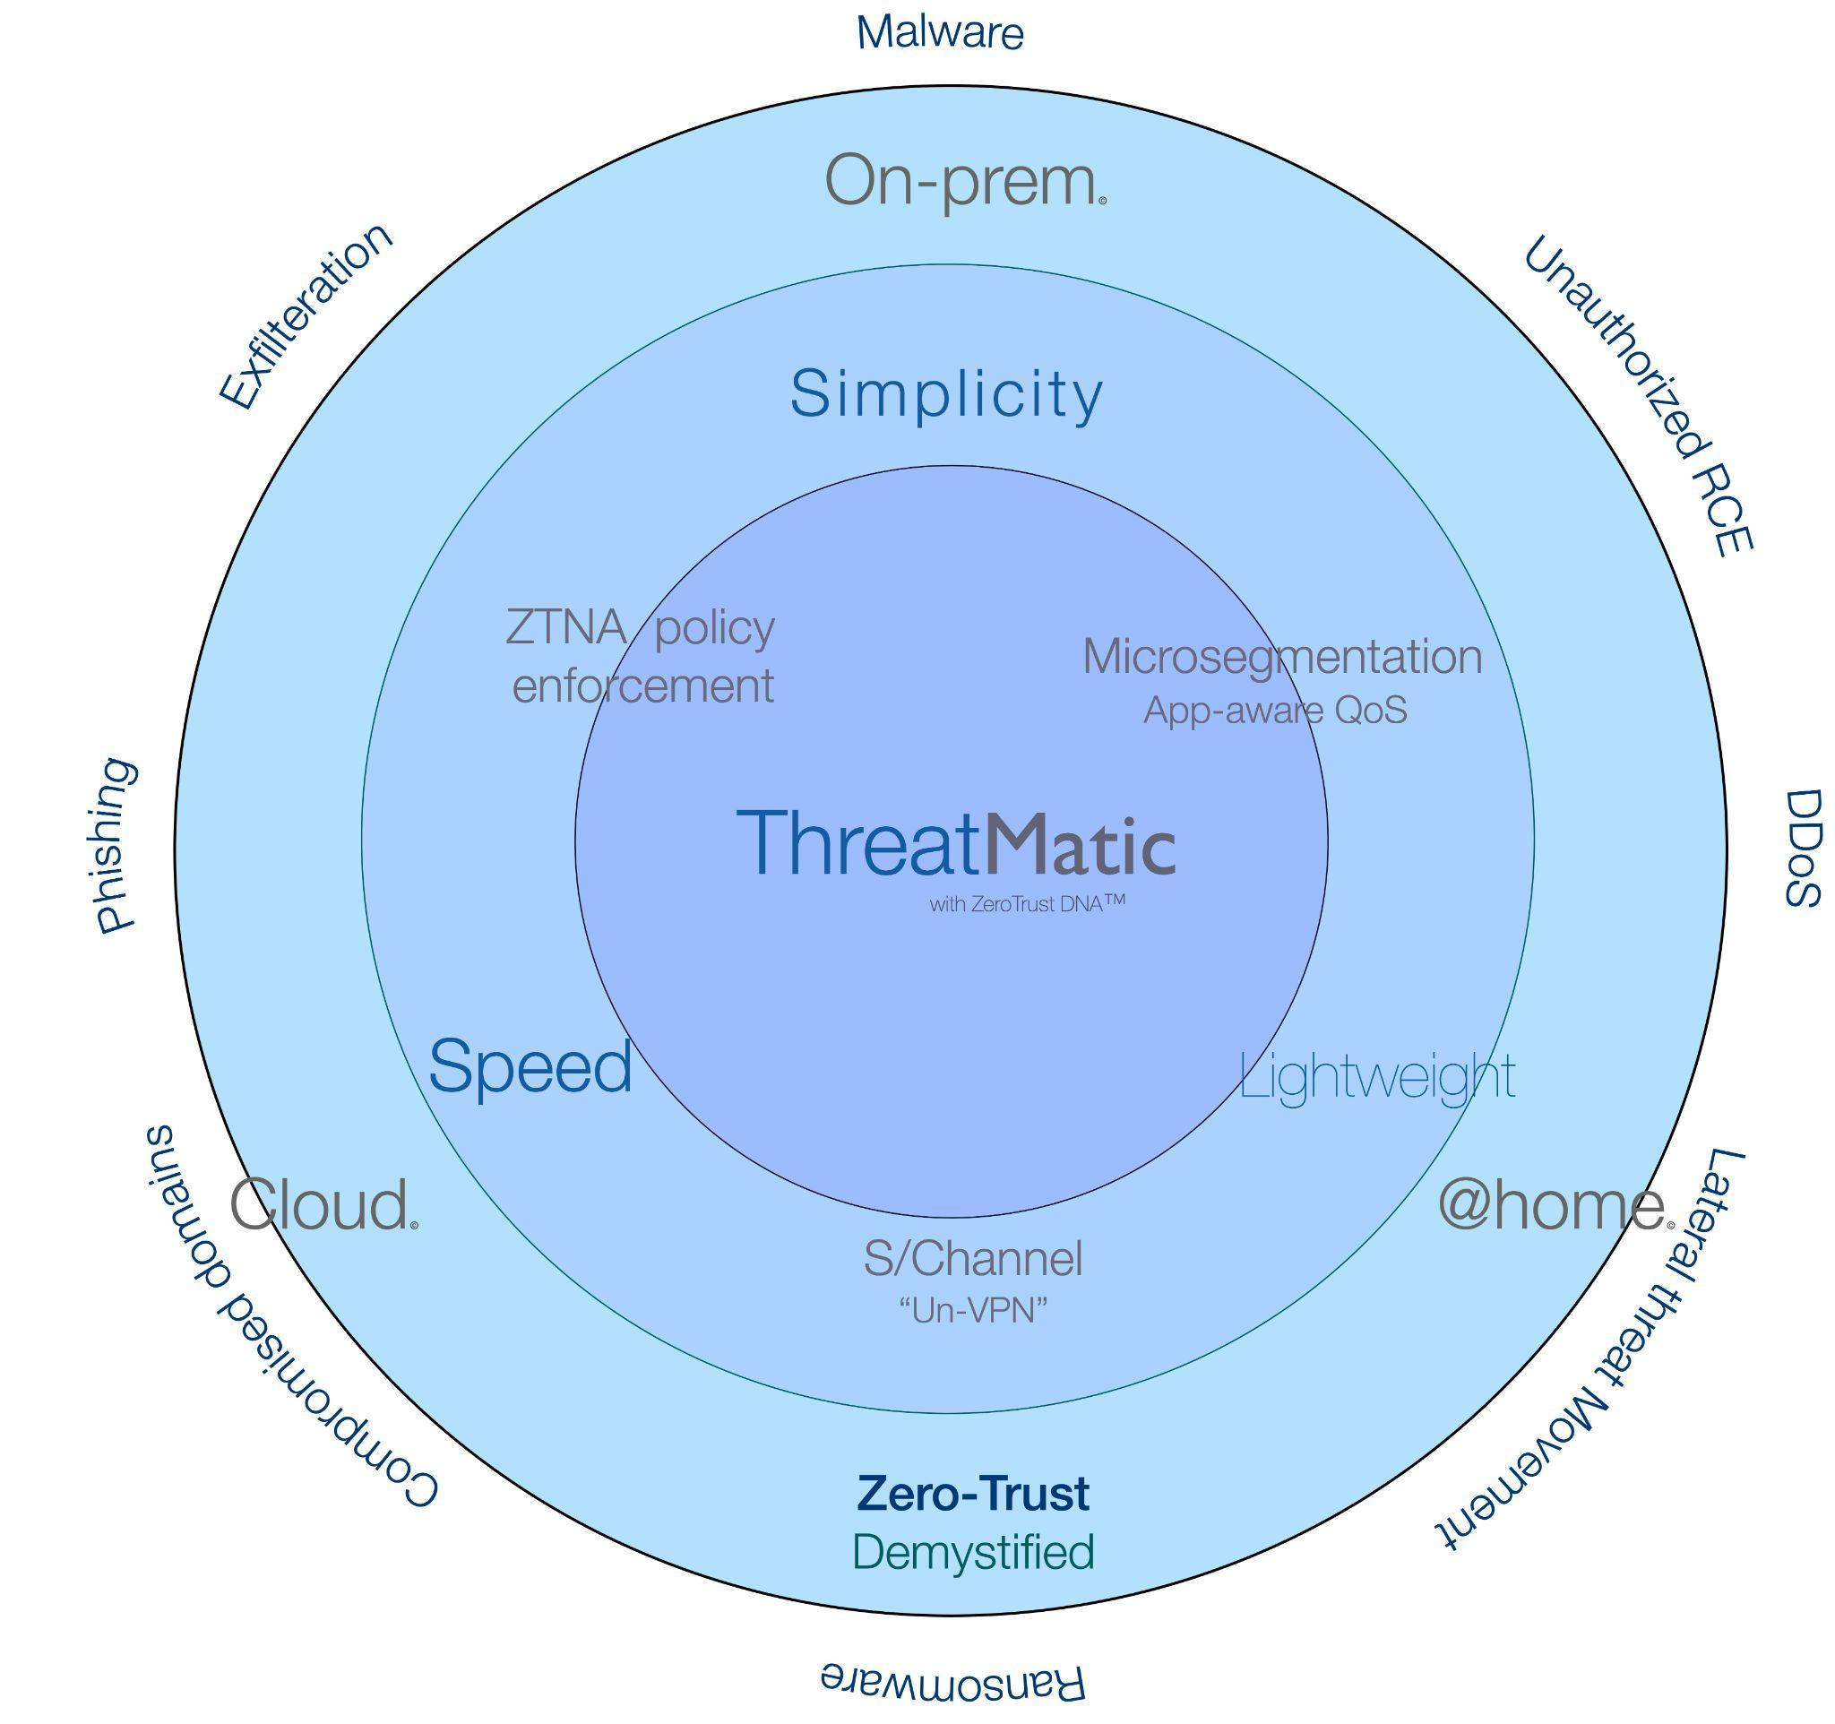
Simplicity Comes Standard
Enforce Zero Trust: Rooted in Identity
S/Channel secure access
On-demand micro-segmentation and app traffic control
✓ App and user ID foundation
✓ Cybersecurity Mesh Architecture (CSMA)
✓ Modern, elastic container-based platform
✓ Self-healing and headless operation
✓ Autoscaling on-premises or in the cloud
✓ De/identified authentication and minimal data retention
✓ Extensive, extensible ML metrics model and APIs

Slide 3
Cybersecurity: (traditional)
Limited perimeter protection
Biased for external threats
Unilateral posture
Vulnerable to zero-day attacks
Malware can diffuse east-west
Single point of enforcement
“Trusted” to “Trusted” blindspot

Slide 4

App and ID aware zero trust model
Flexible/ALE micro-segmentation
Cybersecurity Mesh Architecture
Rules based on user/group/Device
S/Channel “secure channel”
Malware countermeasures
Neutralize Zero-Day attacks

Slide 5









Policy Engine
App and ID aware
Modern UI
App and ID aware
Workload
Active
Directory

Slide 6
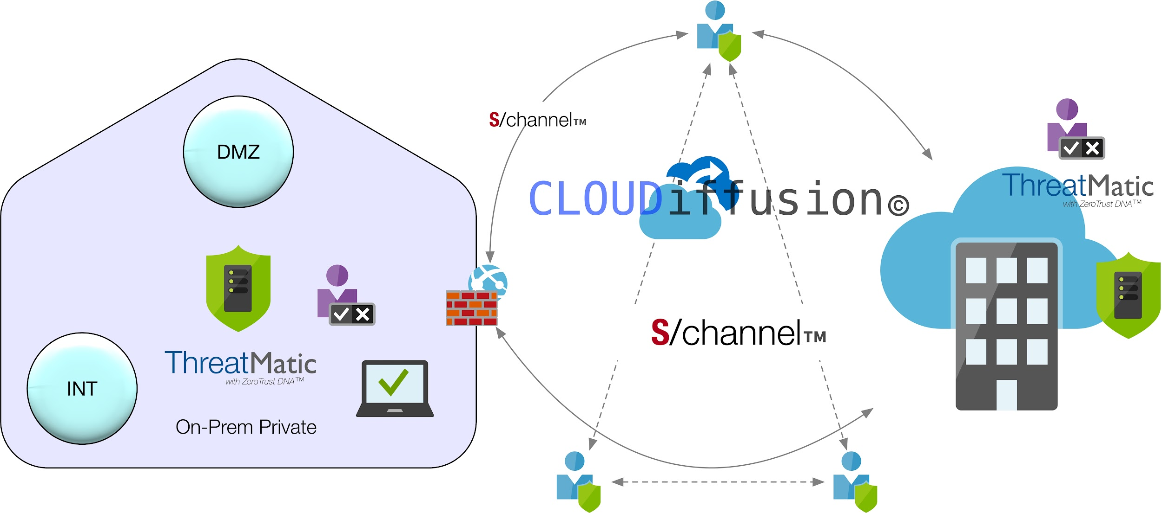

Slide 7

 | ThreatMatic | Illumio | Microsoft | Others
User ID based rules | Yes | Yes | Yes | No
Group ID based rules | Yes | Yes | No | No
Device based rules | Yes | No | Yes | No
Windows package based rules | Yes | No | No | No
Any AD User/Group | Yes | Yes | No | No
Extra-AD device groups | Yes | No | No | No
Name resolution policy control | Yes | No | No | No
Inline bandwidth control QoS | Yes | No | No | No
Simple ergnomics UI | Yes | No | No | No
DNS over HTTP | Yes | No | No | No
DNS blacklisting | Yes | No | No | No
TrueZeroTrust default deny | Yes | No | No | No
Selective traffic steering | Yes | No | No | No
FlexWeight rule ordering | Yes | No | No | No
Granular ingress control at endpoints | Yes | No | No | No
TrustZero server and workload | Yes | No | No | No
Configurable observability | Yes | No | Yes | No
Splunk integrated | Yes | No | No | No
InfluxDB integrated | Yes | No | No | No
On-demand rules sync | Yes | No | No | No
Featherweight agent | Yes | No | No | No
Headless non-stop forwarding | Yes | No | Yes | No
mTLS gRPC channels customizable | Yes | No | No | No
Flexible policy engine placement | Yes | Yes | No | No
Cloudnative design | Yes | No | No | No

Slide 8
 | ThreatMatic | Illumio | Microsoft | Akamai | Zscaler | Palo Alto | FortiGate | CrowdStrike | Perimeter 81 | Nordlayer
User ID based rules | Yes | Yes | Yes | No | Yes | Yes | Yes | Yes | Yes* | Yes*
Group ID based rules | Yes | Yes | Yes | No | Yes | Yes | Yes* | Yes | Yes* | Yes*
Device based rules | Yes | No | Yes | No | No | No | No | No | No | No
Micro-segmentation | Yes | No | No | No | No | No | No | No | No | No
Windows package* based rules | Yes | No | No | No | No | No | No | No | No | No
Any AD User/Group | Yes | Yes | No | No | Yes* | Yes* | No | Yes | Yes* | No
Extra-AD device groups | Yes | No | No | No | No | No | No | No | No | No
Name resolution policy control | Yes | No | No | No | No | No | No | No | No | No
Inline bandwidth control QoS | Yes | No | No | No | No | No | No | No | No | No
Simple ergnomics UI | Yes | No | No | No | No | No | No | No | No | No
DNS over HTTP rules | Yes | No | No | No | No | No | No | No | No | No
DNS blacklisting | Yes | No | No | No | Yes | Yes | No | Yes | No | No
Default deny posture | Yes | No | No | No | No | No | No | No | No | No
Selective traffic steering | Yes | No | No | No | No | No | No | No | No | No
FlexWeight rule ordering | Yes | No | No | No | No | No | No | Yes | No | No
Granular ingress control at endpoints | Yes | Yes | No | No | No | No | No | Yes | No | No
TrustZero server and workload | Yes | No | No | No | No | No | No | No | No | No
Configurable observability | Yes | No | Yes | No | Yes | Yes | No | Yes | No | No
Splunk integrated | Yes | No | No | No | No | Yes | Yes | Yes | No | No
InfluxDB integrated | Yes | No | No | No | No | No | No | No | No | No
On-demand rules sync | Yes | No | No | No | Yes | Yes | No | Yes* | No | No
Featherweight agent | Yes | No | No | No | No | No | No | No | No | No
Headless non-stop forwarding | Yes | No | Yes | No | No | No | No | No | No | No
mTLS gRPC channels customizable | Yes | No | No | No | No | No | No | No | No | No
Flexible policy engine placement | Yes | Yes | No | No | No | No | No | No | No | No
Cloudnative design | Yes | No | No | No | No | No | No | No | No | No
sChannel Proxy | Yes | No | No | No | No | No | No | No | No | No
SideFX Threat Intelligence | Yes | No | No | No | No | No | No | No | No | No

Slide 9
Use Cases: What can do for you?
Defend against malicious DNS records and nameservers
Simple policy against ID and App by user/group/device/device-group
Identity and app/exe based microsegmentation
S/Channel remote access (replaces VPN)
Rapid response to malware attacks (block any app/exe everywhere)
App security metrics with ML and AI autopiloting on roadmap
Ingress posture control for servers and workloads
App aware performance (QoS) on egress
Detect anywhere and protect everywhere posture

Slide 10


Application blocking by user, group, device, device-pool
Any set of endpoints
Any exe
Control access precisely with app or package ID, user/group/device ID, any combination of both, at various layers of the network stack. Generate deep insights into traffic patterns and posture with drill-down analytics, ready for machine learning and auto-piloting actions.

Slide 11

S/channel remote access without VPN
Private Networks
Control access precisely with app or package ID, user/group/device ID, any combination of both, at various layers of the network stack. Generate deep insights into traffic patterns and posture with drill-down analytics, ready for machine learning and auto-piloting actions.

Slide 12



Hostname or IP based fine grained edge egress control
Applications, users and groups, device-groups are restricted to communicate to safe destinations only, east-west granular segmentation which is especially powerful in a multi-tenant environment.

Slide 13

Default-deny Posture
All traffic is denied by default. Only explicitly permitted applications and destinations will be permitted. Think of it a shift-left approach to iron-clad security against malware and zero-day threats.

Slide 14

Microsegmentation policy by user, group, device, device pool
AI-Lab
20.42.93.71
DB-Server
4.236.172.42
Developers
20.119.74.12
Testing
20.119.74.32
Control host to host traffic by user/group/device/device-pool, combine with b/w management for max security and optimal performance. Cordon off any arbitrary group of endpoints and create secure islands of users and workloads.

Slide 15
Control software updates and access to Cloud
To counter threats posed by corrupted or compromised automatic software updates, deploy rules to block at a granular level.

