Slide 1
ASP.NET MVC 3 In Action

Slide 2
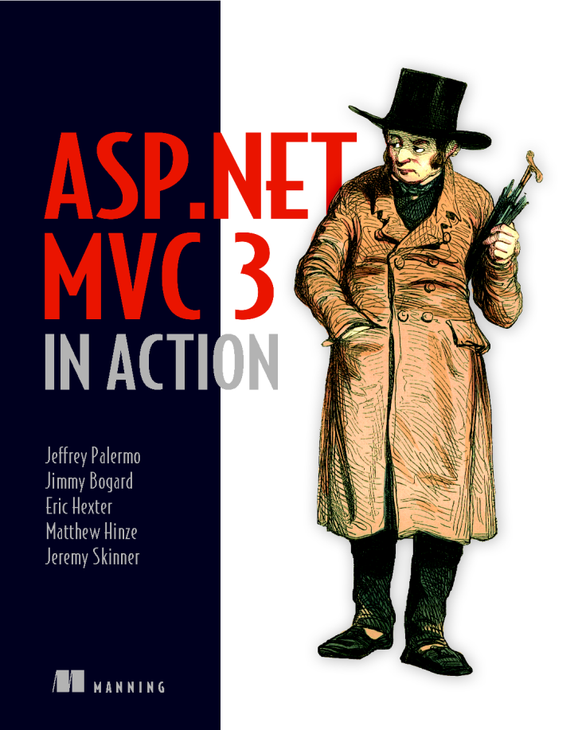
http://bit.ly/mvc3inaction
http://manning.com/palermo3

Slide 3


Slide 4
The Tenets of MVC Programming
Segregated view model
Shape
No reaching
One model, one view
Skinny controllers
Use the source http://codeplex.com/aspnet

Slide 5
Hard Lessons Learned
Understand model binding & avoid extending
Understand HTTP and web framework options
Listen to your tests
Understand the extensibility points

Slide 6
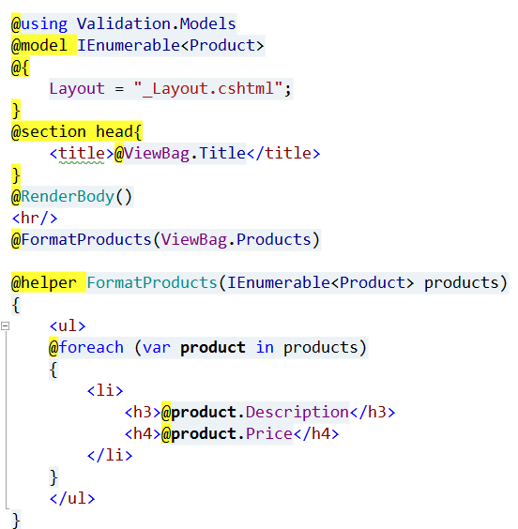
Views (Razor)

Slide 7
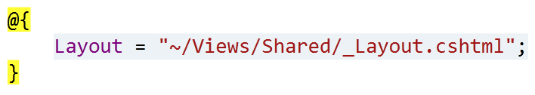
_ViewStart.cshtml
Runs inline at top of every view in scope
Set common properties like Layout
Emit markup?

Slide 8
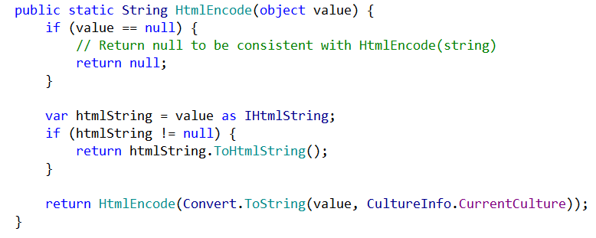
IHtmlString
Won’t get HTML encoded

Slide 9
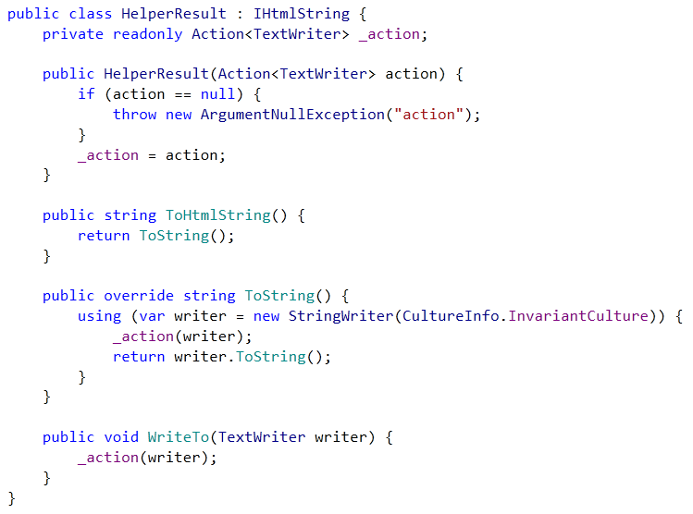
HelperResult

Slide 10

Inline Templates

Slide 11
Unobtrusive Client Validation is awesome
Prevents users from feeling stupid by offering really fast feedback
Favorable performance consideration by avoiding remote calls
Pretty easy to write custom ones (but there is a lot of code, blech)
SOC FTW

Slide 12
Unobtrusive Client-Side Validation
Include script tags for jquery.validate and jquery.validate.unobtrusive
Use Html.BeginForm
Default on

Slide 13
RemoteAttribute
Canonical example is unique usernames

Slide 14
Custom client-side validation
Read the jquery.unobtrusive.validation.js source – it has everything in there

