Slide 1
The Effect of Color on Reaction Time and Cognitive Ability
By:
Dillon Isaacson
Steven Garcia
Matt Hirschi

Slide 2
We played a game called Shapesplosion in class and thought it would be interesting to test if there were different effects by staring at a color before participants played would help or worsen their overall time playing.

Slide 3
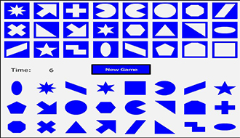

Slide 4
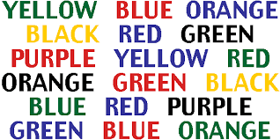
Previous Studies
In 1964 the Journal of Psychology cited a study in which participants were shown names of colors but the names were written in different colors then the ones they described (known as the Stroop Effect). This demonstrates how color affects the cognitive processing ability of human.

Slide 5
Method
We will show people 1 of 2 colors or no color before playing Shapesplosion.
They will look at the color for 30 seconds.
It was in a full screen.
They played Shapesplosion with the fewest number of shapes available.
Mouse usage during game play.
We randomly selected people by counting off 5 people who passed our table.

Slide 6
Factors
Color applied to person.
Red
Blue
No color
Gender
Male
Female

Slide 7
Hypothesis
Color
H0: βi=0;β is the different effects for our color groups: Blue, Red and the Control
Ha: At least one of the βi is different.
Gender
H0: ϕj=0; ϕ is the different effects for our genders: Male and Female
H_{a}: At least one of the ϕ_{j} is different.
Interaction
H₀: β_{i}ϕ_{j}=0
H_{a}: At least one interaction effect is not 0

Slide 8
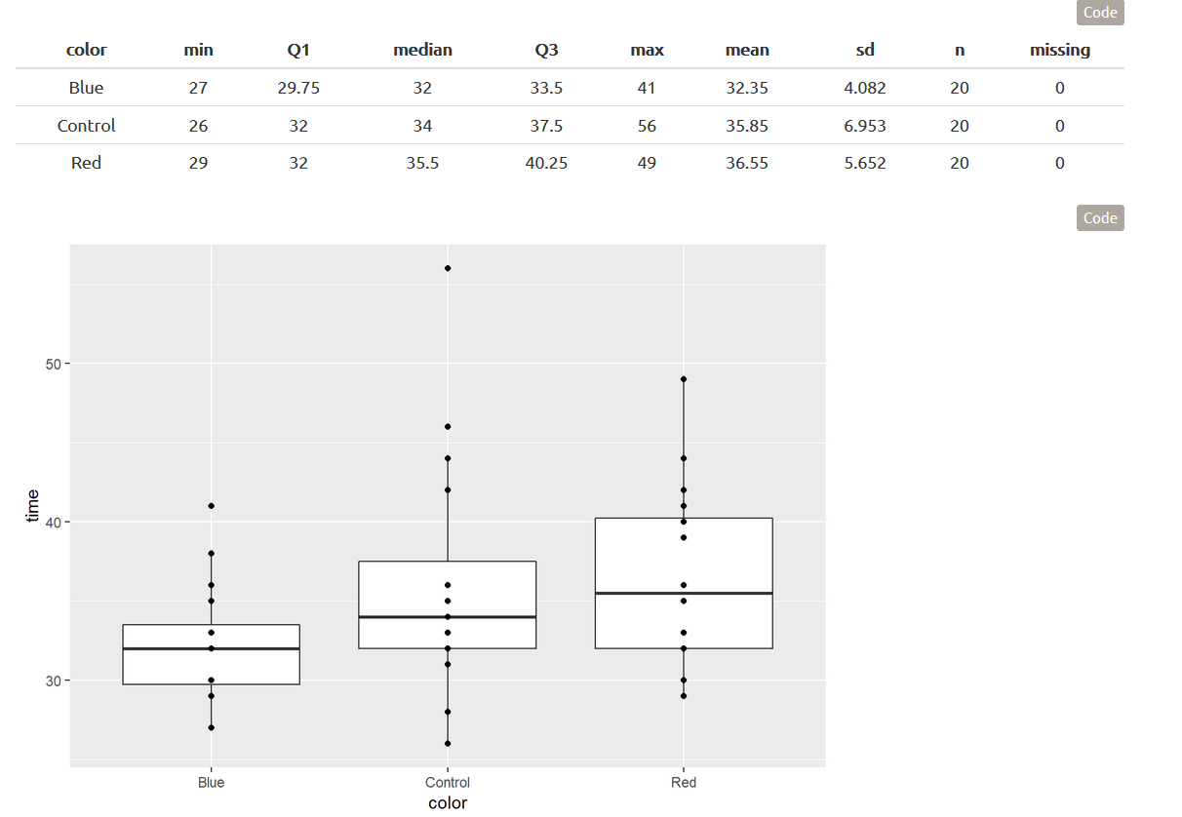
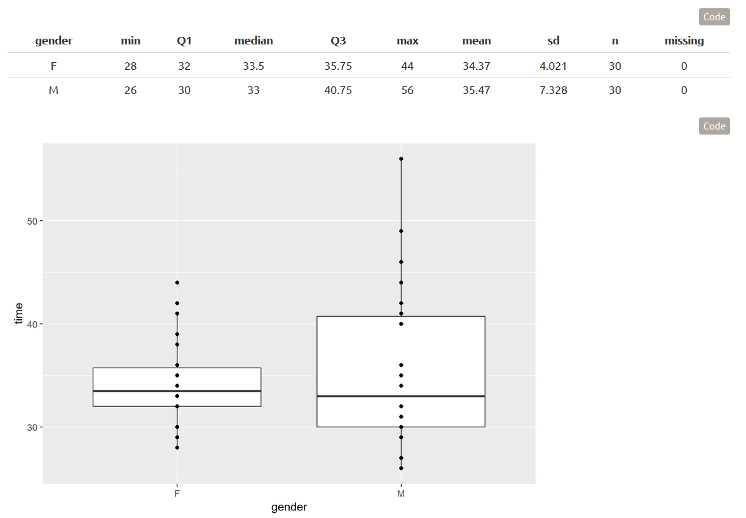
Descriptive Statistics

Slide 9
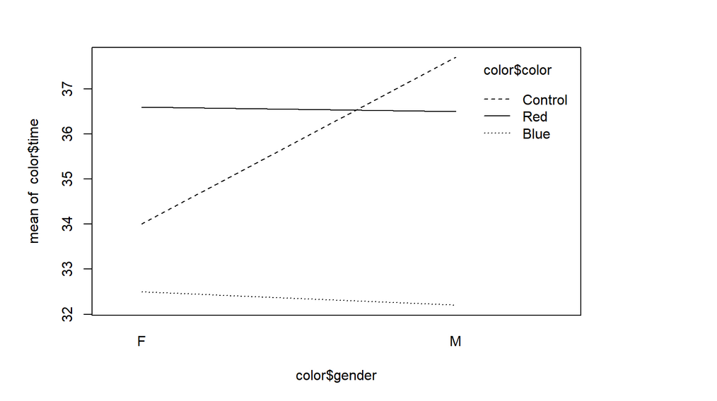
Descriptive Continued

Slide 10
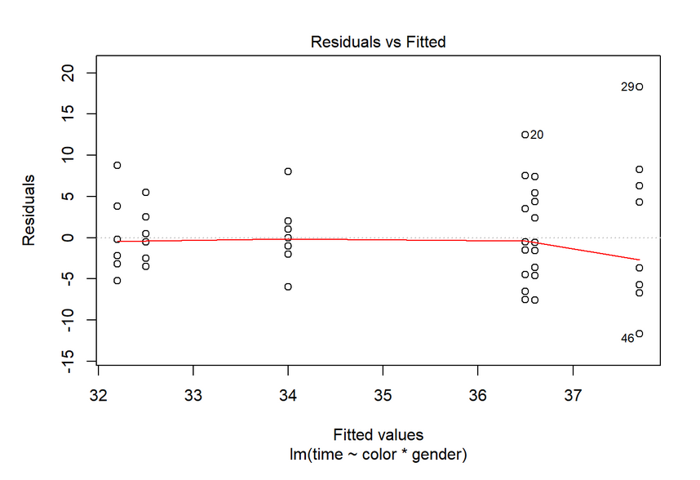
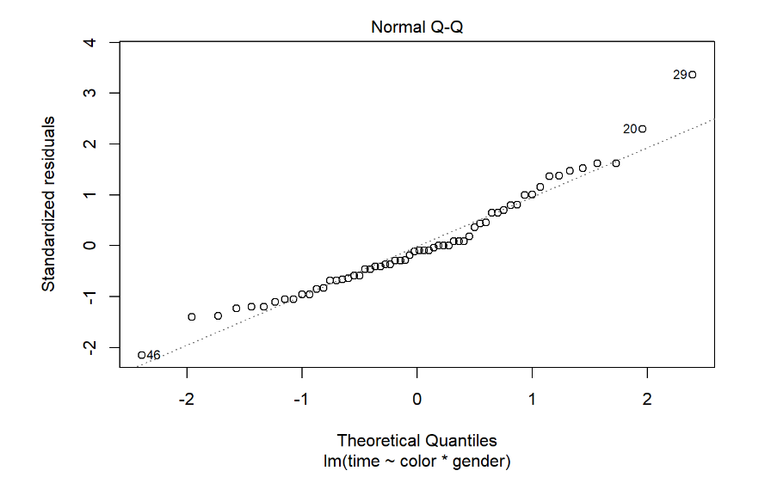
Assumptions

Slide 11
Suggestions for Future Study
Df Sum Sq Mean Sq F value Pr(>F)
color 2 202.5 101.3 3.084 0.05392
gender 1 18.15 18.15 0.5528 0.4604
color:gender 2 50.8 25.4 0.7736 0.4664
Residuals 54 1773 32.84 NA NA

Slide 12
Results
We fail to reject all null hypothesis’ based on low p-values for all main effects and interaction effect.

Slide 13
Suggestions for Future Study
While the p-value for color was insignificant, it appears that there might have been some sort of difference between the mean times which red and blue produced. For example, red produced a mean of 36.55 seconds while blue produced a mean of 32.35 seconds.
While this may not be a big difference, it may suggest that there may be an actual effect.
Some future changes we could make to our design are to measure the effect of age, as there is at least one outlier in our data relating to a considerably more... mature individual.

