Slide 1

GUVI SALES FORECASTING
MUHAMMED HISHAM T
21BDA43

Slide 2
Introduction
Objective:
The primary objective of this project was to deploy a range of advanced Machine Learning techniques to analyze and make predictions based on real-time data.
Obtained data from GUVI Geek Network Pvt. Ltd., a prominent company, which comprised the sales records spanning the past several months.
This project sought to delve into the modern landscape of data visualization tools, particularly focusing on the utilization of PowerBI. The aim was to explore how such tools are currently employed in the industry for data analysis purposes. PowerBI, renowned for its ease of use and learnability, proved to be a valuable asset throughout our analysis.

Slide 3
Problem Statement
To predict the company sales based on the data from previous months. • Created a PowerBI dashboard to visualize sales on the basis of different parameters.
Data
Obtained the sales data for a period of two months from a colleague who is currently employed at Guvi.
The dataset contains: User ID, Product code, Payment status, Coupon code, Lead generation time, Sales date, Source, Product amount including GST, Payment mode, Currency code, and Transaction bank.
The dataset comprises 9514 rows and 11 columns.

Slide 4
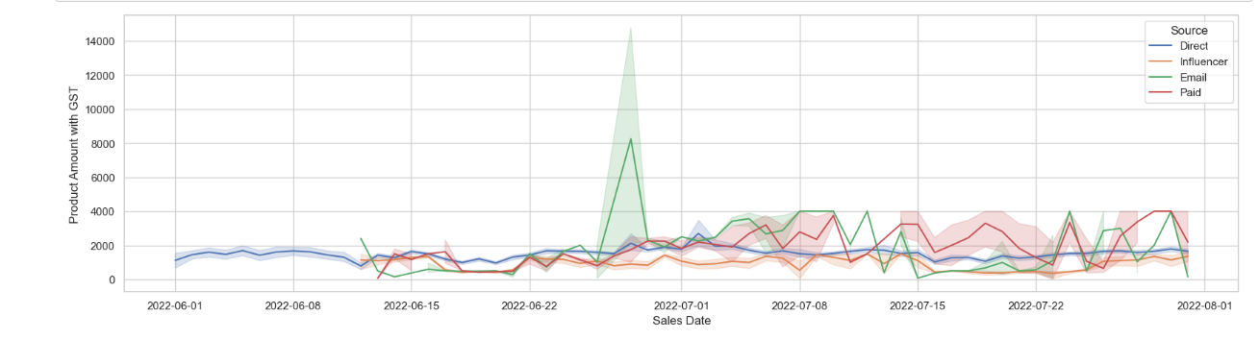
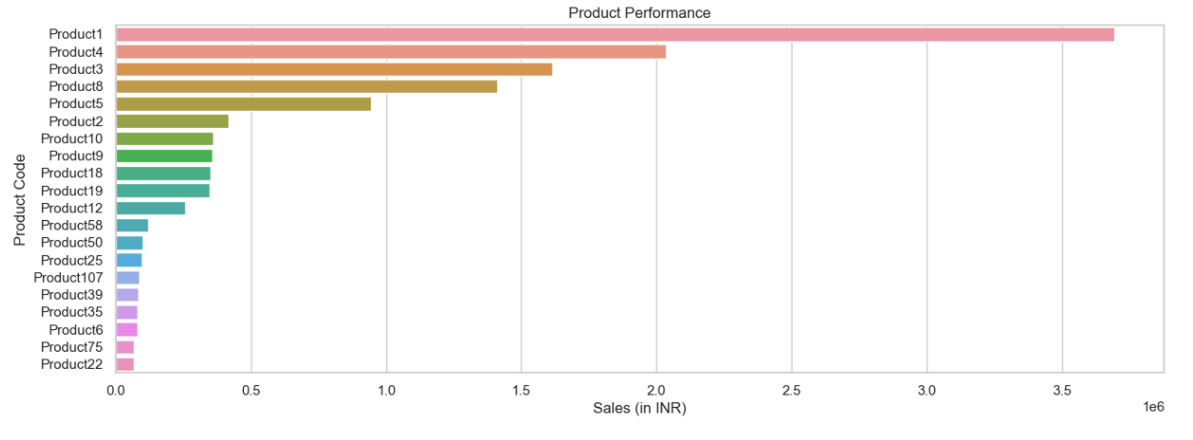
Insights
Sales Trends:
The sales was gradually increased in the middle of 2nd week, June 2022.
2. Product performance:
(Product1,Product4,Product3,Product8) has crossed the total sales of more than 10lakhs.
Product1 has a huge reach from 27 Jun to 4th July.

Slide 5
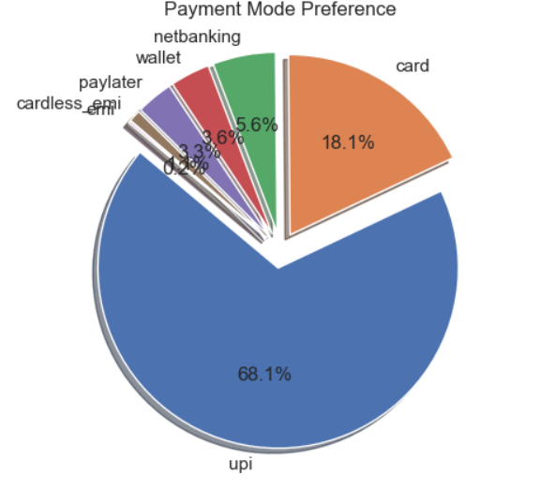
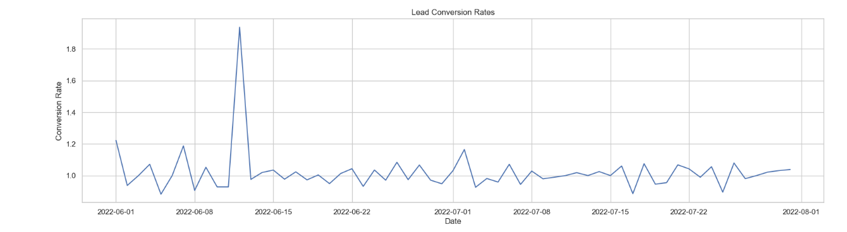
3. Payment mode preference
Apart from 7783'Unknown Payment Mode',Users were mostly preferring 'Upi' and 'card' Transactions.
4.Lead conversion rates:
Lead conversion time was quite higher in the middle of 2nd week, June 2022. which may happened due to sudden increase of sales.

Slide 6
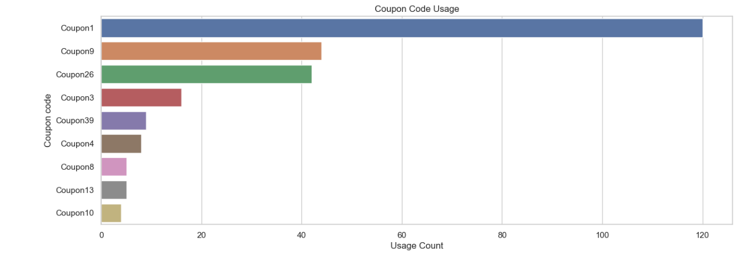
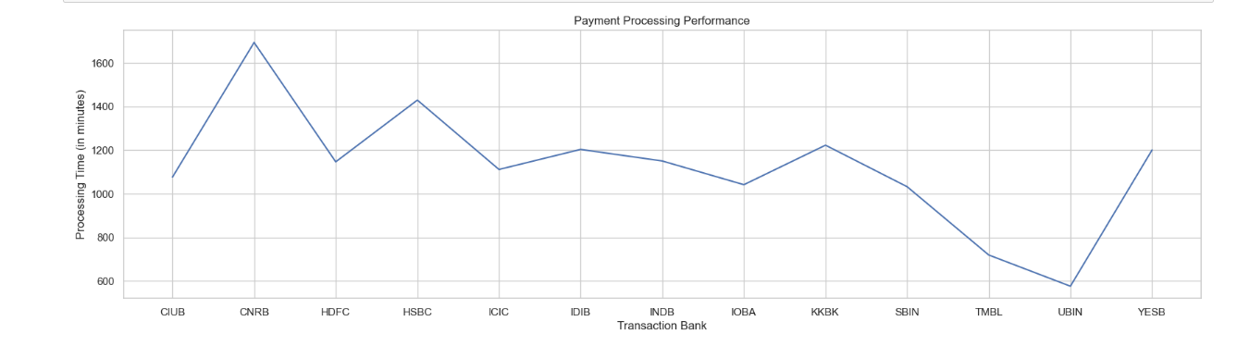
5.Coupon code usage:
Apart 8852 'unknown Coupon Status',(Coupon1, Coupon9, Coupon26) have the more usage counts
6.Payment processing performance:
From the graph we can see that the "CNRB" bank takes more processing time and "UBIN" bank takes the less processing time. Apart from the 9421 'Unknown Bank' values.

Slide 7
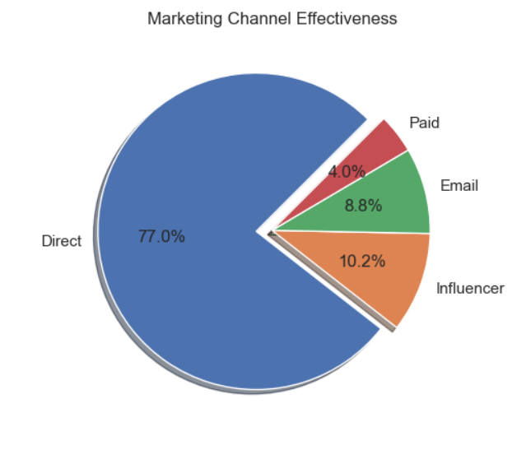
7.Marketing channel effectiveness:
"Direct" source was driving the most sales in the given Two Months.
The source (influence,Email,Paid) have played a significant role in increasing the sales.

Slide 8
Modelling
Linear Regression:
Step 1: Converted the "Sales Date" column to Datetime.
Step 2: Calculate total sales in each month.
Step 3: Train a regression model. Split into test and train data.
Step 4: Prepared next month's data in the form of a DataFrame and predicted the sales for it.
Step 5: Similarly, prepared the data for more than two months in the form of the DataFrame and predicted the sales for the same. In this way, we got the predicted sales for the next three months.
The sales for the next three months are given below:
2022 – 08(August): 1,05,07,078
2022 – 09(September): 1,28,66,338
2022 – 10(October): 1,52,25,597

Slide 9
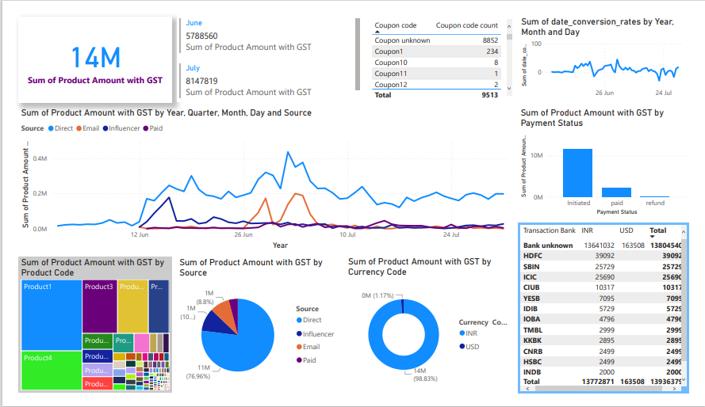
Dashboard

Slide 10
Results
The project revolved around utilizing machine learning techniques, specifically prediction or forecasting, to estimate company sales by leveraging historical data from previous months. I successfully predicted the sales for upcoming 3 months.
Furthermore, I created a PowerBI dashboard with all the necessary parameters.

