Slide 1
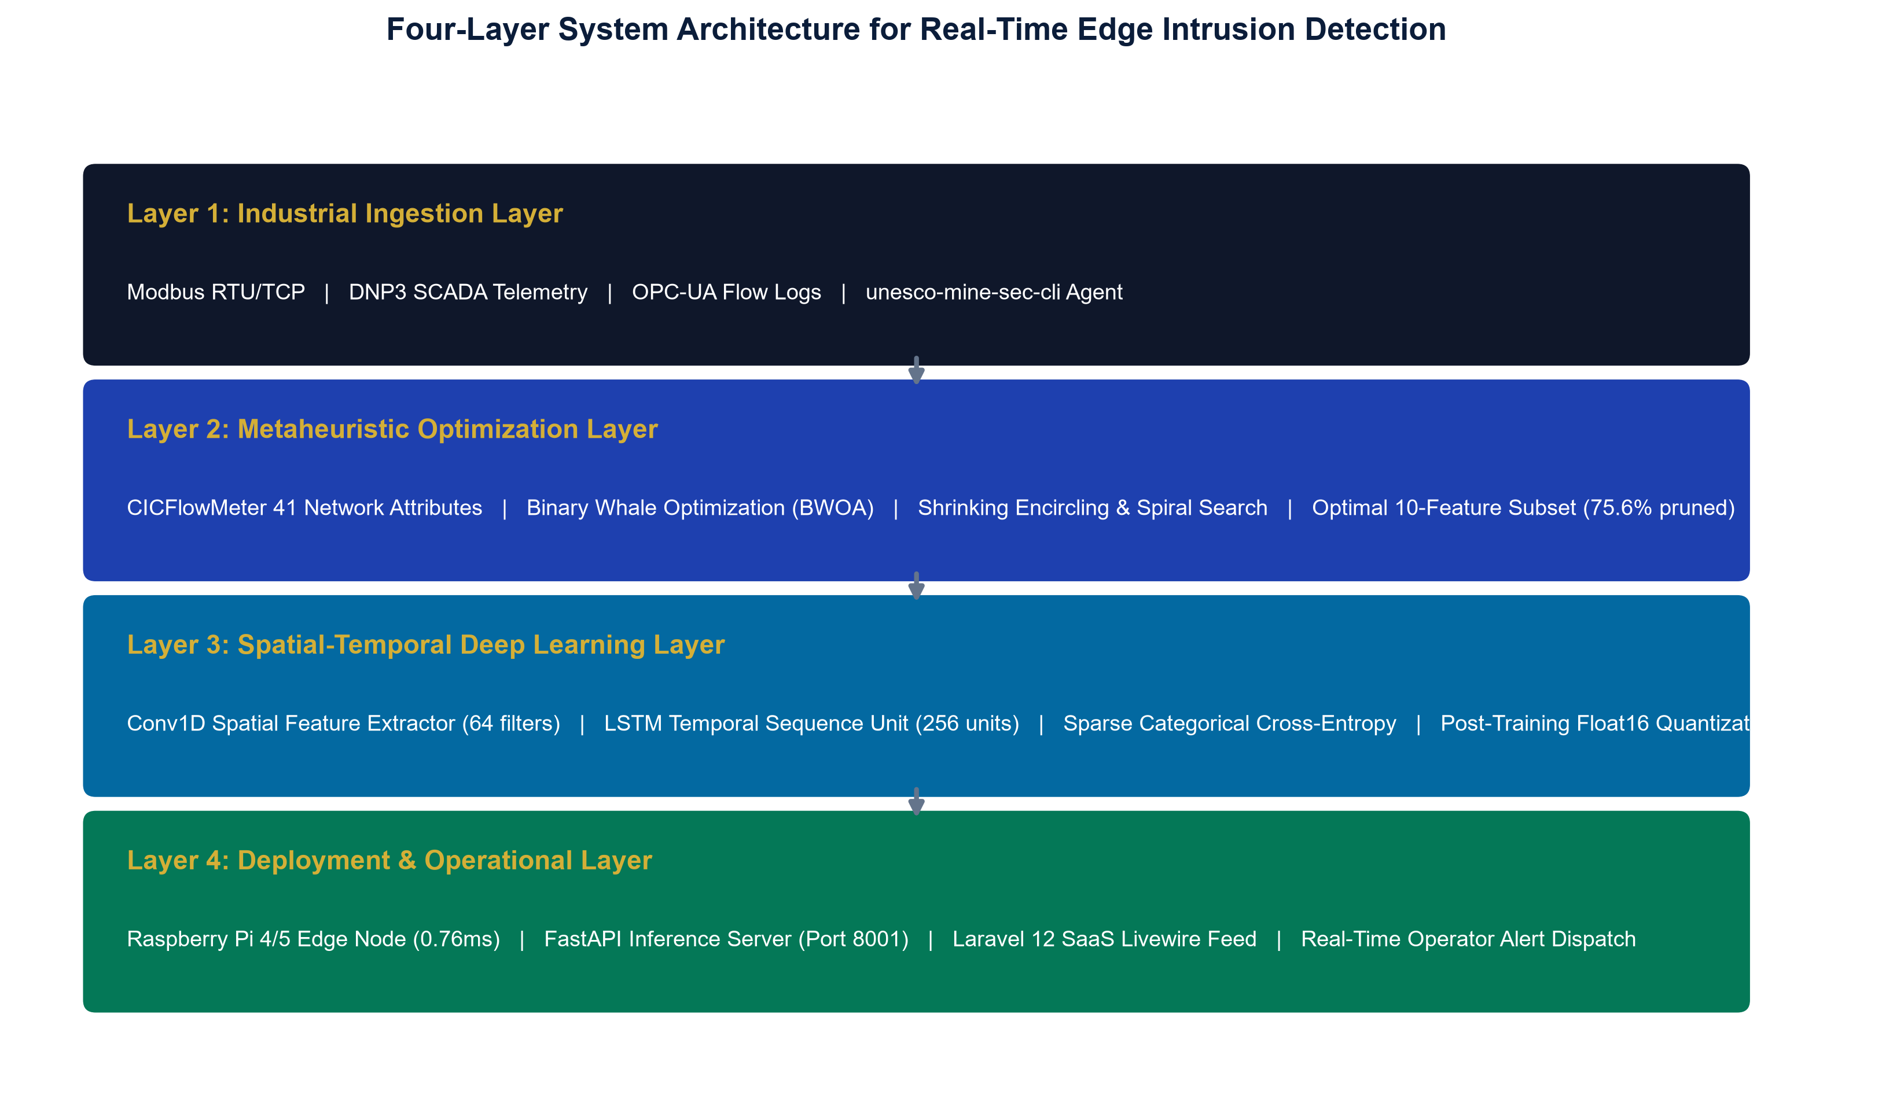
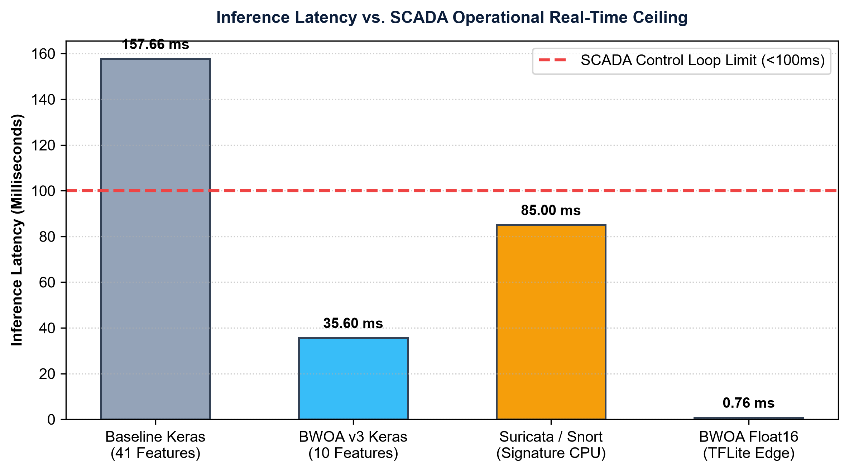
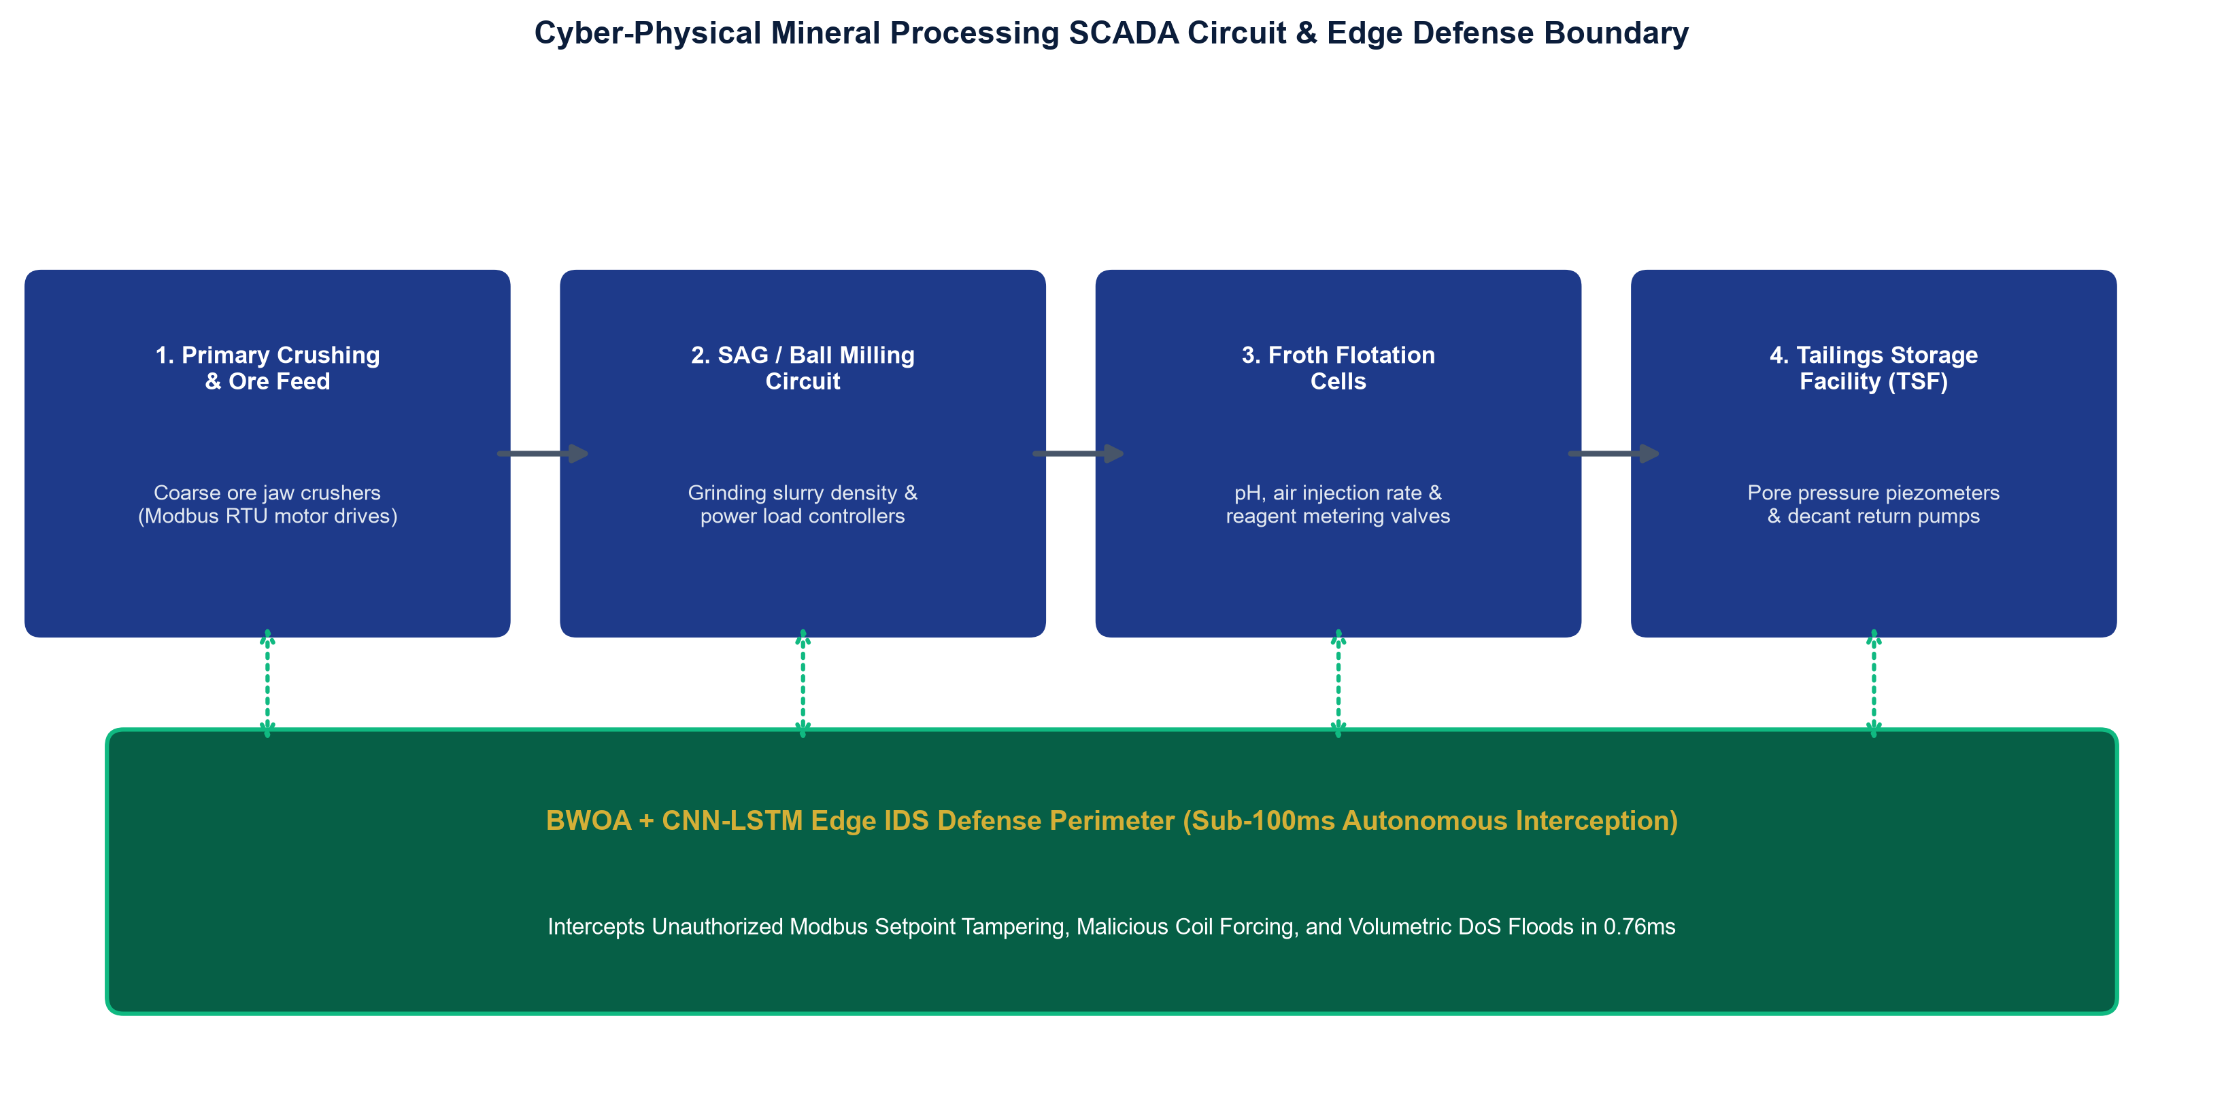
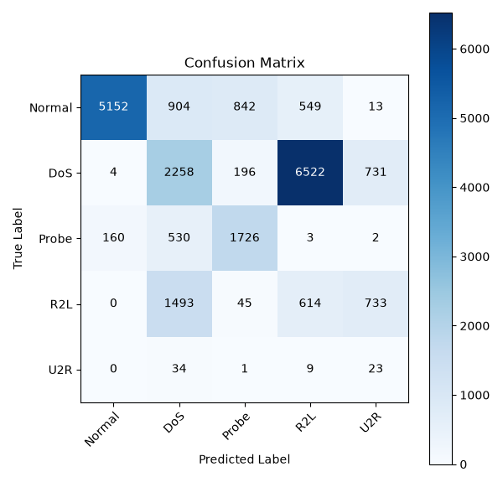
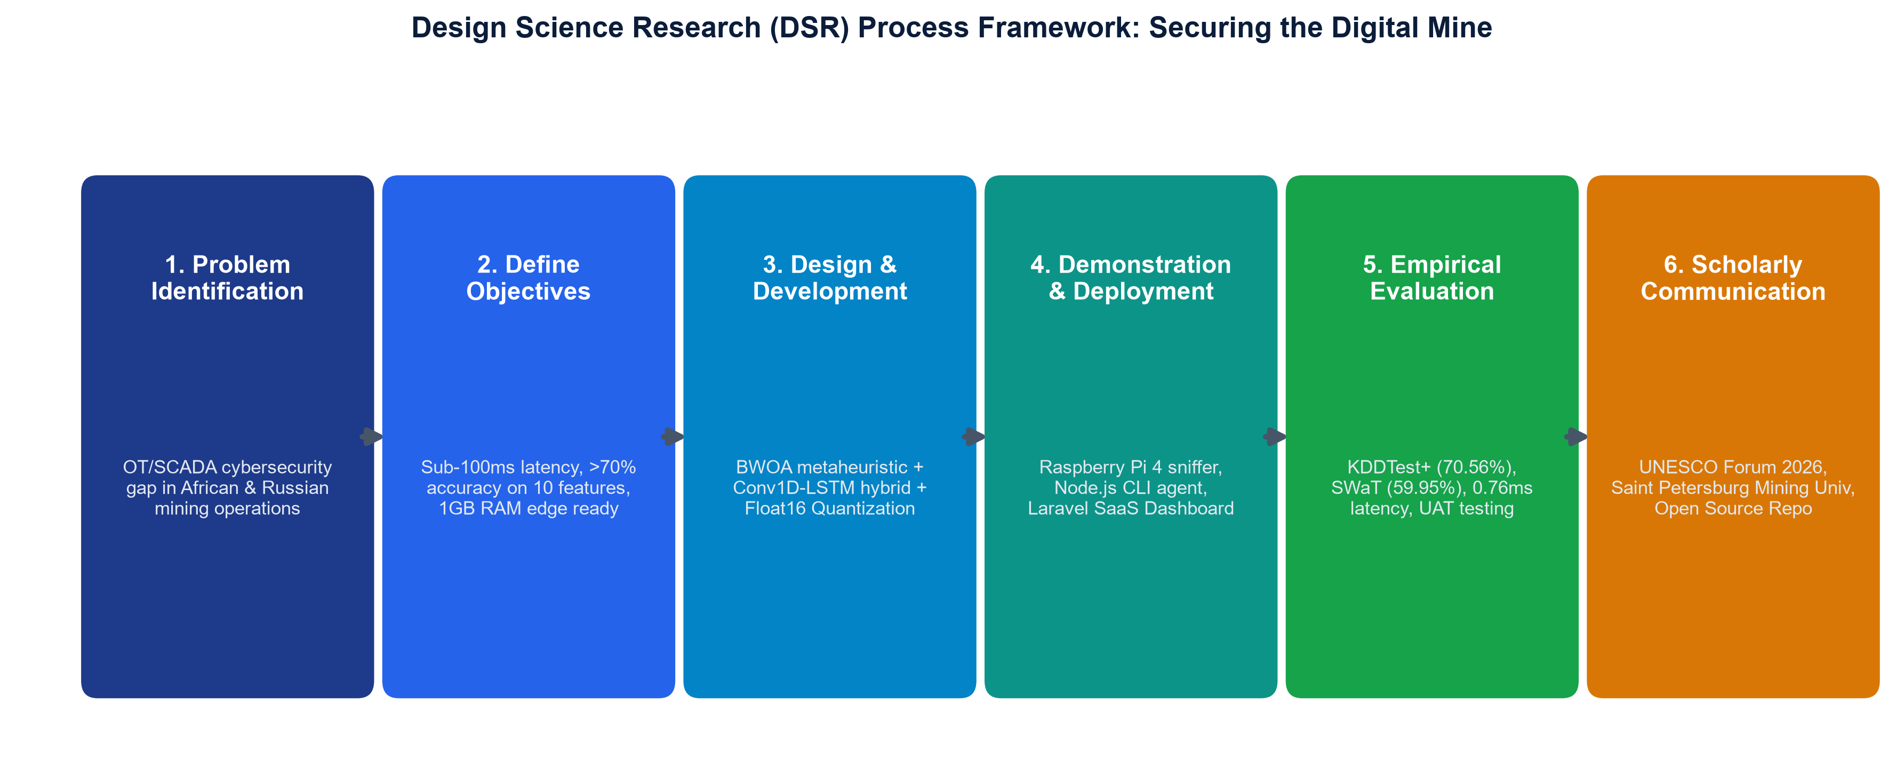
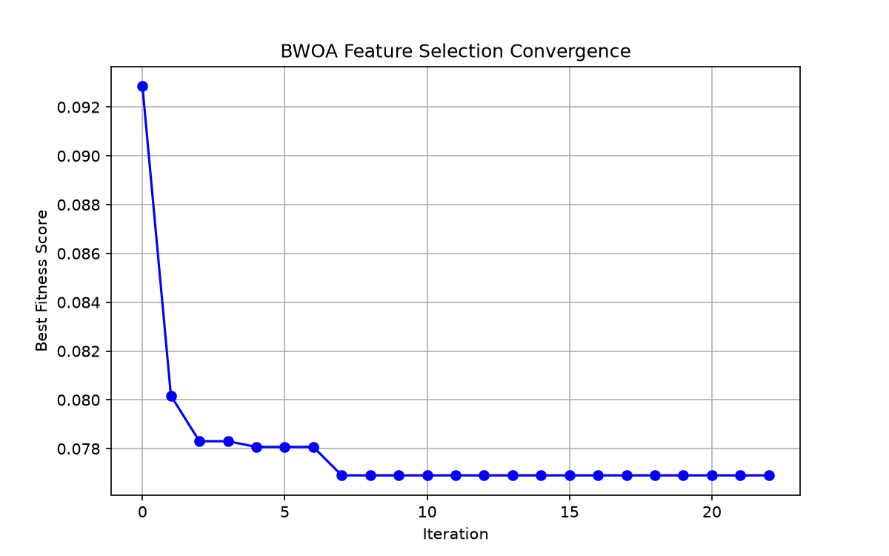
RUSSIAN-AFRICAN FORUM-CONTEST OF YOUNG SCIENTISTS 2026 | UNDER THE AUSPICES OF UNESCO
SECURING THE DIGITAL MINE
A Metaheuristic-Optimized Deep Learning Framework for Real-Time Intrusion Detection in IoT-Enabled Mineral Extraction
Delegation: John Okyere (Lead), Ezekeil Baah, Clement Baffour, Parker Paa Annobil, George Akwesi Bonnah
Department of ICT, University of Education, Winneba & Kayaba Labs | Track 3: Smart Subsoil | Saint Petersburg Mining University
0.76 ms
Edge Inference Latency (207x Speedup vs Baseline)
75.61%
Feature Pruning (41 -> 10) (BWOA Dimensionality Red.)
96.89%
Benign Flow Precision (Zero False Production Halts)
89.04%
DoS Attack Recall (Hardens SCADA PLCs)
0.82 MB
Float16 Quantized Size (Runs on 1GB RAM Pi 4B)
200x+
Estimated Industrial ROI (Averts $50k-$500k/hr Loss)
SECTION 1: INDUSTRIAL THREAT LANDSCAPE
The Death of the Air-Gap in Smart Mines
SECTION 3: TECHNOLOGICAL INNOVATION
4-Layer Edge-to-Cloud Security Architecture
SECTION 5: EMPIRICAL BENCHMARKS
Sub-Millisecond Edge Latency vs SCADA Limit
• Air-Gap Collapse: Smart Subsoil digitalization connects SAG mills, froth flotation circuits, and tailings dams to cloud twins, exposing unauthenticated Modbus/DNP3 protocols to zero-day intrusion.
• Catastrophic Outage Costs: Unplanned mining downtime costs USD $50,000 to $500,000 per hour. Tampering with toxic gas sensors or dewatering pumps creates severe life safety hazards.
• Traditional IDS Failures: Heavyweight enterprise IDS tools require 150+ milliseconds to evaluate 41 features, violating the 20 to 50 millisecond control loop deadlines of industrial PLCs.
■ Layer 1 (Ingestion): Promiscuous packet sniffer capturing Modbus/TCP, DNP3, and OPC-UA streams.
■ Layer 2 (BWOA Pruning): Metaheuristic optimizer prunes 41 features down to 10 vital signals.
■ Layer 3 (Deep Learning): Spatial-temporal Conv1D-LSTM neural classifier quantized to Float16.
■ Layer 4 (SaaS Dashboard): Multi-tenant Laravel Livewire console streaming sub-second alerts.
SECTION 2: RESEARCH METHODOLOGY
Design Science Research (DSR) Execution
SECTION 4: MATHEMATICAL OPTIMIZATION
BWOA Convergence & Neural Layout
SECTION 6: SUSTAINABILITY & ARTIFACTS
UN SDG Impact & Open-Source Ecosystem
◆ SDG 9 (Industry & Innovation): Hardens critical mining cyber-physical infrastructure against zero-day disruption, safeguarding global mineral supply chains.
◆ SDG 8 (Decent Work & Safety): Protects underground worker safety by preventing cyber manipulation of toxic gas sensors, scrubbers, and ventilation grids.
◆ SDG 17 (Partnerships for Goals): Fosters bilateral Russian-African scientific collaboration, technology transfer, and local technical capacity building.
◆ High Economic ROI (200x - 300x): Preventing a single 24-hour ransomware outage on a ball mill saves $300k to $450k against an annual IDS cost of < $1,500.
◆ NPM Edge Sniffer CLI: Install instantly on any gateway via 'npm install -g @mhiskall282/unesco-mine-sec-cli' from GitHub Packages.
◆ Source Code & Reproducibility: Complete repository, notebooks, and 75 unit test suites available at: https://github.com/mhiskall282/Securing-the-Digital-Mine-UNESCO-Project
✓ Stage 1 (Problem Identification): Air-gap loss & SCADA real-time deadlines in African/Russian mines.
✓ Stage 2 (Define Objectives): Target < 1.0 ms latency, < 1.0 MB model size, 1GB RAM edge support.
✓ Stage 3 (Design & Artifact): BWOA metaheuristic + Conv1D-LSTM + Float16 quantization.
✓ Stage 4 (Demonstration): Packaged global CLI agent (@mhiskall282/unesco-mine-sec-cli).
✓ Stage 5 (Evaluation): NSL-KDD benchmark, SWaT transfer learning, and 75/75 unit test suites.
★ Encircling & Bubble-Net: whales adjust velocity using a V-shaped transfer function: V(x) = |x / sqrt(1 + x^2)|.
★ Accuracy Floor Constraint: Enforces strict 75% accuracy floor with penalty weight alpha=0.3.
★ Selected 10 Features: protocol_type, service, flag, src_bytes, hot, su_attempted, serror_rate, same_srv_rate, diff_srv_rate, dst_host_diff_srv_rate.
★ Convergence Speed: Optimal 10-feature mask reached at iteration 23/100 (92.31% RF CV accuracy).

