Slide 1
Software Design-2

Slide 2
How to Do Software Design?
1. Understand Requirements
Study the Software Requirement Specification (SRS).
Clearly understand what the software should do, and under what constraints.
2. Choose a Suitable Design Method
Decide whether to use structured, object-oriented, or component-based design, depending on the system and requirements.
3. Develop the Architectural Design
Identify the main modules or subsystems of the software.
Define how these modules will interact with each other (communication and data flow).
4. Design Component Modules
Break down subsystems into smaller components.
Define internal functionality for each component using pseudocode, flowcharts, or UML class diagrams.

Slide 3
5. Design Interfaces
Specify how components will interact with one another (internal interfaces).
Design user interfaces (external) if the system interacts with end users.
6. Data Design
Define how data will be structured, stored, and accessed.
Include class-level or database-level data models.
7. Use Design Modeling Tools
Create UML diagrams, state charts, sequence diagrams, etc., to visually represent your design.
8. Verify and Review the Design
Conduct design reviews, walkthroughs, or even prototype testing to ensure the design meets all requirements before coding begins.

Slide 4
Major Components of SDS Document
SDS (Software Design Specification) is a detailed technical document that describes how the software system will be built.
Major Components of SDS Document:
Different modules required: Lists all functional units or components of the system.
Control relationships among modules: Describes how control flows between different modules.
Interface among different modules: Specifies how modules communicate or exchange data.
Data structure among the different modules: Defines how data is organized and shared between modules.
Algorithms required to implement among the individual modules: Outlines the key logic or processing steps within each module.

Slide 5
Types of Design Models
Design models are structured representations that help in planning how a software system will be built. They bridge the gap between requirements analysis and actual coding, ensuring that the system’s architecture, components, and behavior are well defined.
There are four types of design elements/ models:
1. Data Design Model: Defines how data is structured, stored, and related.
Tools: ER diagrams, class diagrams.
2. User Interface Design Model: Describes how users interact with the system.
Tools: Wireframes, UI mockups.
3. Architectural Design Model: Shows the high-level structure and module relationships.
Tools: System architecture diagrams.
4. Component-Level Design Model: Details the internal logic of each module.
Tools: Flowcharts, pseudocode.

Slide 6
DATA DESIGN MODEL
Data design is the process of creating a blueprint for how data will be stored, accessed, and managed in a software system. It transforms data requirements (from the requirements phase) into a structured format that supports the system's functions and workflows.
Objectives of Data Design:
Organize data efficiently.
Ensure data integrity and consistency.
Support the operations of each software module.
Minimize data redundancy.
Key Elements of Data Design:
Data Objects (Entities): Real-world items represented in the system (e.g., Student, Course, Invoice).
Attributes: Characteristics or properties of data objects (e.g., Student Name, Student ID).

Slide 7
Relationships: Connections between data objects (e.g., A Student enrolls in a Course).
Data Structures: Logical representation of data like arrays, linked lists, queues, trees, etc.
Database Design: Includes table creation, normalization, and defining primary/foreign keys.
Data Dictionary: A reference that defines each data element’s name, type, size, and description.
Common Tools Used:
ER Diagram (Entity-Relationship Diagram) – shows entities and their relationships.
Class Diagram (in object-oriented systems) – represents classes, attributes, and associations.
Relational Schema – outlines how tables relate in a database.

Slide 8
Example:
For an Online Admission System, the data design would define:
Entities: Student, AdmissionForm, Payment
Attributes: StudentID, Name, DateOfBirth
Relationships: Student → submits → AdmissionForm
N:B: Must visit the below-mentioned links:
More Details for E-R diagram:
https://www.geeksforgeeks.org/sql/how-to-draw-entity-relationship-diagrams/
More Details for Class diagram:
https://www.geeksforgeeks.org/system-design/unified-modeling-language-uml-class-diagrams/

Slide 9
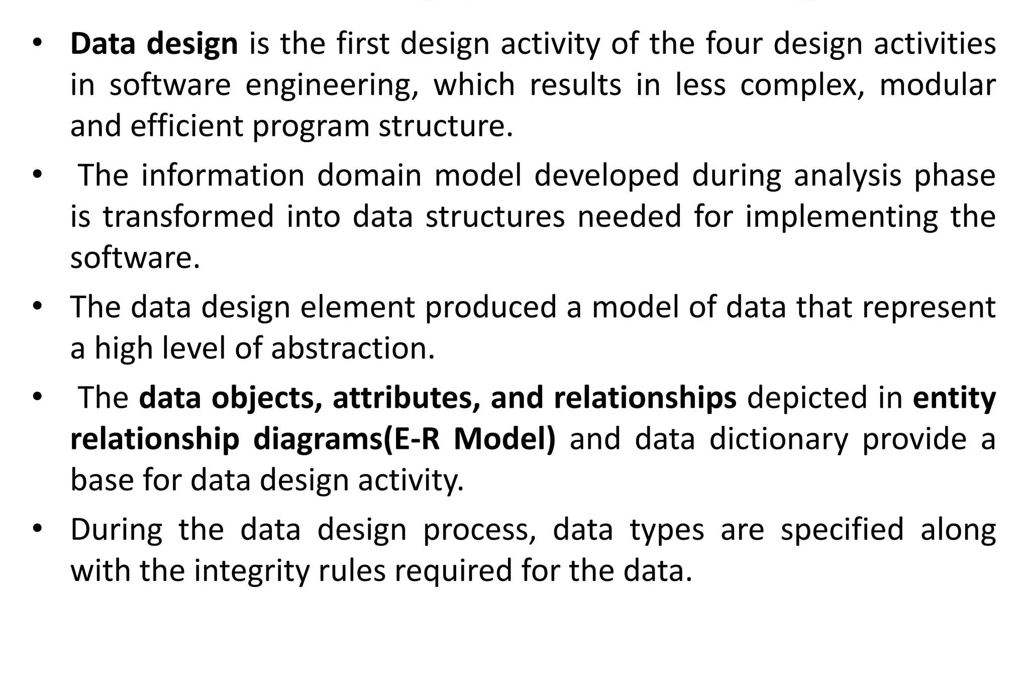

Slide 10
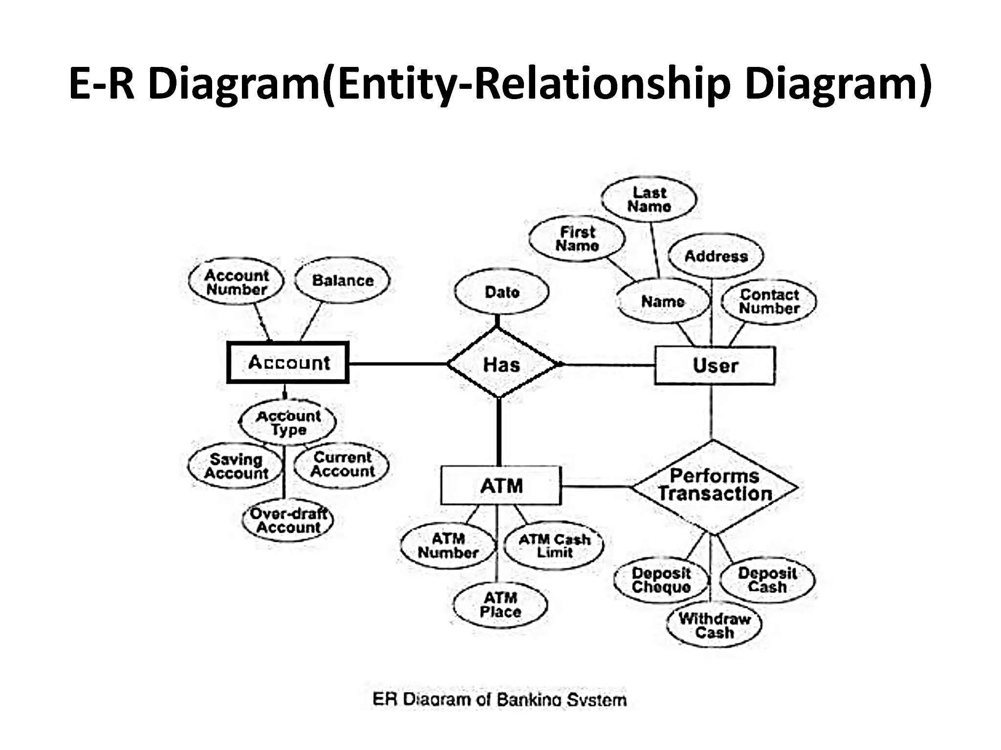

Slide 11
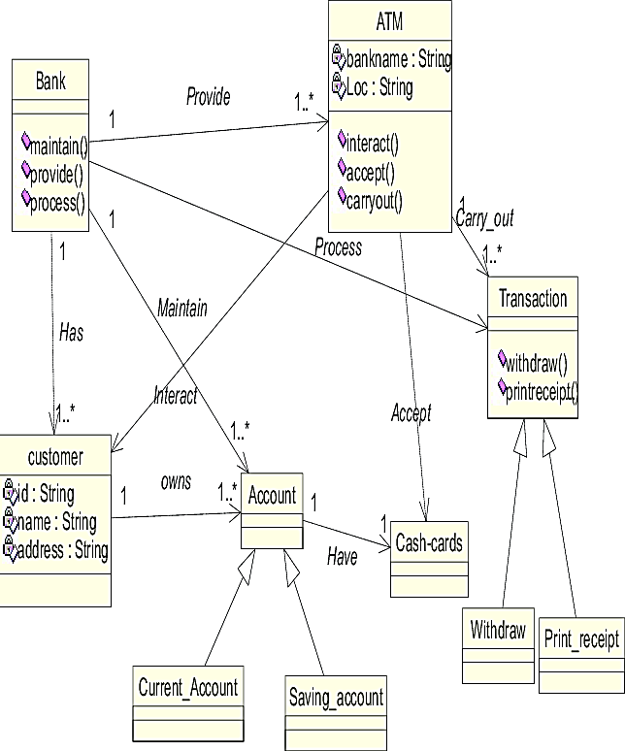
Example of Class/ Data Design – ATM System

Slide 12
1. Bank
a) Bank — Customer
Relationship: Bank has Customers
Type: One-to-many (1 → *)
Explanation: A single bank provides services to many customers. Every customer is registered under a specific bank.
b) Bank — ATM
Relationship: Bank provides ATM
Type: One-to-many (1 → *)
Explanation: A bank manages and operates multiple ATMs for customer access.
c) Bank — Account
Relationship: Bank maintains Account
Type: One-to-many (1 → *)
Explanation: The bank is responsible for maintaining customer accounts, both savings and current types.

Slide 13
2. Customer
a) Customer — Account
Relationship: Customer owns Account
Type: One-to-many (1 → *)
Explanation: A customer can have multiple accounts (e.g., savings, current) in the same or different banks.
b) Customer — ATM (via account & card)
Relationship: Customer interacts with ATM indirectly
Explanation: A customer uses the ATM via their cash card linked to their account, even though there's no direct arrow from Customer to ATM.

Slide 14
3. Account
a) Account — Cash-card
Relationship: Account has Cash-card
Type: One-to-one (1 → 1)
Explanation: Each account is linked with one cash card, which is used for ATM access.
b) Account — ATM
Relationship: ATM processes Account
Type: Many-to-one (ATM accesses many accounts)
Explanation: An ATM processes actions on customer accounts such as withdrawal, balance inquiry, etc.

Slide 15
c) Account — Types (Inheritance)
Types:
Saving_Account
Current_Account
Explanation: Account is a parent class with Saving and Current as its subtypes. This helps organize functionality specific to each account type.
4. ATM
a) ATM — Transaction
Relationship: ATM carries out Transaction
Type: One-to-many (1 → *)
Explanation: One ATM can perform many transactions like withdraw or print receipt.

Slide 16
b) ATM — Cash-card
Relationship: ATM accepts Cash-card
Type: One-to-many
Explanation: ATM accepts customer cash cards to begin the transaction process.
5. Transaction
a) Transaction — Cash-card
Relationship: Transaction accepts Cash-card
Explanation: Each transaction is done using a valid cash card that links to the user’s account.
b) Transaction — Subclasses
Subtypes:
1. Withdraw 2. Print_receipt
Explanation: These are specific types of transactions handled by the ATM. UML generalization shows that these actions are part of the broader Transaction class.

