Slide 1

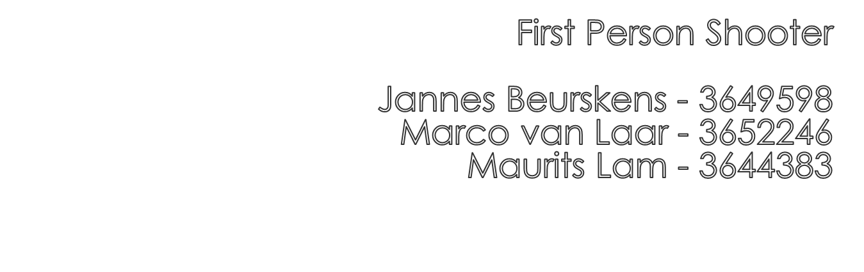
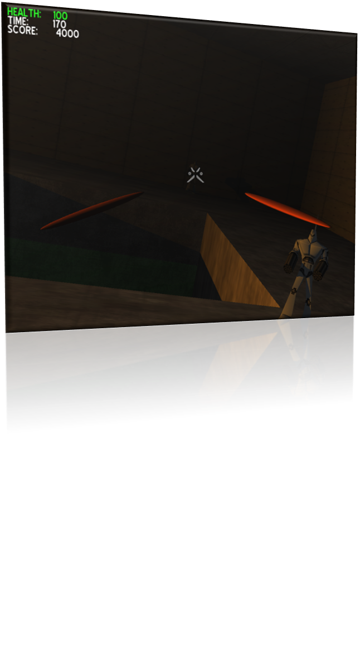
Notes:
Decent as inspiration

Slide 2

Goals
  Reach the exit
Gameplay
  Six degrees of freedom
  Shoot at enemies
  Avoid enemy projectiles
  Be mindful of the timer
  Score points

Slide 3

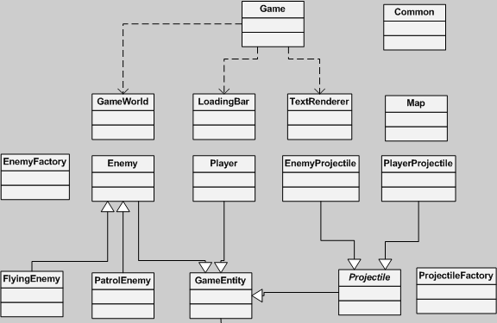

Slide 4

Six degrees of freedom
First-person shooting
Hostile NPCs
Collision detection
Map creation
Map overview
Serialization
Notes:
Task division
Jannes Beurskens: NPCs, serialization
Marco van Laar: collision detection, map creation, map overview
Maurits Lam: 6 DOF, FPS, collision detection, map overview

Slide 5

First person camera
  Gradual increase/decrease in speed
  Projectiles are created at child nodes
    Different methods of shooting
Collision detection
  Rays in all six directions
  Masks to determine type
  Get/set Ogre::Any to get more info about collided object
Projectiles
  Created using a factory
  Similar collision detection (but only uses a front ray)

Slide 6

Base Map class
  Subclasses define levels
    Brushes, lights, entities
  Allows for flexibility and customization
Brush (geometry)
  Based on cube mesh
  Textured Ogre::Entity
GameWorld
  Parses maps
  Manages GameEntities
Texture scaling and lighting issues

Slide 7

Top-down view of constructed map
  Centered on player
  Shows basic geometry
  Shows enemies
Easy switching between views
  Two SceneManagers
  Selective adding of entities to overview
Effectively pauses the game

Slide 8

Challenges:
  Collision detection
  Six degrees of freedom
  Getting it all done in time
  Code clarity (Ogre integration)
  Serialization
Features that did not make it:
  Realistic physics (OgreODE)
  Elaborate animations / graphics
  Pick-ups / power-ups
  Proper GUI

Slide 9


