Slide 1
Tester's Life:
One Sprint in a Cross-functional Team
Tiina Kiuru & Markus Hjort
Featuring Sami Honkonen
Copyright Reaktor 2009
Notes:
3

Slide 2
Goals
Demonstrate testing
  ATDD
  What to test and which approach?
  Cross-functional team
Coding the application is a secondary issue in this session
Copyright Reaktor 2009
Notes:
3

Slide 3
Rules
Questions are encouraged
  We answer right away, if we can
  BUT: if it's too complicated
    Parking Lot
      Write the question to a post-it note and hand it to our PO
      We'll answer the question after demo
  We have a tight schedule and lots of stuff to test....
  Kasvata bullet! Jos tiput kärryiltä, keskeytä
Copyright Reaktor 2009
Notes:
3

Slide 4
Roles
Tiina: Team member specialized in testing
Markus: Team member specialized in programming
Sami: Product Owner
Copyright Reaktor 2009
Notes:
3

Slide 5
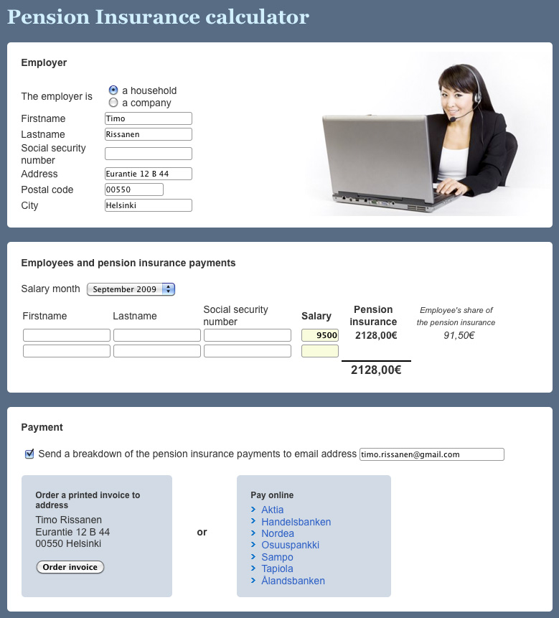
Application
Domain
Copyright Reaktor 2009
Notes:
3

Slide 6
Product Backlog
DONE
1. Order insurance information
In order to
get information about pension insurance
the employer can order pension information package
2. Calculates the insurance cost
In order to
budget insurance costs and compare different insurance companies,
the employer
should get the amount of insurance to be paid
NOT IMPLEMENTED
3. Buy the insurance
In order to
fulfill legal pesion insurance requirement for all his employees,
the employer
should be able to buy the insurance
4. Calculates employee's part of the payment
In order to
be able to deduct employee's part of insurance from the salary,
the employer
should get the amount of employee's insurance payment
5. Multiple employees
In order to
fulfill legal pesion insurance requirement for all his employees,
the employer
should be able to buy pension insurance for several employees at the same time
6. E-mail
In order to
save the insurance information,
the employer
should be able to order the insurance information as an e-mail
7. Internet payment
In order to
put the insurance into force right away,
the employer
should be able to pay it using internet bank
8. National registry
In order to
ensure the employee gets her pension,
the insurance company
has to report the insurance to national insurance registry
Copyright Reaktor 2009
Notes:
3

Slide 7
Already implemented
HTML layout
Infrastructure
Ordering information package
  Employer's contact information
  Submit order
  Register order in application's db
Calculate insurance payment
Copyright Reaktor 2009
Notes:
3

Slide 8
Definition of Done
Functional tests
  Test cases accepted by PO
  Tests implemented and pass (also “old” tests)
  Test code reviewed
Exploratory testing
  Required sessions held
  Bugs on task board
Non-functional testing
  Requirements met
Copyright Reaktor 2009
Notes:
3

