Slide 1
Econ 5010
Applied Computational Methods in Economics and Finance
Garrett Anstreicher

Slide 2
Introductions
About me
  From Iowa City
  Did my Ph.D. in Wisconsin, graduated in 2023.
  Interests: labor economics (broadly speaking)
  Enjoy structural and reduced-form methods
  Hobbies: chess, reading, piano, tennis
And you?

Slide 3
This class
Computational methods, broadly speaking
Also some of the math that explains why these computational methods actually work/are legal.

Slide 4
This class
Why?
  Many people enter an economics PhD program with good Stata/R knowhow but less in the way of numerical computing.
  Also little formal CS training.
My CS training:
    Intro comp sci in undergrad. Got a D on the final.

Slide 5
This class
Why is this so useful?
A higher share of economic work is empirical in focus, but still lots of work that involves numerical computation
  This is especially true in fields like macroeconomics and IO, but also happens in labor, public, etc.
One goal of this course: expand your research options
  Not doing numerical work because it is not needed to answer a research question is a good reason.
  Not doing numerical work because you think it is scary is a bad reason.

Slide 6
This class
Other goal: help you understand, talk intelligently about other research even if you don’t participate in it yourself
  Nice in general to have an understanding of dynamic programming, estimation methods, and so on.
    In part because some of it is just really cool.
  Expands who you can talk to/potentially collaborate with on research.

Slide 7
This class
Final and perhaps most important objective: to save you time in the long run.
  Beyond numerical computation, a more basic goal of this course is to help you understand why some code is fast and some code is slow.
  We will also talk about things like version control, debugging, and agentic coding.
  Using these tools effectively saves gargantuan amounts of time in the long run.
Early on in grad school, it may feel like ideas are the scarce resource
  This will change before long. Eventually, the scarce resource will be time.

Slide 8
Course structure
We will have about 15 weeks together, all told.
Five modules, each three weeks long.
Module 1: Basics of programming and computer usage
Module 2: Optimization
Module 3: Dynamic programming
Module 4: Estimation methods
Module 5: Workhorse applications

Slide 9
Module 1: Basics
Borrows from MIT’s “Missing Semester of your CS Education”
  https://missing.csail.mit.edu/
This part of the class is more about speed than anything else
  Why is some code fast and some code slow?
  What do words like “compilation” or “vectorization” even mean?
  How can you avoid wasting huge amounts of time with bugs and version control mixups?
This part of the class, and the class in general, will be taught in the Julia programming language.
Roughly half the classes will be dedicated to “codealongs.”
  I will work with code on the big screen, and we can write and talk about it together.

Slide 10
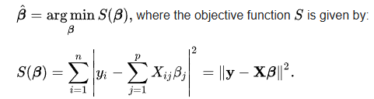
Module 2: Optimization
How can we maximize or minimize functions?
This sounds vague, but it happens all the time in economics
  In most economic models, agents are trying to optimize over a set of choices.
  When estimating a model, we are choosing the parameters that maximize or minimize some feature of the model compared to the data.
  Even least squares is an optimizing problem:

Slide 11
Module 2: Optimization
Most of the time, though, we don’t have the luxury of algebraic solutions or derivatives. This is where computers come in.
We will discuss a variety of optimization problems and some of the math that guarantees we can solve them in the first place, including
  Linear optimization
  Non-linear optimization
  “Black box” optimization

Slide 12
Module 3: Dynamic Programming
Maybe a word you’ve heard before.
Sounds fancy, but what this really is is an algorithmic technique for breaking down big problems into little ones.
Cool in its own right and has many applications in economics.

Slide 13
Module 4: Estimation
How do we choose parameters for economic models? This is what estimation means, in English.
OLS is again an example of this, but usually this isn’t so easy.
Common numerical approaches that we will go over:
  Maximum likelihood
  Simulated method of moments

Slide 14
Module 5: Workhorse Applications
Modules 1-4 will build up to us being able to work through some really interesting and important models, start to finish.
Current plan:
  The McCall search model (macro/labor)
  The Lucas asset pricing model (finance)
  The Hopenhayn model of firm entry (IO)
Suggestions for anything that you would like to see are extremely welcome!

Slide 15
Office Hours
11 AM-1PM, C220N PBB
Or by appointment.
Let me know if this does not work and I can try to adjust.

Slide 16
Evaluation
Each of the first four Modules will have an accompanying problem set.
  Each worth 15% of your grade.
  You are welcome to work together, but please honestly list contributions if you do.
  I advise against procrastinating on these. They will be challenging.
For Module 5, you have a more open-ended term project of coding up and analyzing a simple model of something that you are interested in.
  Deadlines for ensuring progress on this project are in the syllabus.

Slide 17
How should you approach this class?
This is when tests scores and grades start to matter a lot less.
You are now trying to get to a point where you can produce your own novel research.
ChatGPT or Claude can probably do all the work assigned in this class in about 5 minutes.
  But you do not have a robot lift weights for you at the gym.
  Far more important that you learn than get all the “right answers.”
Note: in my experience, copying code can actually be a quite good way to learn
  AS LONG AS YOU DON’T ACTUALLY COPY-AND-PASTE

Slide 18
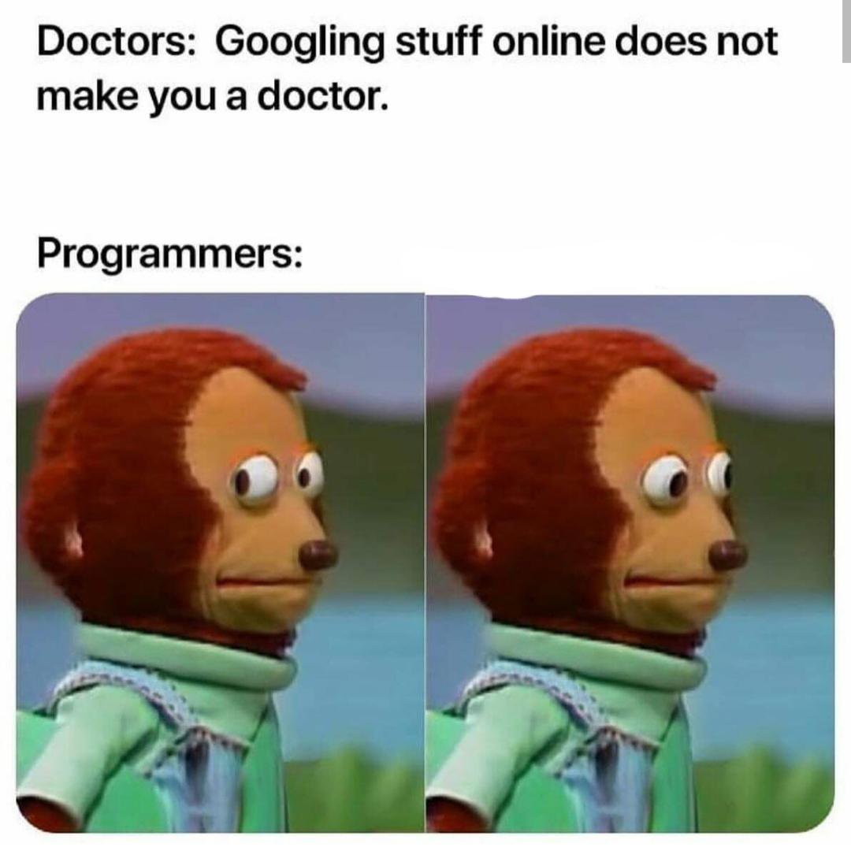
Googling is an important programming skill

Slide 19
How should you approach this class?
Everybody has to do bad research before they can do good research.
  Myself included.
The more aggressively and enthusiastically you do bad research now, the faster you get to do good research in the future.

Slide 20
Thursday’s lecture
We will start coding!
To prepare: install a Julia environment
  I will post a video on Icon going over how to do this.

