Slide 1
ECON 5010
Lecture 4 – Performance

Slide 2
Performance
How long a program takes to run can depend significantly on how well it is optimized.
Proper performance optimization can speed up a program by an order of magnitude or more.
For a complex economic model, this can make a difference of days or weeks.
First, it is helpful to understand why performance can differ so dramatically.

Slide 3
Machine Code
Code performance generally depends on how directly it talks to your computer.
At basic level, computers communicate in zeros and ones.
Humans are bad at writing in zeros and ones, so we instead write in symbolic representations of them.
The symbolic representation that corresponds most directly to machine code is called assembly.

Slide 4
Do not write in assembly.
“Hello World” in assembly:
org 0x100 ; .com files always start 256 bytes into the segment
mov dx, msg ; the address of or message in dx
mov ah, 9 ; ah=9 - "print string" sub-function
int 0x21 ; call dos services
mov ah, 0x4c ; "terminate program" sub-function
int 0x21 ; call dos services
msg db 'Hello, World!', 0x0d, 0x0a, '$' ; $-terminated message

Slide 5
Compilation
Most languages achieve high performance by converting the language into assembly before running it.
This process is called compilation.
This process is most obvious in languages like FORTRAN or C, where you have to compile the code manually before running it.
Languages that don’t convert their code into assembly are typically called interpreted languages.
  For the computer, this is like executing directions in Spanish if the computer only knew English.
  Note: this is often a false dichotomy: many languages have options to be interpreted or compiled

Slide 6
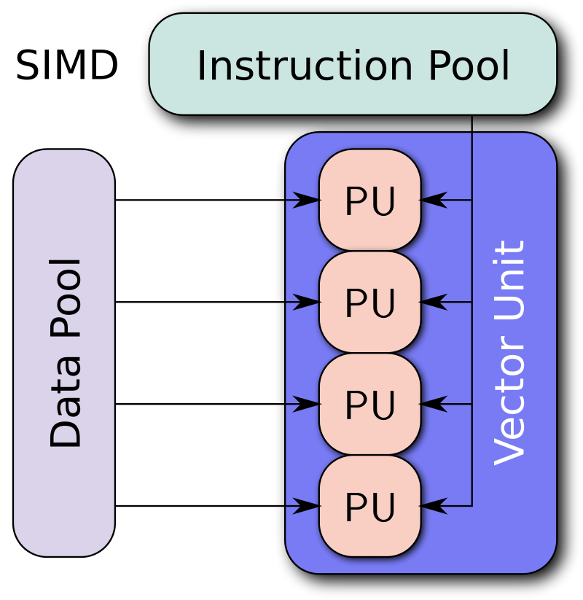
Vectorization
Two meanings to this
  First: conversion of a computer program from scalar implementation to vector implementation (i.e.: operating on a single data point at a time to multiple).
  Typically done automatically when code is compiled.

Slide 7
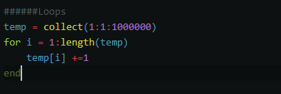

Vectorization
Second meaning: ditching loops in favor of matrix operations.
This is very important in languages like Matlab and R
  Reason: matrix operations in these languages are typically written in C and therefore faster, because they’re compiled!

Slide 8
More on Vectorization
In simple cases, vectorization is easy and intuitive.
Vectorizing complex loops and functions, however, can be extremely difficult and detract considerably from readability.
  In many economic models, it can be more intuitive to write things out in loops.
Vectorization is not required in Julia for performance.

Slide 9
Julia performance tips
Julia compiles functions when run for the first time – JIT (just in time) compilation.
An upshot of this is that anything substantial in your program should be housed in a function so that it can be turned into assembly.
In particular, avoid global variables.
Type declarations are also helpful.
Julia’s profiler also allows you to hunt for bottlenecks. We will discuss this more next week. For now, let’s code a bit!

Slide 10
Background
The part of your computer that executes instructions and mathematical operations is called the CPU.
A feature of modern CPUs is that they often have multiple processing units (cores).
A natural speed improvement may come from distributing the tasks in the program across cores and have them all working at once.
This is called parallelization.
  Matlab – Easy parallelization: “parfor” loop.
  Julia – conceptually easy, but a bit clunkier.
  FORTRAN – Difficult to set up.

Slide 11
Caveats
Passing information across cores and then recollecting takes “overhead” time.
If done poorly, parallel loops can offer minimal performance improvements or may even slow things down.
Solution: tasks allocated in parallel for loops should be non-trivial.
  Example: bootstrapping standard errors

Slide 12
Serious Parallelization
While a typical computer has more than 1 core, they also don’t have that many.
A typical number is 4.
If you’d like to parallelize over dozens or hundreds of cores, you will typically need to use a remote server.
Places like Amazon offer computing services at a reasonable fee.
At UIowa, a good option is the Argon system: https://research.its.uiowa.edu/our-services/computing-services/argon-high-performance-computing-hpc

