Slide 1
ECON 5010
Version Control

Slide 2
SOUND FAMILIAR?
You've probably done this before
REPLICATION_FOLDER
Which version is actually correct?
What exactly changed between drafts?
Who has the latest copy right now?
paper_draft.do
paper_draft_v2.do
paper_draft_v2_edited.do
paper_draft_v2_edited_KEEP.do
paper_FINAL.do
paper_FINAL_seriously.do
paper_FINAL_ACTUALLY_v3.do
Version control tracks every change automatically — so you never have to name a file “FINAL_v3” again.
Untitled 47.do
email_attachment_from_coauthor.do
02

Slide 3
Version control
Economists complain frequently about how hard it is to maintain good version control, especially in collaborative projects.
Computer scientists figured out a pretty good system for version control in 2005.
This system is called Git.
Main features
  Can be used for any text-based file type.
  Never have to have a file name like “draft_v3_final_FINAL” ever again
  COMPLETE documentation of changes made (and when)
  Easily allows for multiple people to work on the same file simultaneously.

Slide 4
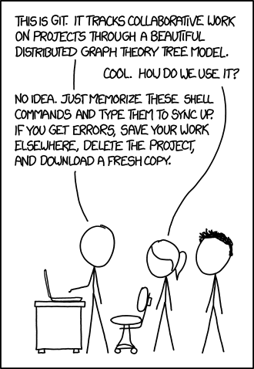

Slide 5
What Git does
Maintains “snapshots” of a project.
  Who made each snapshot
  Messages associated with each snapshot
  And so on
  Allows users to revert to earlier snapshots whenever necessary
Can let you easily answer historical questions about a project
  Who wrote this part of the code, and when/why?
  When did a particular bug start to show up in a project?

Slide 6
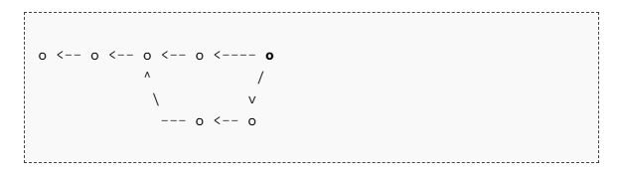
Visualizing this

Slide 7
What is Git, specifically?
Git is just a version control software.
Runs locally on your computer.
Once you have it, no need for any kind of internet connection to use it.
The whole of a project in Git is called a repository.

Slide 8
Git vs. Github
Git: the software.
Github: a website that stores copies of Git repositories.
This allows you to do several new things
  Sync up repositories across multiple machines
  Share and collaborate repositories with others.

Slide 9
Git vs. Github vs. Github Desktop
Github Desktop: a graphical user interface (GUI) that lets you use Git and Github more easily.
  In its vanilla form, Git is used in the command line.
  Computer scientists are good at this, but it is rather scary for many economists (including myself).
Github lets you use Git by clicking intuitively named buttons instead of working in the command line.

Slide 10
Core terminology and functions
Commits: saved checkpoints
A commit is a saved snapshot of your entire project at one point in time.
Example commit history
Add data cleaning script
Created whenever you choose — typically after finishing a small, meaningful piece of work.
Fix typo in variable labels
Paired with a short message describing what changed and why.
Add robustness check for Table 3
Permanent: every commit stays in the history and can always be revisited.
Update figures after referee comments
Together, commits form a timeline you can scroll through, compare, or rewind.
Final proofread before submission

Slide 11
Core terminology and functions
Branches: copies that you can edit without consequence.
A branch is an independent copy of the project you can edit without affecting the main version.
main
Try a new specification, a big rewrite, or a risky idea in isolation.
merge
The main line of work (often called “main”) stays untouched and always usable.
If the experiment works, merge the branch back in.
feature/new-spec
If it doesn't, delete the branch — main was never at risk.

Slide 12
Pushing and pulling
Commits and branches can live solely on your computer. Pushing and pulling refers to interacting with the outside world.
Pushing: sending commits to a remote repository.
Pulling: downloading commits from others (or from other machines).
How coauthors stay in sync: everyone pulls latest version, makes their local changes, and then pushes these changes back up.

Slide 13
PUTTING IT TOGETHER
The basic Git workflow
1
2
3
4
5
→
→
→
→
Clone / create
Edit files
Stage changes
Commit
Push
Get a copy of the repo on your computer
Do your normal work — write code, fix a bug
Choose which edits to include next
Save a snapshot with a short message
Send your commits to GitHub
Then repeat: pull teammates' updates, edit, stage, commit, push — that loop is most of what you'll ever do.
10

Slide 14
Other Important Git Terminology
Clone: making a local copy of a remote repository on your computer.
Fetch: download latest commits without altering your working files. Pulling does this and merges the changes into your active branch.
Merge: combining code histories/changes from two branches into one.
  Merge conflict: This is when changes were made to the same line of code across different branches. Must be resolved manually.
Fork: a personal copy of someone else’s repository on something like Github.

Slide 15
Resources and next steps
Next steps
  Download Git
  Make an account at github.com
  Install Github Desktop
  Collaborate with others in class (see Problem set 1, Question 9).
Resources
  Pro Git – standard reference
  docs.github.com

