Slide 1
ECON 5010
Agentic Coding

Slide 2
AI is obviously everywhere
Better at some things than others, but one thing it’s really good at is coding.
Today we will talk about and demonstrate various levels of AI assistance in coding.
But first, let’s talk a bit about how AI models work in the first place.

Slide 3
What does GPT stand for?
Generative Pre-trained Transformer
  Generative: means it makes stuff
  Pre-trained: indicates that the model went through some process of learning over data.
  Transformer: ???

Slide 4
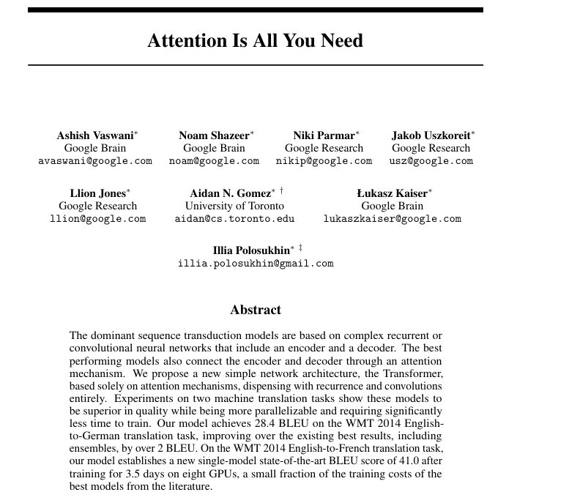

Slide 5
The model
Trained to take in text
Then predicts what comes next.
  Takes form of a probability distribution over next words.

Slide 6
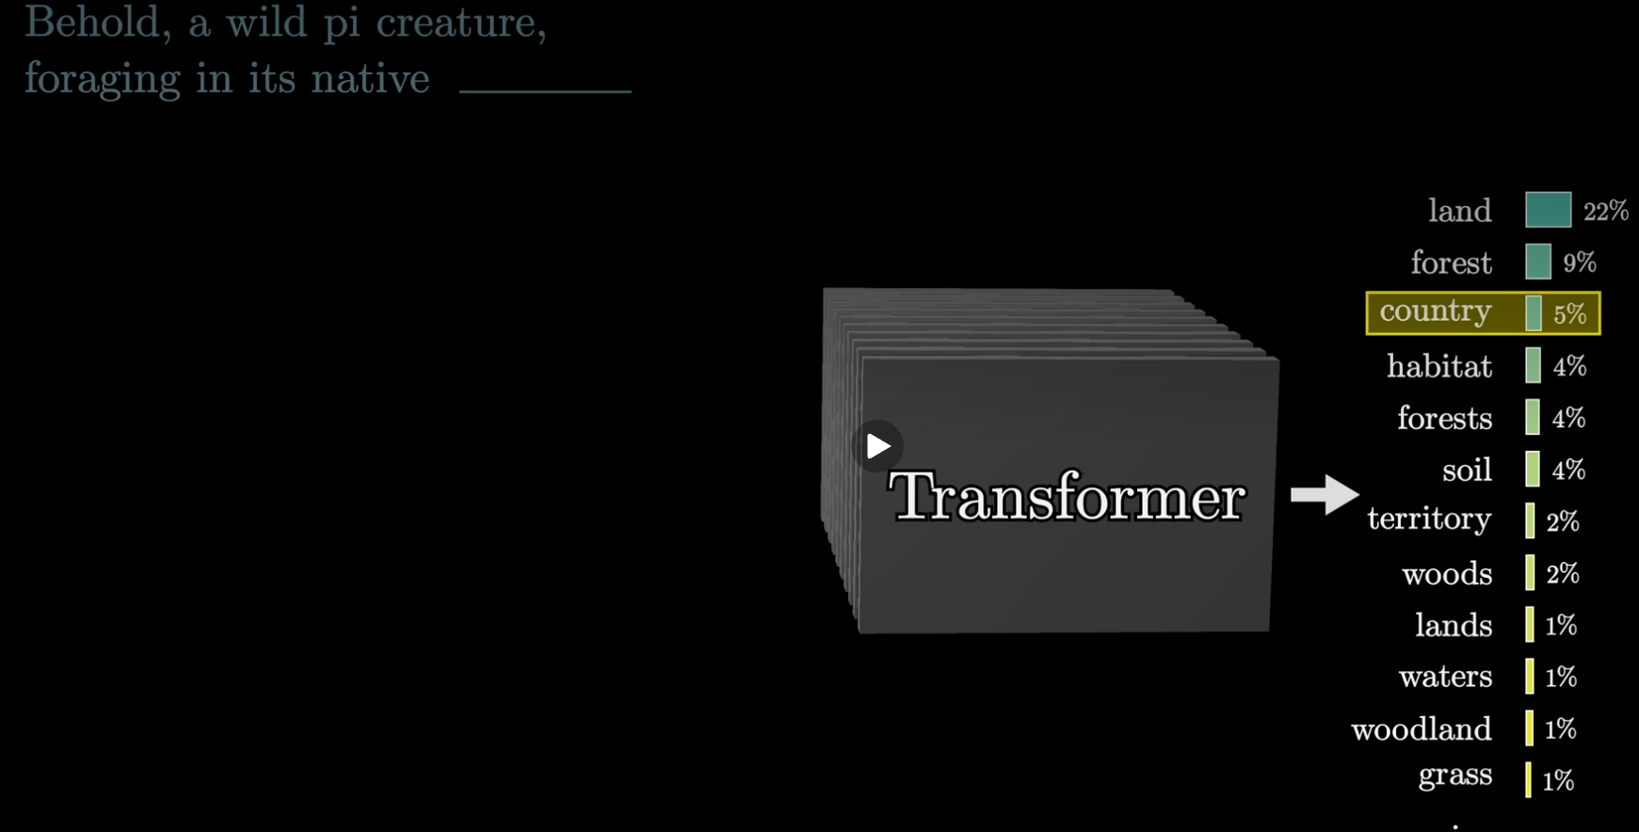

Slide 7
How to go from one word to whole responses?
Predict the next word
Append the word to the prompt
Refeed the prompt into the transformer
Predict the next word
And so on . . .

Slide 8
But how is the prompt handled?
Take the prompt, “To date, the cleverest thinker of all time was _____”
The first step is breaking up this prompt into what are called tokens.
  Sometimes the same as words, but not always.

Slide 9
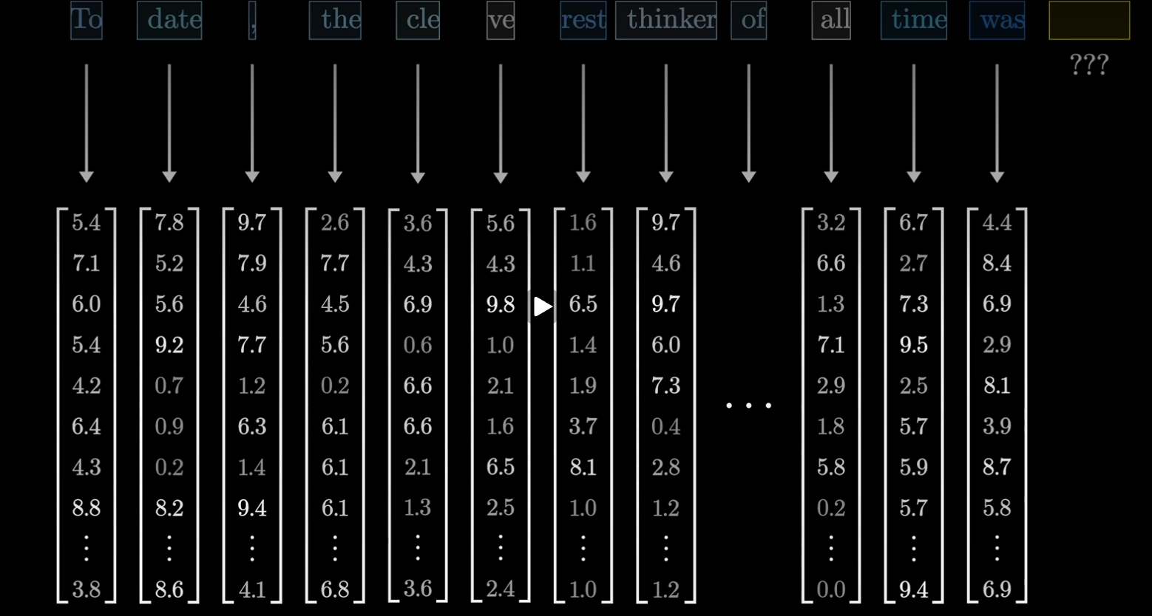

Slide 10
Key Intuition
These vectors are essentially coordinates in an high-dimensional space.
  Enough dimensions to essentially capture meaning in the English language.
  Dimensions capture semantic meaning. One dimension for height, another for gender, another for plurality, etc. Around 12k dimensions in ChatGPT3.
  This is called embedding.
Words or tokens with similar meaning will have similar coordinates
  E.g “hop,” “skip,” and “jump.”
Thematic differences between words will also move in a similar direction
  E.g. going from “king” to “queen” will entail a similar movement in this vector space as going from “man” to “woman”: E(king) – E(queen) = E(man) – E(woman)

Slide 11
More embedding examples
E(Hitler) + E(Italy) – E(Germany) = E(Mussolini)
E(Sushi) + E(Germany) – E(Japan) = E(Bratwurst)
Note that the dot product of vectors gives a measure of their degree of alignment. This ends up being very helpful!

Slide 12
Attention
Initially, the meaning of the word (vector) is essentially in a vacuum.
Using other words in the prompt to update the meaning of each other.
Example: “model”
  “Model” can mean very different things: think “machine learning model” vs. “fashion model”.
“Attention” is the algorithm that updates the meaning of tokens in the prompt based on other tokens present.
While we will not get into the details, the attention operations are matrix operations that turn out to be extremely parallelizable. This is a big part of why it is such a big deal.

Slide 13
After Attention
Tokens are fed through a “multilayer perceptron” step.
  More linear algebra, but interpreting what it does is exceedingly difficult.
  Closest analogue is “asking questions” about the tokens, or “storing facts.”
Then iterate attention and MLP.
  This is essentially a boatload of matrix multiplication operations.
At the end, the final token vector will contain as much meaning as possible and can be used to predict what ought to come next.

Slide 14
So how does this apply to coding?
This kind of method applies well to coding
Applications within VSCode
  Autocomplete
  Inline coding
  Github copilot chat

Slide 15
Beyond this: Desktop assistants
E.g. Claude Cowork
  What this is: LLM model wrapped in an agent interface
Can directly modify and execute files if given permission
Prompting both these models as well as those within VSCode is as much an art as a science.

