Slide 1
Branch Predictor and Fast Branching
By: Matt Kleiser

Slide 2
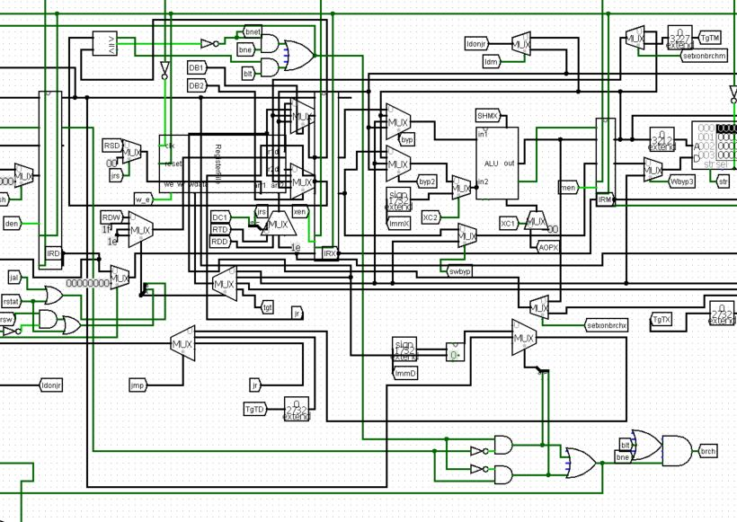
Fast Branching
Branch from the Decode Stage instead of Execute
Must bypass from Execute, Memory Stages as well as LW bypass into Decode Stage
Additional Bypassing and Stall logic necessary for proper completion of processes
Affects bne and blt operations

Slide 3
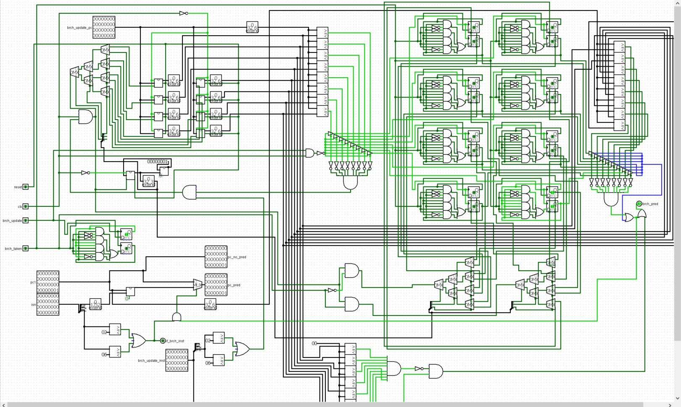
Branch Prediction
2-bit saturating counter direction predictor
8 instruction lookup table
6-bit hash for lookup
Updates only on mispredictions
Edge cases accounted for
ex. Final instruction
Initialize to 00 or 11 only

Slide 4
Testing

