Slide 1
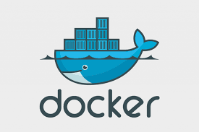
DOCKER ENGINE
What is Docker ?
Docker is an open platform for developing, shipping, and running applications.
Docker is a platform which packages an application and all its dependencies together in the form of containers.

Slide 2
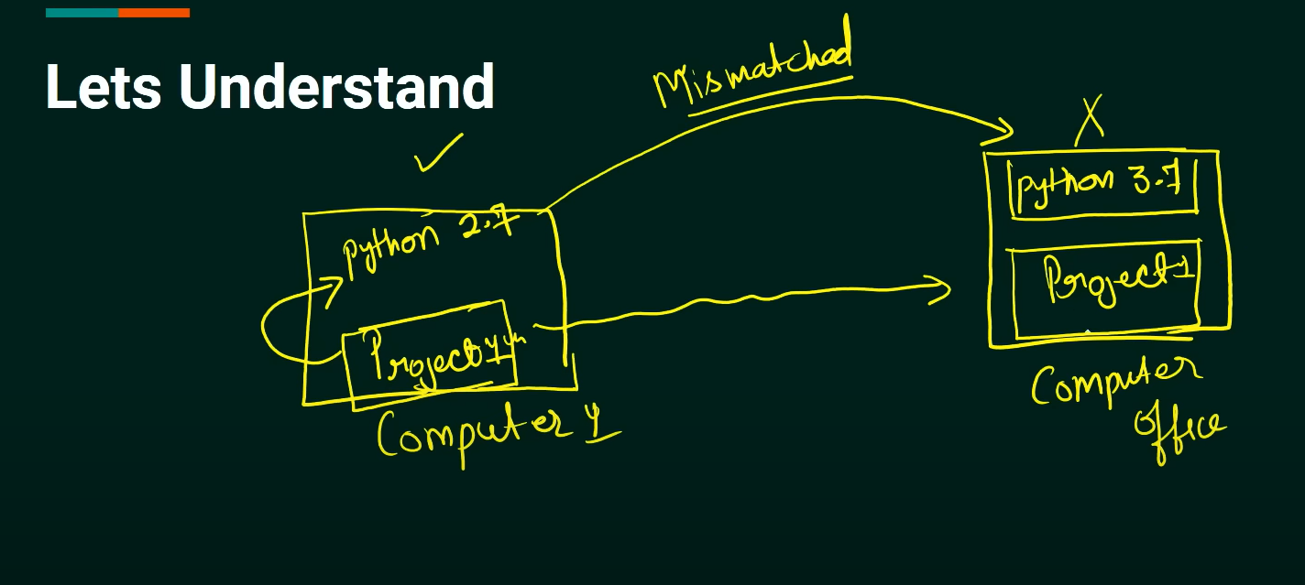
What Problems Docker Solves ?

Slide 3
Dockerfile , Image and Container
Dockerfile:-
Text document which containes all the commands that a user can call on the command line to assemble an image.
How to create a Docker image using a docker file?
In the docker file use the docker components like -- FROM, MAINTAINER, WORKEDIR, COPY, ADD, EXPOSE, RUN, ENV, CMD, ENTRYPOINT, etc.

Slide 4
Docker Components:-
FROM <imge_name>:<version>
WORKDIR </path/to/workdir>
COPY <src> <dest>
ADD <src> <dest>
EXPOSE <port-number>
ENV <set-variables>
USER <set-user-name / set a non-root user of the container >
VOLUME <create or mount the volume>
LABEL <specify metadata information of Docker images>
ARG <set build-time variables with key and value.>
SHELL <set shell options and default shell for the RUN, CMD, and ENTRYPOINT instructions that follow it.>
RUN <command> ( the command is run in a shell)
CMD <command>
ENTRYPOINT <command> <param1> <param2>

Slide 5
Docker Image :
Template to create docker container.
How to Build Docker Image ?
we will build our image using the Docker command. The below command will build the image using Dockerfile from the same directory.
sudo docker build -t nginx:1.0 .
If the Dockerfile is in another folder then you need to specify it explicitly.
sudo docker build -t nginx /path/to/folder
we can list the images by using this command.
sudo docker images
we can remove the images by using this command.
sudo docker rmi image-name
we can remove the images by using this command.
sudo docker rmi -f image-name

Slide 6
How to rename and copy the docker images ?
sudo docker rename images-name new-name
sudo docker tag image-name copy-and-rename-new-images
sudo docker tag new-image user-id/image-name
How to Login , Logout , Push and Pull in Docker Hub ?
sudo docker login ---->give user-name & password
sudo docker logout
sudo docker push user-id/image-name
sudo docker pull user-id/image-name
How to pull the docker image in docker hub ?
sudo docker pull image-name

Slide 7
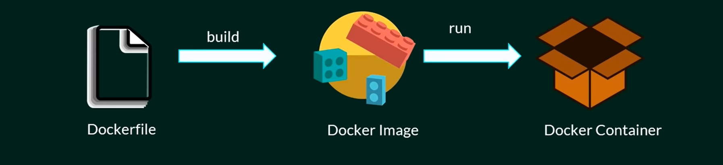
Docker Container :-
Running instance of the docker images. Containers hold entire package to run application.
How to Run Docker Container ?
Run a Container Under a Specific Name:-
sudo docker container run --name [container_name] [docker_image]
We can see running container by using this command.
sudo docker ps
We can see running and stoped container by using this command.
sudo docker ps -a

Slide 8
Run a Container in the Background (Detached Mode) :-
sudo docker run -d [docker_image]
Run a Container Interactively :-
sudo docker run -it [docker_image] /bin/bash
Run a Container and Publish Container Ports :-
-p [host_port]:[container_port]
sudo docker run -p 8080:80 [docker_image]
Run a Container and Mount Host Volumes :
-v [/host/volume/location]:[/container/storage]
sudo docker run -v [/host/volume/location]:[/container/storage] [docker_image]
sudo docker run --name MyqlA -it -d --mount source=<volume-name>,target=<location> mysql
sudo docker run --name MysqlB -it -d --mount source=batman,target=/app mysql
sudo docker run --name My-volume -d -v <local-source-path>:<destination> -p 3002:3000 mysql —>Bind mount.
sudo docker run --name MysqlC -it -d –mount source=superman,target=/app,readonly mysql —>read only volume.

Slide 9
sudo docker run --name My-volume -it -d –mount type=bind,source=home/monir/addvolume,target=/usr/share/nginx/html/ mysql
sudo docker run --name Tmpsf-volume -it -d --tmpfs type=temfs,source=superman,target=/app mysql ——>tmpfs volume.
More Docker Volumes related command :
sudo docker volume create <volume-name>
sudo docker volume ls
sudo docker volume inspect <volume-name>
sudo docker volume rm <volume-name>
sudo docker volume prune —> all volumes are remove this command.
Run a Docker Container and Remove it Once the Process is Complete​ :
sudo docker container run --rm [docker_image]

Slide 10
Docker Networking :- Docker network is a virtual network infrastructure that enables communication between Docker containers running on the same or different hosts. It facilitates seamless connectivity, allowing containers to interact with each other and external networks while providing isolation and security.
Types of Network Drivers :-
bridge: If you build a container without specifying the kind of driver, the container will only be created in the bridge network, which is the default network.
host: Containers will not have any IP address they will be directly created in the system network which will remove isolation between the docker host and containers.
none: IP addresses won’t be assigned to containers. These containments are not accessible to us from the outside or from any other container.
overlay: overlay network will enable the connection between multiple Docker demons and make different Docker swarm services communicate with each other.
ipvlan: Users have complete control over both IPv4 and IPv6 addressing by using the IPvlan driver.
macvlan: macvlan driver makes it possible to assign MAC addresses to a container.

Slide 11
Docker Network all commands :-
sudo docker network create --driver <driver> <name>
sudo docker network create <network-name>
sudo docker network ls
sudo docker network inspect <network-id>
sudo docker run --name My-volume1 -d --network network-id-name --v user/monir/addvalue:/usr/var/app/ -p 3002:3000 mysql
sudo docker run --name My-volume2 -d --network network-id-name --v user/monir/addvalue:/apps -p 3002:3000 mysql —> My-volume1 &My-volume2 container are connecting same network <network-is-name>
sudo docker network rm <network-name>
sudo docker network prune
How to create docker image from docker container ?
sudo docker commit container-name image-name

Slide 12
Access the Running Container’s Shell :-
sudo docker exec -it container-name sh
What is Docker Compose?
Docker Compose is a tool that assists in defining and sharing multi-container applications. By using Compose, we can define the services in a YAML file, as well as spin them up and tear them down with one single command.
Docker compose all commands :
sudo docker compose version
sudo docker compose --help
sudo docker compose up —>This command will take the docker-compose.yml file and start building container.
sudo docker compose up -d
sudo docker compose ps

Slide 13
sudo docker compose exec <service-name> (mysql -u root -p) or bash —>This command is used to get access the terminal of container.
sudo docker compose stop —> This command is used to stop compose started using docker compose up -d.
sudo docker compose down —> This command is used to remove containers entirely. It will not remove volumes. If you want to remove volumes then use --volumes flag.
sudo docker compose config
sudo docker compose down --volumes
sudo docker compose --profile <profile-name> up -d
sudo docker compose --profile <profile-name> down --volumes
sudo docker compose -f <.dev.yml file>up -d
sudo docker compose -f docker-compose.dev.yml up -d

Slide 14
Limitations of Docker :-
Single Kernel Dependency.
2. Ios application Docker can't deploy.
3. Windows Support (for Linux Containers)
4. Security Concerns.
5. Persistent Data Management.

