Slide 1

UnfoldIR - Rethinking Deep Unfolding Network in Illumination Degradation Image Restoration
Student : Mohammad Kazemi
Supervisor : Dr. GhiassiRad
Summer 2026
arXiv:2505.06683

Slide 2
Table of contents
01
02
03
04
Introduction & Problem Statement
Proposed Methodology (UnfoldIR)
Experimental Results
Conclusion & Future Work

Slide 3
Introduction & Problem Statement
01

Slide 4
Illumination Degradation Image Restoration (IDIR):
A set of challenging tasks aimed at mitigating adverse lighting effects such as low contrast and non-uniform noise.
Included Tasks:
Low-light image enhancement (LLIE), underwater image enhancement (UIE), backlit image enhancement (BIE), and medical fundus image enhancement.
Importance:
Improves visual quality and facilitates downstream computer vision tasks (e.g., nighttime object detection).

Slide 5
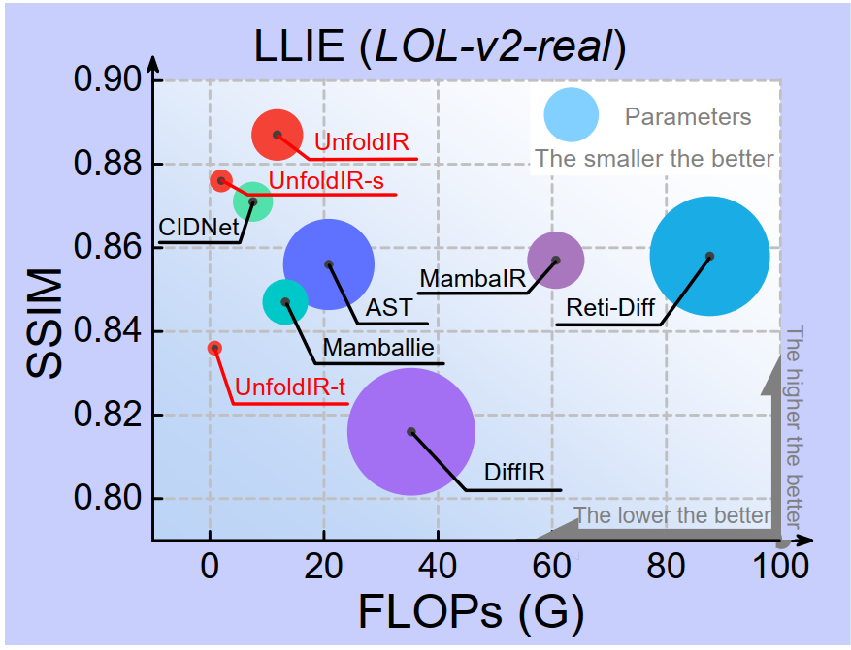
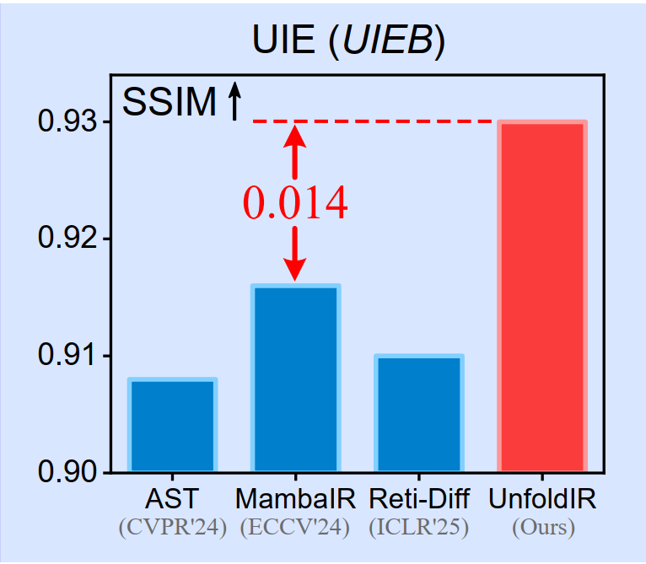
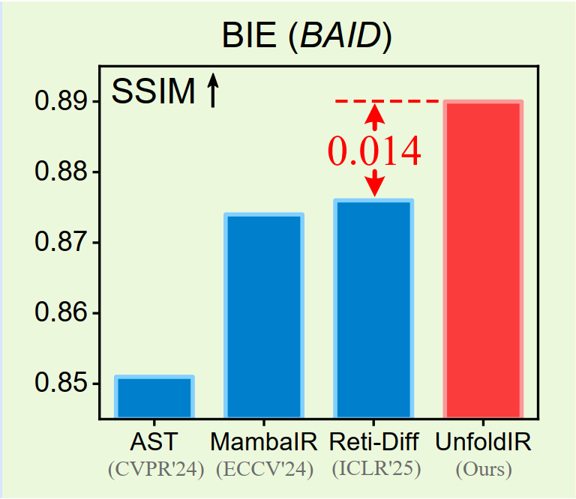
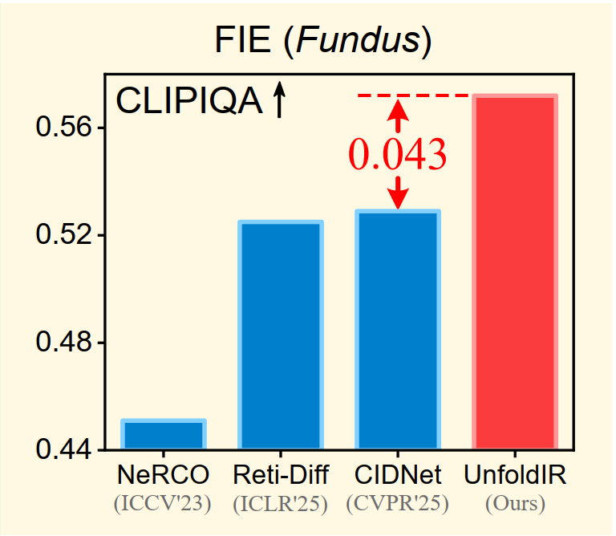

Slide 6
Existing Approaches & Challenges

Slide 7
Model-based (Traditional) Methods:
Rely on manually designed rules with clear interpretability, but suffer from limited generalization capability.
Learning-based (Deep Learning) Methods:
High generalization due to end-to-end training, but act as a "black box" lacking interpretability.
Deep Unfolding Networks (DUNs):
Aim to combine the merits of both by unfolding iterative optimization algorithms into multi-stage neural networks.
Current Challenge:
Existing DUN-based methods still significantly underperform compared to SOTA solvers.

Slide 8
Motivation & Main Idea (UnfoldIR)

Slide 9
Why have DUNs fallen short?
Lack of task-specific regularization terms during the mathematical modeling phase.
Failure to integrate advanced network architectures within the unfolding stages.
Absence of loss functions tailored specifically to multi-stage DUN structures.
The Proposed Solution (UnfoldIR):
Designing a novel DUN framework based on Retinex theory, utilizing advanced Visual State Space (VSS) modules and high-order differential equation solvers.

Slide 10
Mathematical Modeling (Retinex Theory)

Slide 11
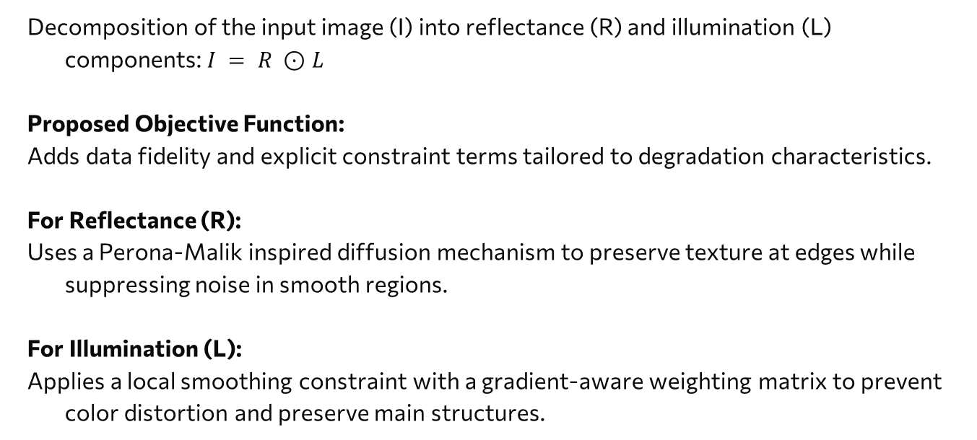
Decomposition of the input image (I) into reflectance (R) and illumination (L) components: $I = R ⊙L$
Proposed Objective Function:
Adds data fidelity and explicit constraint terms tailored to degradation characteristics.
For Reflectance (R):
Uses a Perona-Malik inspired diffusion mechanism to preserve texture at edges while suppressing noise in smooth regions.
For Illumination (L):
Applies a local smoothing constraint with a gradient-aware weighting matrix to prevent color distortion and preserve main structures.

Slide 12
Optimization via Proximal Gradient Algorithm

Slide 13
Solves the objective function by alternating updates for L and R over several iterations.
Splits the update process into two sub-problems:
Gradient Descent Term:
To generate an initial intermediate auxiliary variable.
Proximal Term:
Replaced by deep neural networks to avoid complex closed-form calculations (This is the core concept of Deep Unfolding).

Slide 14
02
Overall Architecture of UnfoldIR

Slide 15
The network is unrolled into K stages (optimal value K=3).
Structure of each stage:
RAIC Module: Reflectance-Assisted Illumination Correction.
IGRE Module: Illumination-Guided Reflectance Enhancement.

Slide 16
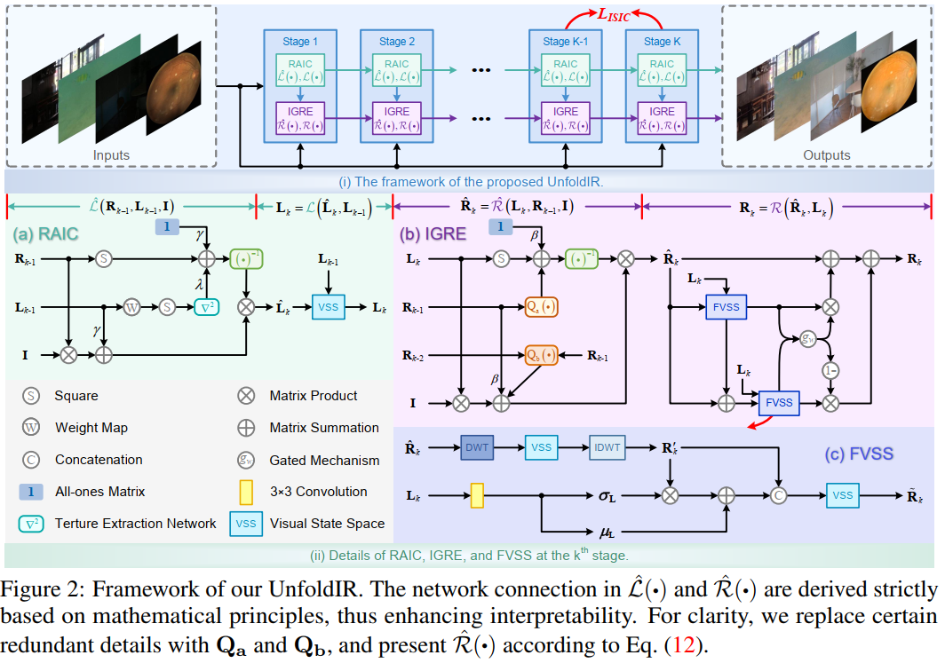

Slide 17
RAIC Module (Illumination Correction)

Slide 18
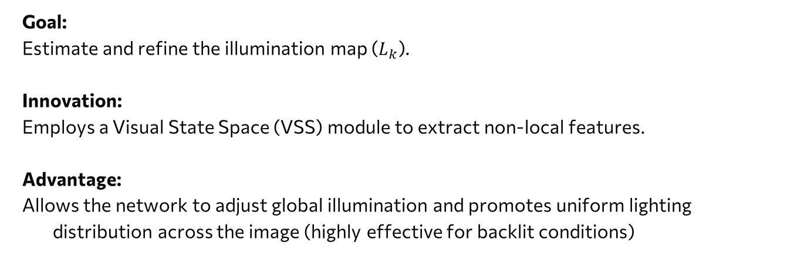
Goal:
Estimate and refine the illumination map ($L_{k}$).
Innovation:
Employs a Visual State Space (VSS) module to extract non-local features.
Advantage:
Allows the network to adjust global illumination and promotes uniform lighting distribution across the image (highly effective for backlit conditions)

Slide 19
IGRE & FVSS Module (Reflectance Enhancement)

Slide 20
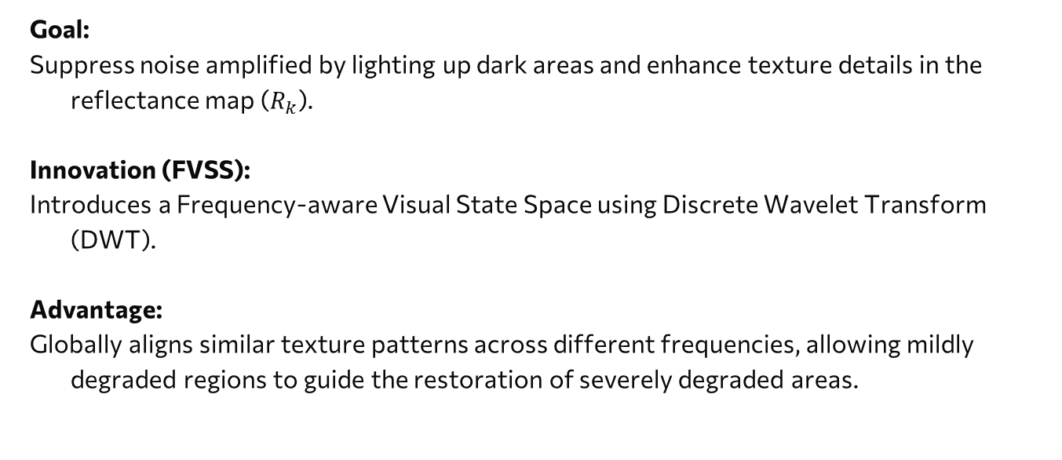
Goal:
Suppress noise amplified by lighting up dark areas and enhance texture details in the reflectance map ($R_{k}$).
Innovation (FVSS):
Introduces a Frequency-aware Visual State Space using Discrete Wavelet Transform (DWT).
Advantage:
Globally aligns similar texture patterns across different frequencies, allowing mildly degraded regions to guide the restoration of severely degraded areas.

Slide 21
Integration with RK2 Differential Solver

Slide 22
Traditional residual networks are mathematically equivalent to a first-order Euler discretization of an ODE, which carries high truncation errors.
Mathematical Innovation:
The FVSS module is embedded within a higher-order Ordinary Differential Equation (ODE) framework—specifically a Second-Order Runge-Kutta (RK2) method.
Advantage:
Provides much higher numerical accuracy, precisely separating noise from texture and significantly enhancing fine structural details.

Slide 23
ISIC Loss Function (Training Innovation)

Slide 24
Inter-Stage Information Consistency (ISIC) Loss:
Applied only during the final two stages of the network.
Goal:
Maintains network stability; ensures that small dynamic changes in illumination do not destroy crucial reflectance details (and vice versa).
Special Advantage:
Since it acts as a framework-specific self-constraint, it enables the model to be robustly deployed even in unsupervised learning settings.

Slide 25
03
Quantitative Results & Evaluation

Slide 26
Extensively evaluated across 5 diverse datasets (LOL, UIEB, BAID, Fundus, and Real-world datasets).
Outperforms leading SOTA methods like Reti-Diff and CIDNet in PSNR, SSIM, and FID metrics.
Lightweight Variants:
Introduced "UnfoldIR-t" (Tiny - 0.09M parameters) and "UnfoldIR-s" (Small) versions with extremely low computational overhead, yet achieving competitive performance.

Slide 27
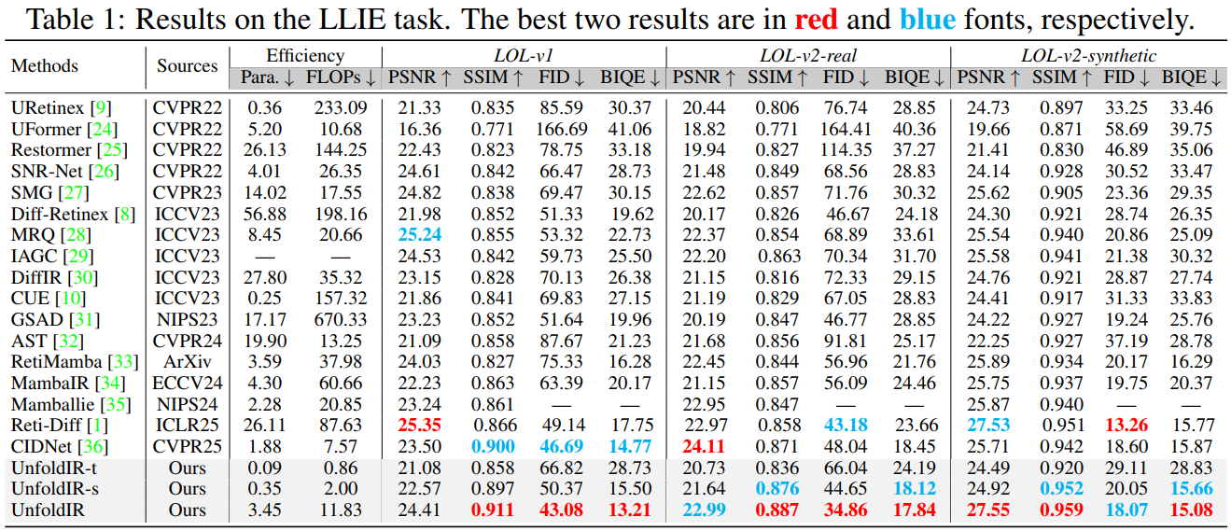

Slide 28
Qualitative Results (Visual Comparison)

Slide 29
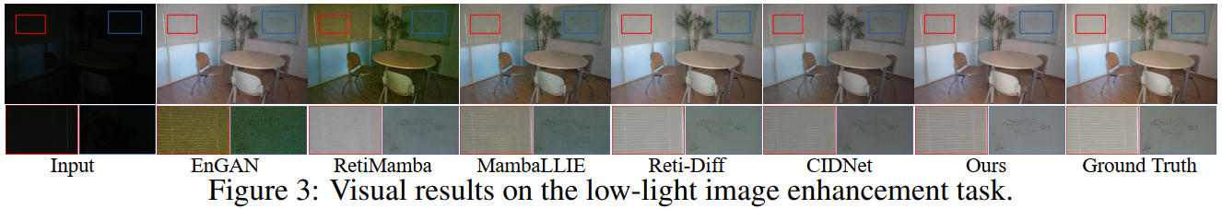
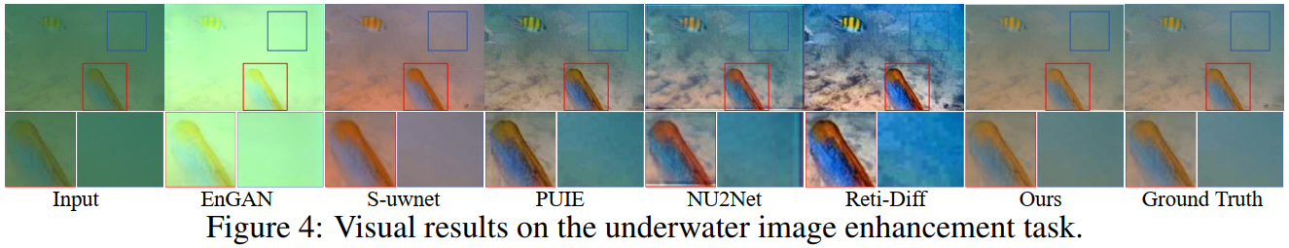

Slide 30
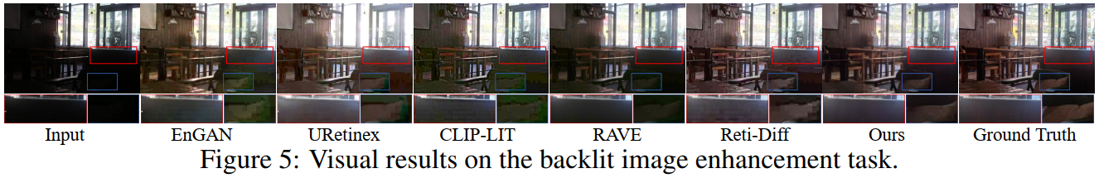
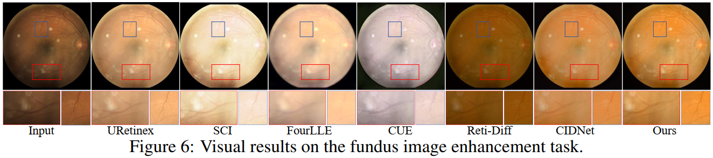

Slide 31
Impact on Downstream Tasks

Slide 32
Low-light Object Detection (ExDark Dataset):
Significant improvement in mean Average Precision (mAP) when using YOLO on UnfoldIR-preprocessed images.
Image Segmentation:
Increased Intersection over Union (IoU) accuracy in both semantic segmentation and concealed object segmentation.
Implication:
The outputs are not only visually pleasing to human eyes but also make the input data much more meaningful and interpretable for high-level machine vision algorithms.

Slide 33
04
Conclusion & Limitations

Slide 34
Conclusion:
UnfoldIR unlocks the true potential of DUNs by seamlessly integrating Retinex theory, Visual State Space (VSS) architecture, and advanced ODE solvers (RK2).
Limitations:
The network sometimes misinterprets extremely subtle textures in the darkest regions as noise and inadvertently removes them (Fig. A5).
Future Work:
Integrating generative techniques (like Diffusion Models) and high-level vision priors for better semantic context interpretation

Slide 35
