Slide 1

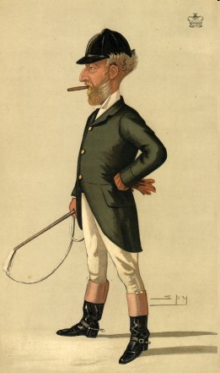
Tutoring the Beast
A few lessons to government from the grassroots
Notes:
Thanks
Hope to tell you a bit about mySociety why I, as an ex civil servant in the Cabinet Office, have found myself running it.

Slide 2
What we won’t be doing
Telling you how to manage huge projects
Evangelising platforms
Describing how everything should be built

Slide 3
Why today?
To show some sites
To explore their merits
To answer your questions

Slide 4
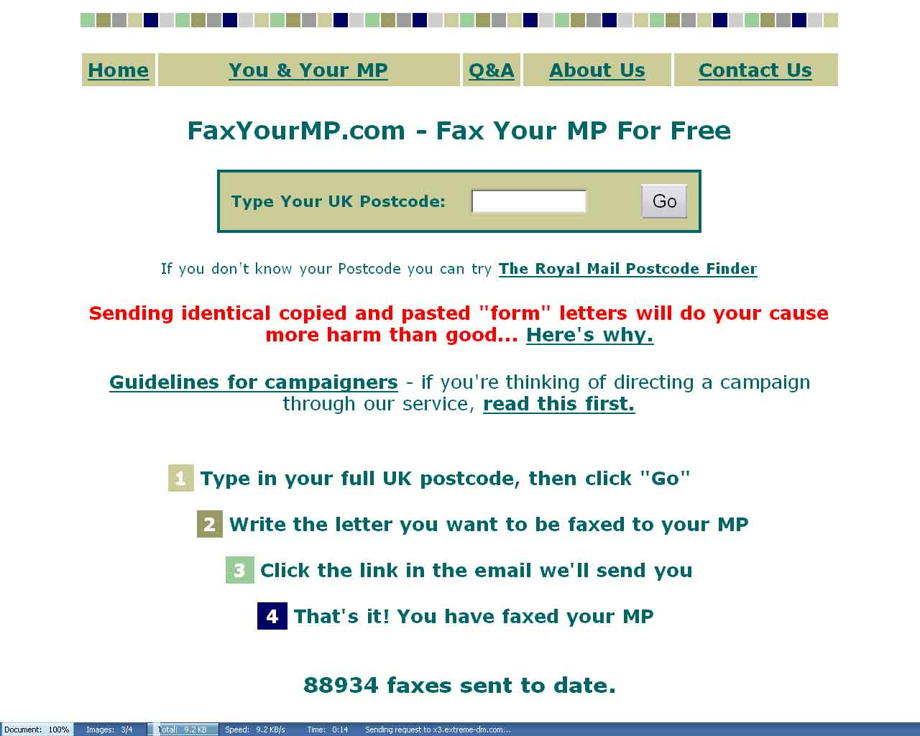

Slide 5
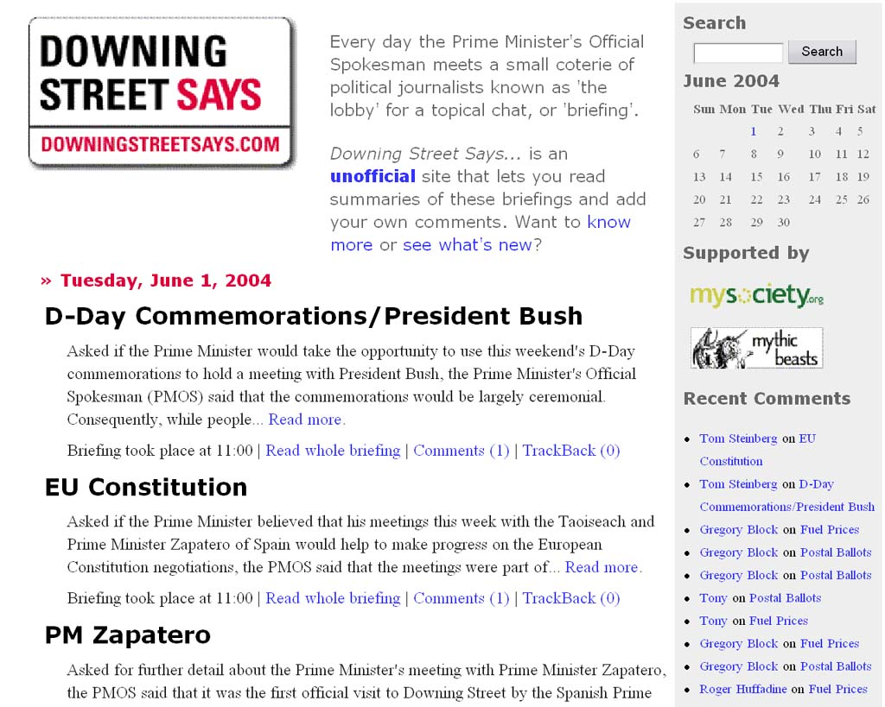

Slide 6
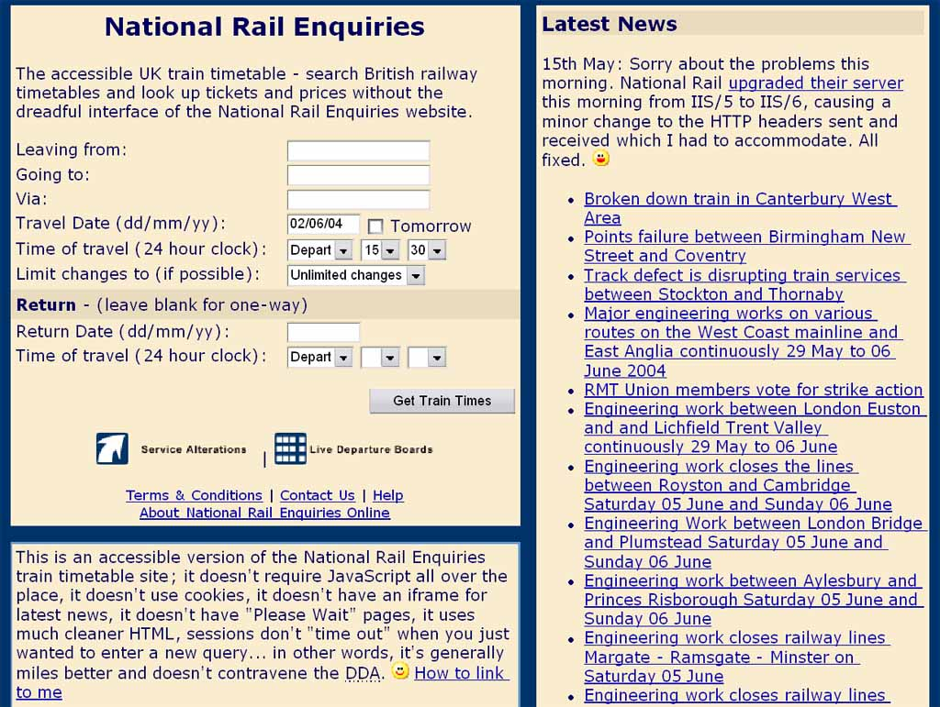

Slide 7
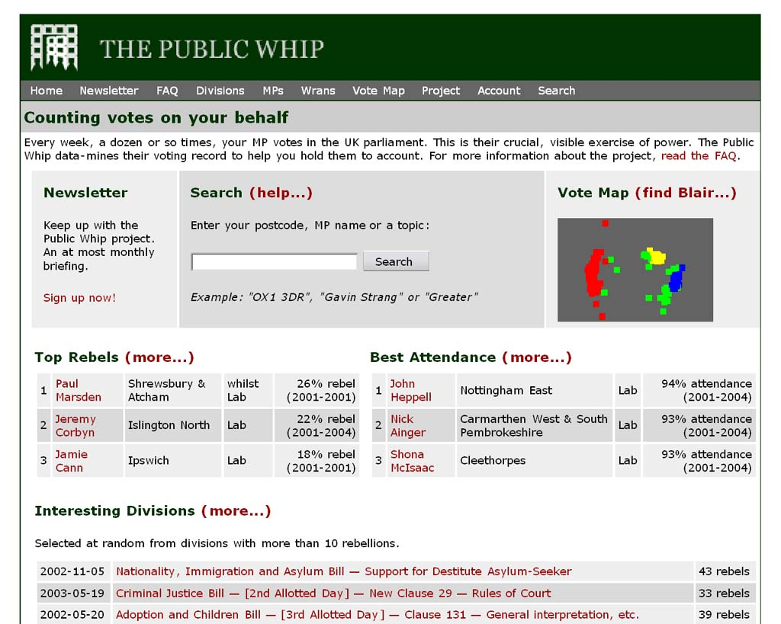

Slide 8
www.faxyourmp.com
www.downingstreetsays.com
www.dracos.co.uk/railway/timetable/
www.publicwhip.org.uk

Slide 9
Some Lessons
Tiny cost per transaction
No expensive support staff
Everyone in UK is a potential user
Ultra usable
Written in Human
Help both govt and citizens
Same cost regardless of traffic

Slide 10
The Scalability Issue
Focus here is on cheaply scaling sites
There are many government services that cannot operate like this
But e-Government legitimacy may be connected to cheap scalability

Slide 11
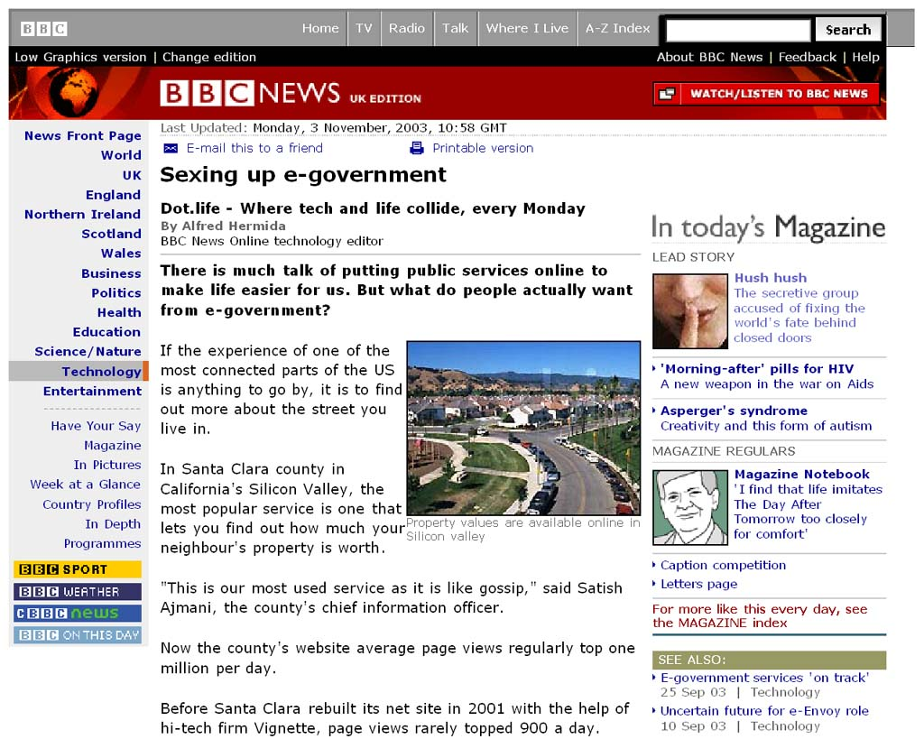

Slide 12
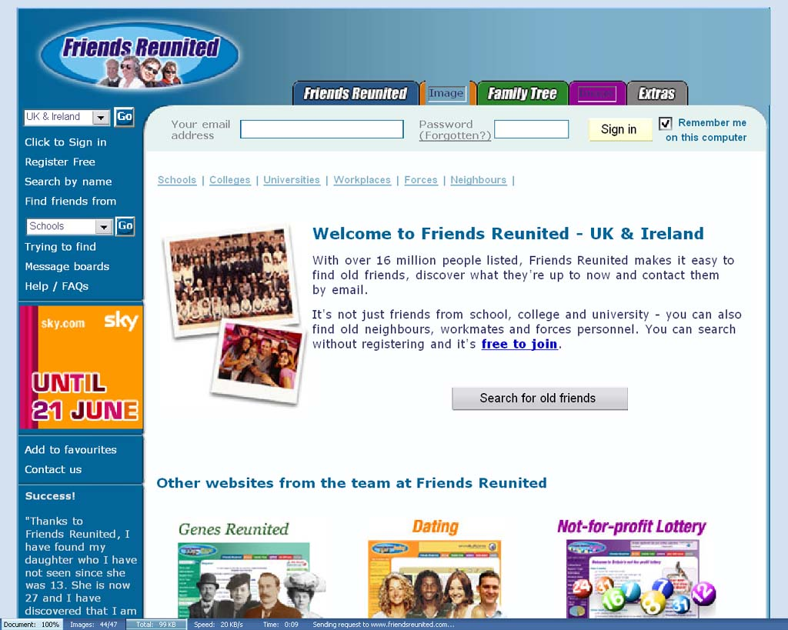

Slide 13
General Lessons
Government data is a goldmine
There are much better ways of accessing it than traditionally employed
Little cutting edge technology required

Slide 14
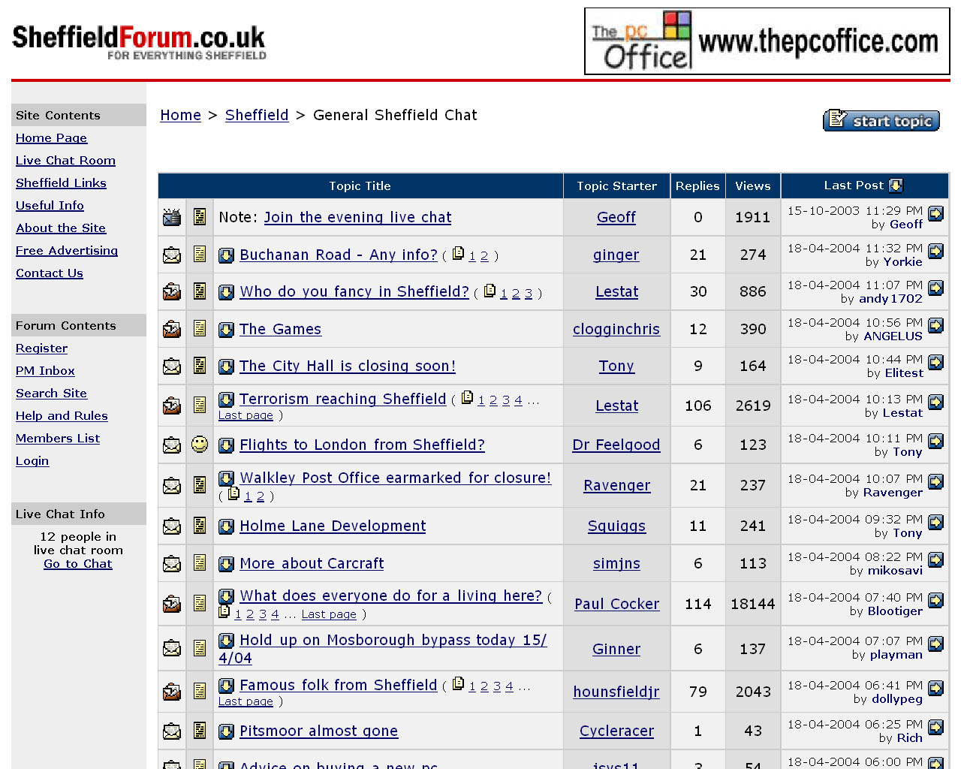

Slide 15
Panning for gold: Identifying useful data
What issues do people read & care about every day?
How much can be anchored to a geographic location?
Would it get more useful if it was placed in context?
What question could you ask your user which would open the data?

Slide 16
Opening the walnut: how to get at the data
Postcodes
Google juice
Things happening today
‘Any standard, as long as it’s a standard’
RSS & Open APIs
Cheap/free experimentation licences

Slide 17
The Design Issue
This isn’t hard now – govt is much better than it was
Increasingly about conceptual design
Must be prepared to have projects evolve
Bad design mustn’t be allowed to kill good ideas.

Slide 18
Single points of access
Because 1 site beats 400
Because 60 million sites also beat 400

Slide 19
What is mySociety?
Building websites that deliver simple, tangible benefits to civil society at very low cost per person helped

Slide 20
Why?
To build good sites
To teach through demonstration

Slide 21
Types of projets we wanted to build
Based on an electronic network.
Some kind of offline, positive impact.
Must have potential for high usage at a fixed cost.

Slide 22
So, we needed:
Lots of good ideas to pick from
Keen, talented developers
Some cash

Slide 23
And in 8 weeks we got…
£10,000 from a benefactor
Coverage from the Guardian, BBC, Register & many others
10,000 visitors in our first week
Over 250 project proposals
About 100 volunteer developers

Slide 24
Project picking soirée
The public was encouraged to leave comments on all the proposals.
An event was held where people argued over the best 25.
The public was consulted on the shortlist.
The advisory panel picked five

Slide 25
And then
ODPM awarded us £250,000 from the e-innovation fund, in partnership with West Sussex County Council

Slide 26
Launch Projects
Notes:
Thanks
Hope to tell you a bit about mySociety why I, as an ex civil servant in the Cabinet Office, have found myself running it.

Slide 27
Give it Away
Lowering barriers to giving stuff away
Enter a postcode
Enter an email address
Tick a box (books, clothes etc.)
Hit Go
Discuss the logistics with a nearby charity

Slide 28
Pledge Bank
“I’ll do it if you’ll do it”
Describe a task.
Set a threshold
Ask people to pledge
Volunteers notified of either success or failure

Slide 29
Challenging assumptions
“The only way to build anything useful is to start with a clearly identified problem and solve it.”
“More harm will come from allowing the public to add context than stopping them”

Slide 30
Challenging assumptions
“Government can’t do anything new and worthwhile online until we have joined up everything internally”
“If it doesn’t work, it was probably a flawed idea in the first place”

Slide 31
And finally..
mySociety to start building projects soon
Sunday
Any questions?

Slide 32
Contact Details
Tom Steinberg
tom@mySociety.org
07811 082158

