Slide 1

Introducing…
Notes:
Thanks
Hope to tell you a bit about mySociety why I, as an ex civil servant in the Cabinet Office, have found myself running it.

Slide 2
What is mySociety?
Building websites that deliver simple, tangible benefits to civil society at very low cost per person helped

Slide 3
Who are you?
Civil servants
Skilled developers
Media experts
Volunteers
Social enterprise

Slide 4
Why?
High opportunity costs in the public and voluntary sectors
My experience of two cultures
Because there are so few FaxYourMP.coms

Slide 5
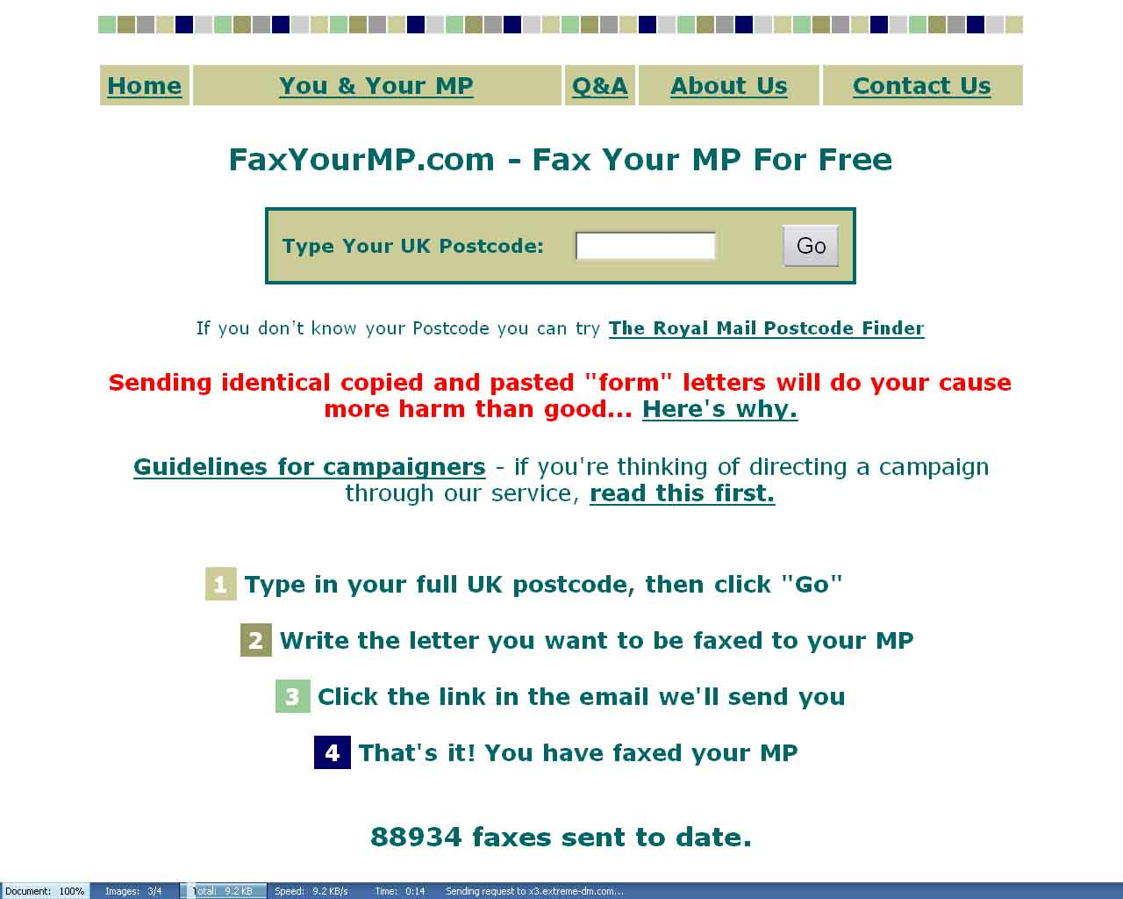

Slide 6
Specific Lessons
Tiny cost per transaction
No expensive support staff
Everyone in UK is a potential user
Ultra usable
Written in Human
Helps both MPs and citizens
Same cost regardless of traffic

Slide 7
General Lessons
Common sense to developers can be heresy in govt.
Suffered bad case of ‘not invented here’ syndrome.
One point of access beats 650
Such sites just weren’t getting built

Slide 8
What we wanted to build
Based on an electronic network.
Some kind of offline, positive impact.
Must have potential for high usage at a fixed cost.

Slide 9
So, we needed:
Lots of good ideas to pick from
Keen, talented developers
Some cash

Slide 10
And in 8 weeks we got…
£10,000 from a benefactor
Coverage from the Guardian, BBC, Register & many others
10,000 visitors in our first week
Over 250 project proposals
About 100 volunteer developers

Slide 11
Project picking soirée
The public was encouraged to leave comments on all the proposals.
An event was held where people argued over the best 25.
The public was consulted on the shortlist.
The advisory panel picked five

Slide 12
And then
ODPM awarded us £250,000 from the e-innovation fund, in partnership with West Sussex County Council

Slide 13
Launch Projects
Notes:
Thanks
Hope to tell you a bit about mySociety why I, as an ex civil servant in the Cabinet Office, have found myself running it.

Slide 14
Give it Away
Lowering barriers to giving stuff away
Enter a postcode
Enter an email address
Tick a box (books, clothes etc.)
Hit Go
Discuss the logistics with a nearby charity

Slide 15
Pledge Bank
“I’ll do it if you’ll do it”
Describe a task.
Set a threshold
Ask people to pledge
Volunteers notified of either success or failure

Slide 16
And three others
FaxYourRepresentative - FaxYourMP.com goes 21st century
NotApathetic - Don't want to vote, but also not apathetic? Let them know why.
YourConstituencyMailingList - Want to hear from your MP & discuss what they say?

Slide 17
New(ish)Technologies Which Matter to e-Participation
Tom Steinberg
Notes:
Thanks
Hope to tell you a bit about mySociety why I, as an ex civil servant in the Cabinet Office, have found myself running it.

Slide 18
Postcodes!
“Because local doesn’t mean 400 identical sites”
planning.beasts.org
forums.upmystreet.com

Slide 19
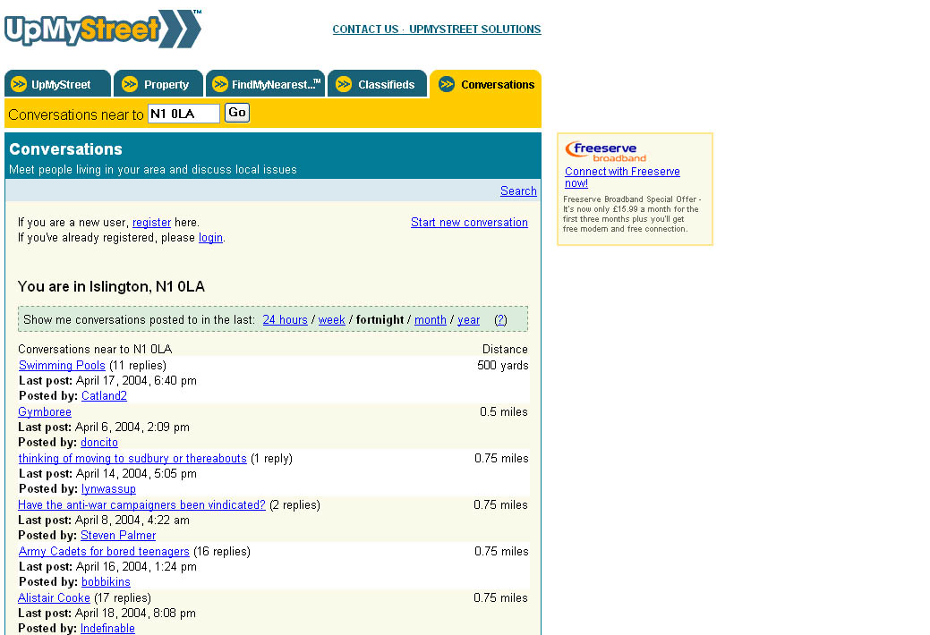

Slide 20
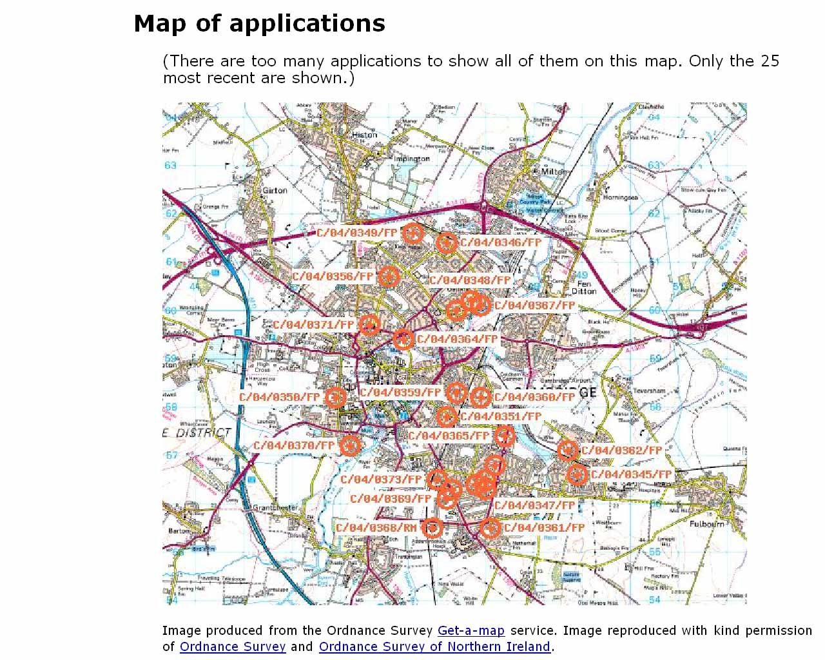

Slide 21
Context & Discussion
DowningStreetSays.Com
Sheffieldforum.co.uk
www.tom-watson.co.uk

Slide 22
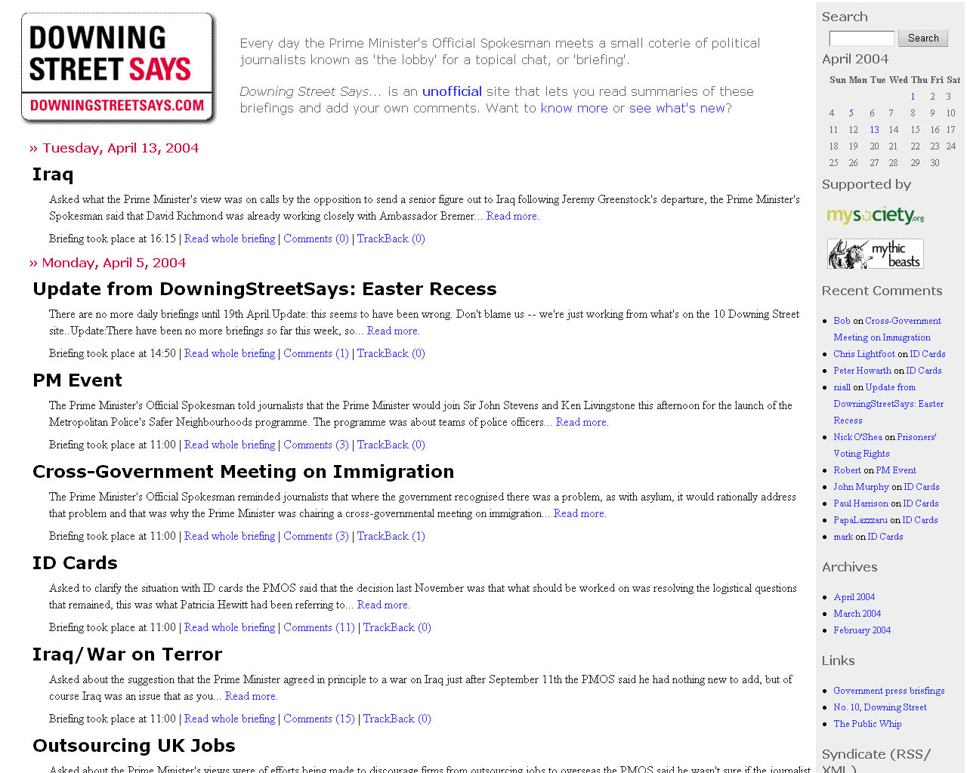

Slide 23
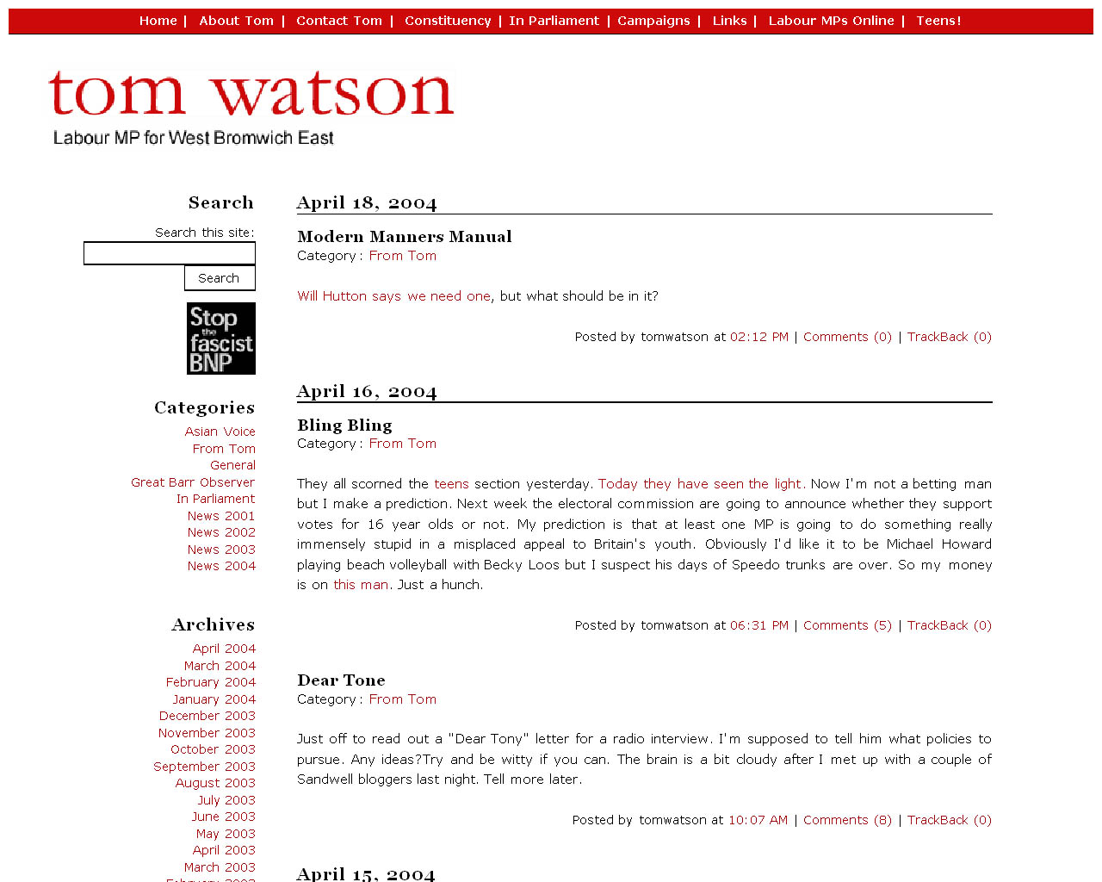

Slide 24
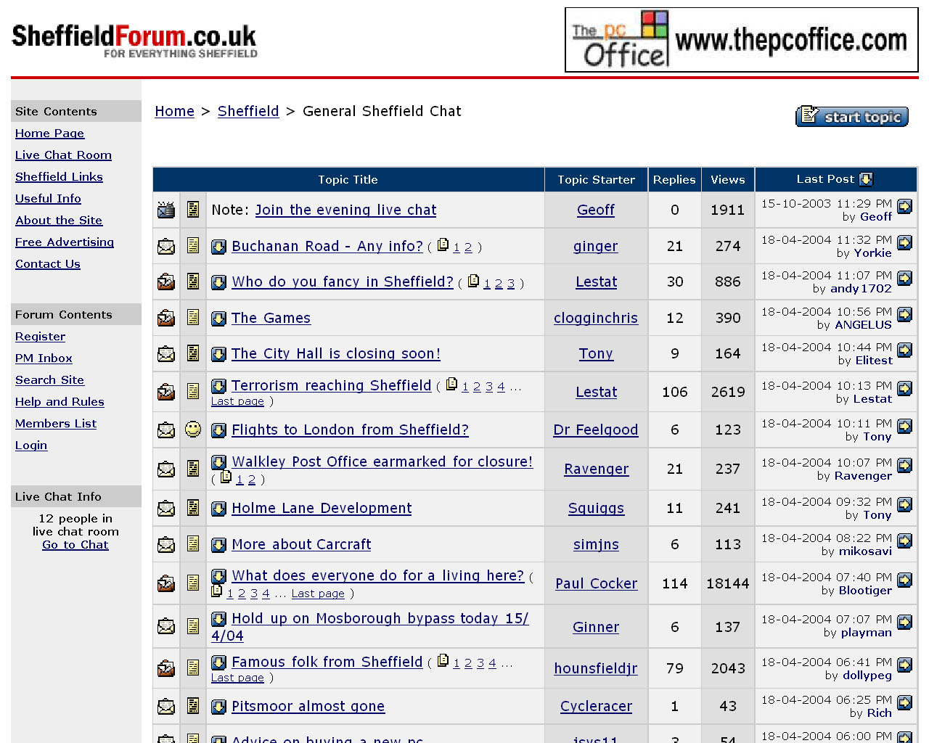

Slide 25
Challenging assumptions
“Government can’t do anything new and worthwhile online until we have national authentication systems”
“If it doesn’t work, it was probably a flawed idea in the first place”

Slide 26
Challenging assumptions
“The only way to build anything useful is to start with a clearly identified problem.”
“Geeks need real-world experts to tell them what to build”

Slide 27
Recommendations
Need structures for geeks & wonks to collaborate on problem analysis.
Avoid new channels of access at all cost – improve the ones you’ve got.
Allow citizens & civil servants to create their own explanations & context for anything, anywhere.

Slide 28
Contact Details
Tom Steinberg
tom@mySociety.org
07811 082158

